Slide 1
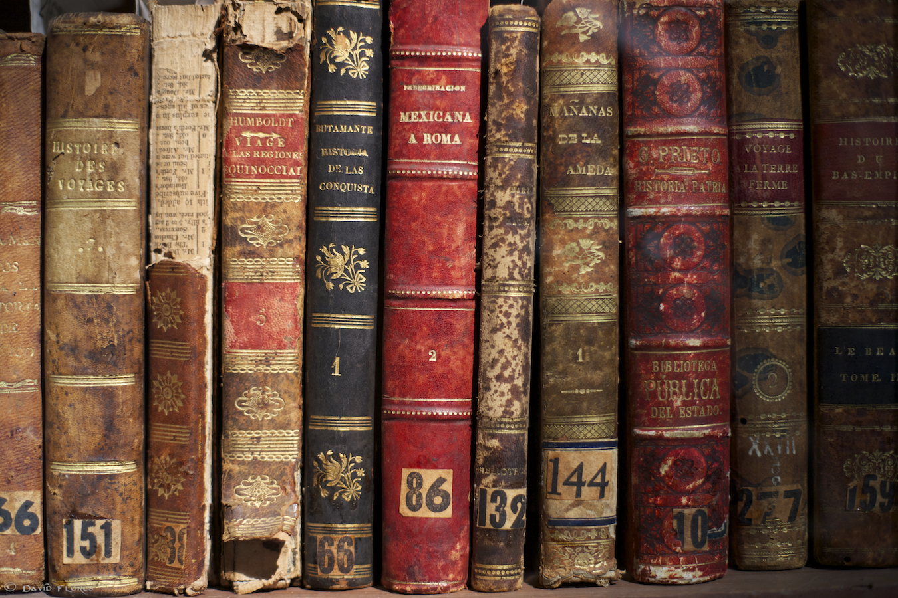
A BRIEF HISTORY OF THE NOVEL

Slide 2
What is Fiction? The English Novel

Slide 3
What is Fiction?
The term ’fiction’ comes from the Latin word fingere and refers to any narrative in prose or verse that is entirely or partly the work of imagination.
Although in its broadest sense fiction includes plays and narrative poems, it is most commonly used when referring to the short story and the novel.

Slide 4
A definition
According to the dictionary a novel is:
a fictional prose narrative of considerable length,
typically having a plot that is unfolded by the actions, speech, and thoughts of the characters.
the literary genre represented by novels.

Slide 5
More definitions
The novel is a worldwide cultural instrument which helped redefine:
the time and space where we live
the way we speak and talk
how we feel
what we do

Slide 6
GENERAL PARAMETERS OF THE NOVEL
GENRE: Fiction: Narrative
STYLE: Prose
LENGTH: Extended
PURPOSE: Mimesis: Verisimilitude
“The Novel is a picture of real life and manners, and of the time in which it is written. The Romance, in lofty and elevated language, describes what never happened nor is likely to happen.” Clara Reeve, The Progress of Romance,1785

Slide 7
Verisimilitude
a semblance of truth
recognizable settings and characters in real time
what Hazlitt calls, “ the close imitation of men and manners… the very texture of society as it really exists.”
The novel emerged when authors fused adventure and romance with verisimilitude and heroes that were not supermen but ordinary people, often, insignificant nobodies.

Slide 8
Narrative Precursors (előfutár) to the Novel
Heroic Epics Gilgamesh, Homer’s Iliad and Odyssey, Mahabharata, Valmiki’s Ramayana, Virgil’s Aeneid, Beowulf, The Song of Roland
Ancient Greek and Roman Romances and Novels An Ephesian Tale and Chaereas and Callirhoe, Petronius’s, Satyricon, Apuleius’s The Golden Ass
Oriental Frame Tales A Thousand and One Nights
Irish and Icelandic Sagas The Tain bo Cuailinge, Njal’s Saga

Slide 9
Narrative Precursors to the Novel
Medieval European Romances Arthurian tales culminating in Malory’s Morte D’Arthur
Elizabethan Prose Fiction Gascoigne’s The Adventure of Master F. J.,Lyly’s Euphues, Greene’s Pandosto: The Triumph of Time, Nashe’s The Unfortunate Traveller, Deloney’s Jack of Newbury
Travel Adventures Marco Polo, Ibn Batuta, More’s Utopia, Swift’s Gulliver’s Travels, Voltaire’s Candide
Novelle Boccaccio’s Decameron, Margurerite de Navarre’s Heptameron
Moral Tales Bunyan’s Pilgrim’s Progress, Johnson’s Rasselas

Slide 10
The First Novels
The Tale of Genji ( Japan, 11th c.) by Lady Murasaki Shikibu
Monkey, Water Margin, and Romance of Three Kingdoms (China, 16th c.)
Don Quixote ( Spain, 1605-15) by Miguel de Cervantes
The Princess of Cleves (France, 1678) by Madame de Lafayette
Love Letters between a Nobleman and His Sister (England, 1683) and Oroonoko (1688)by Aphra Behn
Robinson Crusoe (England, 1719) , Moll Flanders (1722) and A Journal of the Plague Year (1722) by Daniel DeFoe
Pamela, or Virtue Rewarded (England, 1740-1742) by Samuel Richardson
Joseph Andrews (England, 1742) and Tom Jones (1746)by Henry Fielding

Slide 11
Origins
The dominant genre in world literature, the novel is a relatively young form of imaginative writing.
Only about 250 years old in England—and embattled from the start— its rise to pre-eminence has been striking.
After sparse beginnings in 17th century England, novels grew exponentially in production by the 18th century and in the 19th century became the primary form of popular entertainment.

Slide 12
Why
The rise of the novel coincides with the rise of the middle classes in Western Europe
Profound social and economic changes brought the novel into popular prominence
advances in the technology of printing
made written texts available to a growing population of readers
changes in modes of distribution and in literacy rates
brought books and pamphlets to populations excluded from education working-class men and women of all classes
authors became free agents in the literary marketplace
dependent on popular sales for success and sustenance
reflecting the values of a middle-class readership

Slide 13
Types of Novel
Realistic Novel
Picaresque Novel
Historical Novel
Epistolary Novel
Bildungsroman

Slide 14
Realistic Novel
A fictional attempt to give the effect of realism.
This sort of novel is sometimes called a novel of manner.
A realistic novel can be characterized by its complex characters with mixed motives that are rooted in social class and operate according to highly developed social structure. The characters in realistic novel interact with other characters and undergo plausible and everyday experiences.
Examples:
Thirteen Reasons Why by Jay Asher
Looking for Alaska by John Green.

Slide 15
Picaresque Novel
A picaresque novel relates the adventures of an eccentric or disreputable hero in episodic form.
The genre gets its name from the Spanish word picaro, or "rogue."
Examples:
Rudyard Kipling's Kim (1901),
Henry Fielding’s The History of Tom Jones, a Foundling (1749),

Slide 16
Historical Novel
A Historical novel is a novel set in a period earlier than that of the writing.
Examples:
Thackeray's Vanity Fair,
Charles Dickens's A Tale of Two Cities

Slide 17
Epistolary Novel
Epistolary fiction is a popular genre where the narrative is told via a series of documents.
The word epistolary comes from Latin where ‘epistola’ means a letter. Letters are the most common basis for epistolary novels but diary entries are also popular
Examples:
Samuel Richardson’s Pamela and Clarissa,
Bram Stoker’s Dracula,
Alice Walker’s The Color Purple and Bridget Jones’ Diary.

Slide 18
Bildungsroman
German term that indicates a growth.
This fictional autobiography concerned with the development of the protagonist’s mind, spirit, and characters from childhood to adulthood.
Examples:
Jane Eyre by Charlotte Bronte
David Copperfield by Charles Dickens
The Magic Mountain by Thomas Mann etc.

Slide 19
Gothic Novel
Gothic novel includes terror, mystery, horror, thriller, supernatural, doom, death, decay, old haunted buildings with ghosts and so on.
Examples:
Mary Shelley’s Frankenstein
John William Polidori’s The Vampyre,
Bram Stoker’s Dracula,
The Castle of Otranto by Horace Walpole

Slide 20
Autobiographical Novel
An autobiographical novel is a novel based on the life of the author.
Examples:
Charles Dickens’ David Coppefield, Great Expectations
D. H. Lawrence’s Sons and Lovers
Sylvia Plath’s The Bell Jar
Ralph Ellison ‘s Invisible Man
Virginia Wolfe’s The Light House etc.

Slide 21
Satirical Novel
Satire is loosely defined as art that ridicules a specific topic in order to provoke readers into changing their opinion of it. By attacking what they see as human folly, satirists usually imply their own opinions on how the thing being attacked can be improved.
Examples:
George Orwell’s Animal Farm
Jonathan Swift’s Gulliver’s Travel
Joseph Heller’s Catch 22,
Mark Twain’s The Adventure of Huckleberry Finn

Slide 22
Allegorical Novel
An allegory is a story with two levels of meaning - surface meaning and symbolic meaning.
The symbolic meaning of an allegory can be political or religious, historical or philosophical.
Examples:
John Bunyan's Pilgrim's Progress
William Golding's The Lord of the Flies, Edmund Spenser's The Faerie Queene etc.

Slide 23
Regional Novel
A regional novel is a novel that is set against the background of a particular area.
Examples:
Novels of Charles Dickens George Eliot etc.

Slide 24
Novella
A novella is a short, narrative, prose fiction.
As a literary genre, the novella’s origin lay in the early Renaissance literary work of the Italians and the French.
As the etymology suggests, novellas originally were news of town and country life worth repeating for amusement and edification.
Examples:
Joseph Conrad’s Heart of Darkness,

Slide 25
Detective Fiction
Detective fiction is a subgenre of crime fiction and mystery fiction in which an investigator or a detective—either professional or amateur—investigates a crime, often murder.
Examples:
Sir Arthur Conan Doyle’ A Study in Scarlet ( Sherlock Holmes)

Slide 26
Stream of Consciousness Novel or Psychological Novel:
Psychological novels are works of fiction that treat the internal life of the protagonist (or several or all characters) as much as (if not more than) the external forces that make up the plot.
The phrase “Stream of Consciousness” was coined by William James in his Principles of Psychology (1890), to describe the flow of thought of the waking mind.
Examples:
Virginia Wolfe’s To the Lighthouse, Mrs. Dolloway
James Joyce’s Ulysses,
D. H. Lawrence’s Sons and Lovers, The Rainbow.

Slide 27
Roman á these/ Social Fiction/ Political Novel:
The genre focuses on possible development of societies, very often dominated by totalitarian governments. This type of novels must have social and political message. The term generally refers to fiction in Europe and the Soviet Union reacting to Communist rule.
Examples:
George Orwell’s Nineteen Eighty-Four, Huxley’s Brave New World etc.

Slide 28
Prose Romance
This is a novel that is often set in the historical past with a plot that emphasizes adventure and an atmosphere removed from reality.
The characters in a prose romance are either sharply drawn as villains or heroes, masters or victims; while the protagonist is isolated from the society.
Examples:
The Story of the Pillow by Shen Jiji.

Slide 29
Novel of Incident
In a novel of incident the narrative focuses on what the protagonist will do next and how the story will turn out.
Examples: The Wizard of Oz, Star Wars etc.

Slide 30
Novel of Character
A novel of character focuses on the protagonist’s motives for what he/she does and how he/she turns out.
Examples: Jane Austen’s Emma.

Slide 31
Hypertext Novel
Hypertext fiction is a genre of electronic literature, characterized by the use of hypertext links which provide a new context for non-linearity in literature and reader interaction.
The reader typically chooses links to move from one node of text to the next, and in this fashion arranges a story from a deeper pool of potential stories. Its spirit can also be seen in interactive fiction.
Examples:
Mark Z. Danielewski's House of Leaves (2000)

Slide 32
Sentimental Novel
The sentimental novel or the novel of sensibility is an 18th-century literary genre which celebrates the emotional and intellectual concepts of sentiment, sentimentalism, and sensibility.
Examples:
Samuel Richardson's Pamela, or Virtue Rewarded (1740),
Laurence Sterne's Tristram Shandy (1759–67), Sentimental Journey (1768),

Slide 33
Utopian Novel
A utopia is a community or society possessing highly desirable or perfect qualities. It is a common literary theme, especially in speculative fiction and science fiction.
Examples:
Utopia by Thomas Moore,
Laws (360 BC) by Plato,
New Atlantis (1627) by Sir Francis Bacon,
Robinson Crusoe (1719) by Daniel Defoe, Gulliver's Travels (1726) by Jonathan Swift.

Slide 34
Science Fiction
Science fiction is a genre of speculative fiction dealing with imaginative concepts such as futuristic settings, futuristic science and technology, space travel, time travel, faster than light travel, parallel universes and extraterrestrial life. Science fiction often explores the potential consequences of scientific and other innovations.
Examples: The War of the Worlds by H.G. Wells, The Time Machine.

Slide 35
Anti-Novel
An anti-novel is any experimental work of fiction that avoids the familiar conventions of the novel, and instead establishes its own conventions.
Examples: Laurence Sterne's Tristram Shandy.

Slide 36
Fantasy Novel
Stories involving paranormal magic and terrible monsters have existed in spoken forms before the advent of printed literature.
Examples: J. R. R. Tolkien’s The Hobbit, C. S. Lewis’ The Chronicles of Narnia.

Slide 37
Adventure Novel
Adventure fiction is a genre of fiction in which an adventure, an exciting undertaking involving risk and physical danger, forms the main storyline.
Examples: Daniel Defoe’s Robinson Crusoe.

Slide 38
Dystopian Novel
A dystopia is an unpleasant (typically repressive) society, often propagandized as being utopian.
Examples: Fahrenheit 451 by Ray Bradbury, The Giver by Lois Lowry etc.

Slide 39
Mystery Novel
The mystery genre is a type of fiction in which a detective, or other professional, solves a crime or series of crimes. It can take the form of a novel or short story. This genre may also be called detective or crime novels.
Examples: Dan Brown’s The Da Vinci Code.

Slide 40
Literary Background of Eglish Literature

Slide 41
Anglo-Saxon Prose
The oldest example of Anglo-Saxon prose is represented by laws written at the beginning of the seventh century.
However, the most important document from that period is the Anglo-Saxon Chronicle.
It was originally compiled on the orders of King Alfred the Great in approximately AD 890 and subsequently maintained and added to by generations of anonymous scribes until the middle of the twelfth century.

Slide 42
Anglo-Saxon Chronicle
It is a detailed timeline of English history, which includes information on agriculture, science, law, battles, religion and many other topics.
It does not present a complete history of those times and it is not one hundred percent accurate but it does give some idea of what happened in Britain over one thousand years ago.

Slide 43
Anglo-Saxon Prose
The Norman Conquest did not initially affect prose writing. Old English prose texts were copied for more than a century after the Battle of Hastings.
However, in the early 13th century it was necessary to add a glossary to help readers understand the texts, because the English language had changed so much.
French and Latin were the principal languages of prose.

Slide 44
Anglo-Saxon Prose
Those works which were written in English were intended primarily for women who could not read French or Latin, and included several texts on the lives of women saints and the ’Ancrene Wisse’ or ’Rule of Anchoresses’, a manual for the guidance of women recluses outside regular religious orders.

Slide 45
Prose 1350-1500
Prose in the period 1350-1500 was very inferior to poetry.
There were no brilliant literary high points which could be compared to the writings of Chaucer, Langland or the anonymous author of Sir Gawain.

Slide 46
Malory and Wycliffe
The greatest achievement was Sir Thomas Malory’s cycle of Arthurian legends which Caxton, who published the manuscript in 1485, called Morte D’Arthur as he believed it was a translation of a French text.
One of the greatest intellectual figures of the 14th century was John Wycliffe (1330-1384), remembered more for his influence on theological doctrine than for his literary achievement. He did, however, instigate the first translation of the Bible into English and he himself translated the Gospels and a part of the Old Testament.
Today he is considered to be a forerunner of the Reformation, principally because he emphasised the right of any Christian to read the Bible on his own, and considered sacraments less important than the study and preaching of the Bible.

Slide 47
The Renaissance Prose
Prose writing in the Renaissance period did not reach the same standards of excellence as poetry or drama.
The geographical expeditions of the era gave rise to travel literature in which writers gave accounts of the voyages of explorers such as Walter Raleigh and Francis Drake.
The great interest in classical and continental literature led to the translation of many books into English: Thomas North’s translation of Plutarch’s Lives (1579), Chapman’s translation of Homer (1610) were all very influential works.

Slide 48
The Bible
The Authorised Version of the Bible, produced in 1611 by a team of 47 scholars, is unquestionably one of the works which greatly influenced the development of English prose style. Every Protestant home had a copy of the Bible and many families listened to daily readings.

Slide 49
Francis Bacon
One of the most important figures in the development of English prose style was Francis Bacon.
He wrote in Latin and in English, and is best remembered for his Essays (1625), inspired by the French writer Montaigne.
Bacon rejected the long-winded overly ornate Elizabethan style and replaced it with a plainer, more straightforward style, thus helping to pave the way for modern English.

Slide 50
The Puritan and Restoration Literature
The great political and social turmoil of the first half of the 17th century was reflected in the prose writing of the time.
The burning issues of religion, education, politics and philosophy were the subjects of pamphlets, essays and treaties.
The language used in these prose works was heavily influenced by Latin, which was still the principal language of international culture.
Sentences were long and complex in structure, vocabulary was Latinate and concepts were frequently repeated.

Slide 51
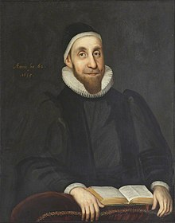
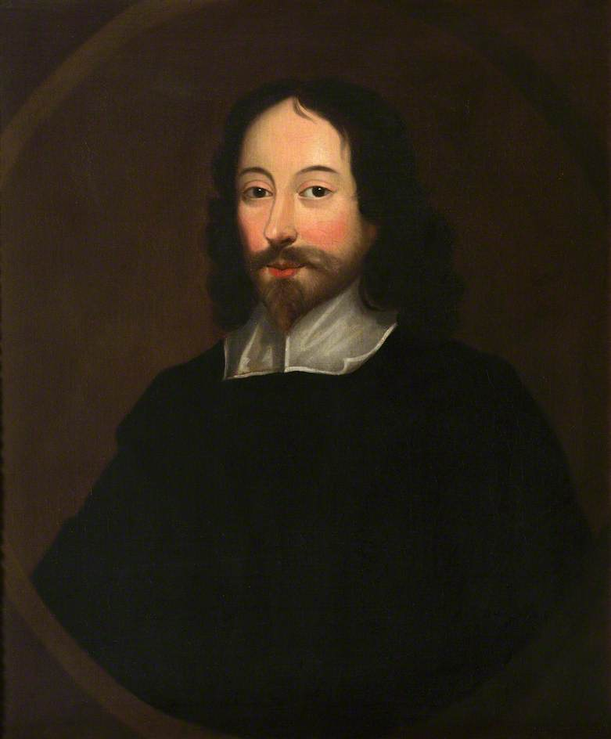
The Puritan and Restoration Literature
Robert Burton and Sir Thomas Browne are perhaps the two most representative prose writers of the period.

Slide 52
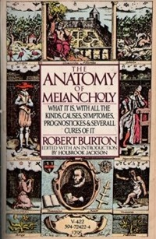
Robert Burton
Robert Burton wrote The Anatomy of Melancholy (1621), a huge treatise of over a million words.
It is an analysis of the causes, symptoms and cures for melancholy, which was considered an illness at the time.

Slide 53
Sir Thomas Browne
Sir Thomas Browne wrote Religio Medici (1642), a spiritual autobiography in which he shows that religion and science can coexist.

Slide 54
John Milton
Although he preferred poetry (he described writing prose as writing with his left hand), John Milton also produced some excellent pamphlets:
including Areopagitica (1644), a defence of free speech and writing,
and Of Education (1664) in which he expresses his opinions on how young people should be educated.

Slide 55
All three of these writers were extremely familiar with Latin, and its influence is clear in their works: the sentences are long and complex with numerous subordinate clauses which often lead to confusion.

Slide 56
John Bunyan
The writer who most successfully captured the Puritan spirit is undoubtedly John Bunyan.
A firm believer in Parliament, he joined Cromwell’s army at the age of 16 to fight against Charles I.
When the army disbanded in 1649 Bunyan returned home to Bedford near London and started preaching.
He was self-taught and based most of his learning on the Authorised Version of the Bible, which had been published in 1611.

Slide 57
John Bunyan
During the Restoration he was imprisoned for 12 years for preaching without a licence.
He subsequently spent several spells in prison but finally obtained a licence and continued preaching until his death in 1688.
He started writing his great masterpiece The Pilgrim’s Progress, which was published in 1678, during one of his periods in prison.

Slide 58
John Bunyan
It is a powerful allegory of man’s quest for salvation that is widely considered to be one of the greatest works of religious literature of all time and a forerunner to the 18th century novel.
It tells the story of the main character, Christian, who travels from the City of Destruction to the City of God, has many adventures and faces many perils on his way.
The language is simple and concise and accurately represents the speech of rural people at the time when Bunyan wrote.
The book’s engaging plot, humorous episodes and often ironic tone made it hugely successful in Britain and abroad.

