Slide 1
The early Middle Ages
The Norman Conquest

Slide 2
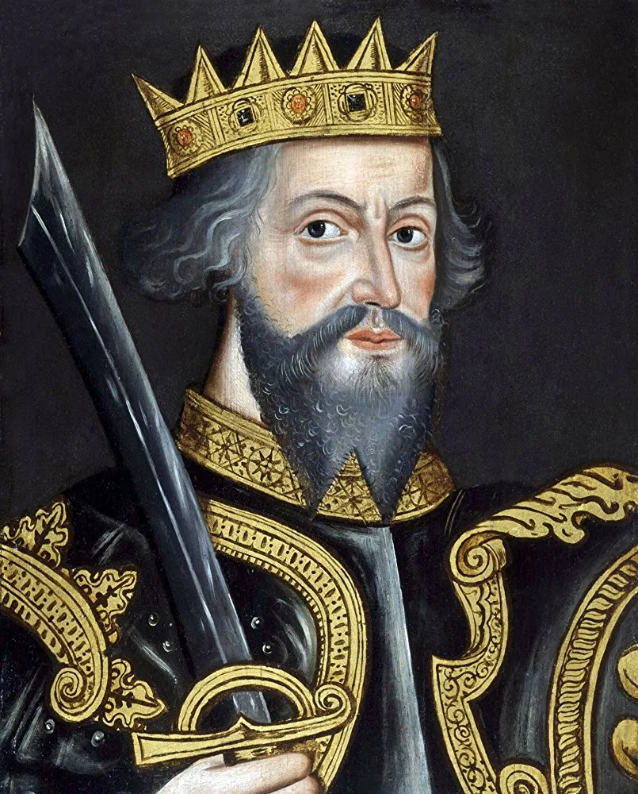
The Norman Conquest
William was now crowned king. His conquest had only just begun and the fighting lasted for another five years. There was an Anglo-Saxon rebellion against the Normans every year until 1070. The small Norman army marched from village to village, destroying places it could not control and building forts to guard others. It was a true army of occupation for at least twenty years. The north was particularly hard to control. and the Norman army had no mercy. When the Saxons fought back. the Normans burnt. destroyed and killed.
By 1086 twenty years after the arrival of the Normans, only two of the greater landlords and only two bishops were Saxon, William gave the Saxon lands to his Norman nobles, After each English rebellion there was more land to give away. His army included Norman and other French land seekers.

Slide 3
Feudalism
William was careful in the way he gave land to his nobles.
In England as each new area of land was captured. William gave parts of it as a reward to his captains. This meant that they held separate small pieces of land in different parts of the country so that no noble could easily or quickly gather his fighting men to rebel. William only gave some of his nobles larger estates along the troublesome borders with Wales and Scotland.
At the same time he kept enough land for himself to make sure he was much stronger than his nobles, Of all the farmland of England he gave half to the Norman nobles, a quarter to the Church, and kept a fifth himself. He kept the Saxon system of sheriffs, and used these as a balance to local nobles.

Slide 4
William organised his English kingdom according to the feudal system which had already begun to develop in England before his arrival.
The word "feudalism" comes from the French word feu, which the Normans used to refer to land held in return for duty or service to a lord.
The basis of feudal society was the holding of land, and its main purpose was economic.
The central idea was that all land was owned by the king but it was held by others called "vassals", in return for services and goods. The king gave large estates to his main nobles in return for a promise to serve him in war for up to forty days

Slide 5
“Homage”
The nobles also had to give him part of the produce of the land .
The greater nobles gave part of their lands to lesser nobles, knights and other "freemen". Some freemen paid for the land by doing military service, while others paid rent.
The noble kept "serfs" to work on his own land. These were not free to leave the estate, and were often little better than slaves. At each level a man had to promise loyalty and service to his lord. This promise was usually made with the lord sitting on his chair and his vassal kneeling before him, his hands placed between those of his lord.
This was called ”homage”.

Slide 6
When a noble died his son usually took over his estate. But first he had to receive permission from the king and make a spec al payment.
If he was still a child the king would often take the produce of the estate until the boy was old enough to look after the estate himself. In this way the king could benefit from the death of a noble.

Slide 7
Domesday Book
William gave out land all over England to his nobles.
By 1086 he wanted to know exactly who owned which piece of land and how much it was worth. He needed this information so that he could plan his economy find out how much was produced and how much he could ask in tax.
He therefore sent a team of people all through England to make a complete economic survey. His men asked all kinds of questions at each settlement
This survey was the only one of its kind in Europe. Not surprisingly, it was most unpopular with the people, because they felt they could not escape from its findings. It so reminded them of the paintings of the Day of Judgement, or "doom". on the walls of their churches that they called it the "Domesday" Book

Slide 8
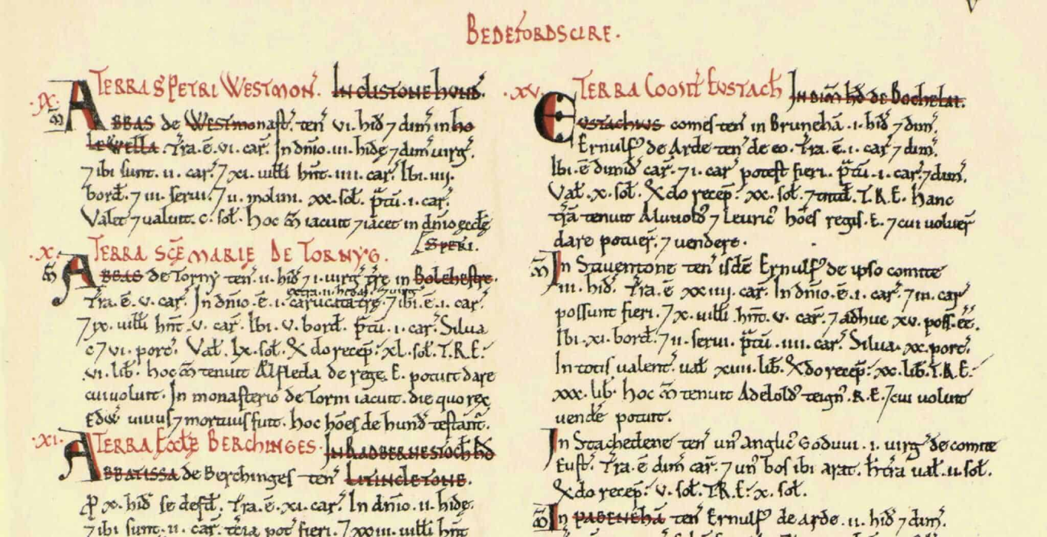

Slide 9
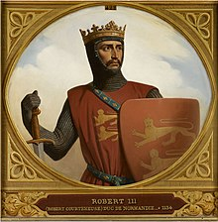
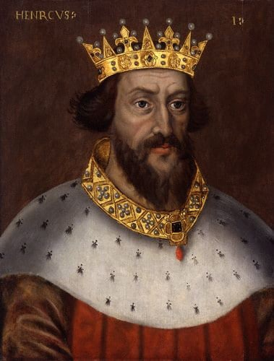
Kinghsip
When William (The Conquerer) died, in 1087, he left the Duchy of Normandy to his elder son, Robert.
He gave England to his second son, William, known as "Rufus" (Latin for red) because of his red hair and red face. When Robert went to fight the Muslims in the Holy Land, he left William(Rufus) in charge of Normandy. After all, the management of Normandy and England was a family business.
William Rufus died in a hunting accident in 1100.
He had not married, and therefore had no son to take the crown . At the time of William 's death, Robert was on his way home to Normandy from the Holy Land.
Their younger brother Henry knew that if he wanted the English crown he would have to act very quickly. He had been with William at the time of the accident. He rode to Winchester and took charge of the king's treasury. He then rode to Westminster. where he was crowned king three days later. Robert was very angry and prepared to invade. But it rook him a year to organise an army.

Slide 10
The Norman nobles in England had to choose between Henry and Robert. This was not easy because most of them held land in Normandy too. In the end they chose Henry because he was in London, with the crown already on his head. Robert's invasion was a failure and he accepted payment to return to Normandy. But Henry wanted more. He knew that many of his nobles would willingly follow him to Normandy so that they could win back their Norman lands.
In 1106 Henry invaded Normandy and captured Robert. Normandy and England were reunited under one ruler.
Henry l's most important aim was to pass on both Normandy and England to his successor. He spent the rest of his life fighting to keep Normandy from other French nobles who tried to take it. But in 1120 Henry 's only son was drowned at sea.

Slide 11
Henry II
Henry II was the first unquestioned ruler of the English throne for a hundred years. He destroyed the castles which many nobles had built without royal permission during Stephen's reign, and made sure that they lived in manor houses that were undefended.
The manor again became the centre of local life and administration. Henry II was ruler of far more land than any previous king
As lord of Anjou he added his father's lands to the family empire. After his marriage to Eleanor of Aquitaine he also ruled the lands south of Anjou

Slide 12
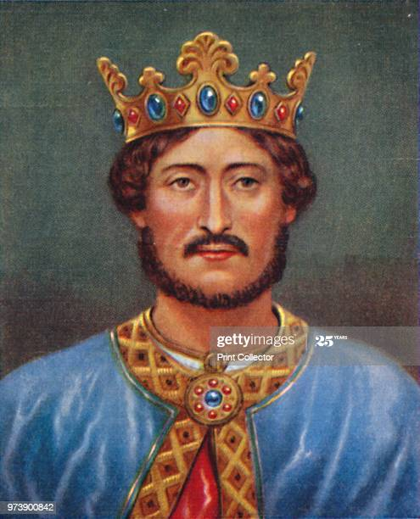
However, Henry quarrelled with his beautiful and powerful wife, and his sons, Richard and John, took Eleanor's side. It may seem surprising that Richard and John fought against their own father. But in fact they were doing their du y to the king of France, their feudal overlord, in payment for the lands they held from him . In 1189 Henry died a broken man, disappointed and defeated by his sons and by the French king.
Henry was followed by his rebellious son, Richard. Richard has always been one of England's most popular kings, although he spent hardly any time in England . He was brave, and a good soldier, but his nickname Coeur de Lion, "lionheart ", shows that his culture, like that of the kings before him, was French . Richard was everyone's idea of the perfect feudal king. He went to the Holy Land to make war on the Muslims and he fought with skill, courage and honour.

Slide 13
King John
1199 - Richard was killed in France.
Richard had no son, and he was followed by his brother, John. John had already made himself unpopular with the three most important groups of people, the nobles, the merchants and the Church.
John was unpopular mainly because he was greedy. The feudal lords in England had always run their own law courts and profited from the fines paid by those brought to court. But John took many cases out of their courts and tried them in the king's courts, taking the money for himself

Slide 14
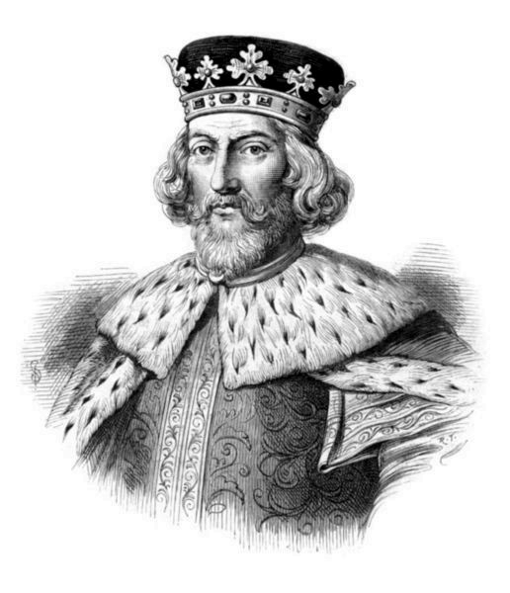
In 1204 King John became even more unpopular with his nobles. The French king invaded Normandy and the English nobles lost their lands there. John had failed to carry out his duty to them as duke of Normandy. He had taken their money but he had not protected their land.
In 1209 John quarrelled with the pope over who should be Archbishop of Canterbury. John was in a weak position in England and the pope knew it. The pope called on the king of France to invade England, and closed every church in the country. At a time when most people believed that without the Church they would go to hell, this was a very serious matter. In 1214 John gave in, and accepted the pope's choice of archbishop
In 1215 John hoped to recapture Normandy. He called on his lords to fight for him, but they no longer trusted him. They marched to London , where they were joined by angry merchants. Outside London at Runnymede, a few miles up the river. John was forced to sign a new agreement.

Slide 15
Magna Carta
This new agreement was known as "Magna Carta" , the Great Charter, and was an important symbol of political freedom. The king promised all "freemen" protection from his officers, and the right to a fair and legal trial.
Hundreds of years later, Magna Carta was used by Parliament to protect itself from a powerful king. In fact Magna Carta gave no real freedom to the majority of people in England. The nobles who wrote it and forced King John to sign it had no such thing in mind. They had one main aim: to make sure John did not go beyond his rigts as feudal lord. Magna Carta marks a clear stage in the collapse of English feudalism. Feudal society was based on links between lord and vassal
The nobles did not allow John's successors to forget this charter and its promises. Every king recognised Magna Carta, until the Middle Ages ended in disorder and a new kind of monarchy came into being in the sixteenth century.

