Slide 1
Introduction to
Shakespeare’s Othello
Then must you speak
Of one that loved not wisely, but too well…

Slide 2
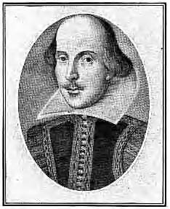
William Shakespeare
Born in April 1564 in Stratford-on-Avon
Received a classical education including Latin, Greek, history, maths, astronomy, and music
Most likely began as an actor
Wrote 38 plays, including comedies, histories, tragedies, and romances
Wrote 4 lengthy poems and a sonnet cycle

Slide 3
Shakespeare Vocabulary
Verse vs. Prose
Meter
Foot
Iambic Pentameter
Blank Verse vs. Free Verse
Sonnet
Quatrain
Couplet
Aside
Monologue
Soliloquy
Allusion
Foil
Tragedy
Tragic Hero
Tragic Flaw

Slide 4
Verse vs. Prose
Verse: Poetic language that includes meter and sometimes rhyme;
organized in lines with a consistent number of syllables
Prose: Ordinary written language with no meter or rhyme; organized in sentences

Slide 5
Prose Verse
“Sir, he’s rash and very sudden in choler, and haply may strike at you. Provoke him that he may, for even out of that will I cause these of Cyprus to mutiny, whose qualification shall come into no true taste again but by the displanting of Cassio” (2.1.294-298).
“Most potent, grave, and reverend signoirs,
My very noble and approved good masters:
That I have ta’en away this old man’s daughter,
It is most true; true I have married her”
(1.3.91-94).

Slide 6
Verse vs. Prose: Usage
Poetic style of verse used for high status characters, great affairs of war and state, and tragic moments.
Prose used for low status characters (servants, clowns, drunks, villains), proclamations, written challenges, accusations, letters, comedic moments, and to express madness.

Slide 7
Verse vs. Prose
In Othello, pay careful attention to the situations in which Iago switches between speaking in verse and speaking in prose.
What importance does his choice of verse or prose seem to have?

Slide 8
Meter
Meter: the pattern of stressed and unstressed syllables.
Meter is responsible for creating the rhythm of a line.

Slide 9
Meter and Foot
Foot: a group of syllables that forms one complete unit of a metrical pattern.
Meter is described in terms of the pattern of stressed and unstressed syllables AND the total number of metrical feet in a line of verse.
Iambic pentameter is the most common metrical pattern in Shakespeare.

Slide 10
Iambic Pentameter
Iamb: unstressed syllable, stressed syllable ˘ /
Pentameter: Lines of five iambic feet; 10 syllables
Example:
˘ / ˘ / ˘ / ˘ / ˘ /
But soft, what light through yonder window breaks?

Slide 11
Blank Verse vs. Free Verse
Blank Verse: Unrhymed iambic pentameter
One equal temper of heroic hearts,
Made weak by time and fate, but strong in will
To strive, to seek, to find, and not to yield.
Free Verse: No regular meter
One’s-Self I sing, a simple separate person, Yet utter the word Democratic, the word En- Masse.

Slide 12
Sonnet
14 line poem, usually written in iambic pentameter
organized in three quatrains and a couplet
typical rhyme scheme abab cdcd efef gg
four-part organization has greater flexibility about where thematic breaks occur
most pronounced break or turn comes with concluding couplet

Slide 13
Sonnet: Quatrain and Couplet
Quatrain: four-line verse stanza, usually rhymed
Couplet: a pair of rhyming verse lines

Slide 14
Aside, Monologue, and Soliloquy
Aside: a character’s remark, either to the audience or another character, that other characters on stage are not supposed to hear
Monologue: an extended speech by a single character that is uninterrupted by others
Soliloquy: a speech a character gives when s/he is alone on stage

Slide 15
Foil - Ellentét
A character whose personality or attitudes are in sharp contrast to those of another character in the same work.

Slide 16
Allusion – Célzás, hivatkozás
Allusion: reference to an event, person, place, or another work of literature
Shakespeare’s work contains numerous allusions to Greek and Roman mythology.

Slide 17
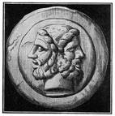
Allusion: Janus
Roman god of gates and doors, beginnings and endings
Depicted with a double-faced head, each looking in opposite directions
Worshipped at the beginning of the harvest time, planting, marriage,, birth, and other types of beginnings.
Also represents the transition (átmenet) between primitive life and civilization, between the countryside and the city, peace and war, and the growing-up of young people.

Slide 18
Tragedy
A serious play representing the disastrous downfall of the hero.
Achieves a catharsis by arousing pity and terror in the audience.
Hero is led into fatal calamity (végzetes csapás) by hamartia (tragic flaw or error) which often takes the form of hubris (excessive pride leading to divine retribution – isteni megtorlás)
Tragic effect depends upon audience’s awareness of the admirable qualities of the hero which are wasted in the disaster.

Slide 19
Classical Tragic Hero
The tragic hero is a good man, important to society
The hero suffers a fall brought about by something in his nature
The fall provokes the emotions of pity and fear in the reader
The tragic character comes to some kind of understanding or new recognition of what has happened

Slide 20
Tragic Flaw – Tragikus hiba
Defect of character that leads to
the hero’s disastrous downfall

Slide 21
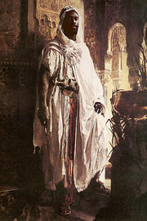
Othello Terminology: Moor
Muslim person of Arab and Berber descent from northwest Africa
Moors invaded Spain and established a civilization in Andalusia lasting from the 8th - 15th centuries
Term Moor comes from the Greek work mauros meaning dark or very black
In Renaissance drama, Moors often symbolized something other than human - and often, indeed, something devilish.

Slide 22
Othello Terminology: Cuckold
a man whose wife is unfaithful to him
Represented with horns growing out of his forehead
“That cuckold lives in bliss
Who, certain of his fate, loves not his wronger;
But O, what damned minutes tells he o’er
Who dotes, yet doubts; suspects, yet strongly loves!”
(3.3.197-200)
“I have a pain upon my forehead, here” (326).

Slide 23
Othello: A Tragedy
Written in 1604
One of the major tragedies - after Hamlet and before King Lear and Macbeth
Fascination (megigézés) with evil
Study the devastating effects of the deadly sins of the spirit: ambitious pride, ingratitude (hálátlanság), wrath (harag), jealousy and vengeful (bosszúálló) hate

Slide 24
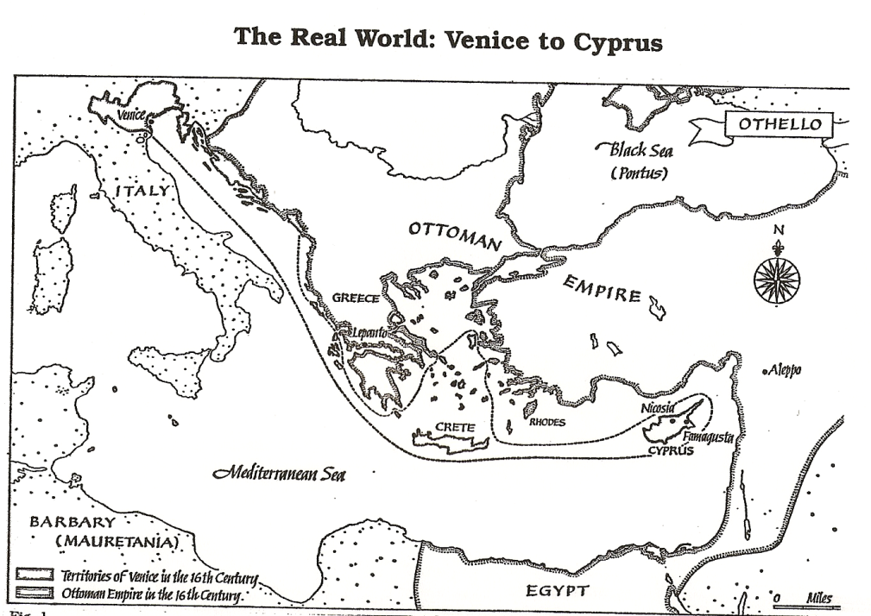
Othello: Setting
Journey from Venice, Italy to Cyprus
Venice = order, rule of reason ?
Cyprus = disorder, rule of passion ?

Slide 25
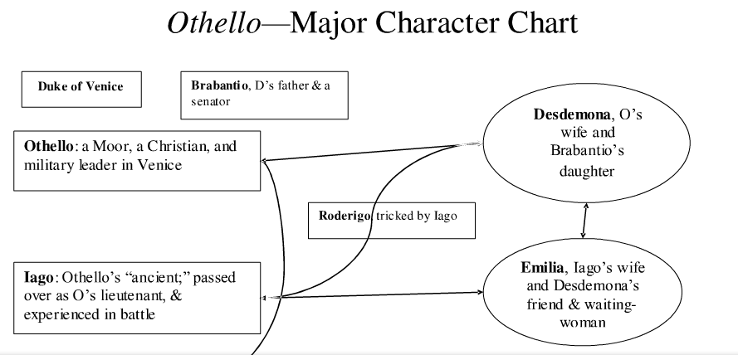
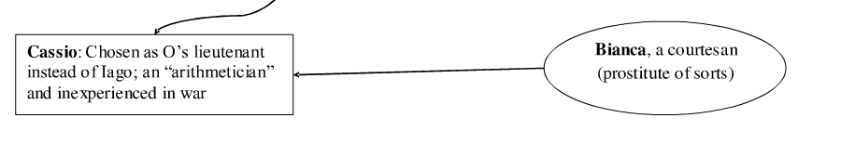

Slide 26
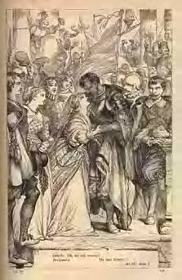
Othello: Poetic Images
Focused on the natural world
Most important pattern – contrast of light and dark, black and white
One cluster is domestic and animal: goats, monkeys, wolves, baboons (pávián), guinea hens (gyöngytyúk), wildcats, spiders, flies, asses, dogs, horses, sheep, serpents, and toads
Other images include green-eyed monsters, devils, poisons, money purses, tarnished jewels, music untuned, and light extinguished

Slide 27
Othello: the Villain
Delights in evil for its own sake
Conscienceless, sinister, and amused by his own cunning
Related to Vice (bűn), the figure of personified evil, from the medieval morality play whose role is to win Humankind away from virtue and corrupt him with worldly enticements (csábítás)
Takes audience into his confidence, boasts in soliloquy of his cleverness, exults in the triumph of evil, and improvises plans with daring and resourcefulness (találékonyság)

Slide 28
Othello: Thematic Ideas
    Nature of love and marriage
    Nature of jealousy
    Nature and use of language
    Male mistrust of women
    Deception (megtévesztés) / Honesty
    Importance of reputation

Slide 29
The Plot
The plot is simple. A man, disappointed of promotion which he thought he had a right to expect, determines on revenge and in part secures it. By a series of careful moves he persuaded the General (Othello) of the adultery of the General's wife (Desdemona) with the lieutenant (Cassio) who has been promoted ahead of him.
As a result, the general first kills his wife then himself, but the ensign (Iago) fails in the second part of his design, since the plot is disclosed.
Cassio receives yet a further promotion and Iago is left facing trial and torture. The plot "scheme" is concerned with one of the strangest and most distressing of human emotions - jealousy - and this is what makes the plot powerful.

Slide 30
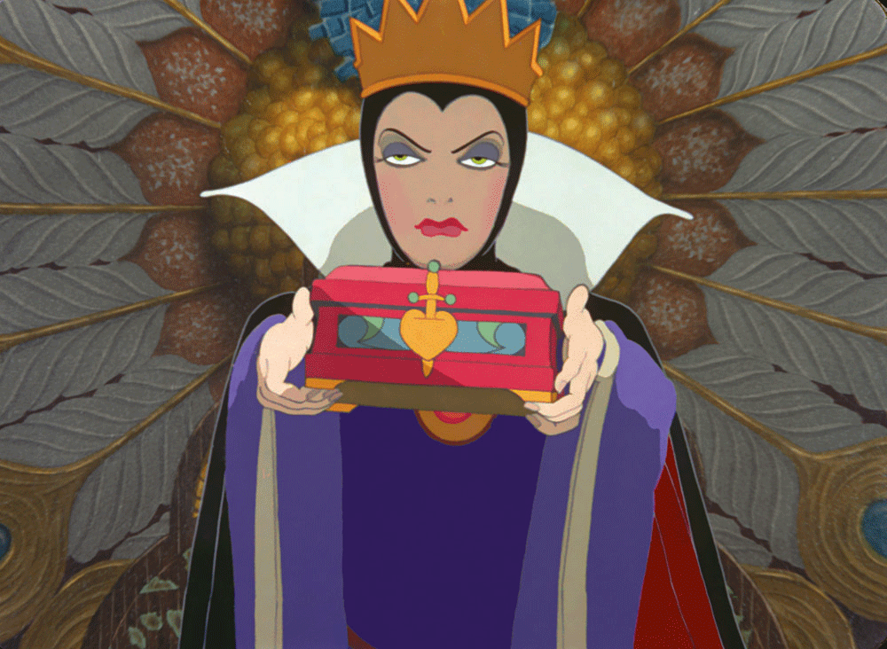
Famous Jealous people

Slide 31
Themes
The play’s central theme is love
  destruction of love = hate
  love and hate together arouse jealousy.
The central conflict is between men and women and this is presented through a series of parallel and contrasting couples.
Desdemona/Othello, Emilia/Iago, Bianca/Cassio and a number of fantasy couples:
  Roderigo/Desdemona, Cassio/Desdemona, Othello/Emilia.

Slide 32
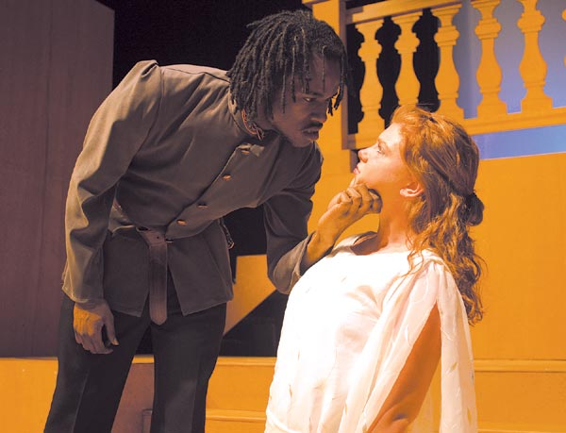
A deep exploration of the central issues in Othello

Slide 33
Source material
Shakespeare’s Othello was based on Giraldi Cinthio’s Gli Hecatommithi
  The main plot was derived from Cinthio’s short story, but Shakespeare adapted it drastically.
  Gli Hecatommithi major theme was that mixed-race marriages cannot work
    Othello has more complex characterization and deals with many other issues.

Slide 34
Publication history
The first printed copy of Othello came in 1622, called the First quarto.
  *It was printed from a scribal transcript by Shakespeare
The First folio was printed one year later
  *Printed from a transcript by Ralph Crane
The Second quarto was printed in 1630
The Second folio was printed in 1632

Slide 35
Contemporary performance reviews
For contemporary audiences, the question becomes whether or not white actors can or should play Othello?

Slide 36
Central issues in Othello
Race
Gender and sexuality
Class

Slide 37
Historical context of race
In the 1560’s some seamen actively participated in slave trade.
Queen Elizabeth in 1601 issued an edict expelling Africans from the country for taking jobs away.
During the Elizabethan era there was a blend of cultural experiences that hadn’t previously been experienced which led to a fear of Africans and other foreigners
  Shakespeare was able to transform the fear into plays of great social significance.
In the late 16th century Africans function in three different ways to society
  1: Household servants
  2: Prostitutes
  3: Court entertainers

Slide 38
Historical context of race—defining racial terms
Moor—Originally: a native or inhabitant of ancient Mauretania, a region of North Africa corresponding to parts of present-day Morocco and Algeria. Later usually: a member of a Muslim people of mixed Berber and Arab descent inhabiting north-western Africa (now mainly present-day Mauritania), who in the 8th cent. conquered Spain. In the Middle Ages, and as late as the 17th century, the Moors were widely supposed to be mostly black or very dark-skinned, although the existence of ‘white moors’ was recognized.
Black—Having an extremely dark skin; strictly applied to negroes and negritos, and other dark-skinned races; often, loosely, to non-European races, little darker than man Europeans.
Definitions from the Oxford English Dictionary

Slide 39
More on the Moor
Etymologically, Moors were people native of Mauritania—a region in ancient Morocco.
Often pertained (vonatkozik) to people from Africa
Moors other times are referred to as Arabians, Turks, and Spaniards.
Moor also could signal religious affiliations (hovatartozás), not just race and regional affiliations.
During Shakespeare's time, not coincidentally, Moors became very complex, not fitting one single mold but carrying signs of many cultural traditions.

Slide 40
Race as it pertains to Othello
What race should we suppose Othello to belong?
  Shakespearian experts believed that Othello was Oriental (Keleti) as recently as 1941.
  Elizabethans did not make careful distinctions between Moors and Negroes.
    The term Moor was applied to Arabs, Berbers, Syrians and Negroes in Shakespeare’s time.

Slide 41
Race
Othello’s appearance is regularly and consistently described as though he’s black or of African descent.
Other passages do not describe his appearance, but they help show his racial identity:
Barbantio accuses Othello of using magic, and Elizabethans associated Moors with witchcraft.
  Iago calls Othello the devil, Barbary Horse (Berber Ló) and Lascivious Moor (Buja Mór)
  In Titus Andronicus, a Shakespeare play, Aaron is black and referred to as a Moor
    Elizabethan’s thought devils took the form of Moors and Negroes
    Barbary Horses are from Northern Africa
    Lascivious Moor: people born in hot countries

Slide 42
Racist attitudes toward Othello
Characters in Othello rarely refer to Othello by his real name; they instead call him the Moor or some racist variation.
Iago: refers to Othello as the Moor more than 20 times, by name only 5.
Roderigo: does not refer to Othello by name, calling him the Moor twice and thicklips once.
Brabantio and Emilia also never refer to Othello by name, calling him the Moor instead.
Othello’s Africanness becomes essential to the play because he is perceived by other characters as an other. A deeper look into these characters and how they refer to Othello further supports their racist attitudes.

Slide 43
Iago’s attitude toward Othello
Refers to Othello in racist terms constantly:
“an old black ram” (I.i.111)
“the devil” (I.i.91)
“Barbary horse” (I.i.111)
He also says that Othello marring Desdemona is making “the beast with two backs” (I.i.115-116) it is a euphemistic metaphor for two persons engaged in sexual intercourse.
I am one, sir, that comes to tell you your daughter and the Moor are now making the beast with two backs.

Slide 44
Roderigo’s attituded toward Othello
Desdemona’s marriage to Othellos is a “gross revolt” (I.i.134). (teljes lázadás)
Their marriage is also “gross clasps of a lascivious Moor” (I.i.126).
Roderigo and Iago confirm the Elizabethan stereotypes, implying that Othello’s blackness connotes ugliness, lust, bestiality, treachery, and the demonic.

Slide 45
Brabantio’s view of his new son-in-law
Brabantio has a positive relationship with Othello until he elopes with his daughter.
  He does not want a black man marrying his daughter.
  Accuses him of being a “foul thief,” “damned,” and of attracting Desdemona through witchcraft.
  Being a bond slave and pagan (I.ii.99)
  Calls Othello a thing, not a person.
    Lodovico also calls Othello a thing when he demands his corpse to be hid at the end of the play.

Slide 46
Emilia’s subtle racist attitude
Emilia does not seem to have any racist attitudes toward Othello throughout the entire play…until the end —
When Othello tells her he murdered Desdemona, Emilia snaps with racial fiery: “O, the more angel she, and you the blacker devil!” (V.ii.129-131).
This quote implies that she always thought of Othello as a devil, now he is a blacker devil.
  Her accusation of him being a blacker devil implies that being black is negative in her view.

Slide 47
Desdemona’s view on her husband’s race
Although Desdemona is married to him, she makes it clear that it is not because of his physical appearance:
  “I saw Othello’s visage in his mind” (I.iii.252).
  She marries him because of his stories and his mind, so she was able to overlook his blackness.
    This still shows she has a racist attitude.

Slide 48
Love, Sex, and Marriage— historical context
Family during Elizabethan and Jacobean England and its three major traits:
  Matrix of procreation (nemzés) and education of the young
  Focus on economic activity—production and consumption
  Site for the exercise of patriarchal authority and the reproduction of age and gender hierarchies.
  In a rapidly growing metropolis, additional freedom and wider circle of acquaintances that London society offered wives and husbands created temptation the tested sexual morels to the limit.

Slide 49
Sexuality in Shakespeare’s time
There was an obsession with chastity of women.
The phenomenon of heterosexual jealousy
  There was anxiety and violence engendered in men because of the regulation of women’s sexuality.
  In any society where women are constructed as others by men, jealousy and paranoia will be present.

Slide 50
Love, Sex, and Marriage— women in Shakespeare’s work
Women were mistreated during the time of Shakespeare, and these rules applied to all women other than aristocratic women:
  Women were excluded from universities and learned professions
  Married women lost the right to their own property.
  Wife beating was accepted and often used to solve a domestic dispute.
    A man who was beaten by his wife failed to live up to his patriarchal expectations, and he was looked down upon.

Slide 51
Love, Sex, and Marriage in Othello
Often in Shakespeare’s work, men marginalize women to privilege their manly virtues. Also, women and men mistreat whores to privilege the feminine virtue of chastity.
Othello’s love for Desdemona, and vice versa, is pure, but as the play progresses Othello’s love gets tarnished.
Emilia mediates between wife and whore; between Desdemona and Bianca.
Morality is legislated by property owner
  If you own the world—as men d0—you can make the rules, so men define right as what they do and wrong as what women do.
  Rodergio and Iago speaking of marriage and money at the beginning of the play instantly defines Desdemona as a prize.
  Desdemona ultimately gives in, not because of Othello’s manliness and strength, but rather because of her true love for Othello.

Slide 52
(Erotic?) love in Othello
A core element in Othello is an intense focus on the sexual relationship between and man and a woman (Othello and Desdemona).
  Many readers think Desdemona is too good to be true—she’s too innocent to be a wife, but she’s too wifely to be innocent
  When Desdemona explains her transfer of feeling from her father to husband, shows in archetypal terms how a girl becomes a woman.
  The marriage of an old man and a young woman was generally used in a farce, but Shakespeare inverts expectations and intensifies the response.

Slide 53
Women’s voices in Othello
A revealing conversation between Desdemona and Emila comes when Desdemona prepare for bed in Act V.
  The women talk about men and women
  The women are alone when they have this talk, so their private freedom makes them feel protected from men.
  The conversation here reveals Desdemona’s naive purity and Emilia’s pragmatism.
  The women talk about this subject because their husbands simply will not listen to them about it.

Slide 54
Order and class
Ideas about the nature of mankind, government, the society organization and the inferiority of women were widely debated.
Standards prescribed for political order did not always meet social realities.
Man had an ability to recognize virtue was an endowment from God.
The inferiority of women was ‘proved’ through passages from the Christian Bible.

Slide 55
Military class
There was a surge of social mobility that occurred at the boundaries between ruling and subject classes in late 16th century England.
  A commander’s lieutenant is a sign of his powers.
    By choosing a subordinate captain, the captain is choosing a replacement for himself, so it’s an important role.
      Iago makes clear from the beginning of the play the he covets Cassio’s lieutenancy position.

Slide 56
Religion
Shakespeare was Christian, wrote for a predominately Christian audience, and Othello had a Christian setting.
The play has been interpreted with Othello representing God, Cassio is the figure of Adam, Desdemona is Christ and Iago is Satan.
  Many of the speeches in the play have a Christian ring—
    “I would not kill thy unprepared spirit” V.ii.31
    “I am not what I am”
    “sorrow’s heavenly. /It strikes where it dot love” V.ii.20

Slide 57
Otherness in a play about an other
Othello is considered an other in the play for a variety of reasons.
  He has to assimilate to Christianity
  He is of different race
    Iago plays on his race and uses stereotypes to distance Othello and make him seem an outsider to other characters.

Slide 58
It has often been debated whether or not Othello should be played by a black actor. He sometimes was played by a white actor whose face was painted black:
http://www.youtube.com/watch?v=F96DlM3N5KQ

Slide 59
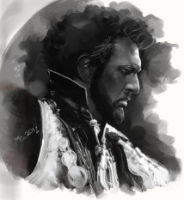
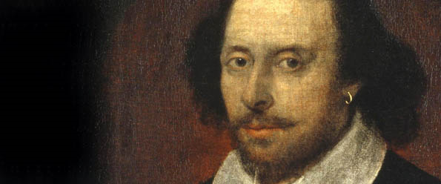
OTHELLO
By William Shakespeare

Slide 60
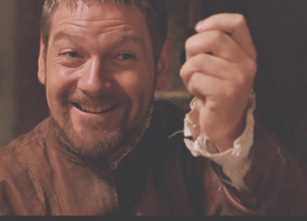
Iago’s Motives
Ambition
Envy of Cassio’s promotion
Sexual jealousy of Othello
Profit from robbing Roderigo
Pleasure of deceiving Roderigo and Othello

Slide 61
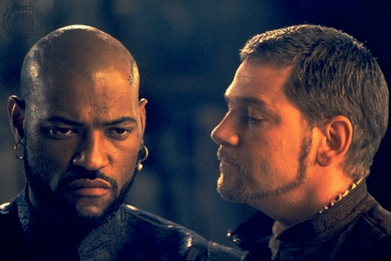
Iago’s Motives
Sexual jealousy of Cassio
Love for Desdemona
Hatred of Cassio’s handsomeness
Hatred of Othello
“Motiveless malignity”

Slide 62
Iago
Intelligent
Cunning
Capable of tempting and controlling characters around him
Villain without conscience
Diabolically evil while appearing to be honest, trustworthy

Slide 63
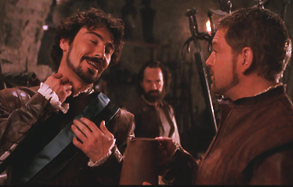
Iago
Reduces human nature to its least attractive traits
Coarse, blunt
Suspicious view of human nature - allows him to locate weakness in others; encourage its dominance of whole personality

Slide 64
Iago’s Techniques for Deception
Instigates others to act
Pretends to speak only out of the best motives
Works through insinuation rather than through explicit lies

Slide 65
Othello
Greatness
Tragic hero
Virtues carried to excess
  Loves - “too well”
  Trusts - too much
  Great sense of moral virtue - punishes sin
  Sensitive nature - vivid fantasies

Slide 66
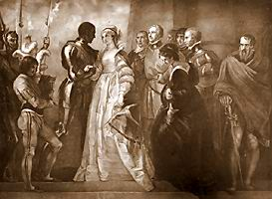
Othello
“Free and open nature”
“Constant, loving, noble nature”
Energetic
Desire for perfection
Trusting

Slide 67
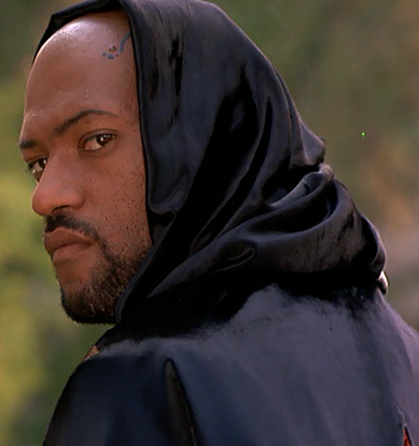
Othello’s Insecurities
HIS BLACKNESS
  A Moor (North Africa)
  Negative stereotyping
  by other characters
    Lascivious
    Unnatural mate for white woman
    Practitioner of black magic

Slide 68
Othello’s Insecurities
HIS LACK OF SOPHISTICATION
  Not a native of Venice
  At home on battlefield, not in sophisticated Venetian society
  Lacks self-confidence
  Trusts Iago’s view

Slide 69
Othello’s Insecurities
HIS AGE
  Older than Desdemona
  Iago plays on this insecurity

Slide 70
Iago
Manipulates all minor and major characters
Plays upon their individual weaknesses
Makes them instruments in his scheme to deceive Othello

Slide 71
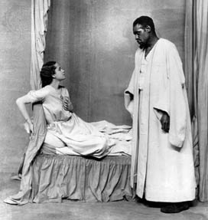
Desdemona
Admirable
Self-contained
Speaks forcefully and to the point when she confronts her father
Speaks playfully with Iago while waiting for Othello’s ship

Slide 72
Desdemona
Is known for her innocence, purity
Can plead for Cassio - but not for herself
Dutiful, obedient
Can be regarded as model Elizabethan wife

Slide 73
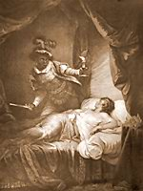
Dramatic Irony
Characters’ belief in Iago’s honesty
Othello’s belief in Desdemona’s guilt

Slide 74
Confidant(e) - serves a major character as a friend
Emilia - confidante to Desdemona
Roderigo - confidant to Iago

Slide 75
Foil - illuminates a more important character
Emilia, Bianca - foils to Desdemona
Cassio - foil to Iago

Slide 76
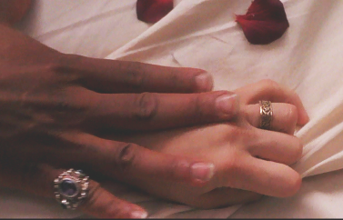
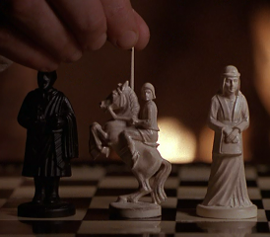
Symbols- Concrete items which represent something
Else
Handkerchief –
  Othello's and Desdemona's wedding bed.
Chess Pieces –
  the characters

