Slide 1
Student life.
Oxford and Cambridge Universities.
Prepared by Edina Homoki

Slide 2
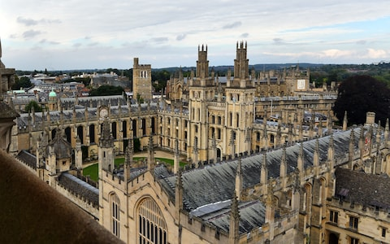
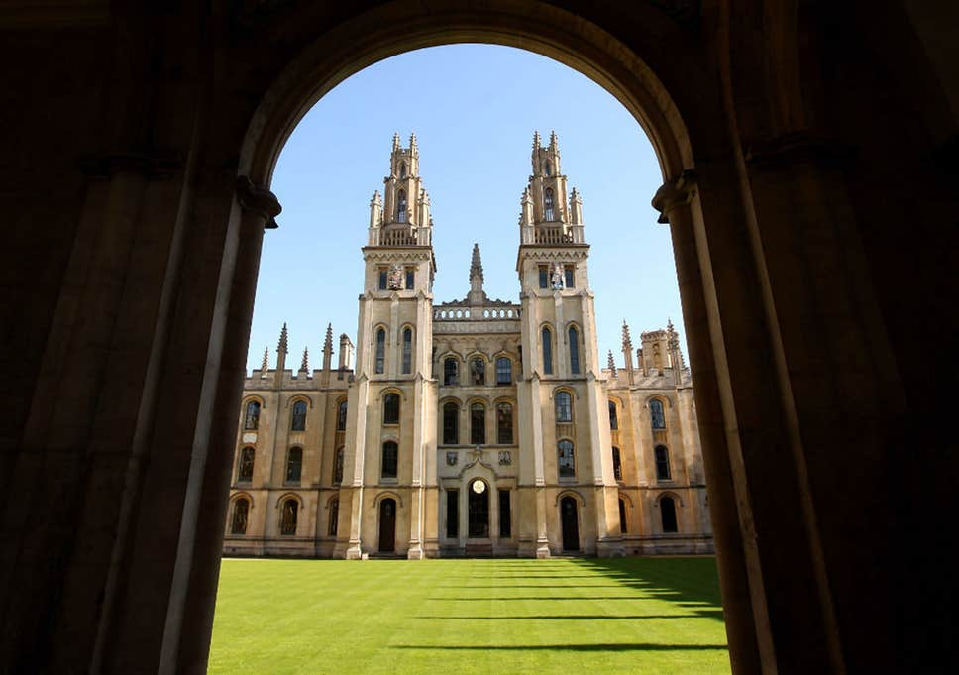
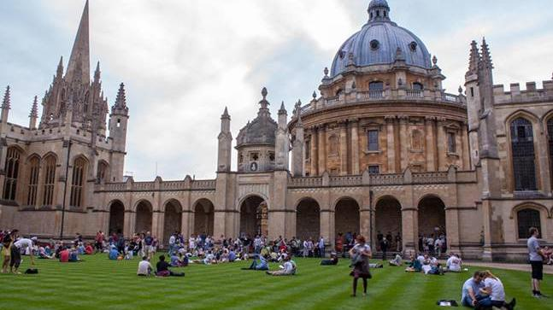
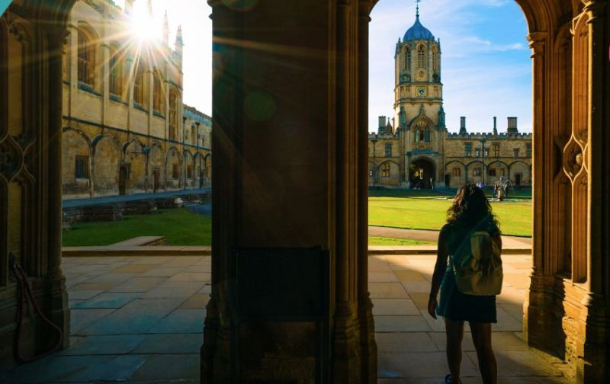
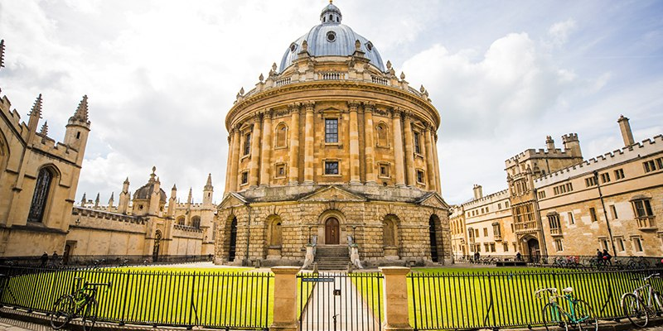
1096

Slide 3
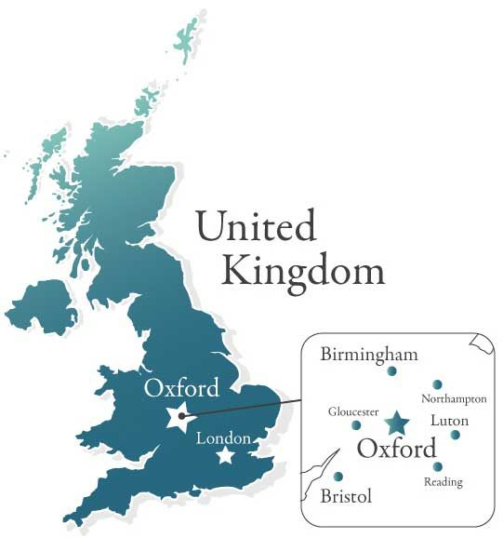
The University of Oxford is a collegiate research university in Oxford, England.

Slide 4
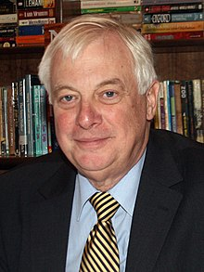
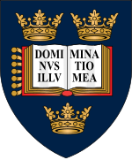
Chancellor:
The Lord Patten of Barnes
Budget: £2.237 billion
Established: 1096
Motto:
‘The Lord is my light’
Students: 23,975
Type:
Public research university
Colours: Oxford Blue
Athletics:
The Sporting Blue
Website:ox.ac.uk
Coat of arms
of the University of Oxford

Slide 5
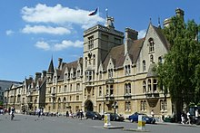
History
There’s no official date for when Oxford University was founded, although records show that teaching (in one form or another) existed at Oxford in 1096.
It was during the 12th century that the University really began to grow.
In 1167 Henry II banned English students from attending the University of Paris, which led to Oxford University numbers rising rapidly.
In the 13th century the first colleges were founded. Today the University is made up of 38 different, self-govering colleges.
Balliol College,
one of the university's oldest
constituent colleges

Slide 6
History
The University was a centre for political and religious controversy throughout the centuries.
It was the centre of the Royalist party during the English Civil War (1642–1649).
However, from the mid-18th century, the University played very little part in any political conflicts.
In 1878, academic halls were set up for women, then, in 1920, women were granted full membership of the University. It wasn’t until 1974 that five all-male colleges first admitted women, but now all colleges admit both men and women.

Slide 7
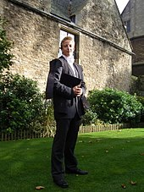
Student life
Traditions
Academic dress is required for examinations, matriculation, disciplinary hearings, and when visiting university officers.
An undergraduate student at the University of Oxford in subfusc for matriculation

Slide 8
Student life
Traditions
Some colleges have formal hall six times a week, but in others this only happens occasionally. At most colleges these formal meals require gowns to be worn, and a Latin grace is said.
Balls are major events held by colleges; the largest, held triennially in 9th week of Trinity Term, are called commemoration balls; the dress code is usually white tie.

Slide 9
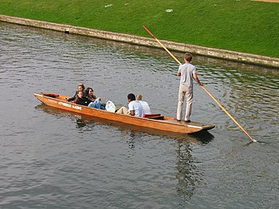
Student life
Traditions
Many other colleges hold smaller events during the year that they call summer balls or parties. These are usually held on an annual or irregular basis, and are usually black tie.
Punting is a common summer leisure activity.

Slide 10
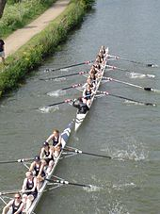
Student life
A blue is an award given to those who compete at the university team level in certain sports.
Sport is played between college teams, in tournaments known as cuppers. Significant focus is given to annual varsity matches played against Cambridge, the most famous of which is The Boat Race, watched by a TV audience of between five and ten million viewers.

Slide 11
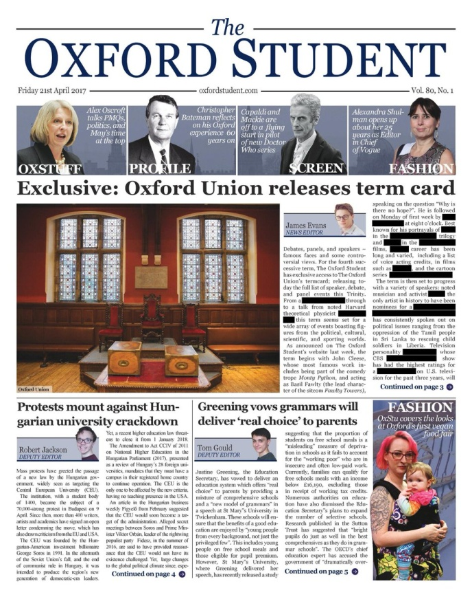
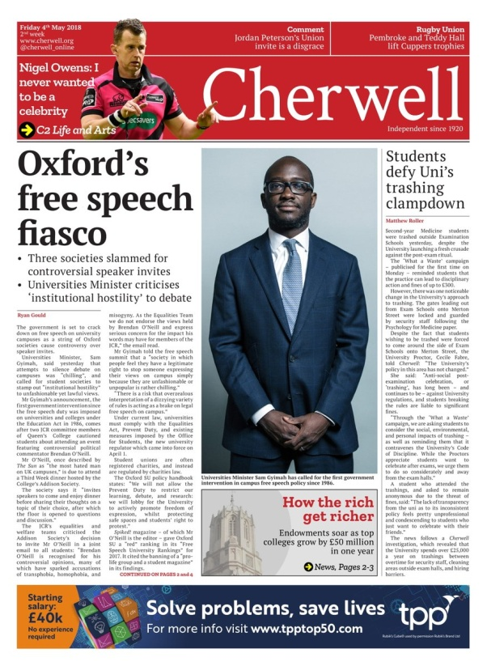
Student life
There are two weekly student newspapers
The Oxford Student is a newspaper produced by and for students of the University of Oxford; often abbreviated to The OxStu. The paper was established in 1991.
Cherwell is a weekly student newspaper published entirely by students of Oxford University. Founded in 1920.

Slide 12
Student life
Other publications include the Isis magazine, the satirical Oxymoron, and the graduate Oxonian Review.
Most colleges have chapel choirs. Music, drama, and other arts societies exist both at collegiate level and as university-wide groups, such as Oxford University Dramatic Society and the Oxford Revue.
The student radio station
is Oxide Radio.

Slide 13
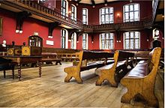
Student life
Most academic areas have student societies of some form which are open to students studying all courses, for example the Scientific Society.
There are groups for almost all faiths, political parties, countries and cultures.
The Oxford Union hosts weekly debates and high-profile speakers. There have historically been elite invite-only societies such as the Bullingdon Club.
The Oxford Union's debating chamber

Slide 14
Interesting facts
1. Ruth Lawrence, a child prodigy, passed the Oxford University maths exam at age 10, coming first out of all 530 candidates, she then completed the degree a year early by age 13.
2. There is a bell in the Oxford University library that hasn’t stopped ringing for more than 175 years. Researchers are afraid that opening the bell would ruin an experiment to see how long it will last.
3. An Oxford University study concluded that men need at least two “guys nights” a week to stay healthy.
4. A research study led by Oxford University found out that atheists and highly religious people are the ones least scared of death.

Slide 15
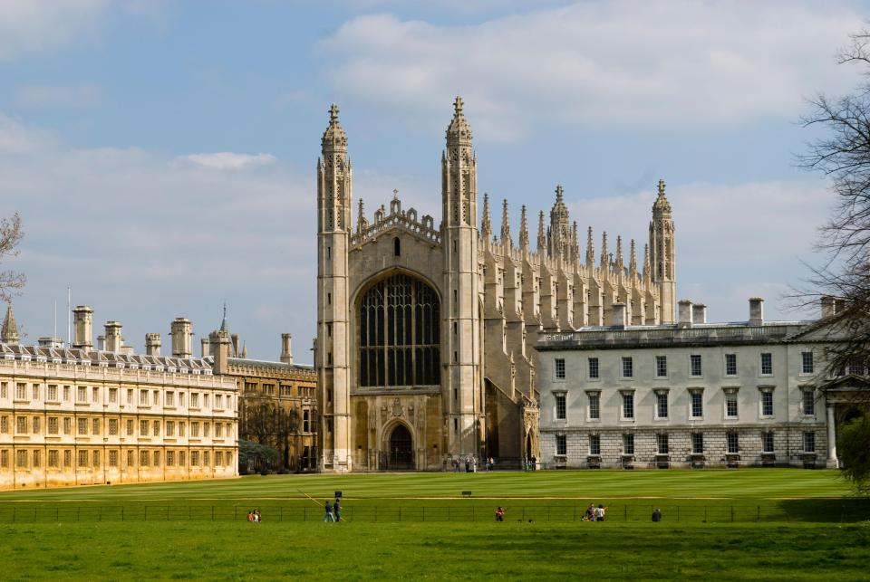
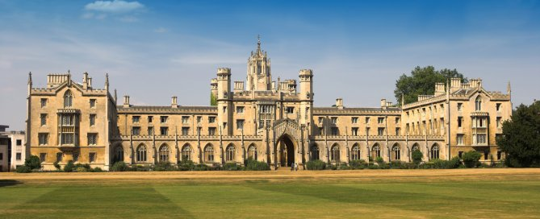
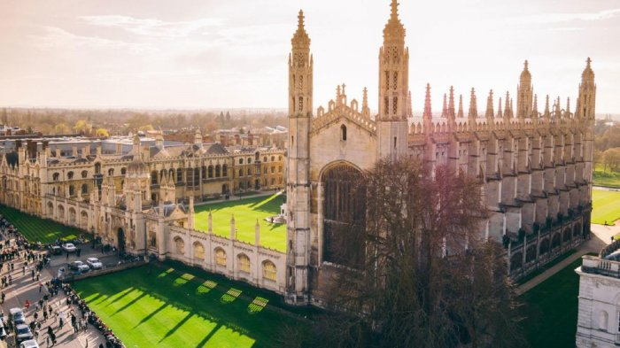
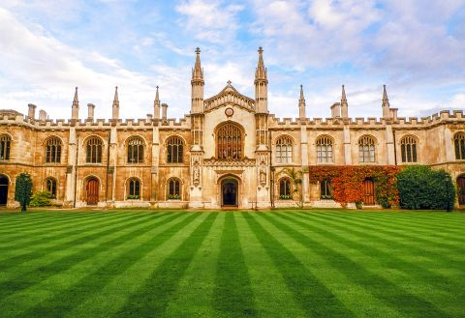
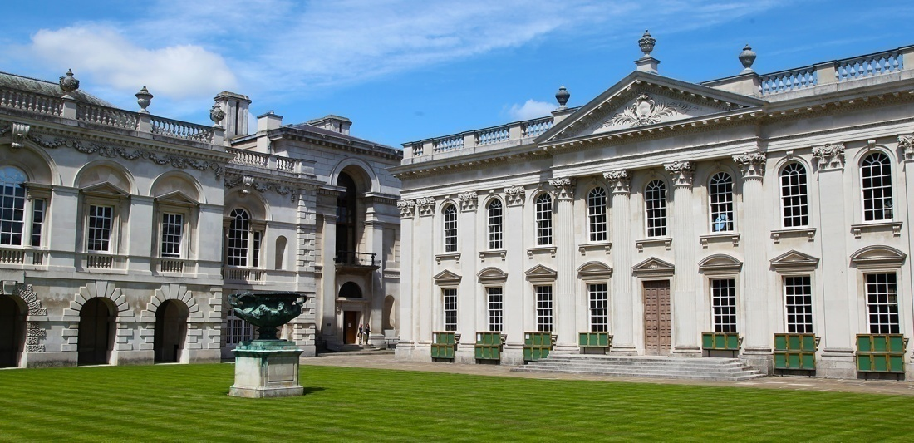
1209

Slide 16
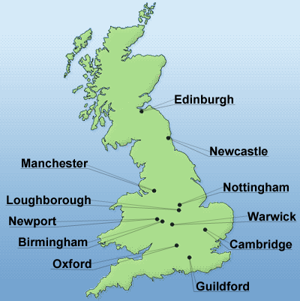
The University of Cambridge is a collegiate public research university in Cambridge, United Kingdom.

Slide 17
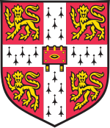
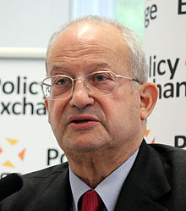
Students: 19,955
Colours: Cambridge Blue
Established: 1209
Athletics:
The Sporting Blue
Coat of arms
Budget: £1.965 billion
Type:
Public research university
Motto:
‘From this place, we gain enlightenment and precious knowledge’
Chancellor:
The Lord Sainsbury
of Turville
Website: cam.ac.uk

Slide 18
History
The start of the university is generally taken as 1209, when scholars from Oxford migrated to Cambridge.
In 1318 Cambridge received formal recognition as a studium generale from Pope John XXII.
Cambridge remained fairly insignificant until about 1502, when a professorship of divinity was founded—the oldest in the university.
In 1511 Desiderius Erasmus went to Cambridge and did much to inculcate the new learning of the Renaissance there.
In 1546 Henry VIII founded Trinity College (which was and still remains the largest of the Cambridge colleges).

Slide 19
History
In 1663 the Lucasian professorship of mathematics was founded, and six years later the first holder resigned in favour of Isaac Newton, then a young fellow of Trinity. Newton held the chair for over 30 years and gave the study of mathematics a unique position in the university.
In 1871 the university established the Cavendish professorship of experimental physics and began the building of the Cavendish Laboratory.
The University of Cambridge began to award PhD degrees in the first third of the 20th century. The first Cambridge PhD in mathematics was awarded in 1924.

Slide 20
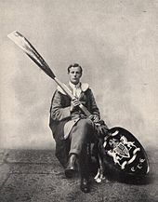
Myths, legends and traditions
A discontinued tradition is that of the wooden spoon, the 'prize' awarded to the student with the lowest passing honours grade in the final examinations of the Mathematical Tripos. The last of these spoons was awarded in 1909.
It was over one metre in length and had an oar blade for a handle.

Slide 21
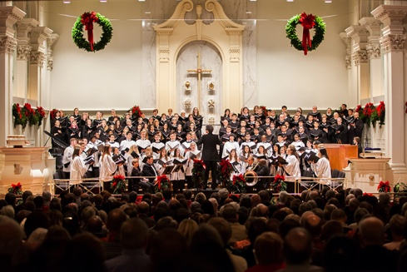
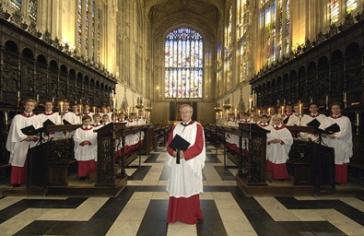
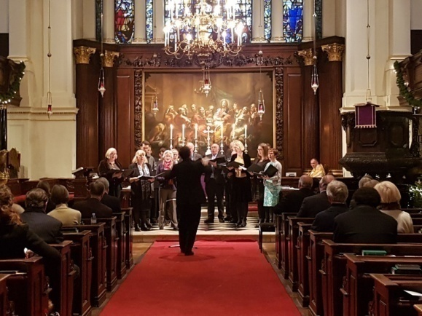
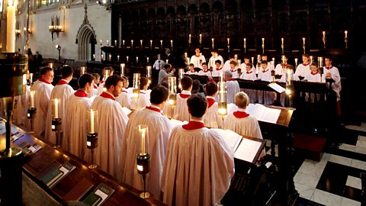
Myths, legends and traditions
Each Christmas Eve, BBC radio and television broadcasts The Festival of Nine Lessons and Carols sung by the Choir of King's College, Cambridge. The radio broadcast has been a national Christmas tradition since it was first transmitted in 1928 (though the festival has existed since 1918). The radio broadcast is carried worldwide by the BBC World Service and is also syndicated to hundreds of radio stations in the US. The first television broadcast of the festival was in 1954.

Slide 22
Student life
Student Unions
CUSU
(the Cambridge University Students‘ Union)
The GU (the Graduate Union)
Represents all University
students
Represents graduate students

Slide 23
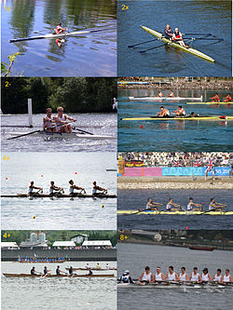
Student life
Sport
Rowing is a particularly popular sport at Cambridge, and there are competitions between colleges, notably the bumps races, and against Oxford, the Boat Race. There are also Varsity matches against Oxford in many other sports, ranging from cricket and rugby, to chess and tiddlywinks.

Slide 24
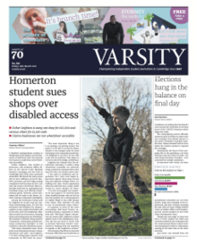
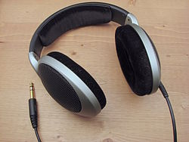
Student life
Newspaper and radio
Cambridge's oldest student newspaper is Varsity .
Established in 1947.
The student radio station, Cam FM, is run together with students from Anglia Ruskin university. One of few student radio stations to have an FM licence (frequency 97.2 MHz), the station hosts a mixture of music, talk, and sports shows.

Slide 25
Interesting facts
1. Charles – Prince of Wales, the heir to the throne for the United Kingdom, graduated at Trinity College.
2. The statesman Oliver Cromwell and the popular poet John Milton were graduates of the University of Cambridge.
3. The university’s academic year is divided into 3 terms of about 8 weeks each.
4. The colleges provide their students with lodgings and meals; assign tutors and offer social, cultural and athletic activities.

Slide 26
Frequently Asked Questions About
Student Life in the UK
1. Do students tend to work part-time during their studies?
Yes. Many students at universities in the UK have part-time student jobs, typically in hospitality, academic tutoring or for their student union.
2. What are the living costs while studying in the UK?
According to the National Union of Students, the average living costs of studying in the UK in London are about £13,400
3. What happens during Freshers' Week?
In the UK, the term 'fresher' refers to a new undergraduate student. Freshers' Week is held at the start of the year to welcome the new intake of e students.

Slide 27
Frequently Asked Questions About
Student Life in the UK
4. What if I fail an exam or year?
If you fail a year, you may get a chance to re-sit your exams, though your marks may be capped at 40% (that is, a third-class degree). If you fail again, you would typically have to retake the entire year, drop out or consider switching to a new subject. Failing individual coursework assignments would probably do no more than hurt your grade average, though in some cases you may be allowed to resubmit.
5. How many hours of class time a week should I expect?
Most full-time undergraduate courses in England, Wales and Northern Ireland are split across a period of three years (four, if you plan on doing a foundation degree). In Scotland, the norm is four years. You could expect between 15 and 25 hours of class-time a week.

Slide 28
“
Every student can learn, just not on the same day, or the same way.
George Evans
Prepared by Edina Homoki

