Slide 1
The main cities of United Kingdom
P.M

Slide 2
Introduction
The United Kingdom (official name United Kingdom of Great Britain and Northern Ireland) consists of four countries united under one monarch and government. The countries are England, Scotland, Wales and Northern Ireland.
England has traditionally been the dominant nation within the UK has over 80 percent of the share of the total population. People in Scotland and Wales have proud national traditions and languages. Scottish Gaelic is mainly spoken in the north west of the country, by a small proportion of the population. Welsh has a much bigger number of people speaking the language and all public signs in Wales are displayed in both Welsh and English.
P.M

Slide 3
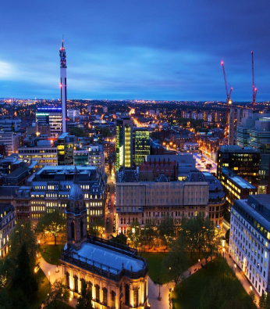
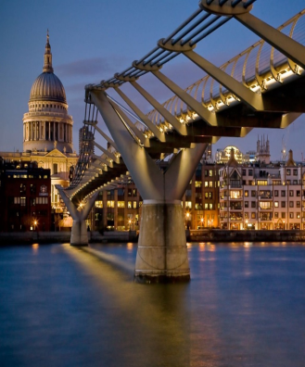
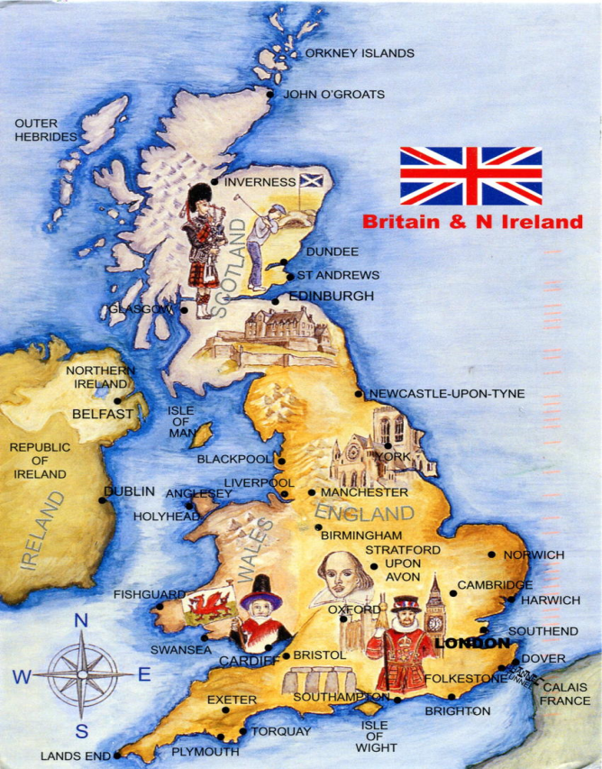
United Kingdom
Capital: London
Official language: British English
Government: Unitary parliamentary democracy and constitutional monarchy.
Monarch - Elizabeth II
Prime Minister - Theresa May
Population (2016 estimate): 65,110,000
Currency: Pound sterling (GBP)
P.M

Slide 4
United Kingdom: Countries and Major Cities
Scotland
Wales
Glasgow, Edinburg
Cardiff, Neath
England
Northern Ireland
London, Birmingham, Liverpool, Bristol, Manchester, Sheffield, Leeds, Leicester
Belfast, Bangor
P.M

Slide 5
London
London is the capital and most populous city of England and the United Kingdom. Standing on the River Thames in the south east of the island of Great Britain, London has been a major settlement for two millennia. It was founded by the Romans, who named it Londinium.
London is a leading global city in the arts, commerce, education, entertainment, fashion, finance, healthcare, media, professional services, research and development, tourism, and transportation. It is crowned as the world's largest financial centre. London is a world cultural capital. It is the world's most-visited city as measured by international arrivals and has the world's largest city airport system measured by passenger traffic.
P.M

Slide 6
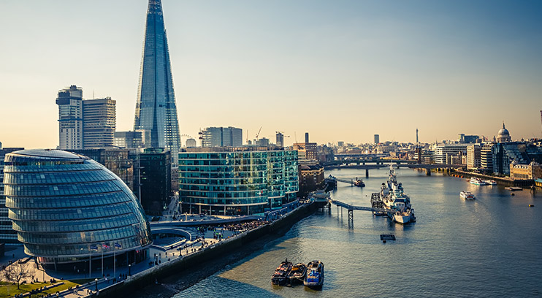
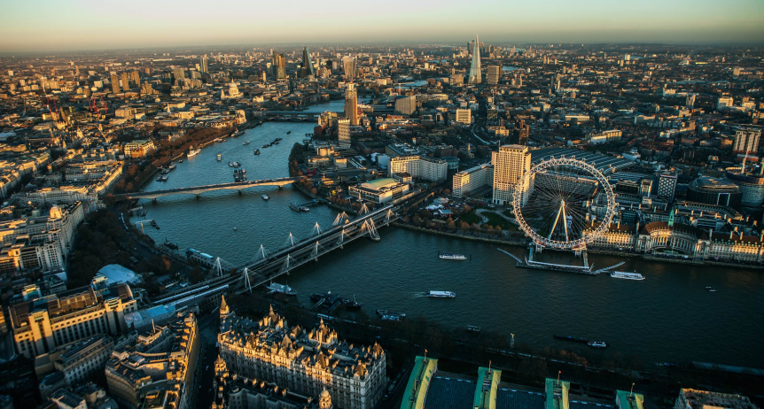
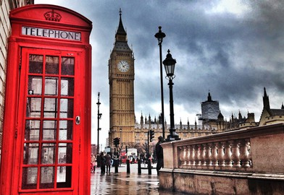
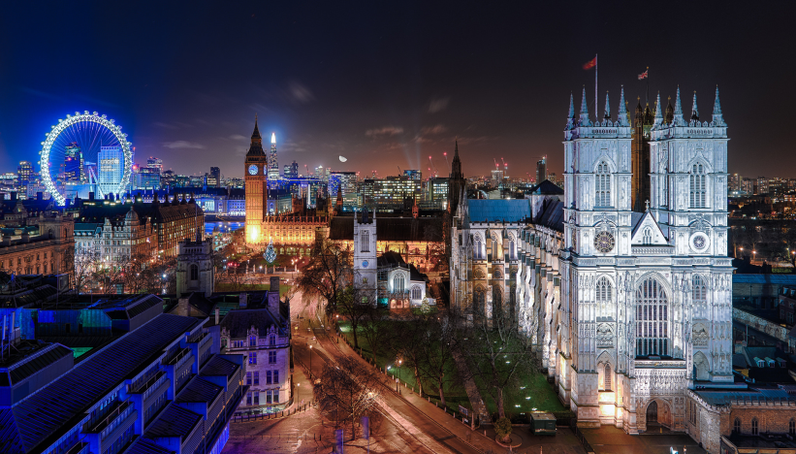
Sovereign State: United Kingdom
Country: England
Region: Greater London
Settled by Romans 43 AD (as Londinium)
Counties City & Greater London
Population (2015): Greater London - 8,673,713
P.M

Slide 7
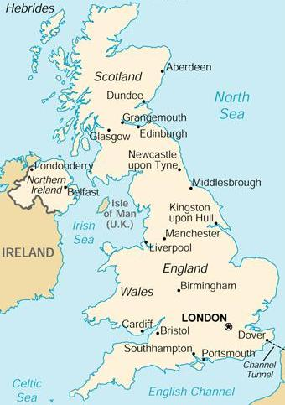
Geography
London is located in southeastern England. It lies astride the River Thames. The city of London is the capital of the United Kingdom, and it is Britain’s largest metropolis. It is the country’s economic, transportation and cultural center, according to Encyclopedia Britannica.
P.M

Slide 8
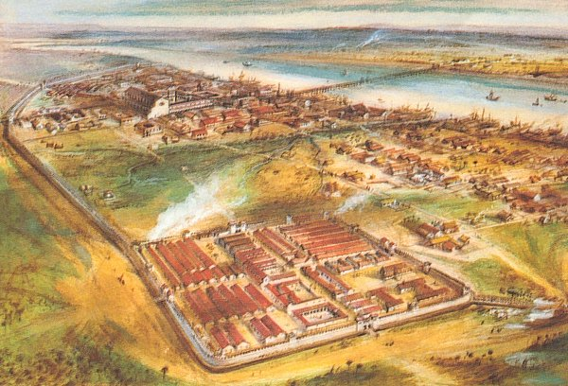
Londinium
London is one of the oldest cities in the world, and it was founded by the Romans in 40 A.D. and called Londinium.
P.M

Slide 9
Accent in London
There are many accents that are traditionally thought of as London accents. The most well known of the London accents long ago acquired the Cockney label, which is heard both in London itself, and across the wider South East England region more generally.
The widely heard and spoken accent is RP (Received Pronunciation) in various forms, which can often be heard in the media and many of other traditional professions
P.M

Slide 10
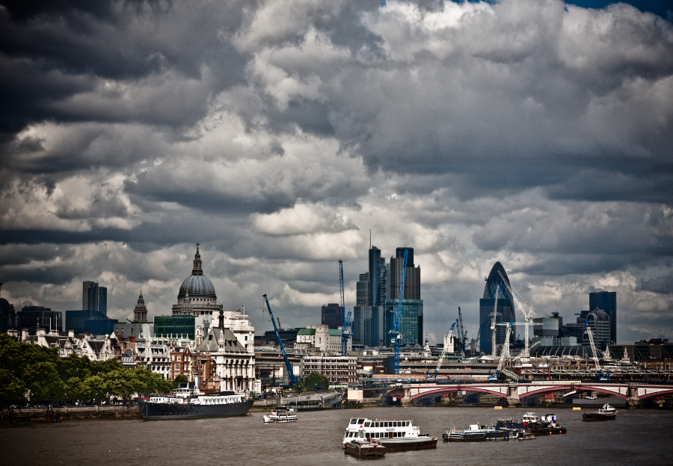
Climate
London has a temperate marine climate like much of the British Isles, so the city rarely sees extremely high or low temperatures.
P.M

Slide 11
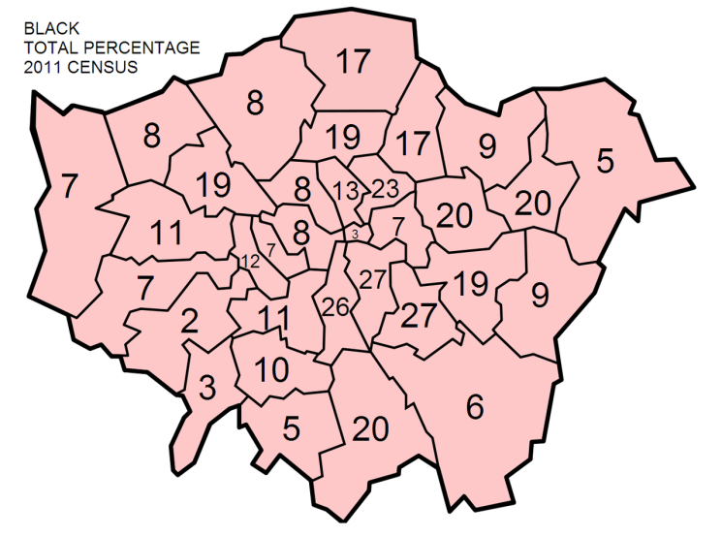
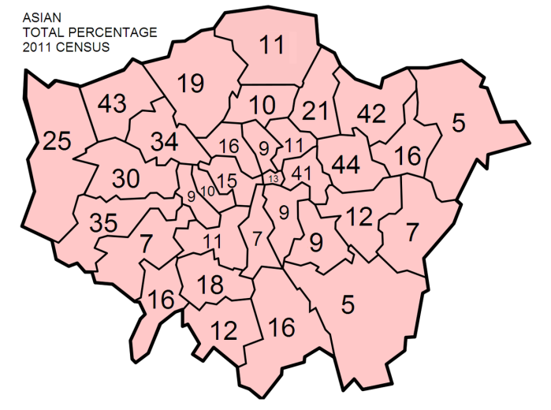
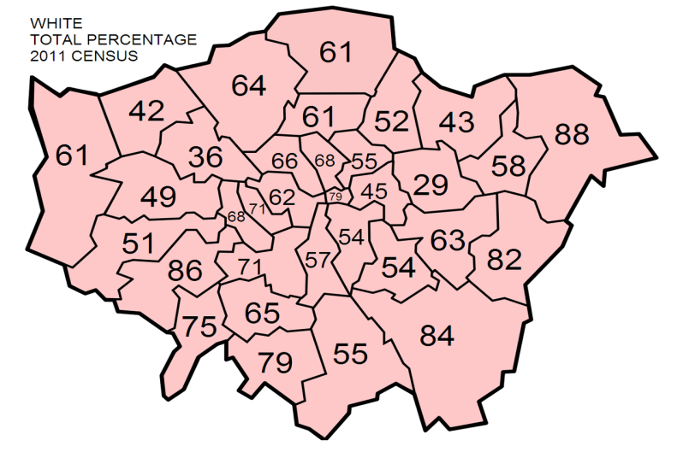
Districts
Since 1965 Greater London has been divided into 32 districts in addition to the ancient City of London.
P.M

Slide 12
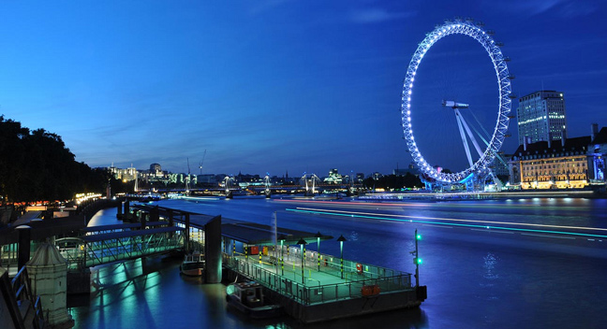
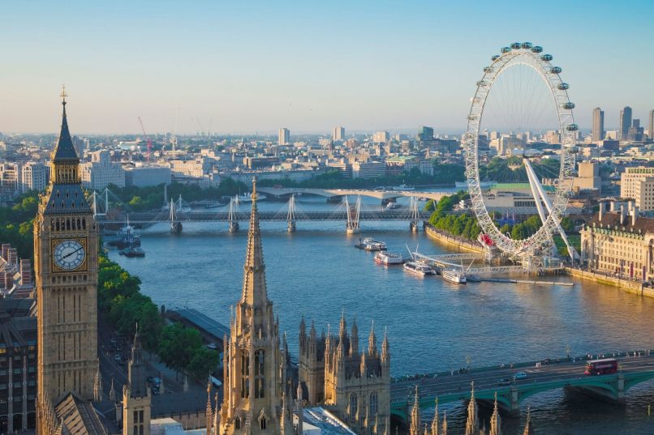
The river Thames
London has the river Thames, which runs through the middle of city and it is 215 miles long.
P.M

Slide 13
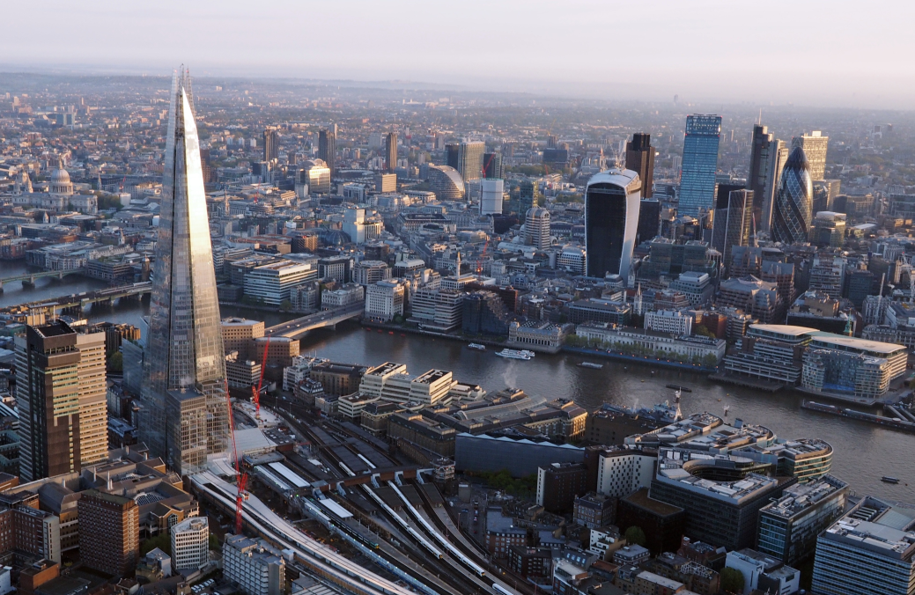
Economy
THE CITY OF LONDON is the world’s largest financial centre alongside New York. It is home to the London stock Exchange and Lloyds of London.
P.M

Slide 14
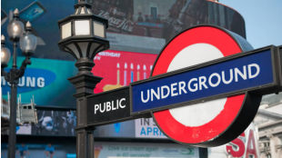
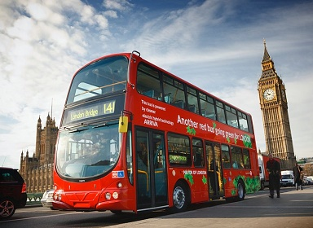
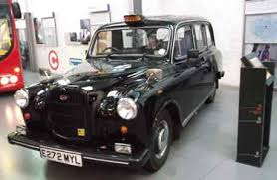
Transport
London public transport include: London Underground, London Buses, River Services and the National Rail.
P.M

Slide 15
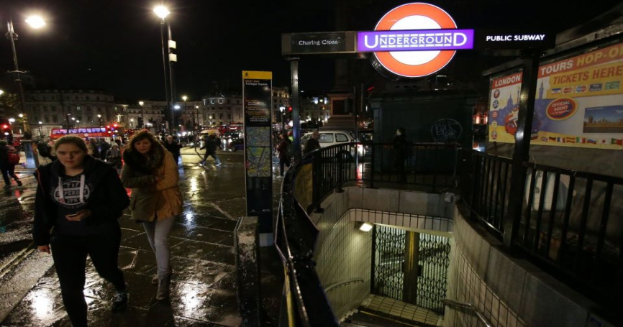
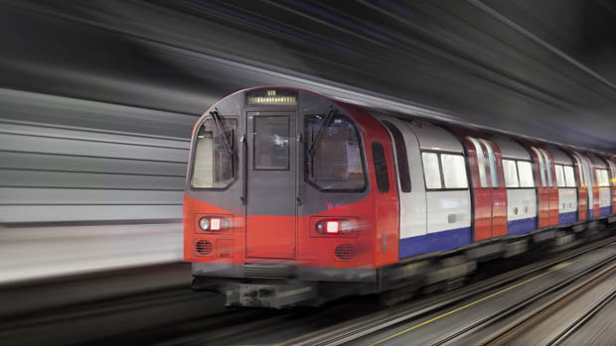
The London Underground
The Underground is also called “tube” , because of the cylindrical shape of the system’s deep-bore tunnels. It has 276 stations and runs over 243 miles (408km) of line, making it the longest railway in the world.
P.M

Slide 16
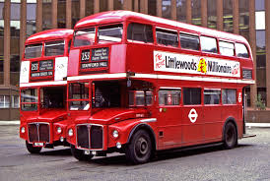
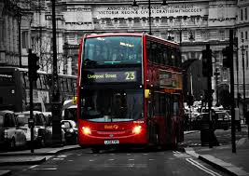
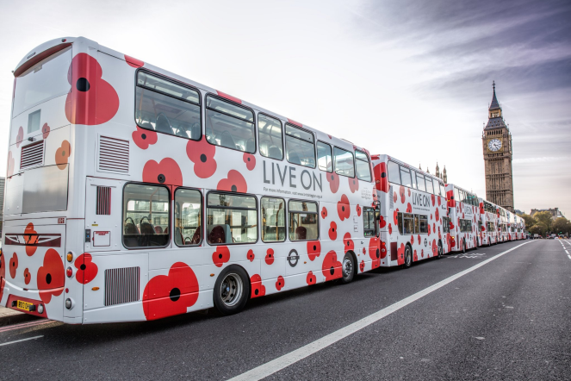
THE RED DOUBLE DECKER BUSES
The buses known as the red double decker buses and rail network in London is very well developed, frequent and efficient.
P.M

Slide 17
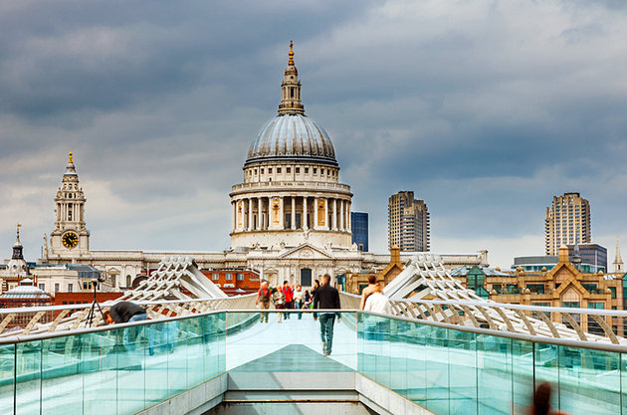
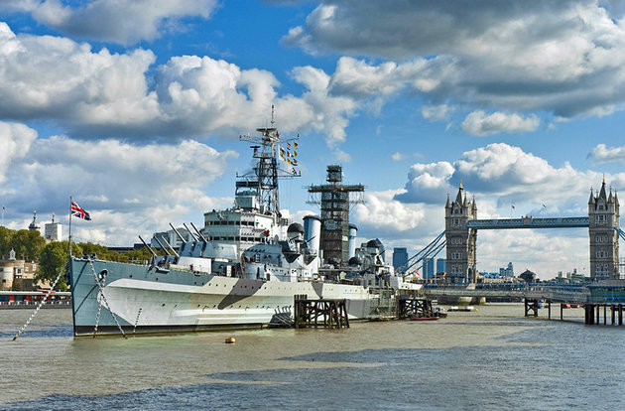
Tourists attraction
London has rich cultural history but, at the same time, it is regarded as one of the most modern cities in the world. The most famous tourist attractions are the Big Ben, the House of Parliament, the Queens palace, Buckingham Palace, the Tower of London.
P.M

Slide 18
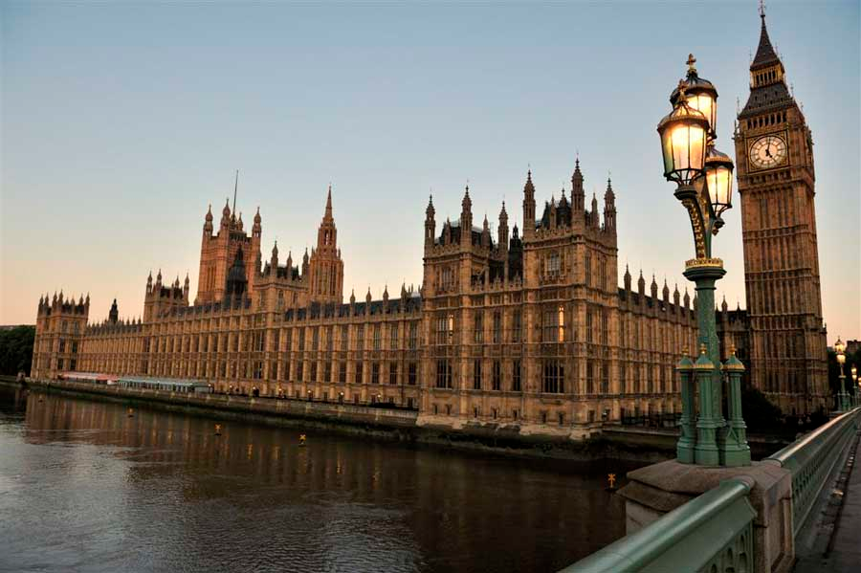
Parliment
The Houses of Parliament is where the two Houses of the Parliament of the United Kingdom (Houses of Commons and Lords) meet for political purposes. The oldest part of the building dates back to 1907.
P.M

Slide 19
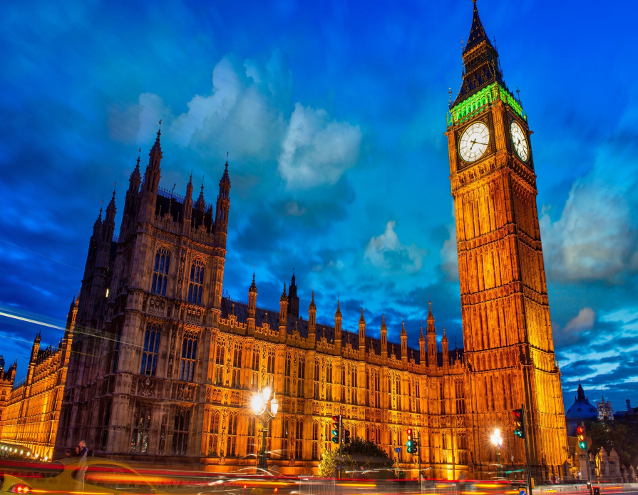
Big Ben
Big Ben isn’t the clock on the tower, but just the bell inside it. People all over the world can hear its sound on the radio and TV programmes. It’s always right, never too fast or too slow.
P.M

Slide 20
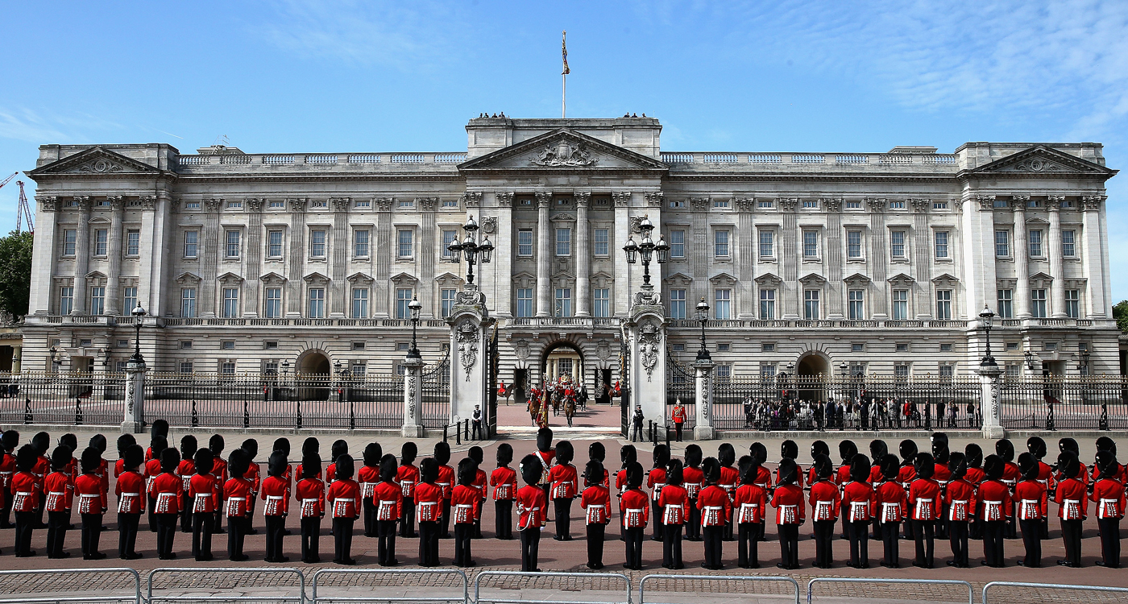
Buckingham Palace
Buckingham Palace is the official home of the British Monarch in London. When the flag is put up on the pole, it means that the Monarch is in the palace. It is also a famous tourist attraction because of the Queen’s Royal guards.
P.M

Slide 21
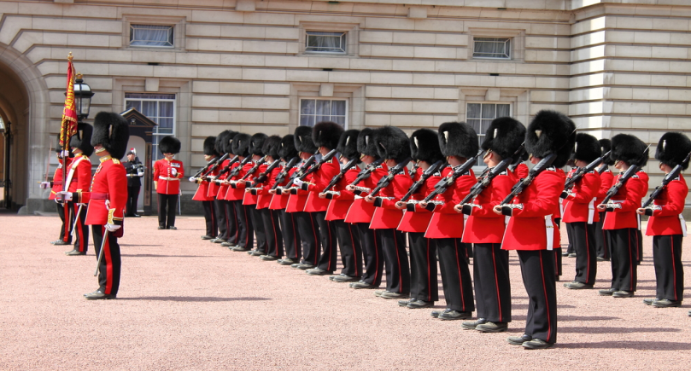
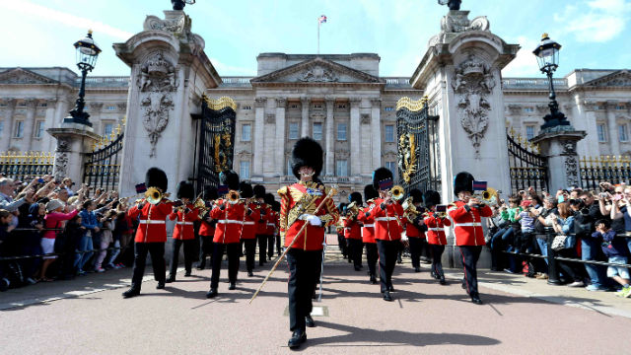
The Royal Guard
Every morning at half past eleven people all over the world come to see the changing of the guards: the capital of the Old Guard gives the Keys of Buckingham Palace to the captain of the New Guard.
P.M

Slide 22
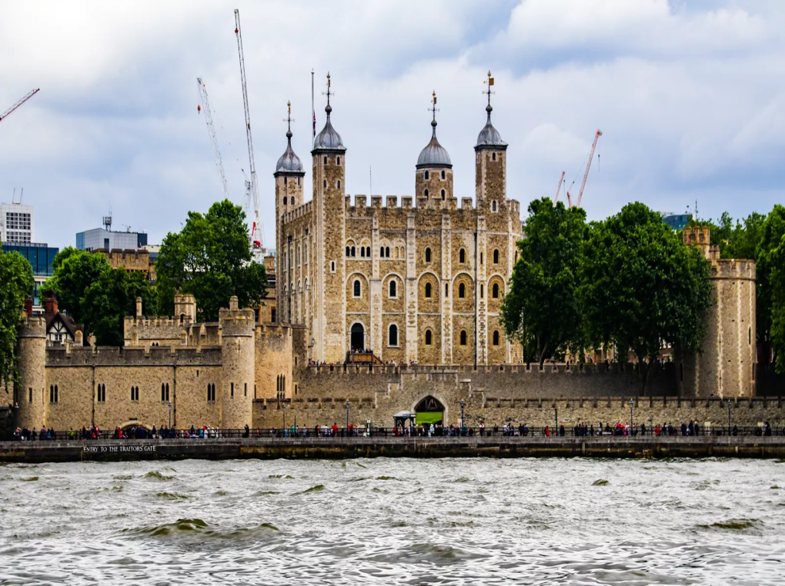
The Tower of London
The Tower of London is a historic tower in the centre of London. The Tower’s primary function was a fortress, a royal palace, and a prison. Many prisoners were executed in this tower.
P.M

Slide 23
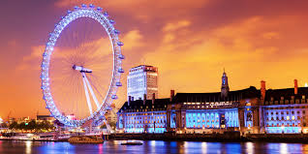
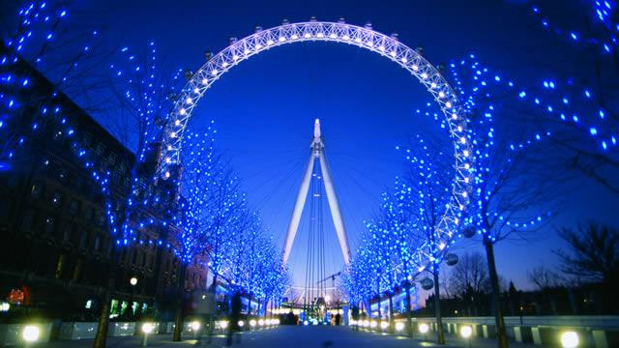
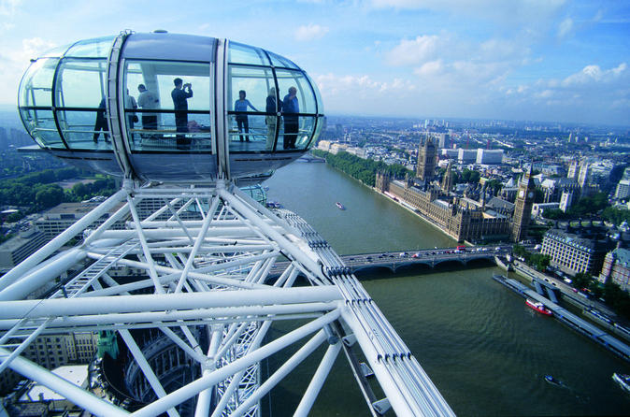
The London Eye
The London Eye , also known as the Millennium wheel was built in 1999, and since then the biggest observation wheel in the world. It is 170 m high and you can see the beautiful London skyline from the top.
P.M

Slide 24
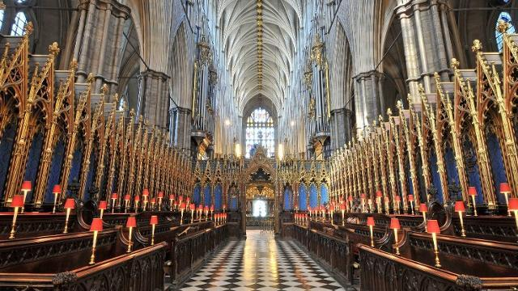
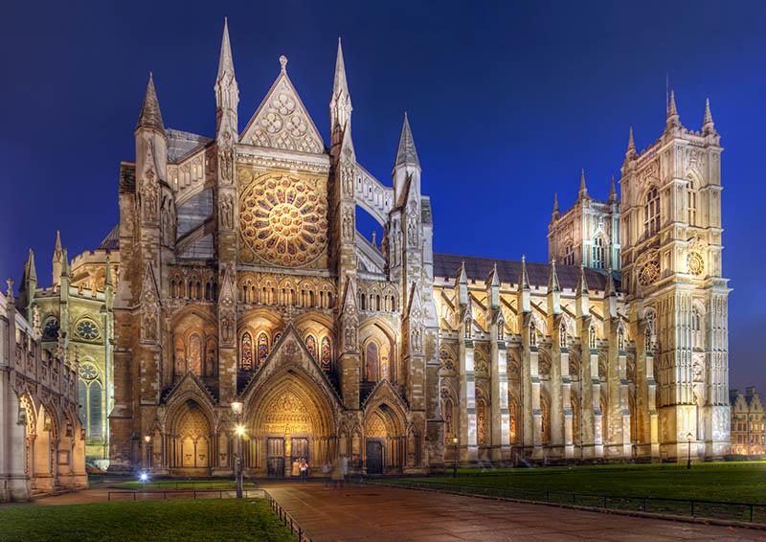
Westminster Abbey
Westminster Abbey was begun by Henry III in 1245. It’s one of the most important Gothic buildings in the country with the medieval shrine of an Anglo-Saxon saint still at its heart.
P.M

Slide 25
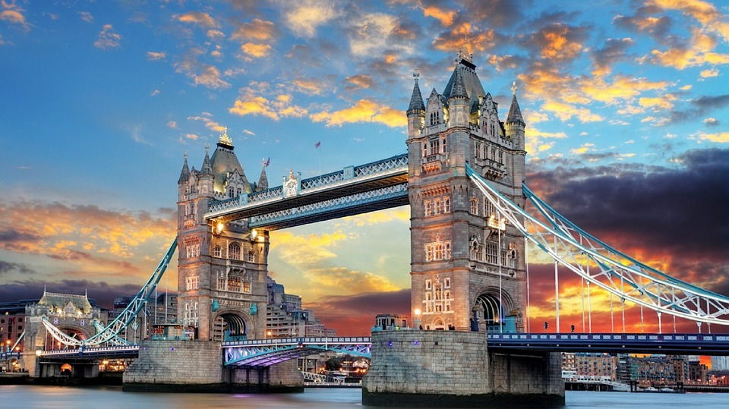
The Tower Bridge
The Tower Bridge is a bridge closed to the Tower of London which gives it its name. It has become an iconic symbol in London, and it’s situated over the River Thames.
P.M

Slide 26
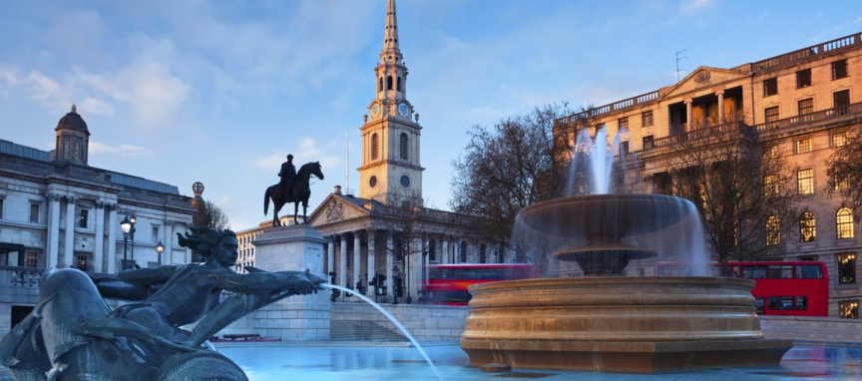
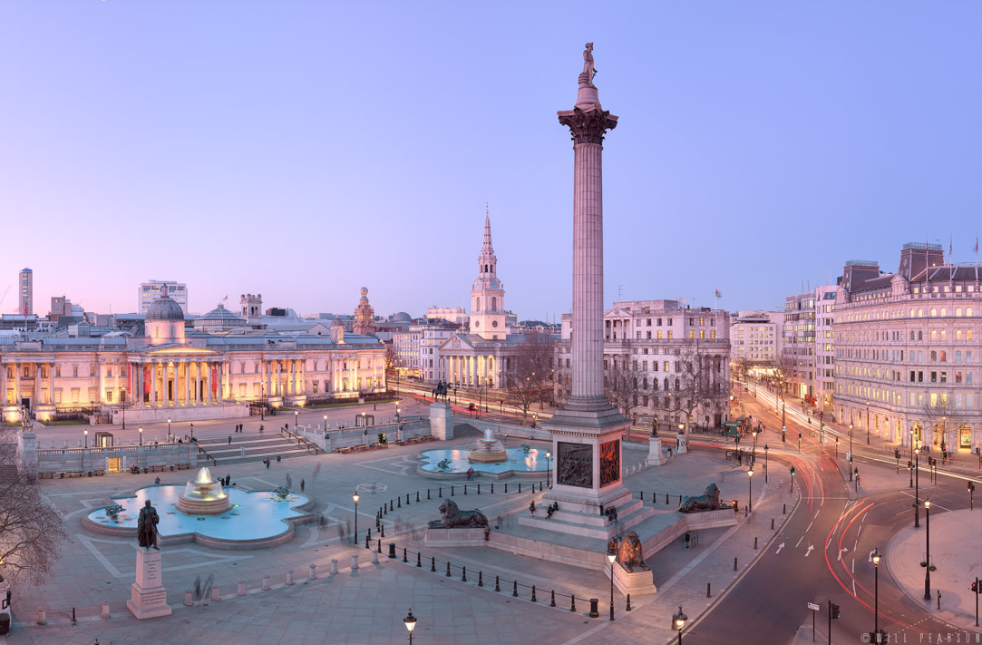
Trafalgar Square
Trafalgar Square is a square in London and its name commemorates the Battle of Trafalgar (1805), a British naval victory of the Napoleonic Wars.
P.M

Slide 27
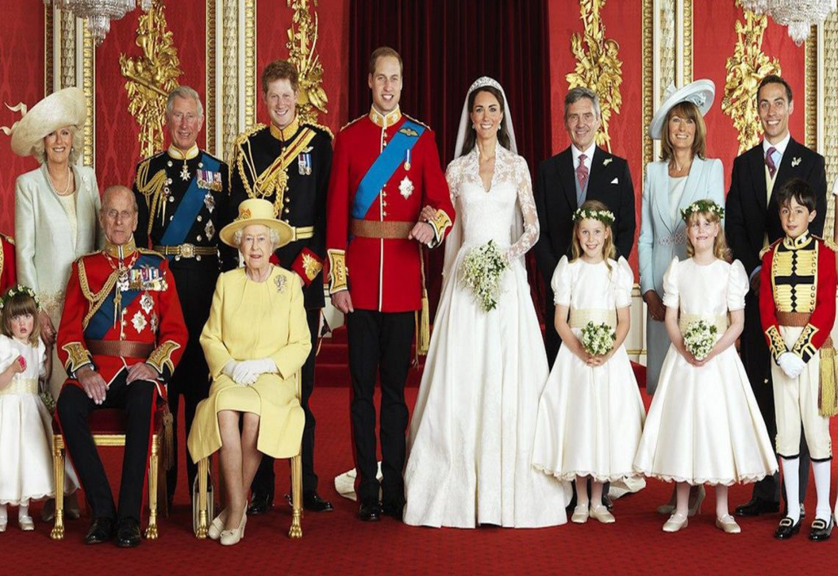
The Royal Family
The British Royal Family lives in England and resides mainly in London at Buckingham Palace. The Royal family is formed by Queen Elisabeth II and her husband Philip, Duke of Edinburgh, their son Charles, and his two sons William and Henry.
P.M

Slide 28
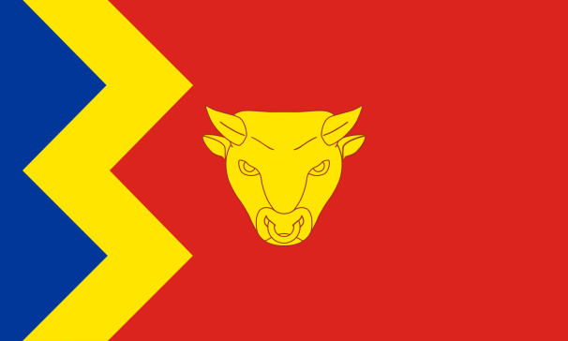
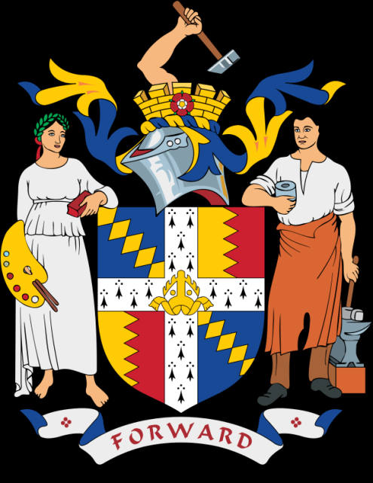
Birmingham
Sovereign state - United Kingdom
Constituent country - England
Region - West Midlands
Ceremonial county - West Midlands
Historic county – Warwickshire
Population (2014 mid year estimate.): 1,101,360
Ethnicity:
57.9% White (53.1% White British)
26.6% Asian
8.9% Black
4.4% Mixed Race
2.0% Other
P.M

Slide 29
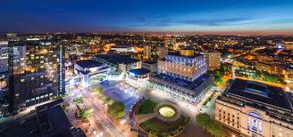
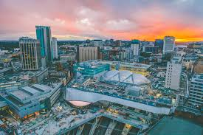
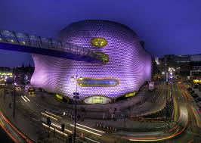
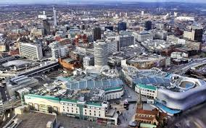
Birmingham
Birmingham is a major city and metropolitan borough of West Midlands, England lying on the River Rea, a small river that runs through Birmingham. It is the largest and most populous British city outside London.
P.M

Slide 30
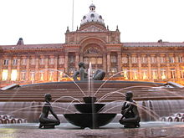
Government
Birmingham City Council is the largest local authority in Europe with 120 councillors representing 40 wards. Its headquarters are at the Council House in Victoria Square.
P.M

Slide 31
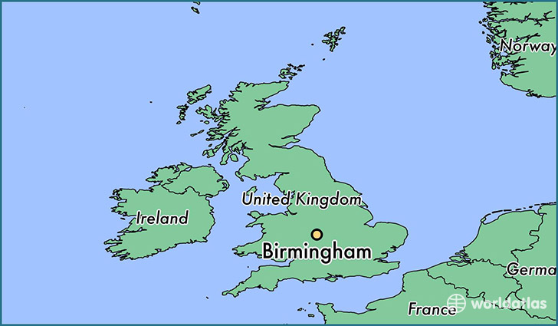
Geography
Birmingham is located in the centre of the West Midlands region of England on the Birmingham Plateau – an area of relatively high ground, ranging between 500 and 1,000 feet (150 and 300 metres) above sea level and crossed by Britain's main north-south watershed between the basins of the Rivers Severn and Trent.
P.M

Slide 32
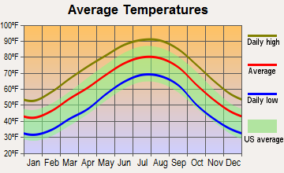
Climate
Birmingham has a temperate maritime climate, like much of the British Isles, with average maximum temperatures in summer (July) being around 21.3 °C (70.3 °F); and in winter (January) around 6.7 °C
P.M

Slide 33
Economy
Birmingham is the largest centre in Great Britain for employment in public administration, education and health.
P.M

Slide 34
Dialect
The local dialect is called Brummie.
P.M

Slide 35
Tourist Attractions in Birmingham
Historic City Center
Thinktank
Birmingham Museum & Art Gallery
Jewellery Quarter
St Philip's Cathedral
National SEA LIFE Centre
P.M

Slide 36
University of Birmingham
The University of Birmingham a public research university located in Birmingham, United Kingdom. It received its royal charter in 1900 as a successor to Queen's College, Birmingham and Mason Science College making it the first English civic or 'red brick' university to receive its own royal charter.
P.M

Slide 37
Glasgow
Glasgow is the largest city in Scotland, and third largest in the United Kingdom. Historically part of Lanarkshire, it is now one of the 32 council areas of Scotland. It is situated on the River Clyde in the country's West Central Lowlands. Inhabitants of the city are referred to as Glaswegians.
P.M

Slide 38
Glasgow
Population - 606,340 (2016)
Language - English, Scots, Scottish Gaelic
Country - Scotland
Sovereign state - United Kingdom
P.M

Slide 39
Geography
Glasgow is located on the banks of the River Clyde, in West Central Scotland. Its second most important river is the Kelvin whose name was used in creating the title of Baron Kelvin and thereby ended up as the SI unit of temperature.
P.M

Slide 40
Culture
The city has many amenities for a wide range of cultural activities, from curling to opera and ballet and from football to art appreciation; it also has a large selection of museums that include those devoted to transport, religion, and modern art. Many of the city's cultural sites were celebrated in 1990 when Glasgow was designated European City of Culture.
The city's principal municipal library, the Mitchell Library, has grown into one of the largest public reference libraries in Europe, currently housing some 1.3 million books, an extensive collection of newspapers and thousands of photographs and maps
P.M

Slide 41
Dialect
Glaswegian, otherwise known as the Glasgow patter, is a local variety of Scots.
Glaswegian is a dialect, more than an alternative pronunciation; words also change their meaning depending on context, e.g. "away" can mean "leaving" as in A'm away, an instruction to stop being a nuisance as in away wi ye, or "drunk" or "demented" as in he's away wi it.
P.M

Slide 42
Architecture
Glasgow | Dakota Deluxe Hotel
The Burrell Collection
Glasgow City Council
Breaks in Glasgow
P.M

Slide 43
Edinburgh
Edinburgh is the capital city of Scotland and one of its 32 local government council areas. Located in Lothian on the Firth of Forth's southern shore, it is Scotland's second most populous city and the seventh most populous in the United Kingdom. The 2014 official population estimates are 464,990 for the city of Edinburgh.
P.M

Slide 44
Climate
Like most of Scotland, Edinburgh has a temperate, maritime climate which is relatively mild despite its northerly latitude. Winter daytime temperatures rarely fall below freezing and are milder than places such as Moscow and Newfoundland which lie at similar latitudes. Summer temperatures are normally moderate, rarely exceeding 22 °C
P.M

Slide 45
Economy
Edinburgh has the strongest economy of any city in the United Kingdom outside London and the highest percentage of professionals in the UK with 43% of the population holding a degree-level or professional qualification.
P.M

Slide 46
Festivals and celebrations
The city hosts the annual Edinburgh Festival, a series of events that run between the end of July and early September each year. The best known of these events are the Edinburgh Festival Fringe, the Edinburgh International Festival, the Edinburgh Military Tattoo and the Edinburgh International Book Festival.
P.M

Slide 47
Edinburgh's Hogmanay
The annual Edinburgh Hogmanay celebration was originally an informal street party focused on the Tron Kirk in the Old Town's High Street. Since 1993, it has been officially organised with the focus moved to Princes Street.
P.M

Slide 48
If you in Scotland, you must visit these places.
P.M

Slide 49
Cardiff
Cardiff is the capital and largest city in Wales and the eleventh-largest city in the United Kingdom. The city is the country's chief commercial centre, the base for most national cultural and sporting institutions, the Welsh national media, and the seat of the National Assembly for Wales. The unitary authority area's mid-2011 population was estimated to be 346,100.
P.M

Slide 50
Cardiff
Sovereign state - United Kingdom
Country - Wales
Region - South Wales
Ceremonial county - South Glamorgan
Historic County - Glamorgan
Local government - Cardiff Council
City status: 1905
P.M

Slide 51
The most exciting places in Cardiff
Cardiff Castle
Cardiff Car Hire
Wales Millennium Centre
Missoula
P.M

Slide 52
Belfast
Belfast is the capital and largest city of Northern Ireland, the second largest on the island of Ireland, and the heart of the tenth largest Primary Urban Area in the United KingdomOn the River Lagan, it had a population of 286,000 at the 2011 census and 333,871 after the 2015 council reform.
P.M

Slide 53
Belfast
District - City of Belfast
County: County Antrim, County Down
Country - Northern Ireland
Sovereign state - United Kingdom
P.M

Slide 54
Interesting facts:
Titanic was built in Belfast.
Queen’s University taught both Catholic and Protestants from 1845.
Liam Neeson first trod the boards at Belfast’s Lyric Theatre.
John Wood dunlop invented the pneumatic tyre in Belfast.
Belfast Zoo is home to the only Goodfellow’s kangaroos in the United Kingdom and Ireland.
P.M

Slide 55
List of towns in the British Virgin Islands
Name of town | Island
East Eng-Long Look | Tortola
Belle Vue | Jost Van Dyke
The Settlement | Anegada
Road Town | Tortola
Spanish Town | Virga Gorga
P.M

Slide 56
P.M

Slide 57
Tortola
Tortola is the largest and most populated of the British Virgin Islands, a group of islands that form part of the archipelago of the Virgin Islands.
P.M

Slide 58
Jost Van Dyke
Jost Van Dyke (sometimes colloquially referred to as JVD or Jost) is the smallest of the four main islands of the British Virgin Islands, measuring roughly 8 square kilometres.
P.M

Slide 59
Virgin Gorda
Virgin Gorda is the third-largest (after Tortola and Anegada) and second most populous of the British Virgin Islands (BVI). Located at about 18 degrees, 48 minutes North, and 64 degrees, 30 minutes West, it covers an area of about 8 square miles (21 km²). Christopher Columbus is said to have named the island "The Fat Virgin", because the island's profile on the horizon looks like a fat woman lying on her side.
P.M

Slide 60
Anegada
Anegada is the northernmost of the British Virgin Islands (BVI), a group of islands that form part of the archipelago of the Virgin Islands. It lies approximately 15 miles (24 km) north of Virgin Gorda.
P.M

Slide 61
Question parts.
Which attraction in London do you consider to be the most interesting?
List the capitals of England, Scotland, Wales and Northern Ireland.
Which accents are used in London?
What do you know about Edinburg festivals and celebrations?
The most exciting part of my presentation…?
P.M

