Slide 1
THE UK AND NI. FAMOUS MUSEUMs AND GALLERIES
Melinda
Papp

Slide 2
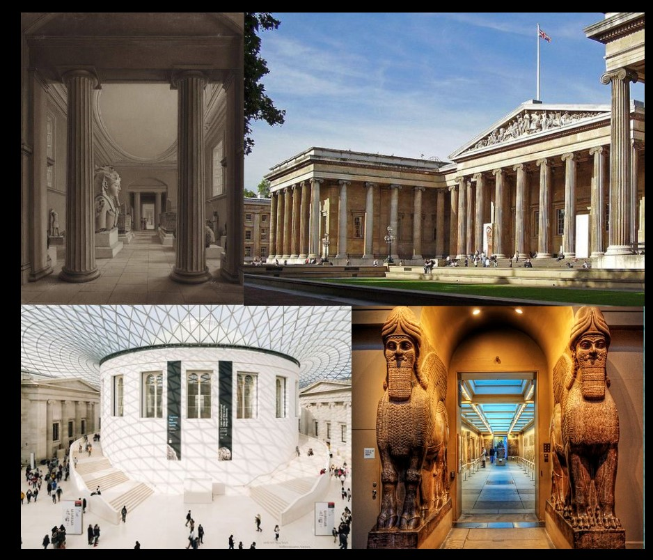
FAMOUS MUSEUMS AND GALLERIES IN ENGLAND
British Museum (London)
The British Museum is home to one of the largest collections of works and artefacts coming from all over the world. The museum was opened in 1759 and is dedicated to human history, art, and culture. The museum has ten departments with various collections, including artefacts dedicated to indigenous peoples of Africa, Oceania and the Americas, antiquities illustrating the cultures of ancient Rome,
Greece and Egypt, Buddhist paintings or
drawings by Leonardo da Vinci, Raphael
and Michelangelo and extensive
numismatic collections.
Museum type: History and Anthropology,
Art and Design.

Slide 3
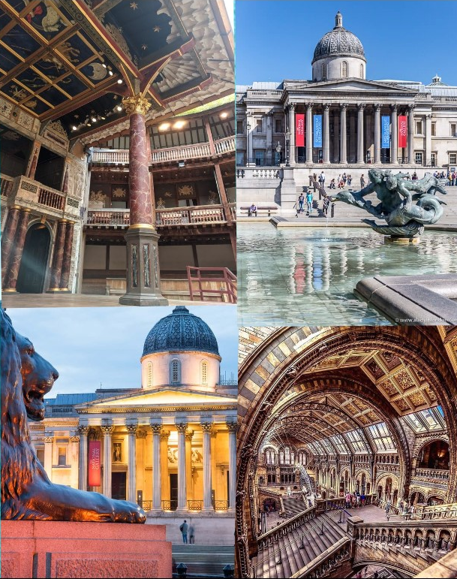
FAMOUS MUSEUMS AND GALLERIES IN ENGLAND
National Gallery (London)
The National Gallery is an art gallery that is housed in a neoclassical building built in 1838. The gallery holds an art collection of over 2.600 pieces which contains European paintings from the 13th to
the 19th centuries. The highlights include
paintings by El Greco, Jan van Eyck, Rembrandt,
Rubens, Michelangelo, and many more
famous artists.
Museum type: Art and Design

Slide 4
FAMOUS MUSEUMS AND GALLERIES IN ENGLAND
Tower of London
Also known as Her Majesty's Royal Palace and Fortress, The Tower of London was one of the many castles built as part of the Norman Conquest of England. It has been extended several times in the past and has always played a major role in English history. For some time, the Tower was used as a prison. Many notable figures were imprisoned here, including Sir Walter Raleigh with his wife Elizabeth Throckmorton,
Guy Fawkes, Anne Boleyn and even Elizabeth I.
Besides this, the Tower was used as an armoury, a
treasury, a menagerie, the home of the Royal Mint,
a public record office, and the home of the Crown
Jewels of England.
Museum type: History and Anthropology

Slide 5
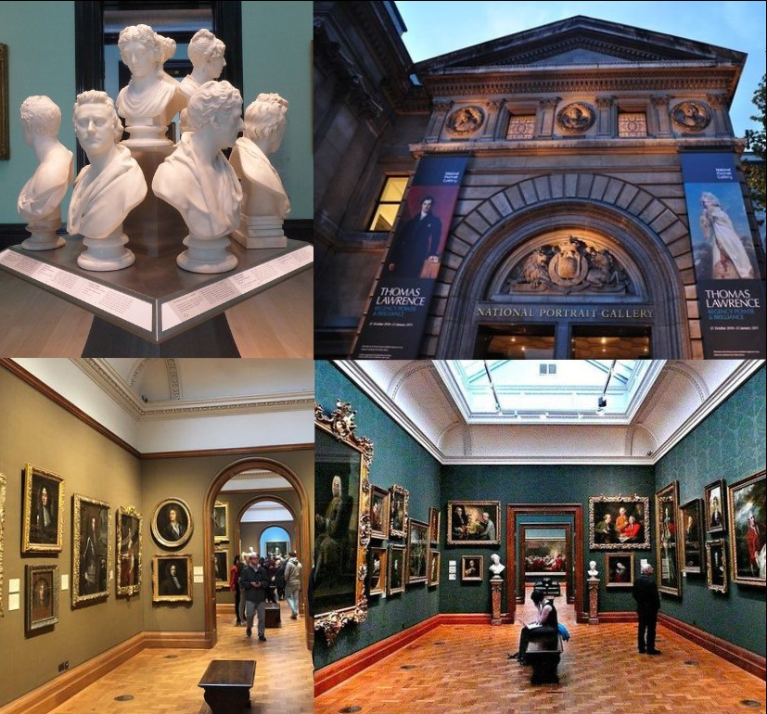
FAMOUS MUSEUMS AND GALLERIES IN ENGLAND
National Portrait Gallery (London)
The National Portrait Gallery (NPG) was the first portrait gallery in the world when it opened in 1856. The gallery houses a collection of portraits of historically important and well known British people. Works in the National Portrait Gallery include photographs, caricatures, paintings, drawings and sculpture and are all selected on the basis of
the significance of the person, not that of the
artist. A well known piece is the Chandos
portrait, the most famous of the portraits
that may depict William Shakespeare.
Museum type: Art and Design

Slide 6
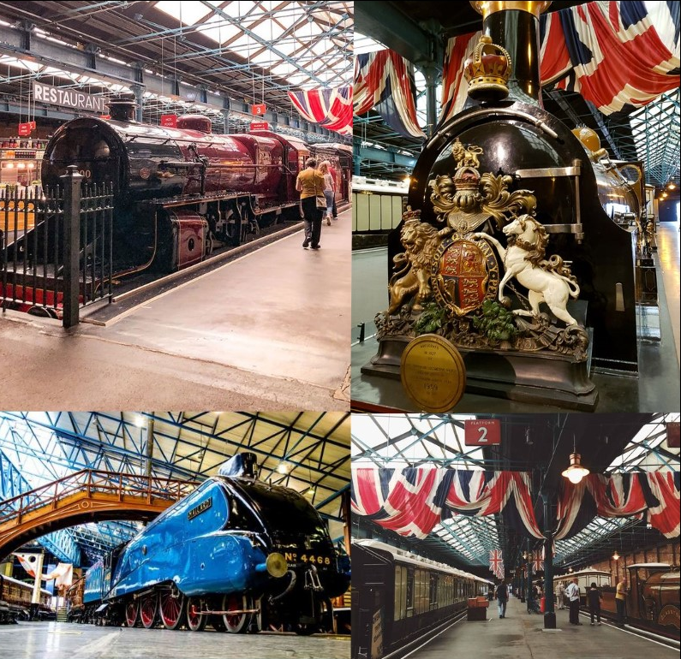
FAMOUS MUSEUMS AND GALLERIES IN ENGLAND
National Railway Museum (York)
The National Railway Museum (NRM) is devoted to telling the story of rail transport in Britain and its impact on society. The museum holds the national collection of historically significant railway vehicles and collections of other artefacts and written and pictorial records, of social, technical, artistic and historical interest. The museum
houses over 100 locomotives and almost 300
other items of rolling stock, almost all of
which either ran on the Great Britain railways
or were built there.
Museum type: Science and Technology,
History and Anthropology

Slide 7
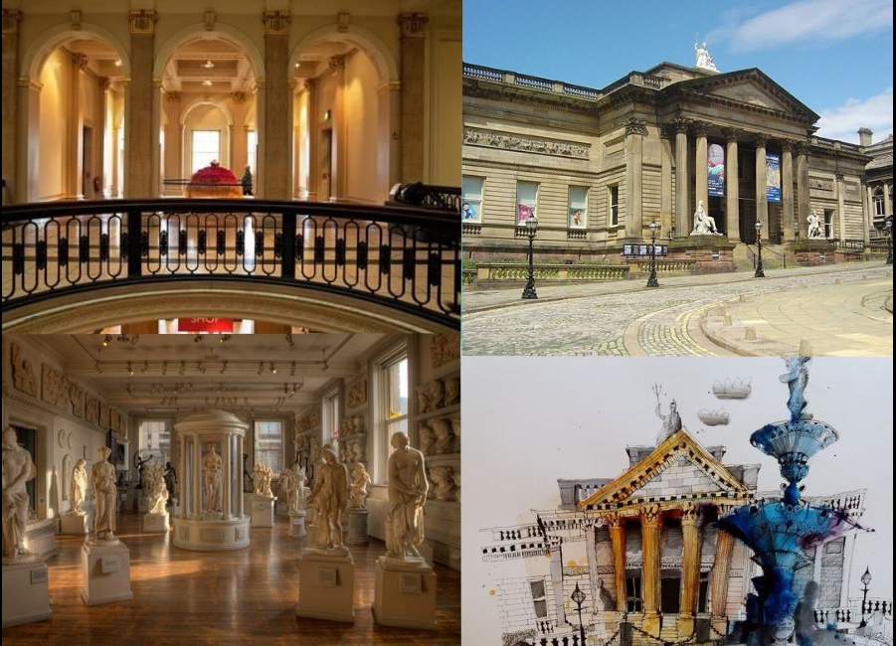
FAMOUS MUSEUMS AND GALLERIES IN ENGLAND
Walker Art Gallery (Liverpool)
The Walker Art Gallery houses one of the largest art collections in England. Its collections includes paintings, sculpture and decorative art from the 13th century to the present day. The gallery is home to Italian and Netherlandish paintings from 1300–1550, European art from 1550–1900, including works by Giambattista Pittoni, Rembrandt, Poussin and Degas, Tudor portraits and a fine collection of
Victorian and Pre-Raphaelite art.
Furthermore, The Walker Art Gallery
displays contemporary art including
work by David Hockney, Lucian Freud
and Bridget Riley.
Museum type: Art and Design

Slide 8
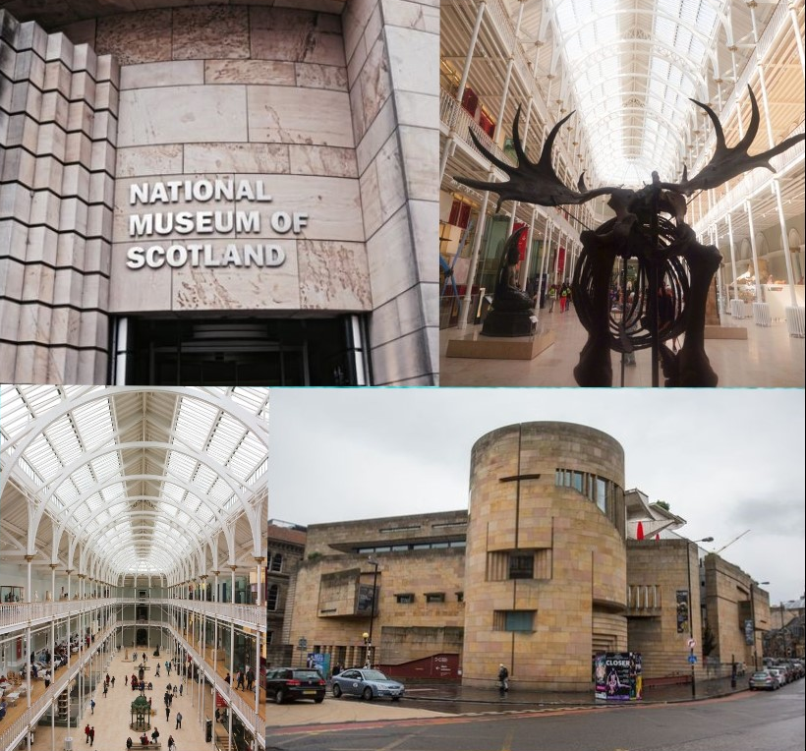
FAMOUS MUSEUMS AND GALLERIES IN Scotland
National Museum of Scotland (Edinburgh)
The National Museum of Scotland is housed in a Romanesque Revival building. The collection of the museum includes a wide variety of objects that are displayed on seven floors, including artifacts from the age of dinosaurs up to current technology and science. It takes visitors on a journey through the history around the
world (particularly Scotland) taking in the
wonders of nature, art, design and fashion
and science and technology. A well known
exhibit of the museum is the stuffed body
of Dolly the sheep, which was the first
cloned mammal.
Museum type: History and Anthropology,
Art and Design

Slide 9
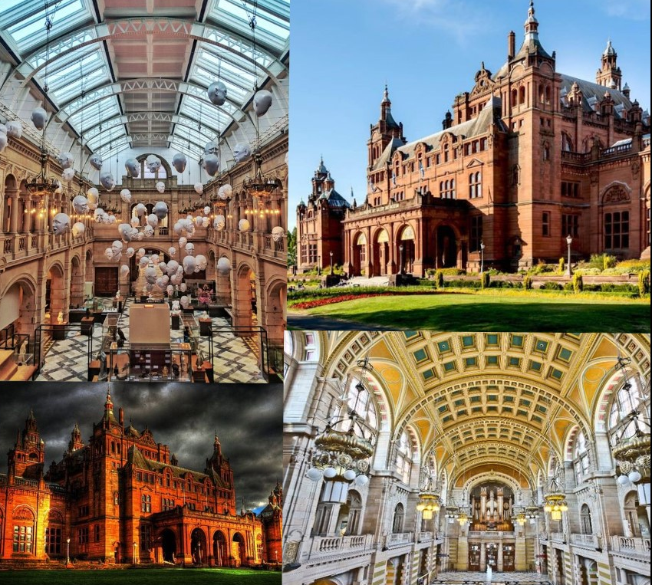
FAMOUS MUSEUMS AND GALLERIES IN Scotland
Kelvingrove Art Gallery and Museum (Glasgow)
The Kelvingrove Art Gallery and Museum is a museum and art gallery in Glasgow, situated adjacent to Kelvingrove Park. The museum houses an impressive collection of arms and armour and a vast natural history collection. The art collection includes works by some Old Masters such as Rembrandt van Rijn, Gerard de Lairesse,
and Jozef Israëls, Impressionists including
Claude Monet, Pierre-Auguste Renoir,
Camille Pissarro, Vincent van Gogh and
Mary Cassatt, Dutch Renaissance, Scottish
Colourists and some works by artists from
the Glasgow School.
Museum type: Art and Design, Nature and
Natural History

Slide 10
FAMOUS MUSEUMS AND GALLERIES IN Scotland
Edinburgh Castle
This most famous of Scottish castles has a complex building history. The oldest part, St Margaret’s Chapel, dates from the 12th century; the Great Hall was erected by James IV around 1510; the Half Moon Battery by the Regent Morton in the late 16th century; and the Scottish National War Memorial after the First World War. Edinburgh Castle features exhibits related to Weapons and War. Key themes,
people and exhibits in the museum include:
The Honours (Crown Jewels) of Scotland,
The National War Museum of Scotland, The
Stone of Destiny, The One o’ Clock Gun and
Mons Meg.
Museum type: History and Anthropology

Slide 11
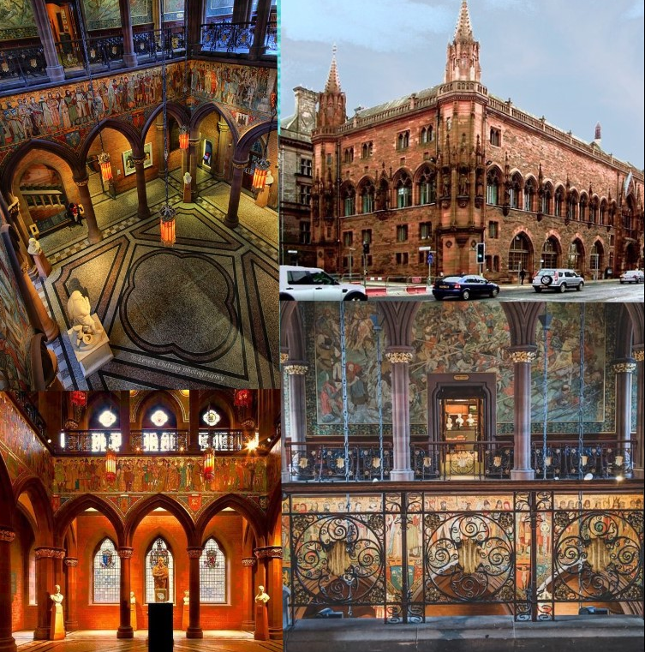
FAMOUS MUSEUMS AND GALLERIES IN Scotland
Scottish National Portrait Gallery (Edinburgh)
The Scottish National Portrait Gallery is an art museum in Edinburgh housed in a red sandstone Gothic revival building that was built between 1885 and 1890, designed by Robert Rowand Anderson. The museum holds the national collections of portraits and the Scottish National Photography Collection. The total
collections consists of around 3,000 paintings
and sculptures, 25,000 prints and drawings
and 38,000 photographs, beginning in the
Renaissance.
Museum type: Art and Design

Slide 12
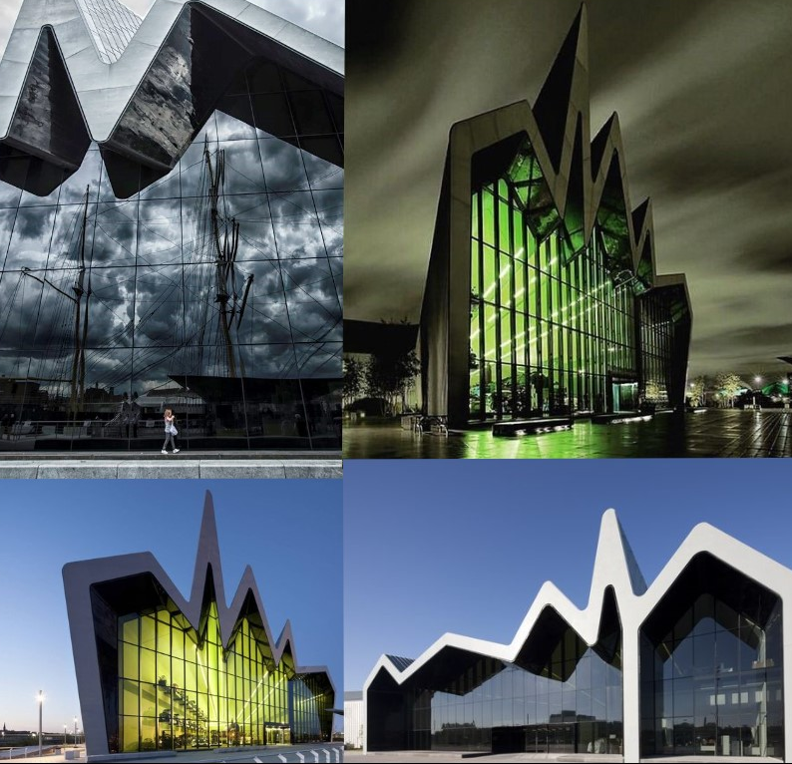
FAMOUS MUSEUMS AND GALLERIES IN Scotland
Riverside Museum (Glasgow)
The Riverside Museum (Glasgow Museum of Transport) is home to over 3,000 objects that detail Glasgow’s rich past from its days as maritime powerhouse to a glimpse into daily Glasgow life in the early to mid 20th Century. ​Amongst the objects on display
Are everything from skateboards to
locomotives, paintings to prams,
velocipedes to voiturettes, vintage cars
to a stormtrooper, there really is
something to delight visitors of all ages.​
Museum type: History and Anthropology,
Art and Design

Slide 13
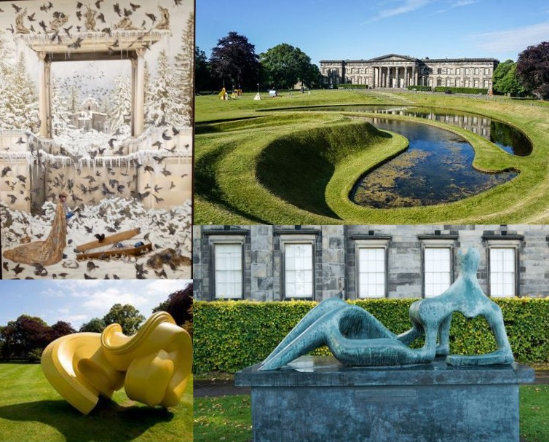
FAMOUS MUSEUMS AND GALLERIES IN Scotland
Scottish National Gallery of Modern Art (Edinburgh)
It houses the collection of modern and contemporary art dating from about 1900 to the present with over 6000 paintings, sculptures, installations, video work, prints and drawings. The museum is situated in two buildings that face each other, Modern One and Modern Two. Modern One is housed in a neoclassical building, which was
designed by William Burn in 1825.
Modern Two was built in 1833 and is
now used to show the collection of
Dada and Surrealist art and work by
Eduardo Paolozzi.
Museum type: Art and Design

Slide 14
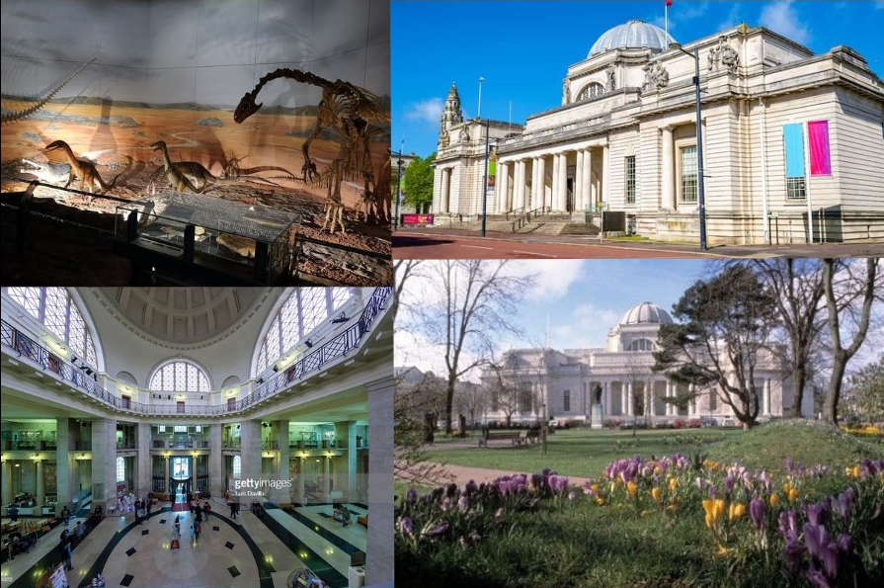
FAMOUS MUSEUMS AND GALLERIES IN Wales
National Museum Cardiff
National Museum Cardiff is a museum in Cardiff. The museum features exhibits related to Decorative and Applied Art, Fine Art, Natural Sciences, Coins and Medals and Archaeology. Key themes, people and exhibits in the museum include Evolution of Wales, Impressionist, La Parisienne, The Blue Lady, The Kiss, Cezanne, Renoir,
Manet, Monet and Rodin.
Museum type: Nature and
Natural History, Art and Design

Slide 15
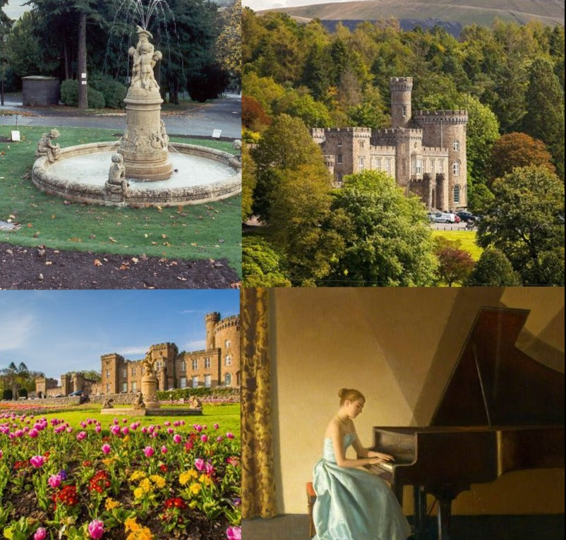
FAMOUS MUSEUMS AND GALLERIES IN Wales
Cyfarthfa Castle Museum and Art Gallery
Cyfarthfa Castle Museum and Art Gallery is a museum in Merthyr Tydfil. The museum features exhibits related to Natural Sciences, Archives, Fine Art, Decorative and Applied Art, Personalities, World Cultures, Costume and Textiles, Social History, Science and
Technology, Coins and Medals and Music.
Museum type: Art and Design, History
and Anthropology

Slide 16
FAMOUS MUSEUMS AND GALLERIES IN Wales
Erddig Museum (Wrexham)
Erddig is a museum in Wrexham. The museum features exhibits related to: costume and textiles, coins and medals, personalities, land transport, music, archives, decorative and applied art, social history and fine art.
Museum type: History and
Anthropology, Art and Design

Slide 17
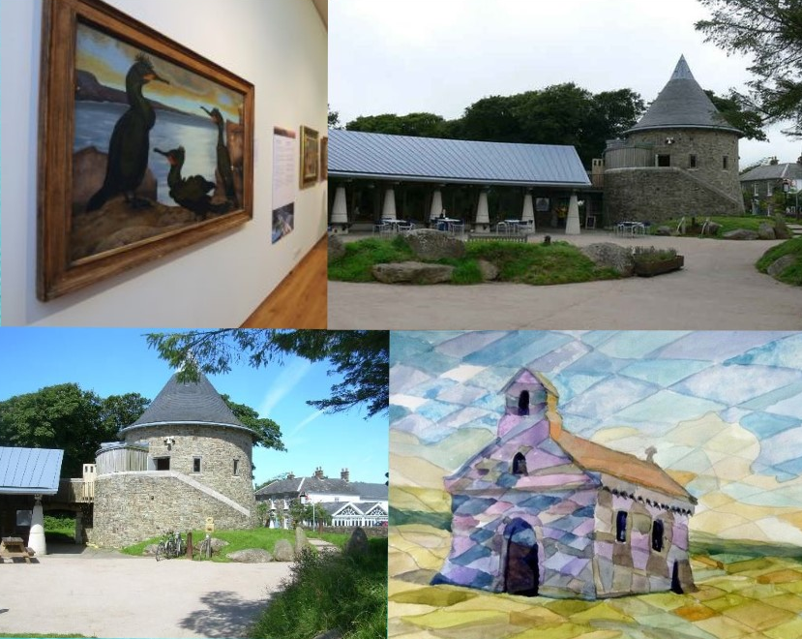
FAMOUS MUSEUMS AND GALLERIES IN Wales
Oriel y Parc Gallery
Oriel y Parc includes a Visitor Centre, Artist in Residence Studio, a Discovery Room which hosts family friendly art and nature activities, a Tower which hosts local arts exhibitions and community run classes, and a café. There is also a Class A Landscape Gallery, which was built to house works from Amgueddfa Cymru-National Museum
Wales including exhibits by Graham
Sutherland which were bequeathed to
the people of Wales.
Museum type: Nature and Natural
History

Slide 18
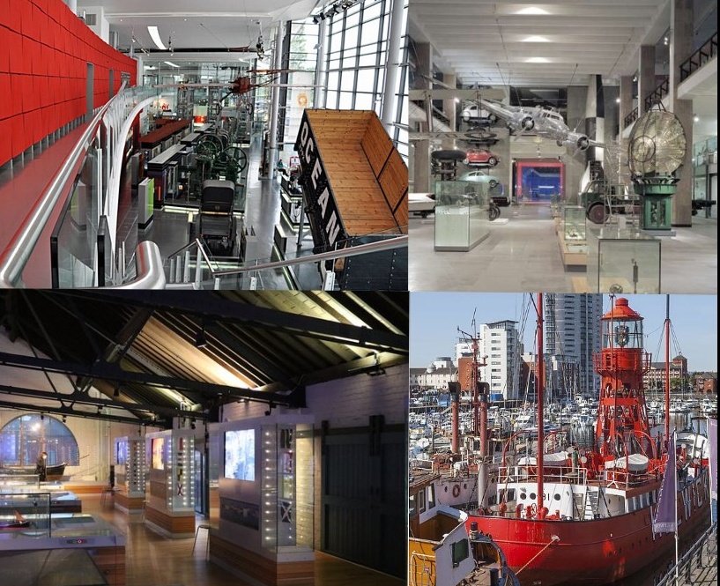
FAMOUS MUSEUMS AND GALLERIES IN Wales
National Waterfront Museum (Swansea)
National Waterfront Museum is a museum in Swansea. The museum features exhibits related to Inland Waterways, Agriculture, Trade and Commerce, Maritime, Social History, Science and Technology, Archives, Architecture, Land Transport and
Industry.
Museum type: Science and
Technology, History and
Anthropology

Slide 19
FAMOUS MUSEUMS AND GALLERIES IN Wales
Newport Museum and Art Gallery
Newport Museum and Art Gallery is a museum in Newport. The museum features exhibits related to Religion, Science and Technology, Industry, Social History, Agriculture, Coins and Medals, Music, Fine Art, Medicine, Personalities, Archives, Decorative
and Applied Art, Maritime, Natural
Sciences, Costume and Textiles,
Archaeology and Land Transport.
Museum type: Art and Design,
History and Anthropology

Slide 20
FAMOUS MUSEUMS AND GALLERIES IN Northern Ireland
Titanic Belfast
Titanic Belfast is a museum in Belfast. The museum features exhibits related to: industry, maritime and social history.
Museum type: Specialized and
Alternative, Science and Technology

Slide 21
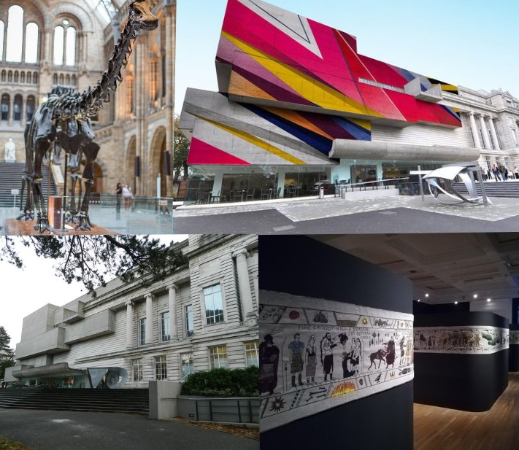
FAMOUS MUSEUMS AND GALLERIES IN NI
Ulster Museum (Belfast)
Ulster Museum is a museum in Belfast. The museum features exhibits related to: social history, photography, weapons and war, science and technology, natural sciences, costume and textiles, archives, world cultures, decorative and applied art, toys and hobbies, archaeology, industry, coins and medals and fine art.
Key themes, people and exhibits in the
museum include: fine and applied
arts, natural history, local history,
archaeology and ethnography.
Museum type: History and Anthropology

Slide 22
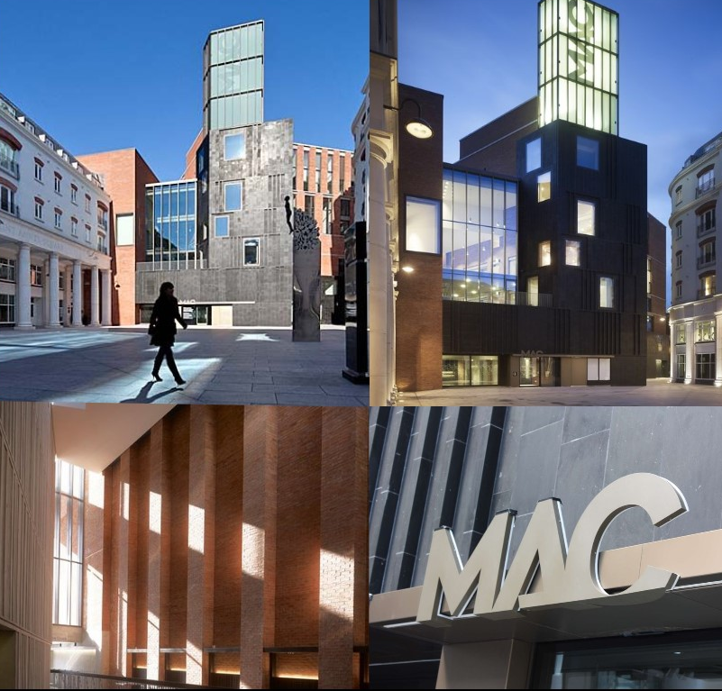
FAMOUS MUSEUMS AND GALLERIES IN NI
Metropolitan Arts Centre (Belfast)
The MAC (Metropolitan Arts Centre) is Belfast’s new arts venue. Selecting, creating and mixing up music, theatre, dance and art – bringing local and international talent under one roof.
Museum type: Art and Design

Slide 23
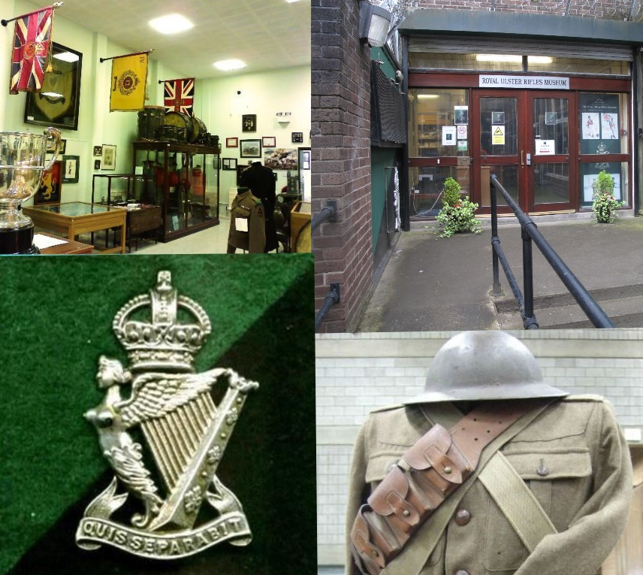
FAMOUS MUSEUMS AND GALLERIES IN NI
Royal Ulster Rifles Museum (Belfast)
The museum houses an extensive collection of uniforms, badges, medals and regimental memorabilia covering the history of the Regiment and the campaigns in which it has fought since its formation in 1793.
Museum type: History and
Anthropology,Specialized and
Alternative

Slide 24
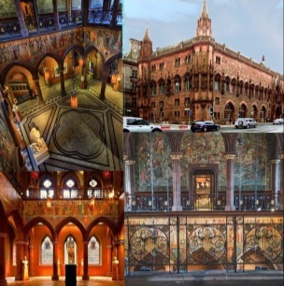
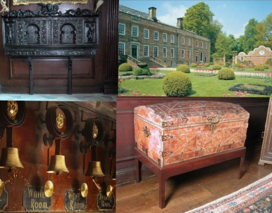
THANK YOU FOR YOUR ATTENTION!

