Slide 1
Language
Lecture 1

Slide 2
Communication and signs
Language is the most effective means of human communication.
Communication – the transmission of information (transfer of a message) between a source and a receiver by means of signs.
Sign – something physical that represents something other than itself. Signs have an exponent, a meaning and a set of referents.
The exponent of a sign is its physical manifestation, which can be perceived by the receiver of the message (gestures, facial expressions, pictures, sounds, a word, etc.).
The individual qualities, actions and states in the world to which a sign refers together constitute the reference (extension) of the sign.
The meaning of a sign is the concept which it evokes in its users and which can be identified with a set of semantic features.

Slide 3
Communication and signs
The signs used in a communication system constitute a code.
Signs can be symbolic, iconic and symptomatic.
When the exponent of a sign bears an arbitrary relationship to the sign’s referents, the sign is a symbol. E.g. the colours used in traffic lights or the pronunciation of words.
When there is a natural resemblance between the exponent and the referents of the sign, the sign is an icon. E.g. the stylised silhouette of a man or a woman on a public lavatory door or onomatopoeic words (buzz, dingdong, cuckoo).
When the exponent of a sign is mechanically linked to its source in such a way that it is a spontaneous reflection of the state of the source, the sign is a symptom. E.g. blushing is the symptom of embarrassment, a trembling voice is the symptom of excitement, smoke is the symptom of fire.

Slide 4
Linguistic communication
Human beings communicate in lots of ways, but the most effective way of human communication is linguistic communication, i.e. the use of language. The basic signs used in linguistic communication are words.
The linguistic signs and the rules for their combinations used by a community constitute a linguistic code (a language).
The model of linguistic communication:
Speaker (articulatory organs or hands)
Sound waves or writing (signal)
Hearer (auditory organs or eyes)

Slide 5
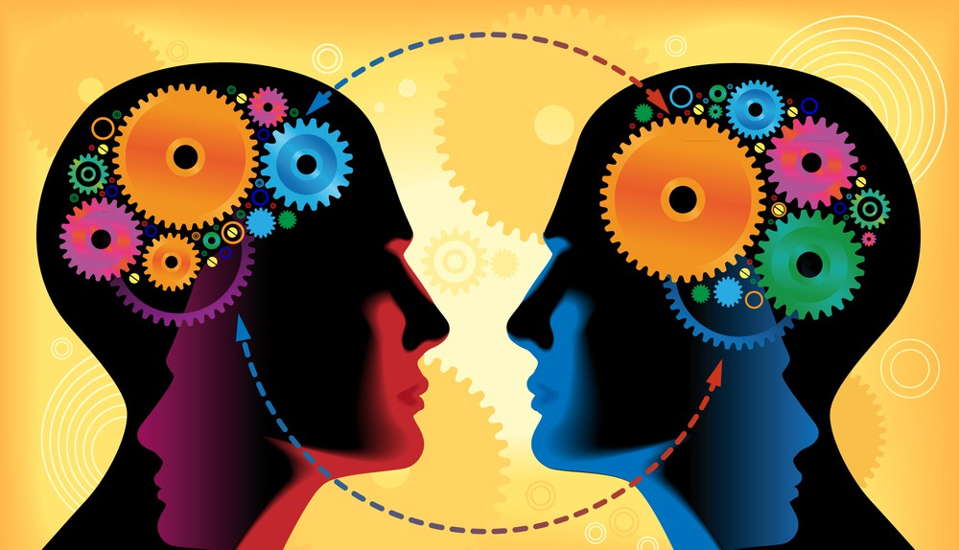
Linguistic communication
Human beings must share the same linguistic code (speak the same language), so that linguistic communication can take place between them.
Animal communication is mostly automatic and instinctive. Linguistic communication between human beings is predominantly intentional, relying mostly on symbolic signs and it can be totally independent of the situation.
We can compare human language and animal communication systems in terms of the design features of language.

Slide 6
Human languages | Animal communication systems
Arbitrariness: the absence of a natural bond between sign-exponents and their referents. E.g. words, except for onomatopoeic ones. | Bee-dancing: the special movements that bees perform with their wings and bodies to communicate the direction of a source of nectar.
Duality: double articulation, every human language is organised into two layers (phonemes = meaningless + morphemes, words, sentences = meaningful). | There is no evidence that duality is present in any animal communication system.
Patterning: every language has certain ways of combination, ways in which phonemes can be combined into words, and words into sentences. | This feature is also missing from animal communication systems.
Creativity: human beings can produce and understand an infinite number of new messages. | Only a limited amount of creativity can be observed in bee-dancing.
Displacement: the ability to use language in connection with things and events remote in space and time. We can talk about past, present, future, and we can even lie. | It is only present in connection with the place of food in bee-dancing.

Slide 7
The discrete nature of language
Linguistic communication is vocal (articulatory organs), verbal (words) and it involves the use of discrete language elements.
Words as lexical items are discrete because they differ from one another. This means that two word-realisations either represent the same word or two different words.
Words are composed of basic sounds called phonemes: those sounds that are capable of distinguishing otherwise identical words. If you replace one phoneme with another in a particular word, you may get a different word which no longer means the same.
When the only difference between two words is one phoneme, these words constitute a minimal pair.

Slide 8
The discrete nature of language
Phonemes can be looked upon as segmental elements, because they are in a sense the smallest building blocks (= segments) of words and sentences. But words and their sequences in sentences also contain supra-segmental elements, which are “superimposed” upon units that are or can be larger than segments, such as syllables.
The most significant supra-segmental elements are stress patterns and pitch patterns.
Stress is a degree of the prominence of a syllable. Stress patterns are patterns of syllabic prominence.
The innumerable degrees of syllabic prominence that are physically possible and may actually occur in real speech can be grouped into discrete degrees in English: non-stress, tertiary stress, secondary stress, and primary stress (in order of increasing strength).

Slide 9
The discrete nature of language
In English, stress patterns are able to distinguish words that are otherwise identical. For example, the noun insult has the primary stress on its first syllable, whereas the verb insult has it on the second syllable.
Pitch patterns (= tones) are permanent pitch configurations that are carried by syllables or syllable sequences. The commonest pitch patterns are the falling (high-low), rising (low-high), falling-rising (high-low-high), rising-falling (low-high-low), high level (high), and low level (low) tones.
In some languages, such as Chinese or Thai, pitch patterns are used as lexical tones or “word melodies”, because they can distinguish the meanings of words that are segmentally identical. Such languages are called tone-languages.

Slide 10
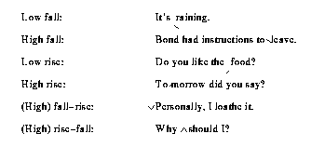
The discrete nature of language
In other languages, such as English or Hungarian, there are no word-melodies, but pitch patterns are used in intonation, i.e. as parts of “utterance melodies”, because they distinguish the meanings of utterances that are in other respects identical. Such languages are called intonational languages.
Intonation can be transcribed (represented on paper) by means of tonetic stress marks, i.e. graphic symbols which simultaneously indicate stress and intonation.

Slide 11
Paralanguage
Accompanying and occasionally even replacing language, we can also find behaviour which is not vocal or, if vocal, not verbal and not discrete. Variations in this kind of behaviour, used during and instead of linguistic communication, are called paralinguistic features or paralanguage.
Non-verbal features of paralanguage: gestures, bodily movements, facial expressions (bowing, waving, raising our eyebrows, shaking our head, etc.).
Vocal paralinguistic features: meaningful noises like hm, pff, the wolf whistle, throat clearing. Some are intentional, others are not.
In speech, loudness-level of an utterance, tempo, pause-length are all gradable, so they belong to paralinguistic rather than linguistic communication.

