Slide 1
Research methods and Organization IN LINGUISTICS
Viktória Ferenc
ferenc.viktoria@kmf.org.ua

Slide 2
Objectives of the course
to give a comprehensive overview of research methodology from collecting the data to reporting the results
to help students critically evaluate published research in their field and to design their own research studies
the ultimate scope of the course is to have students prepare the research proposal for their thesis

Slide 3
lectures on the main topics of research methodology
Classification and Basic Concepts
Research Questions, Research Trends
Data Gathering: Quantitative, Qualitative and Mixed Methods
Data Analysis
The structure of a publication
Legal and ethical aspects of research
The relationship between research and education

Slide 4
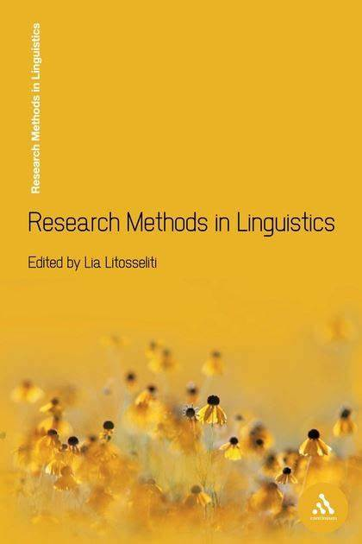

Further readings
(PDF uploaded at google classroom)

Slide 5
active participation of the students in the following tasks:
(1) Defining research problems: writing a 300-word research proposal giving (a minimum of 4) reasons why students think it is a good research problem (September 30).
(2) Designing research methods: design a mini questionnaire or an interview guide (October 15)
(3) Critical analysis of relevant academic literature: writing a literature review (600 words) for the selected problem (November 15)
(4) Data analysis: make an individual sample of qualitative or quantitative analysis (November 30)
(5) Reporting the results: writing a well structured (IMRAD) research report (December 15)
(6) A final exam.

Slide 6
Research Trends in Linguistics
TOPIC 1

Slide 7
The Beginnings
Since 2000 years HUMAN LANGUAGE is an object of admiration and a topic of serious researches.
The first observations on the origin, meaning and correctness of the language were often subjective, but an objective approach already existed in ancient times as well.
At the end of the 18th century a new field of research began to emerge, centered on LANGUAGE.

Slide 8
Historical developementsHistorical developements
Ancient Greeks: Aristotle, Plato
Ancient Romans: Marcus Terentius Varro, Cicero, Quintilianus, Julius Ceasar, Aelius Donatus, Priscianus
Ancient Indians: Hindu priests, Panini
Middle Age: translation began to evolve with the increase in missionary activities
Renaissance: with the discovery of the New World, many new languages came to the attention of researchers, the spread of printing, and the fact that Latin was being replaced by modern languages accumulate huge changes in the research of language

Slide 9
Linguistics in the 21th centuryLinguistics in the 20th century
The development of MODERN LINGUISTICS began at the 18th century and it continues to this day.
Two major linguistic schools, an American and a European, together make up modern linguistics.

Slide 10
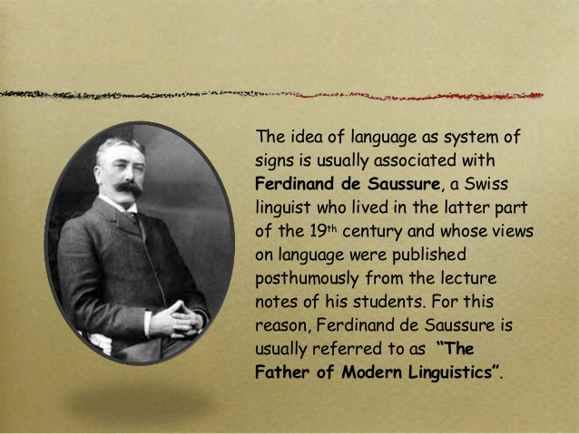
Ferdinand de Saussure (1857-1913)Ferdinand de Saussure (1857-1913)

Slide 11
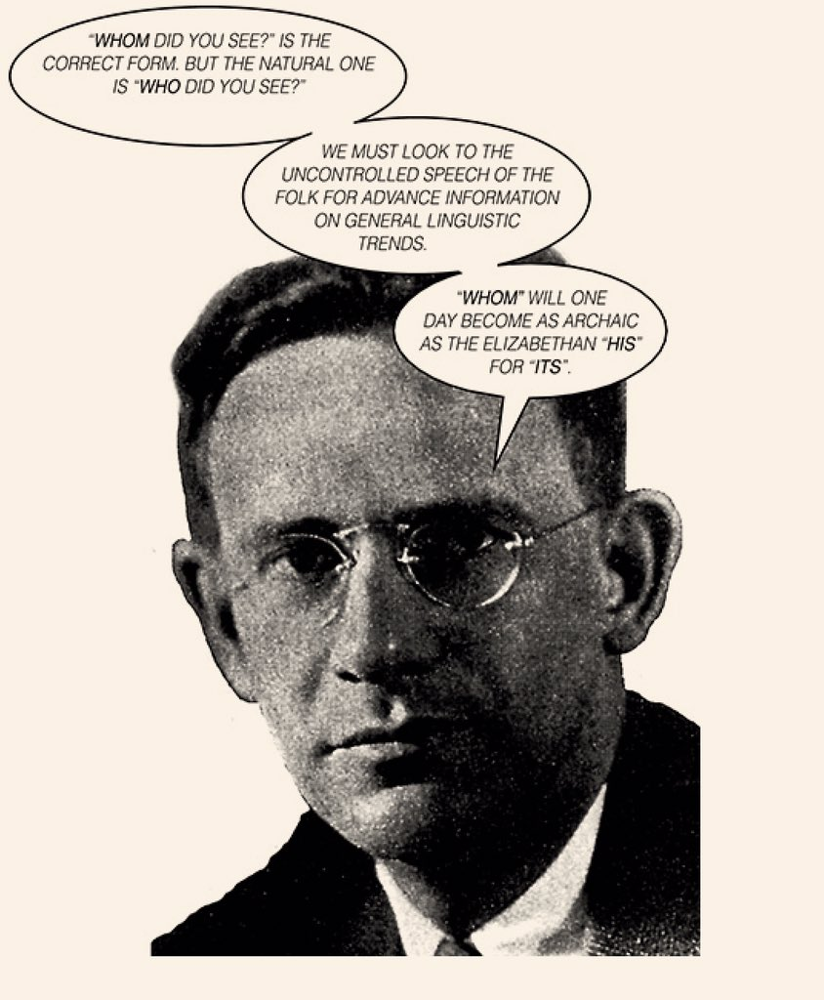
Edward Sapir
(1884-1939)

Slide 12
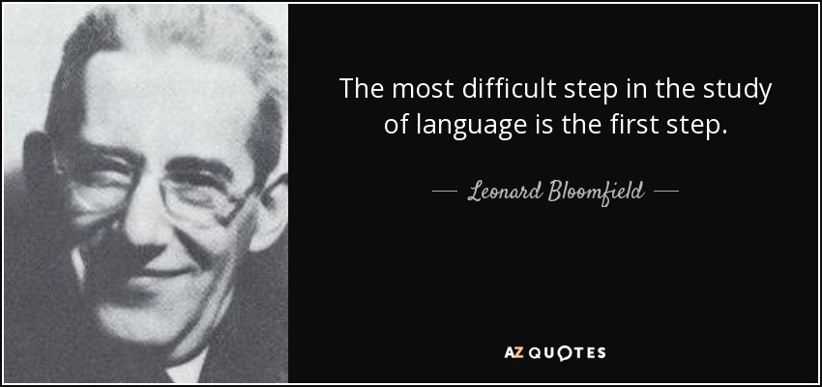
Leonard Bloomfild (1887-1949)Leonard Bloomfild (1887-1949)

Slide 13
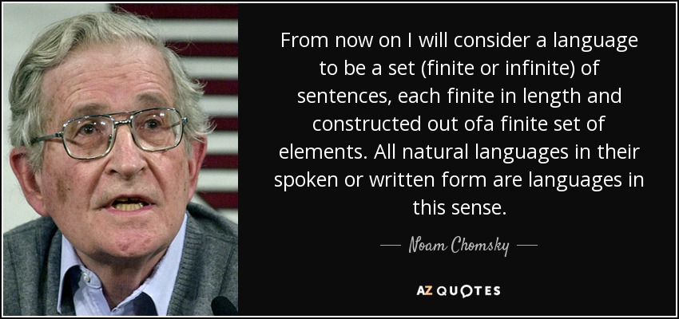
Noam Chomsky (1928 - )Noam Chomsky (1928 - )

Slide 14
Interdisciplinary Research Areas in Linguistics
TOPIC 2

Slide 15
linguistics like other sciences
Seeks an objective, systematic, consistent and explicit characterization of its subject.
It collects data, tests hypotheses, develops models, and sets up theories.
However, it is unique in that it overlaps with both the “Hard” Sciences (e.g. Medicine and Biology) and the Humanities (e.g. Philosophy, Sociology).
Linguistics encompasses both the Natural Sciences and the Humanities, thus covering a vast area, that can be a major attraction for those wishing to pursue linguistic researches ☺

Slide 16
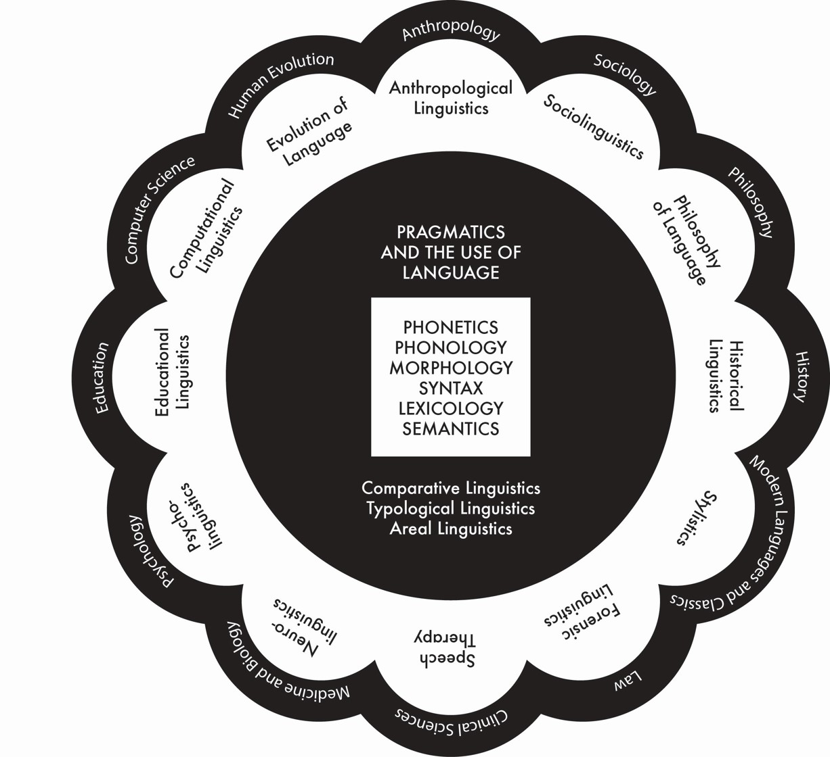

Slide 17
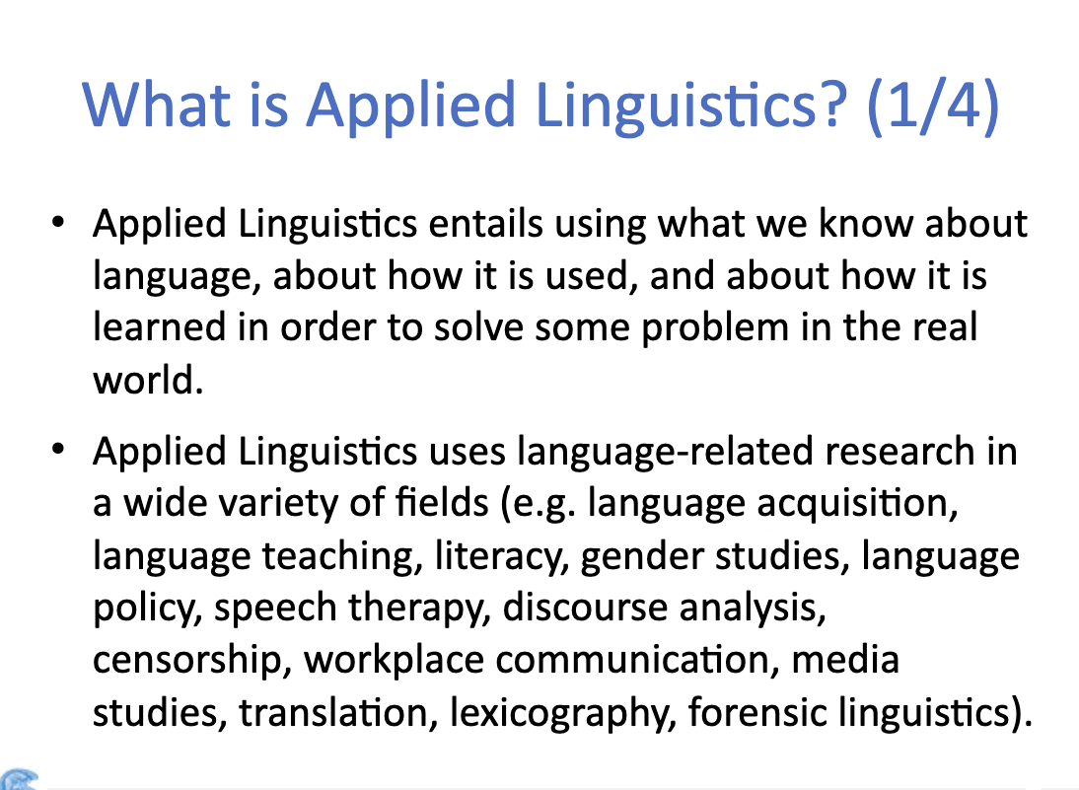

Slide 18
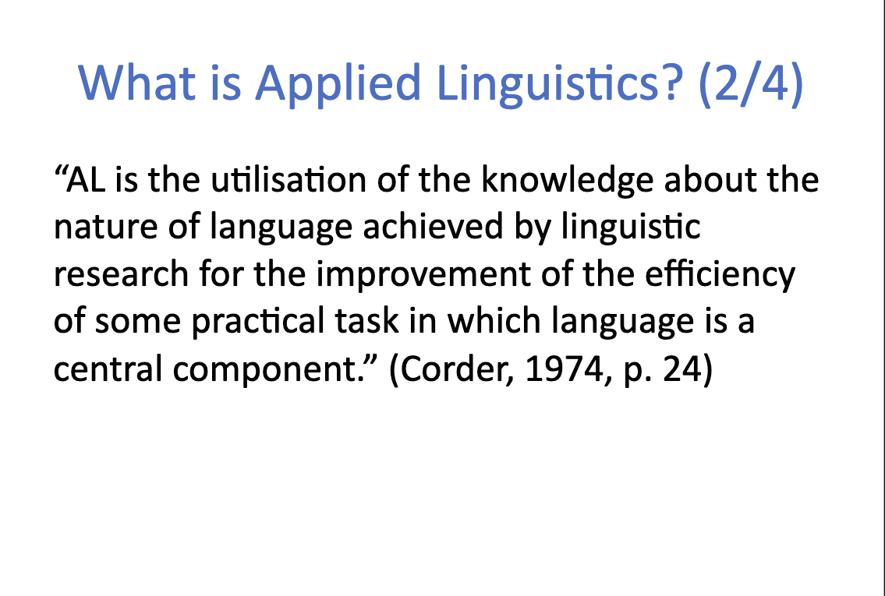

Slide 19
THE ’Scientific’ aPPROACH
TOPIC 3

Slide 20
The Scientific Approach
The society of the 21st century is also called the knowledge-based society, because scientific results play a fundamental role in its operation.
The vast majority of new knowledge is provided by scientific research.
Scientific thinking has a strict logical system and rules, the acquisition of the basic concepts and principles, and the way of scientific thinking is obligatory for every researcher in the field.

Slide 21
The scientific research
By scientific research we therefore mean an activity that
explores new knowledge,
the results of which meet the requirement of provability
and can be incorporated into the theory of science.

Slide 22
BASIC Characteristics of a Research
TOPIC 4

Slide 23
Classification Of Researches
According to the PURPOSE of the research: basic research and applied research.
According to the research METHODS: theoretical research and empirical research.
Based on the DIRECTION of the research process: inductive research and deductive research.
By DATA TYPE: Qualitative research and quantitative research.
Research based on the relationship to LITERARY ANTECEDENTS: primary research and secondary research.

Slide 24
The research process
• preparation for research
• indication of the purpose of the research
• acquaintance with the literature
• data collection
• data processing
• data analysis
• drawing conclusions, formulating results
• sharing results (publication)

Slide 25
Basic concepts
Research questions (RQ) and Hypotheses
Qualitative and Quantitative data
IMRAD structure in publications

Slide 26
Research Questions in Linguistics
By definition, the purpose of scientific research is to solve scientific questions.
[Research questions] are vehicles that you will rely upon to move you from your broad research interest to your specific research focus and project, and therefore their importance cannot be overstated. (Mason, 2002: 20)

Slide 27
The Research Question (RQ)
TOPIC 5

Slide 28
RQ-DATA-ANALYSISRQ-DATA-ANALYSIS
Without research questions, you will flounder; with them, you will be guided in terms of data needed, data collection methods and data analysis.
What data do I need?’ The answer is ‘That which best enables me to answer my research question(s)’. ‘
How do I analyse it?’ ‘In a way which allows me to address my research question(s)’.

Slide 29
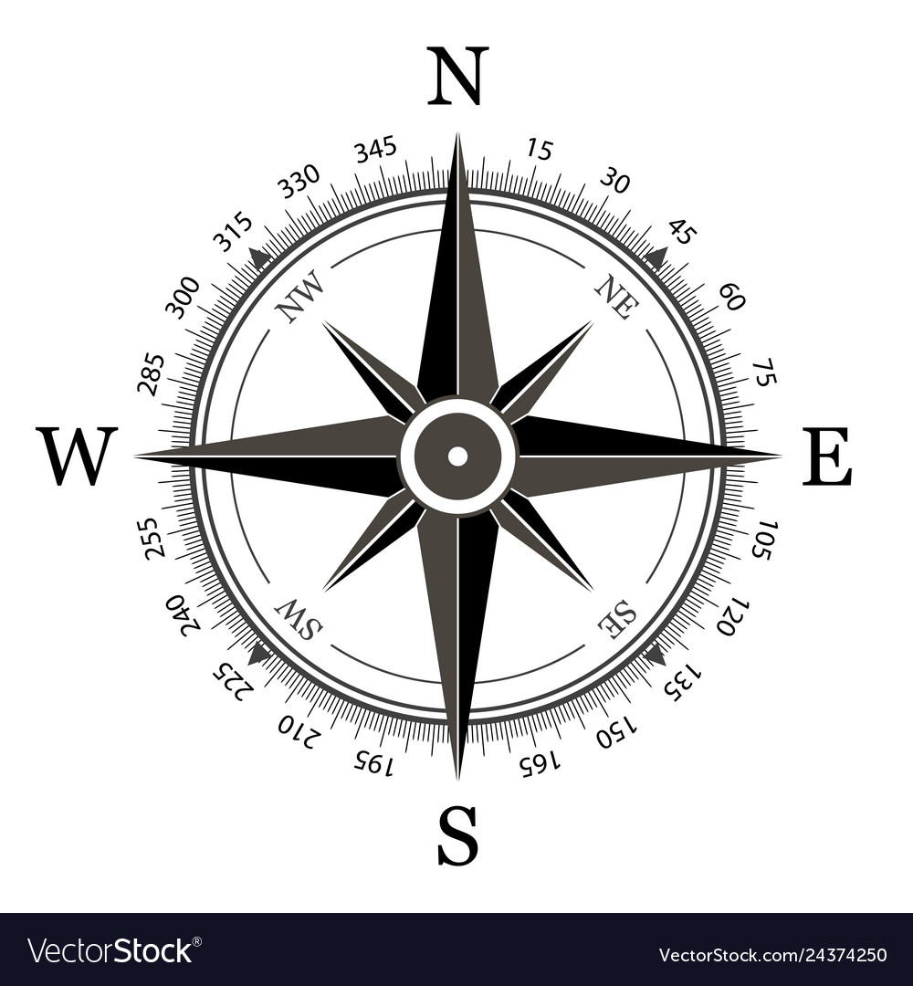
You can see RQ as an initial direction – like a compass point, whose needle is swinging.
At some point, however, your research questions need to stabilize (although there is room for getting their wording accurate right up until the end of the research project).

Slide 30
Hypothesis vs. RQHypothesis vs. RQ
You may be used to the term hypothesis rather than research question.
Hypotheses are more characteristic of the natural than the social sciences.
A hypothesis is conventionally worded as a STATEMENT, which is to be investigated and proved or disproved through empirical study.
A research question however is a QUESTION, and should be worded as an interrogative, It is not a topic, although it grows out of a topic.

Slide 31
Hypothesis vs. RQHypothesis vs. RQ
‘In terms of school library use, boys in Year 6 of UK Primary Schools borrow (a) more works of non-fiction than fiction, and (b) more works of non-fiction than do girls.’
What are the borrowing practices of UK Primary School Year 6 girls and boys in terms of fiction and non-fiction?’

Slide 32
Types of research questions
Descriptive: How, When, Where, What, Is/Are, Do/Does and To what extent?
Explanatory: Why?
Less frequently:
Evaluative: What is the best? Sholud the teachers encouraged?

Slide 33
For ExampleExample
Descriptive: What are the borrowing practices of UK Primary School Year 6 girls and boys in terms of fiction and non-fiction?’
Explanatory: Why …

Slide 34
sequence and hierarchy between RQ-s
In many research projects, RQ1 is descriptive (Does . . .?) and RQ 2 explanatory (Why does . . .?)
Primary/secondary
Main/contributory
Overarching/subordinate
Empirical/methodological/theoretical
Researcher-generated/participant-generated

Slide 35
document all your decisions
 | Research Question | Data needed | Data collection | Data analysis
1
2
3
NOTE
One research question might require two sources of data. Conversely, one source of data might address more than one research question – and therefore your table will need adapting.
! But if you find that you have an empirical research question lacking data with which to address it, or data with no corresponding research question, then you have a useful alert to the fact that you need to reconsider your research design!

Slide 36
Operationalizing RQ-s
Note that interview questions are not the same as research questions. It would be unreasonable to put your research question directly to a respondent.
You need to be sure that you can get the relevant data, and can get enough of it.

Slide 37
TASK 1
(1) Defining research problems: writing a 300-word research proposal giving (a minimum of 4) reasons why students think it is a good research problem
(by October 8).

Slide 38
Types of Data Collection
TOPIC 6

Slide 39
Qualitative vs. Quantitative Methods
We can distinguish between two basic types of methodological frameworks under which all other methods and approaches – in linguistics or any other discipline – can be subsumed: qualitative methods on the one side, and quantitative methods on the other.
Recently in social science research this dichotomy has become less rigid, and the use of mixed methods methodologies and triangulation approaches (the use of several methods to support each other) has increasingly led to the simultaneous use of quantitative and qualitative methods.

Slide 40
Qualitative vs. Quantitative Methods
– two types of data collection procedures (e.g. interviews and surveys)
– two types of data (e.g., numerical and textual)
– two types of data analysis (statistical and thematic)
– two types of conclusions (‘objective’ and ‘subjective’, etc.).

Slide 41
In a nutshell
Quantitative approach
Numerical data
Statistical analysis
Qualitative approach
Textual data
Thematic analysis
‘Subjective’ conclusions
‘Objective’ conclusions

Slide 42
TASk 2
(2) Designing research methods: design a mini questionnaire/ interview guide (by October 15)

Slide 43
Quantitative Methods
TOPIC 7

Slide 44

STEPS of a survey research
Designing a questionnaire
Test the questionnaire
Elaborate research sample
Train the interviewers
Access respondents, fill out questionnaires
Coordinate the interviewers simultanously
Collect the questionnaires
Data processing/ recording
Cleaning of the database
Analyses

Slide 45
The most frequently used research designs in quantitative research
Cross-sectional design: we collect a comparatively large amount of data at one point in time, hence obtaining a snapshot of the status quo.
Longitudinal studies, however, are based on the repeated collection of data over a longer period of time, hence enabling us to observe any changes in variables which may occur over time.(Panel and cohort).
In experimental designs, we as researchers deliberately and explicitly manipulate the variables in order to prove/disprove our hypothesis. Experiments usually comprise two groups of participants: the experimental group (EG), that is, the group that is undergoing the ‘treatment’ or stimulus, and the control group (CG), which is unaffected by the stimulus.

Slide 46
quantitative linguistic variables
Quantitative research, is deductive: based on already known theory we develop hypotheses/ research question, which we then try to prove (or disprove) in the course of our empirical investigation. Hypotheses are statements about the potential and/or suggested relationship between at least two variables.
‘the older a learner, the less swear words they use’ (two variables)
or ‘age and gender influence language use’ (three variables).

Slide 47
The variable
The Oxford English Dictionary (OED) defines variable (noun) as ‘Something which is liable to vary or change; a changeable factor, feature, or element. ’
A variable is an object, event, idea, feeling, time period, or any other type of category you are trying to measure.
A frequent variable in linguistics (and other social and psychological sciences) is gender. Gender is a variable which, with human beings, can have two possible values: male or female.
Age, ethnicity can also be a variable.
It should be well-defined.

Slide 48
INDEPENDENT AND DEPENDENT VARIABLES
INDEPENDENT variable that stands alone and isn't changed by the other variables you are trying to measure. For example, someone's age might be an independent variable. Other factors (such as what they eat, how much they go to school, how much television they watch) aren't going to change a person's age. In fact, when you are looking for some kind of relationship between variables you are trying to see if the independent variable causes some kind of change in the other variables, or dependent variables.
DEPENDENT variable is something that depends on other factors. For example, a test score could be a dependent variable because it could change depending on several factors such as how much you studied, how much sleep you got the night before you took the test, or even how hungry you were when you took it. Usually when you are looking for a relationship between two things you are trying to find out what makes the dependent variable change the way it does.

Slide 49
categorical and continuous variables
In general, we distinguish between two basic kinds of variables: categorical variables and continuous variables.
Categorical variables are those variables whose values can be easily separated into discrete categories.
Continuous variables, however, cannot be easily classified into categories this way. Rather, they are variables whose values exist on a mathematical scale.
Transforming a continuous variable into a categorical one ( e.g. age into age-groups).

Slide 50
reliability and validity
Reliability refers to our measure repeatedly delivering the same (or near same) results. Ideally, if we use the same measure with the same people under the same conditions, our measure should give us the same result.
Validity refers to our measure actually measuring what it is supposed to measure. It is often an important issue when using questionnaires and in particular when we measure abstract concepts such as attitudes.

Slide 51
Collecting Quantitative/ Numerical data
Not only do we need a set of tools to get our data, we also need to think about a coherent and solid framework around which we organize our data collection.
We might have a well-working questionnaire (which we have used before, and which we know is reliable and valid), however, we need to think carefully about how, when, in which order, and who with (in terms of sample) we deploy them. If we just randomly record people and ask them to complete the questionnaire, what we will get is a pile of data (good!) but certainly not the kind of data we want and need in order to answer our research questions (bad!).

Slide 52
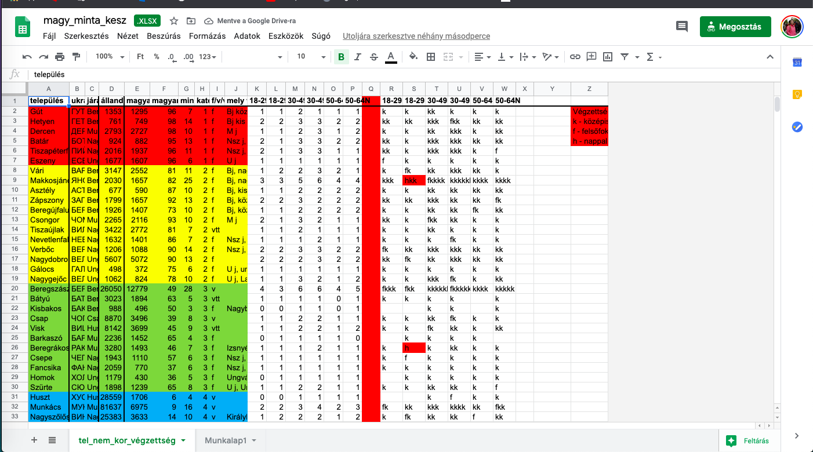
The SAMPLE

Slide 53
questionnaires
The major benefits of questionnaires: they can, potentially, generate a large amount of data which is comparatively simple to process.
Questionnaires must be perfect before we distribute them: we must be confident that they work well and that they reliably generate valid data.
The major challenge: How do I phrase my questions so they address exactly the issues I want to investigate?
Two types of questions: open and closed.

Slide 54
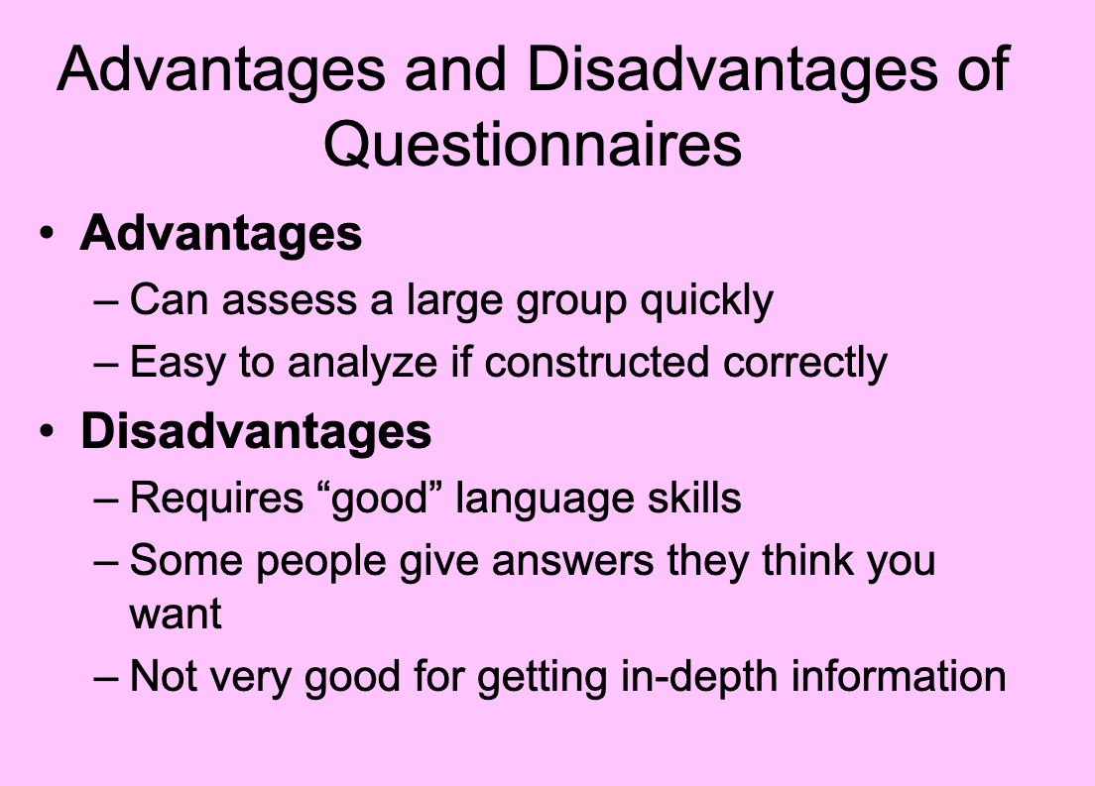

Slide 55
BASIC RULES in QuestionNaire design
Use statements that are interpreted in the same way by members of different subpopulations of the population of interest.
Use statements where persons that have different opinions or traits will give different answers.
Think of having an "open" answer category after a list of possible answers.
Use positive statements and avoid negatives or double negatives.
Do not make assumptions about the respondent.
Use clear and comprehensible wording, easily understandable for all educational levels
Use correct spelling, grammar and punctuation.
Avoid items that contain more than one question per item (e.g. Do you like strawberries and potatoes?).

Slide 56
Structure of a questionnaire
(1) Questions and explanations for the respondent
Aim of the research, greetings
Socio-demographic data (age, sex, type of settlement, educational level, family background, etc.)
Thematic data 1
Thematic data 2
Thematic data 3
(II) Questions and explanations for the interviewer

Slide 57


The role of the interviewer and the respondent
Paper-BASed Questionnaire
Online Questionnaire

Slide 58
Ask comprehensive and ‘objective’ questions
Questionnaires must be anonymous and voluntary.
Questionnaires must measure neutrally and objectively.
Typical (and rather extreme) examples of leading questions take the form of ‘Don’t you think that . . .?’, or include semantically strongly loaded terms which are best avoided, for example, ‘good’/‘bad’ and their synonyms, ‘ugly’, ‘stupid’ or ‘unnecessary’

Slide 59
Open versus closed questions and multiple item responses
Closed questions which provide respondents with a set of possible answers to tick from – from a quantitative point of view – is preferable as they are just easier to process.
Similar to the phrasing of questions, we have to take great care in designing our answer options.
We must provide them with a set of all possible (and/or relevant) answers in order to get an accurate picture. Hence, especially with large-scale studies, researchers often conduct prestudies with interviews or focus groups to see what potential issues/answers a particular topic raises.

Slide 60
Ask what you need to know
‘Do you think the students are interested in learning English?’ (‘Yes or No’ type of question)
‘To what extent do you think your students are interested in learning English?’ (Likert scales)
‘On a scale from 1 to 5, whereby 5 indicates “very interested” and 1 indicates “not interested at all”, to what extent do you think your students are interested in learning English? Please circle your answer’
1 2 3 4 5

Slide 61
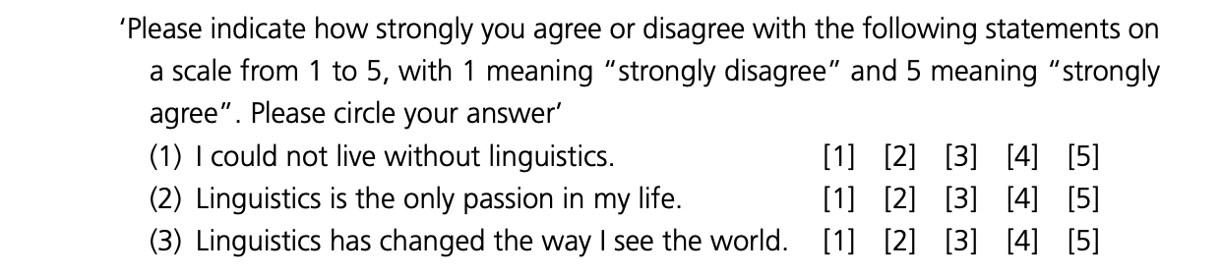
5 point Likert scale

Slide 62
Processing Quantitative/ Numerical data
TOPIC 8

Slide 63
Processing
Questionnaire coding - creating database
Computer-assisted analysis: Microsoft Excel, SPSS Statistics

Slide 64
CODING
Our questionnaire consists of nothing more than ticked (and unticked) boxes and a few numbers (for respondents’ age, for example) or possibly individual words or short phrases (open-ended questions)
In order to enable a computer-assisted analysis, we need to ‘translate’ all variable outcomes in our questionnaire into a neat set of numbers.
A common way of coding sex is to assign the number ‘1’ to ‘male’ and the number ‘2’ to ‘female’ (or vice versa). Depending on whether a respondent is a woman or a man, we can then input ‘2’ or ‘1’ respectively, into our software.

Slide 65
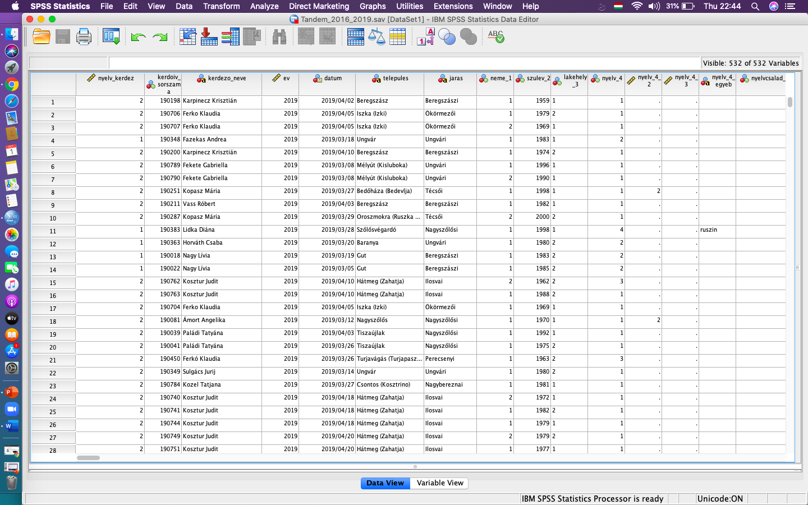

Slide 66
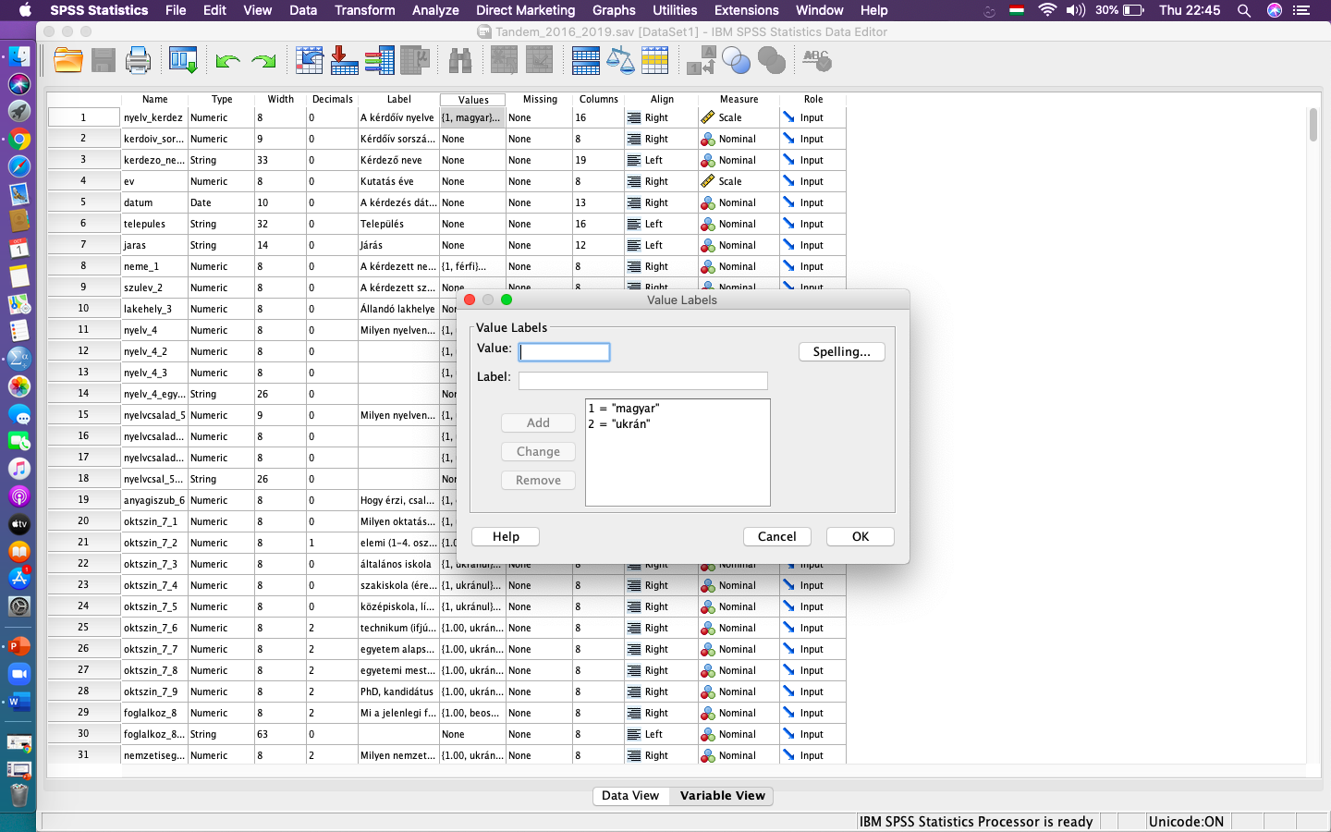

Slide 67
Analysis of Quantitative/ Numerical data
TOPIC 9

Slide 68
statistics
The choice of which test to use depends primarily on the kind and number of variables in your data set, and the sorts of relationships that exist between the variables you consider.
Statistics are designed to determine whether apparent patterns in a data set really are patterns – whether they are what we call statistically significant.

Slide 69
some of the basic concepts
Cases that involve one dependent variable and one independent variable.
Frequency
Crosstabulation
Compare means

Slide 70
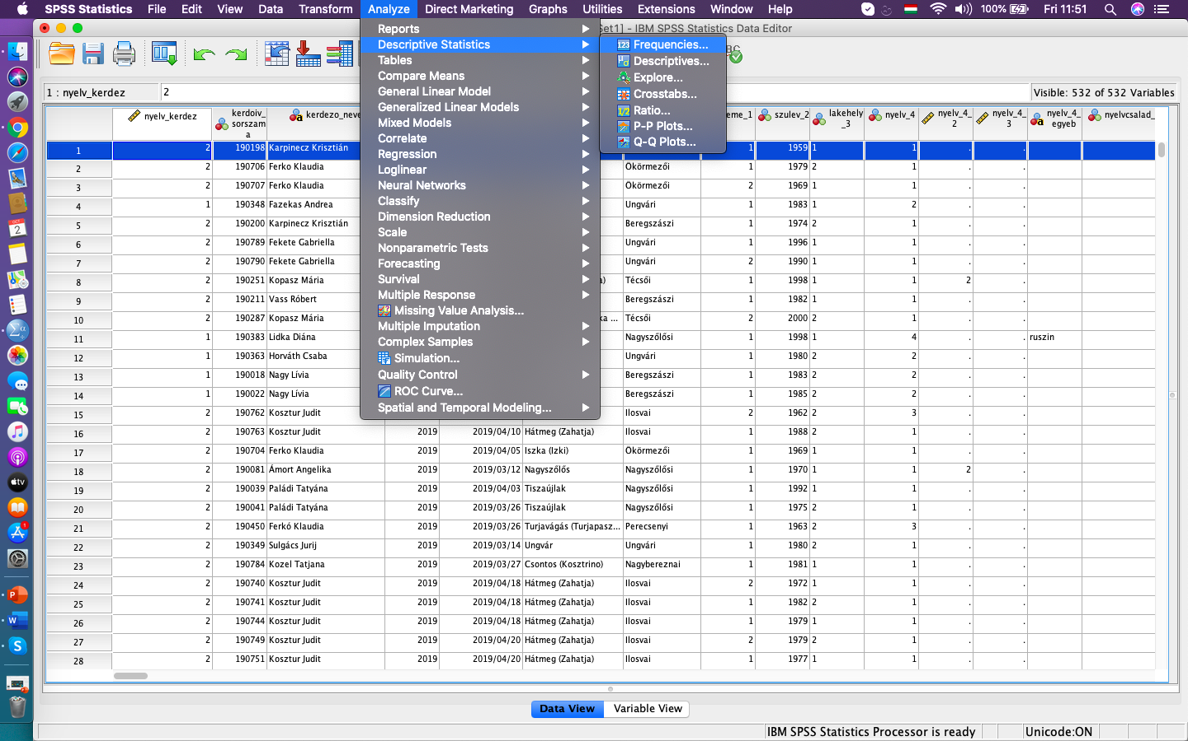
Frequency

Slide 71
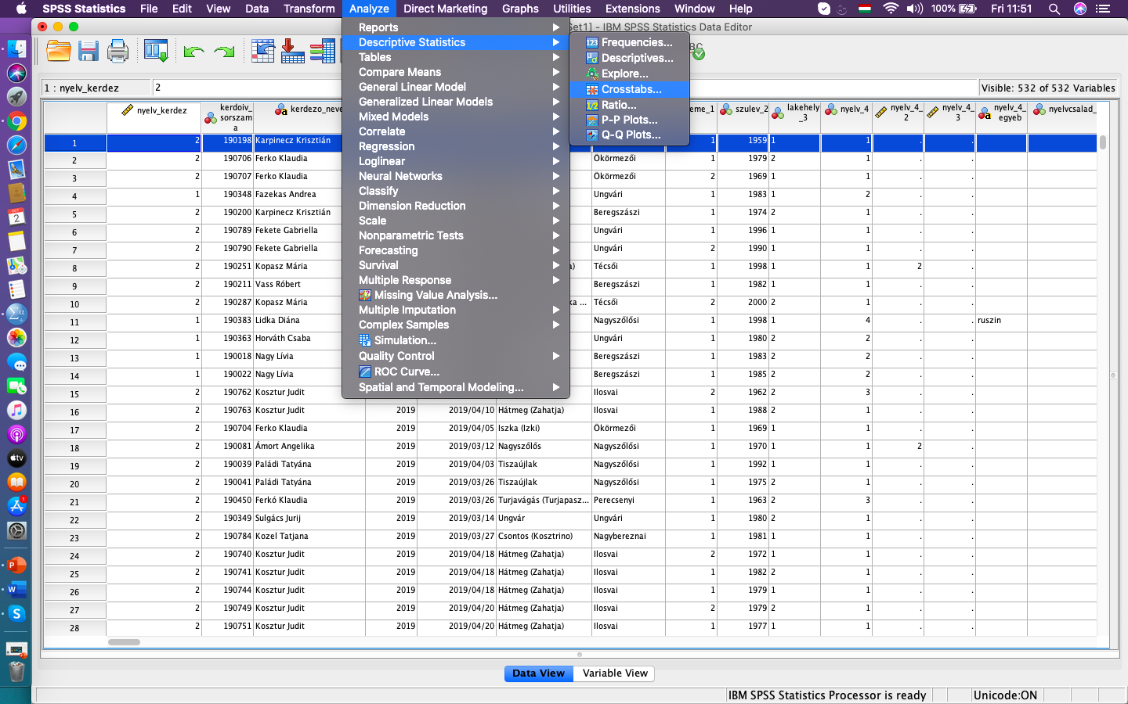
Crosstabulation

Slide 72
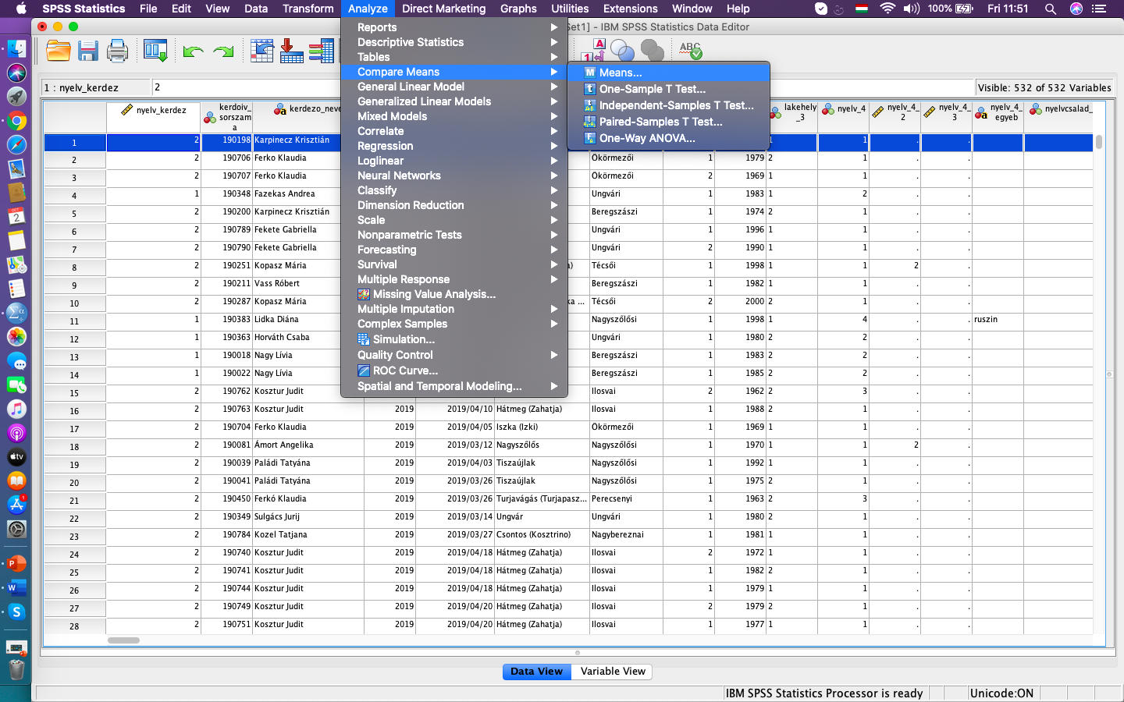
Compare means

Slide 73
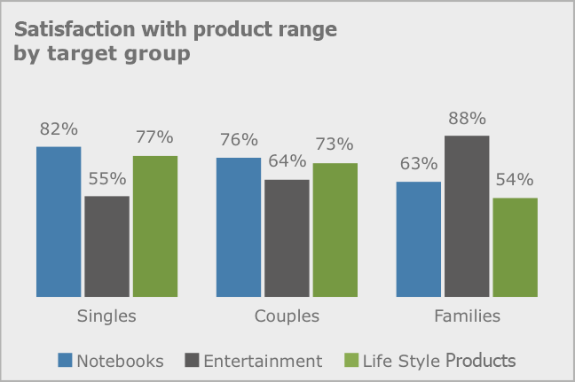
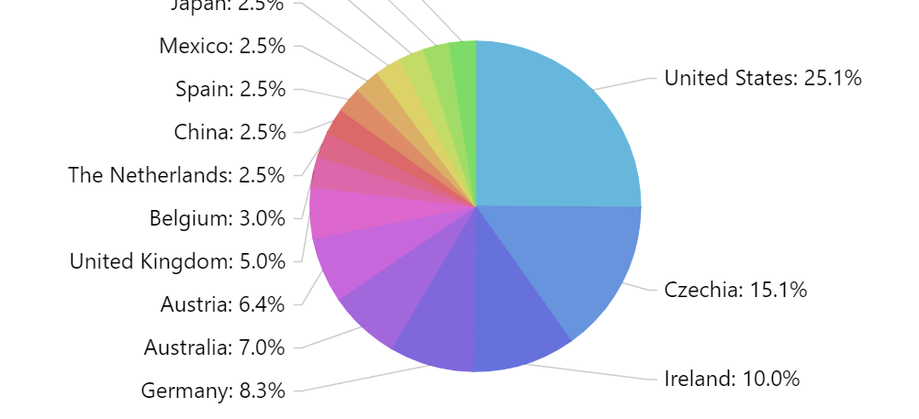
Data Visualisation

Slide 74
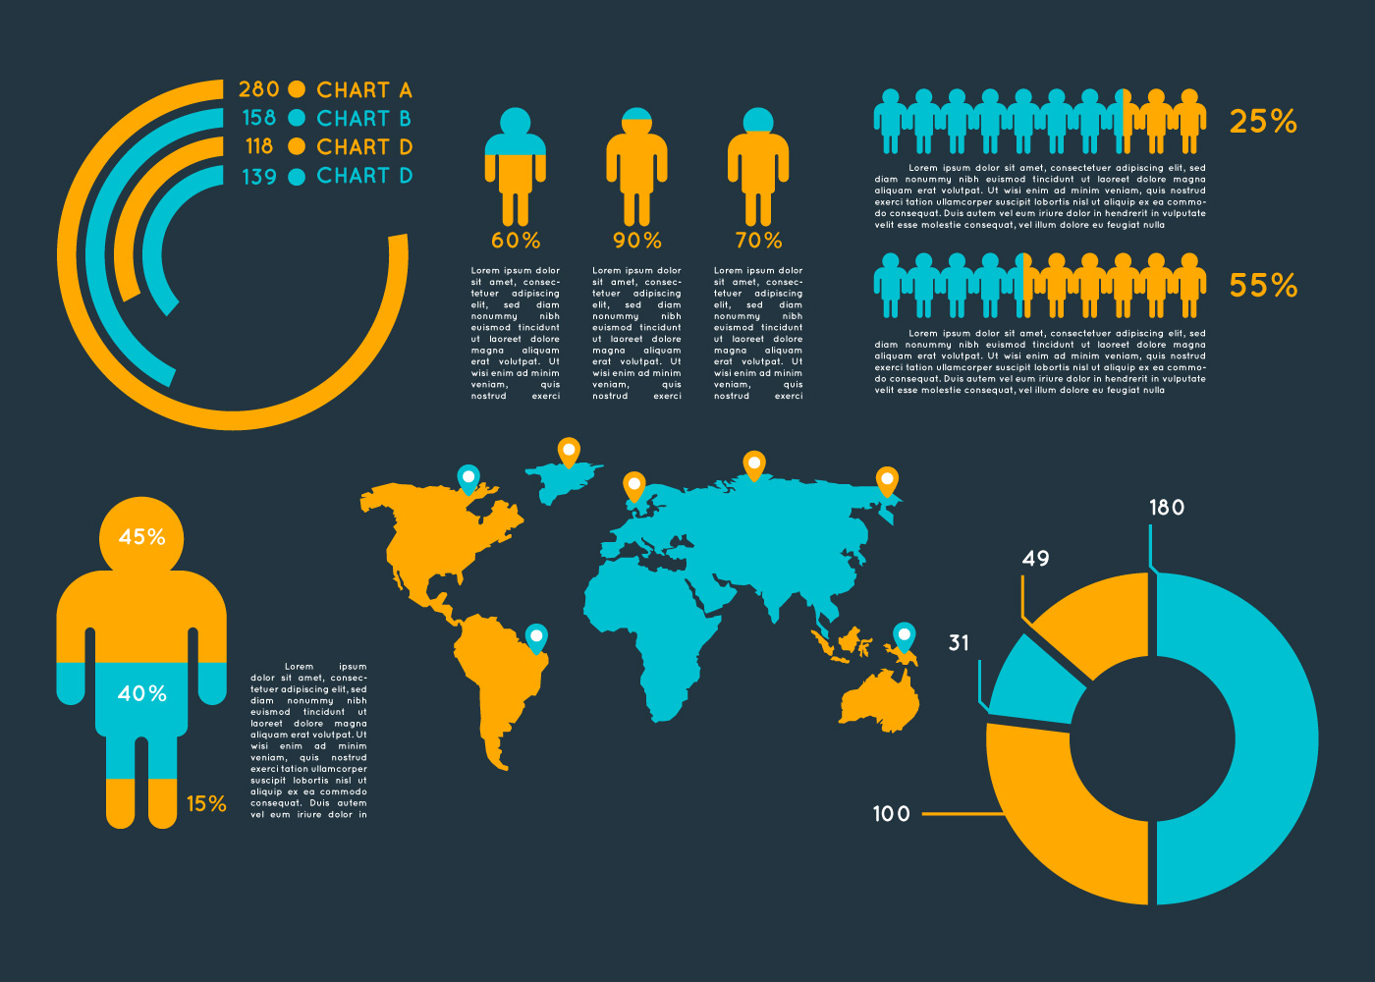
Data Visualisation

Slide 75
Qualitative methods
TOPIC 10

Slide 76
In a nutshell
Quantitative approach
Numerical data
Statistical analysis
Qualitative approach
Textual data
Thematic analysis
‘Subjective’ conclusions
‘Objective’ conclusions

Slide 77
Collecting Qualitative/ textual data
Conversation (’talk’) as a research method
The study of ‘text’ (written discourse) or ‘talk’ (spoken discourse)
Being an interviewer – skills and techniques
Selecting interviwees – how many?

Slide 78

The Interview
Interviews can be defined as a qualitative research technique which involves “conducting intensive individual interviews with a small number of respondents to explore their perspectives on a particular idea, program or situation.”
6 tips for making interviews:
https://www.youtube.com/watch?v=MDbNWqUbP-c

Slide 79
Types
Structured interviews consist of a series of pre-determined questions that all interviewees answer in the same order. Data analysis usually tends to be more straightforward because researcher can compare and contrast different answers given to the same questions.
Unstructured interviews are usually the least reliable from research viewpoint, because no questions are prepared prior to the interview and data collection is conducted in an informal manner. Unstructured interviews can be associated with a high level of bias and comparison of answers given by different respondents tends to be difficult due to the differences in formulation of questions.
Semi-structured interviews contain the components of both, structured and unstructured interviews. In semi-structured interviews, interviewer prepares a set of same questions to be answered by all interviewees. At the same time, additional questions might be asked during interviews to clarify and/or further expand certain issues.

Slide 80
Interview guide
(1) Structure: It helps to focus and organize your line of thinking and therefore questioning. It is a list of the high level topics that you plan on covering in the interview with the high level questions that you want to answer under each topic.
(II) Timing: it helps you with pacing during an interview. If you’re ten minutes into a thirty minute interview and you realize that you’ve only covered one topic out of the five on your guide, then you still have time to get back on track.
Length: one page.

Slide 81
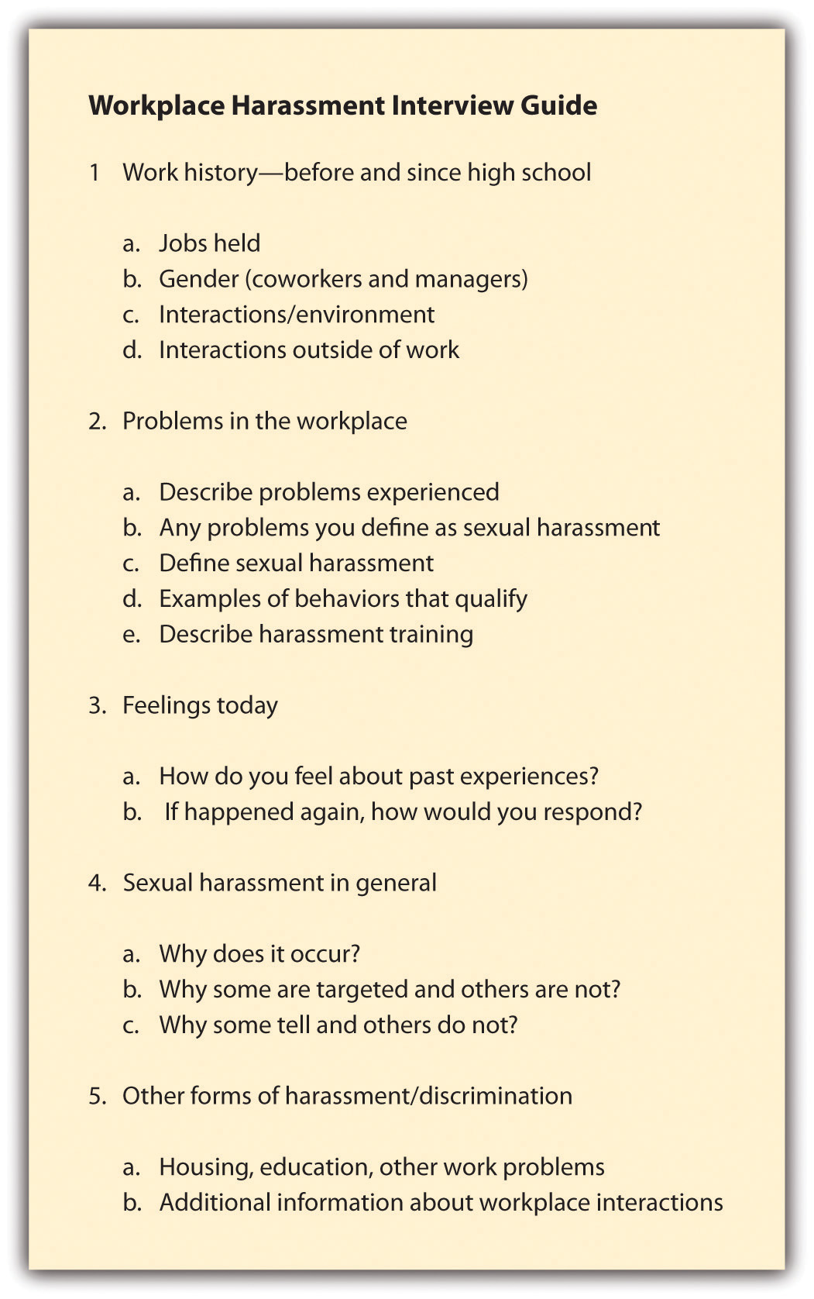
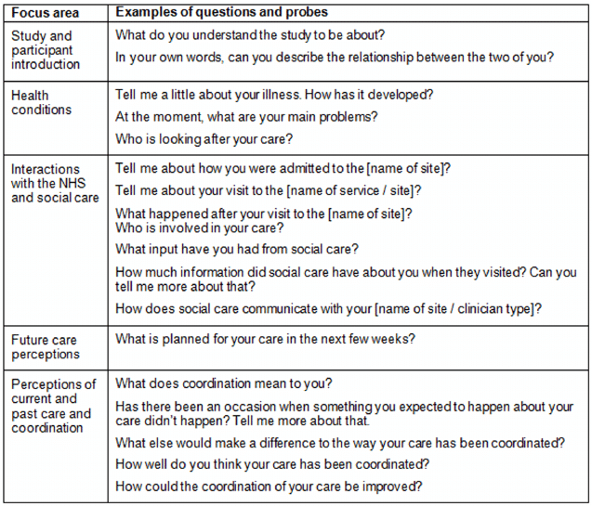

Slide 82
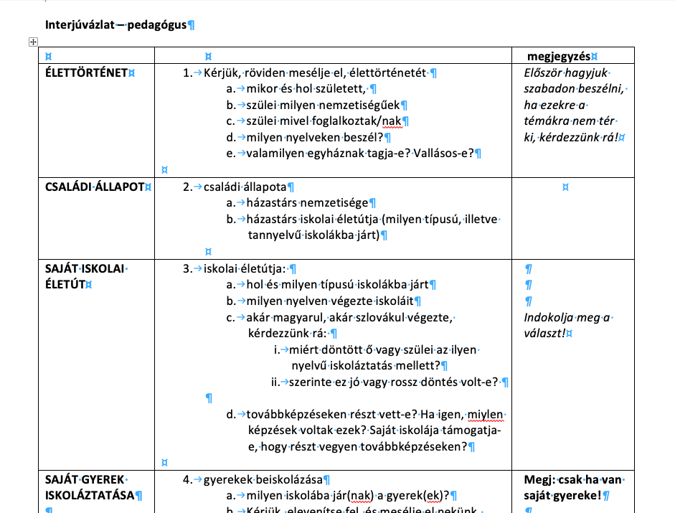

Slide 83
Being an Interviewer
you should have an open mind and refrain from displaying disagreements in any forms when viewpoints expressed by interviewees contradict your own ideas
timing and environment for interviews need to be scheduled effectively: interviews need to be conducted in a relaxed environment, free of any forms of pressure for interviewees whatsoever.
important: the interviewer should give a brief, casual introduction to the study; stress the importance of the person’s participation; and assure anonymity, or at least confidentiality, when possible.

Slide 84
The Interviewer Effect
Because an interview is a social interaction the appearance or behavior of the interviewer may influence the answers of the respondent. This is a problem as it can bias the results of the study and make them invalid.
For example, the gender, ethnicity, body language, age, and social status of the interview can all create an interviewer effect.
For example, if a researcher was investigating sexism amongst males, would a female interview be more preferable than a male? It is possible that if a female interviewer was used male participants may lie (i.e. pretend they are not sexist) to impress the interviewer, thus creating an interviewer effect.

Slide 85
Variables you should consider
Gender and age: This can have a big effect on respondent's answers, particularly on personal issues.
Personal characteristics: Some people are easier to get on with than others. Also, the accent and appearance (e.g. clothing) of the interviewer can have an effect on the rapport between the interviewer and interviewee.
Also, the language the interviewer uses should be appropriate to the vocabulary of the group of people being studied. For example, the researcher must change the language of questions to match the social background of respondents' age / educational level / social class / ethnicity etc.
The interviewer must ensure that they take special care when interviewing vulnerable groups, such as children. For example, children have a limited attention span and for this reason, lengthy interviews should be avoided.
Ethnicity: People have difficulty interviewing people from a different ethnic group.

Slide 86
Selecting interviwees – how many?
Choose the adequate person accorting to your research questions.
One person or a group of people – focus group interview.
Focus group interview is a qualitative approach where a group of respondents are interviewed together, used to gain an in‐depth understanding of social issues. The method aims to obtain data from a purposely selected group of individuals rather than from a statistically representative sample of a broader population.

Slide 87

Focus Group/ Moderator
The role of the interview moderator is to make sure the group interact with each other and do not drift off-topic.
Ideally, the moderator will be similar to the participants in terms of appearance, have adequate knowledge of the topic being discussed, and exercise mild unobtrusive control over dominant talkers and shy participants.

Slide 88
Processing Qualitative/ Textual data
TOPIC 11

Slide 89
From Talk to Textual Data
Interview Transcription is the process of documenting a conversation between two or more people.
While there’s no denying that transcription is time-consuming, the process can be simplified with several methods:
Using Audio-to-Text Converters (see https://www.indianscribes.com/best-audio-to-text-converters/)
Transcribing manually
Hiring a Transcriptionist

Slide 90
In simple transcripts, paraverbal and non-verbal elements of communication are usually omitted. Dialect and colloquial language is approximated to standard language. The focus of simple transcripts lies on readability. It is easier to learn to produce such a transcript and the transcription takes less time. These transcription conventions prioritize content.
A detailed transcript based on a complex set of transcription rules is necessary if the subsequent analysis does not merely focus on the semantic content of a conversation. In such cases, prosodic elements (e.g. intonation, primary and secondary emphasis, volume, speed and pitch) are included. If necessary, a phonetic transcription is added, e.g. in dialect research) and non-verbal phenomena are documented in a more complex way.

Slide 91
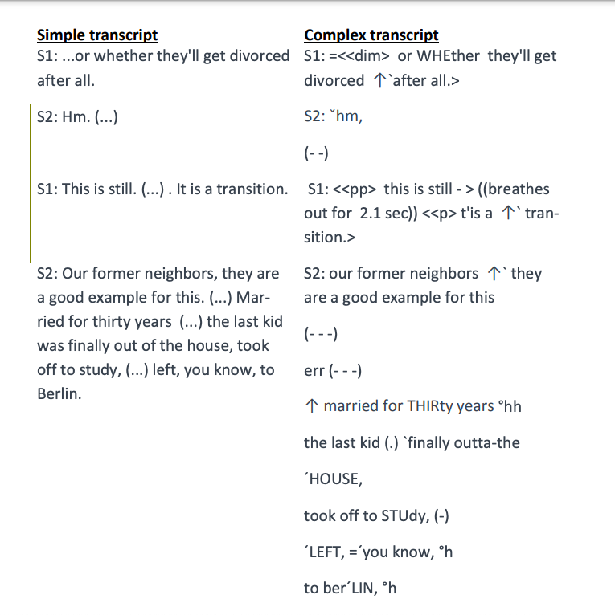

Slide 92
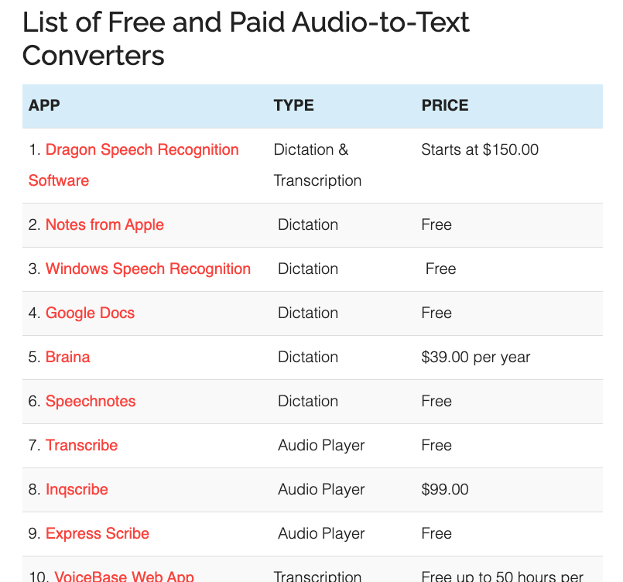
Using Audio-to-Text Converters https://www.indianscribes.com/best-audio-to-text-converters/

Slide 93
the sociolinguistic interview
Mitigating ‘the observer's paradox’, enabling the analyst to obtain natural speech data.
William Labov (Labov 1984): the sociolinguistic interview.
Hungarian context: http://buszi.nytud.hu/a-buszi-rol/az-interjuk-felepitese/iranyitott-beszelgetes

Slide 94
Analysis of QuaLitative/ Textual data
TOPIC 12

Slide 95
Types of analysis
Conversation Analysis (CA)
Discourse Analysis (DA)
Critical Discourse Analysis (CDA)
Feminist Post-structuralist Discourse Analysis (FPDA).
Narrative Analysis
The Grounded Theory
Content Analysis or Thematic Analysis

Slide 96
Conversation Analysis (CA)
CA is an approach to the study of social interaction and talk-in-interaction that, although rooted in the sociological study of everyday life, has exerted significant influence across the humanities and social sciences including linguistics.
Drawing on recordings (both audio and video) naturalistic interaction (unscripted, non-elicited, etc.) conversation analysts attempt to describe the stable practices and underlying normative organizations of interaction by moving back and forth between the close study of singular instances and the analysis of patterns exhibited across collections of cases.

Slide 97

discourse analysis
Discourse analysts not only study language use 'beyond the sentence boundary' but also prefer to analyse 'naturally occurring' language use, not invented examples.
In Europe, Michel Foucault became one of the key theorists of the subject, especially of discourse, and wrote The Archaeology of Knowledge.
In this context, the term 'discourse' no longer refers to formal linguistic aspects, but to institutionalized patterns of knowledge that become manifest in disciplinary structures and operate by the connection of knowledge and power.

Slide 98
Critical Discourse Analysis (CDA)
CDA stems from a critical theory of language which sees the use of language as a form of social practice.
All social practice are tied to specific historical contexts and are the means by which existing social relations are reproduced or contested and different interests are served.
How is the text positioned or positioning?
Whose interests are served by this positioning?
Whose interests are negated?
What are the consequences of this positioning?
Where analysis seeks to understand how discourse is implicated in relations of power, it is called critical discourse analysis.

Slide 99
Feminist poststructuralist discourse analysis (FPDA)
FPDA is an approach to analysing the discourse of spoken interaction principally.
FPDA focuses on the ways in which speakers negotiate their subject positions within competing and interwoven discourses.
FPDA has been used by a range of international scholars of gender and language to analyse texts such as: classroom discourse, teenage girls' conversation, and media representations of gender.
The feminist part of FPDA considers gender difference to be a dominant discourse among competing discourses when analysing all types of text.

Slide 100
Narrative analysis
Some qualitative data, such as interviews or field notes may contain a story.
Narrative analysis helps understand the underlying events and their effect on the overall outcome.
For example, the process of choosing a product, using it, evaluating its quality and decision to buy or not buy this product next time.

Slide 101
The grounded theory
This method of analysis starts by formulating a theory around a single data case.
The methodological strategies of grounded theory are aimed to construct middle-level theories directly from data analysis.
Therefore the theory is “grounded’ in actual data.
Then additional cases can be examined to see if they are relevant and can add to the original theory.

Slide 102
Content/Thematic Analysis
This is the most common example of qualitative data analysis.
It refers to the categorization, tagging and thematic analysis of qualitative data.
Content analysis is the study of documents and communication artifacts, which might be texts of various formats, pictures, audio or video.
Social scientists use content analysis to examine patterns in communication in a replicable and systematic manner.
Thematic analysis extracts themes from text by analysing the word and sentence structure.

Slide 103
How to do it?
Read all the interview text and identify themes
Use memos, list of codes.
Identify themes which recure accross all the interviews
Combine themes to draw a bigger conceptual picture

Slide 104
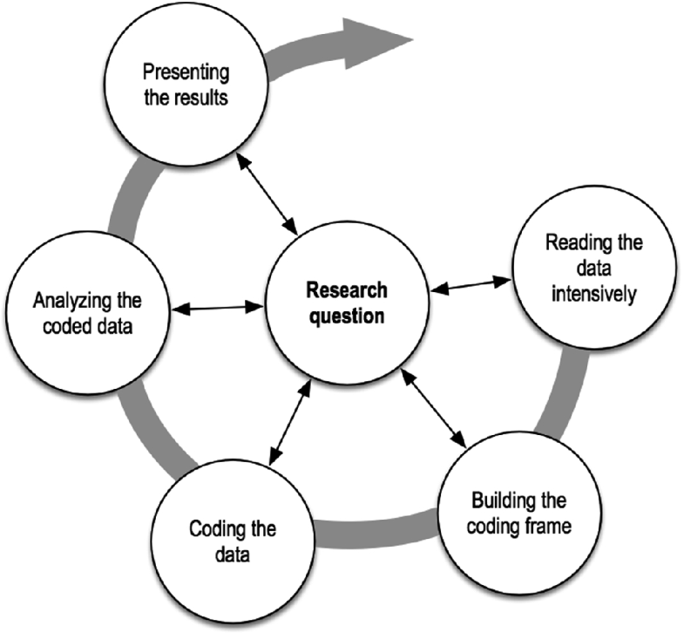

Slide 105
What is a Code?
Coding is the process of labelling and organizing your qualitative data to identify different themes and the relationships between them.
Identifying a consistent and clear unit of coding is vital, and researchers' choices range from a single word to several paragraphs, from texts to iconic symbols.
The process of the initial coding scheme or approach to coding is contingent on the particular content analysis approach selected.
Video tutorial on coding: https://www.youtube.com/watch?v=BAKRKZq_Ebo

Slide 106
The most important terms
Frequency
Sequence
Inductive
Deductive

Slide 107
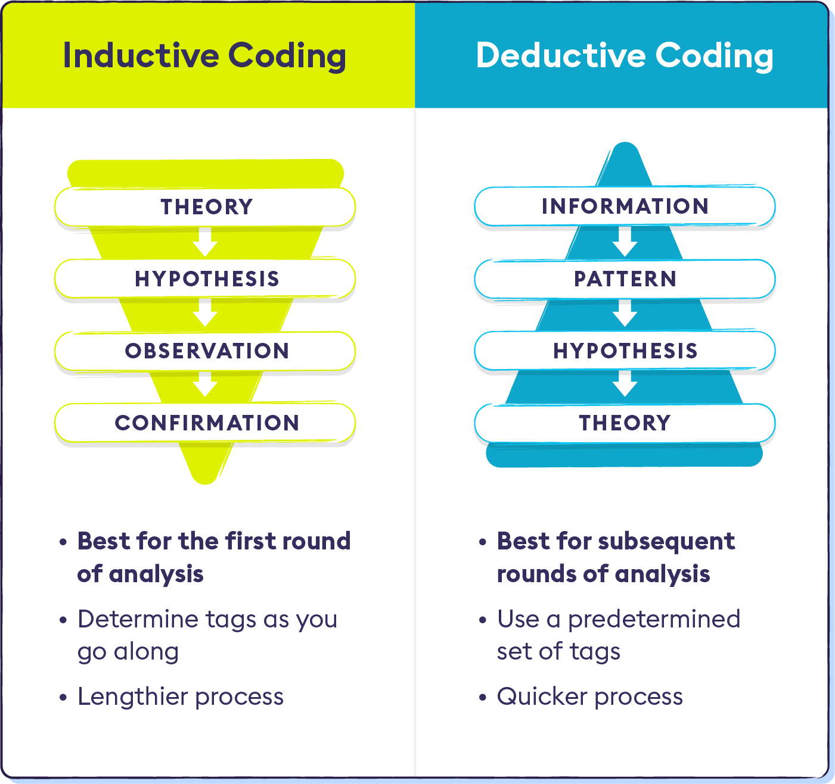
Through a directed (inductive) content analysis, the scholars draft a preliminary coding scheme from pre-existing theory or assumptions.
While with the conventional (deductive) content analysis approach, the initial coding scheme developed from the data.

Slide 108
Computer aided CODING
BASIC CODING TECHNIQUIES IN ATLAS.TI (https://atlasti.com/)
Create a new code
Apply (existing) codes
In-vivo coding
Quick coding
Tutorial: https://www.youtube.com/watch?v=TUZpXEySp1U

Slide 109
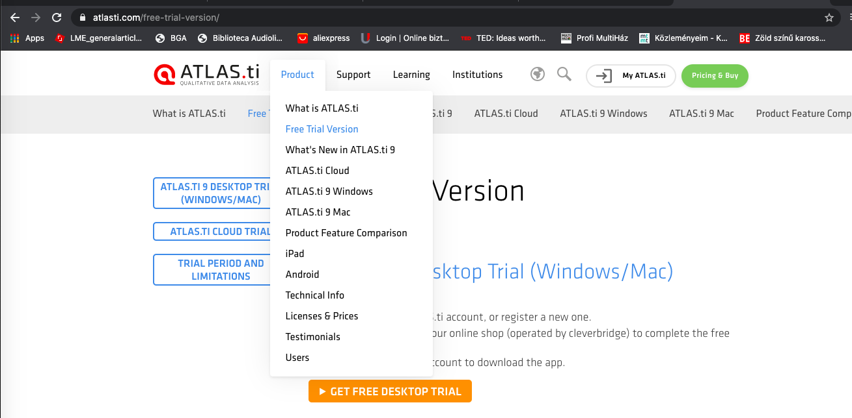
Creat an Account (free Trial)

Slide 110
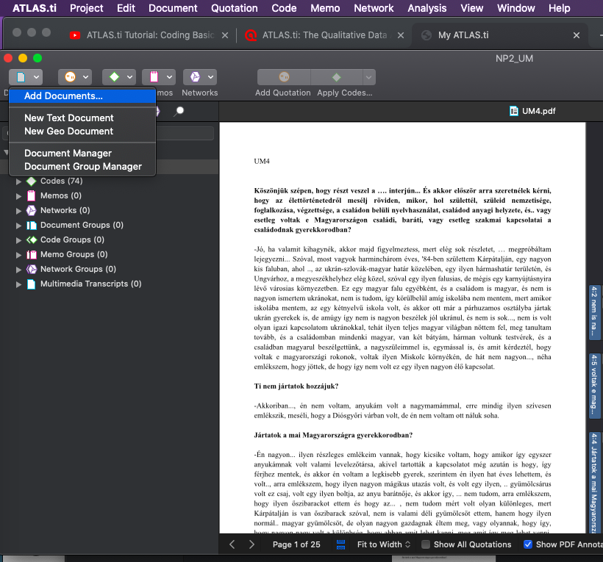
ADD document (rTX, PDF)

Slide 111
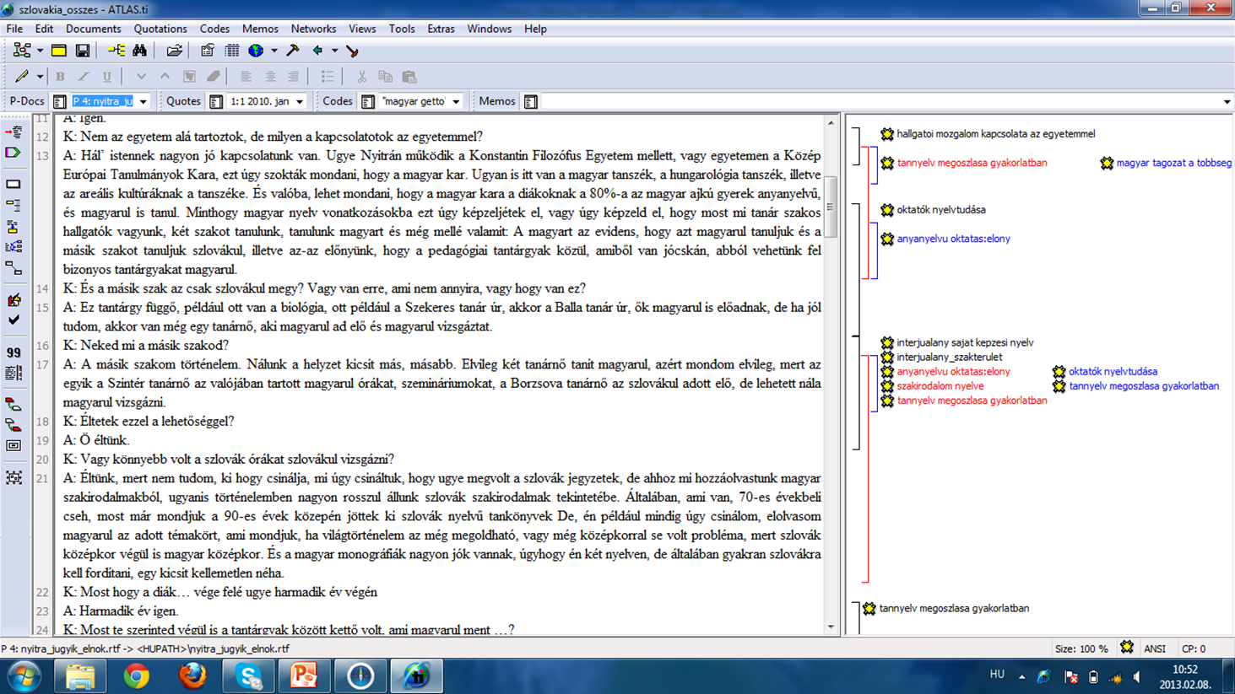

Slide 112
Code manager
Kárpátalja (15 interjú) |  | Dél-Szlovákia (12 interjú)
Többségi nyelv ismerete Munkaerő-piaci átmenet A tannyelv gyak. megoszlása Munkaerőpiac: nyelvtudás Oktatók nyelvtudása Nyelvoktatás a felsőoktatásban Idegen nyelv Oktatás minősége Mobilitás Támogatáspolitika Anyanyelvi oktatás: erősségek Többségi állam - régió viszony Szaknyelvoktatás Hallgatók nyelvi tudatossága Emeltszintű érettségi ukránból Oktatók tudományos fokozata | 62 61 48 45 37 33 28 28 27 23 21 21 21 20 19 19 | Szakválaszték A tannyelv gyak. megoszlása Oktatók nyelvtudása Idegen nyelv Tannyelvpolitikai elvek Munkaerő-piaci átmenet Többségi nyelv ismerete Létszámadatok Pedagógusképzés Nyelvoktatás a felsőoktatásban Hallgatók nyelvi tudatossága Munkaerőpiac: nyelvtudás Demográfiai hullámvölgy Magyarság társadalmi igényei Akkreditáció Magyar tannyelvű felsőoktatás Mobilitás Oktatók tudományos fokozata | 51 51 46 42 42 37 33 33 31 31 28 26 26 24 21 21 21 19

Slide 113
Relation between Codes – hierarchy
Nyelvi dimenzió, 9 kód, 88 interjúrészlet
Oktatásfejlesztési dimenzió, 12 kód, 113 interjúrészlet
Oktatáspolitikai dimenzió, 13 kód, 121 interjúrészlet

Slide 114
Relevant TASK
(3) Critical analysis of relevant academic literature: writing a literature review (600 words) for the selected problem (November 15)
(4) Data analysis: make an individual sample of qualitative or quantitative analysis (November 30)

Slide 115
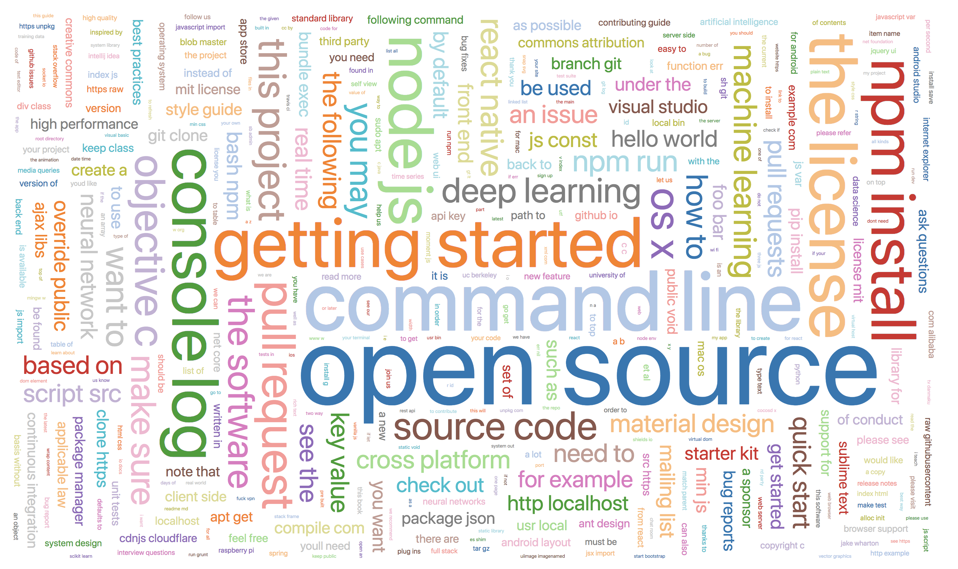
Visualisation of textual data?

Slide 116
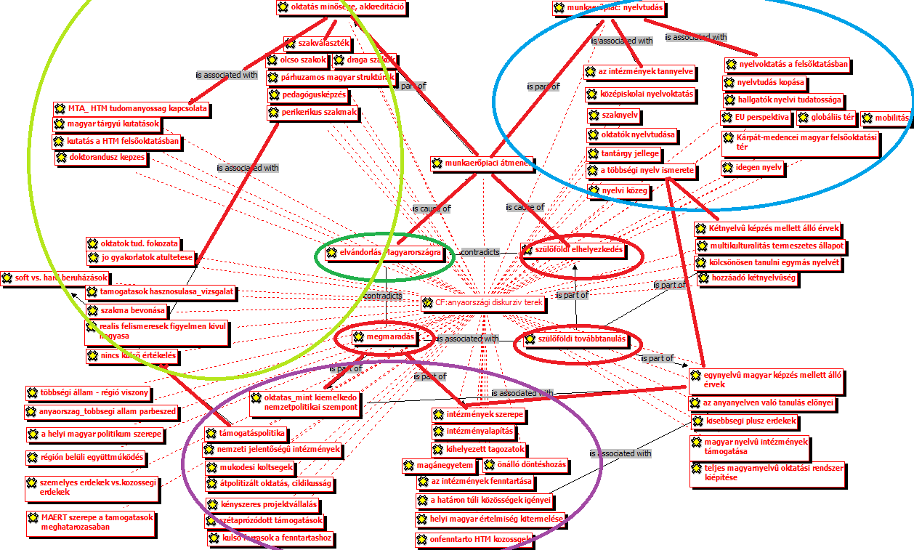

Slide 117
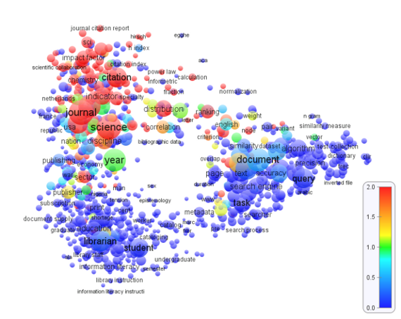

Slide 118

Barabási Albert-László
https://barabasi.com/publications

Slide 119
Mixed methods
TOPIC 13

Slide 120
Mixed methods study
‘Mixed methods’ is a research approach whereby researchers collect and analyse both quantitative and qualitative data within the same study.
It is fashionable and can be superior to investigation produced either by qualitative or quatitative approach alone (mono-method).
Mixed methods research requires a purposeful mixing of methods in data collection, data analysis and interpretation of the evidence.

Slide 121
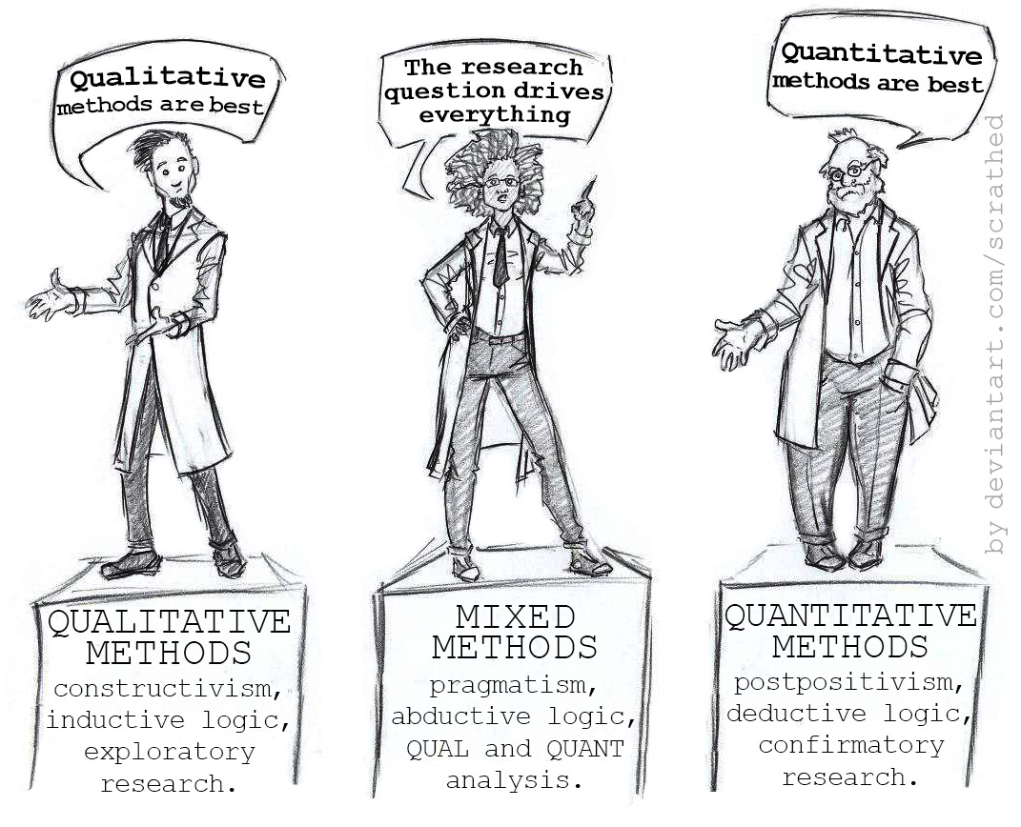

Slide 122
A popular ‘Umbrella’ term
All the terms below refer to the same concept:
Multitrait-multimethod research
Interrelating qualitative and quatitative data
Methodological triangulation
Multimethodological research

Slide 123
The purpose of the Mixed methods approach
Expanding the understanding of a complex issue
Validating findings through ‘triangulation’
Reaching multiply audiences

Slide 124
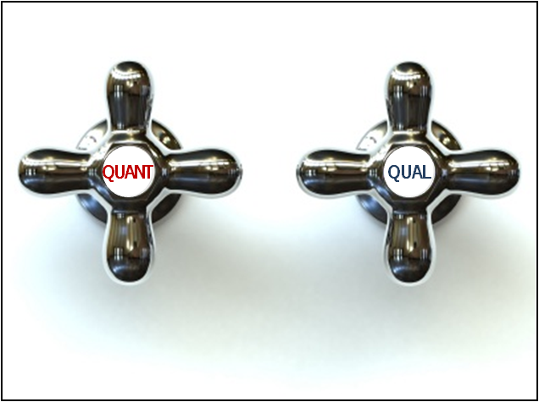
Main types of MIXED METHods design
The two most widely accepted typological principles are:
Sequence (concurrent or sequental collection of data)
Dominance (dominant and less dominant, degree of priority)

Slide 125
9 types
QUAL + QUAN
QUAL + quan
QUAN +qual
QUAN → QUAL
QUAL → QUAN
quan → QUAL
qual → QUAN
QUAN → qual
QUAL → quan
UPPERCASE – dominant
lowercase – less dominant
A plus sign (+) represents concurrent collection of data
An arrow (→) represents a sequential collection of data

Slide 126
The structure of a publication
TOPIC 14

Slide 127
Typical questions included on Referee’s Evaluation Forms for scientific journals
1. Is the contribution new?
2 . Is the contribution significant?
3. Is it suitable for publication in this Journal?
4. Is the organisation acceptable?
5. Do the methods and the treatment of results conform to acceptable scientific standards?
6. Are all conclusions firmly based in the data presented?
7. Is the length of the paper satisfactory?

Slide 128
8. Are all illustrations required?
9. Are all the figures and tables necessary?
10. Are figure legends and table titles adequate?
11. Do the title and Abstract clearly indicate the content of the paper?
12. Are the references up to date, complete, and the journal titles correctly abbreviated?
13. Is the paper excellent, good, or poor?
See for example: https://en.wikipedia.org/wiki/List_of_applied_linguistics_journals

Slide 129
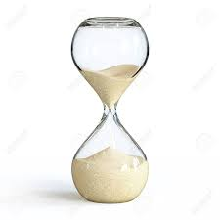
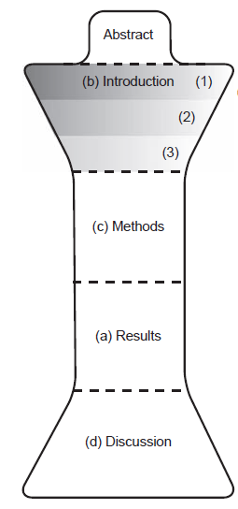
Notes:
Discuss: Does this hourglass shape also represent the understanding of a research article in your culture or workplace? If not, can you suggest a diagram that shows how your understanding of a research article is different?

Slide 130
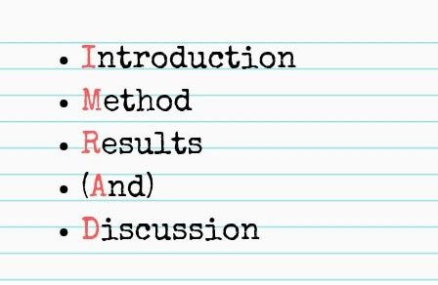
(A)IMRAD - structre

Slide 131
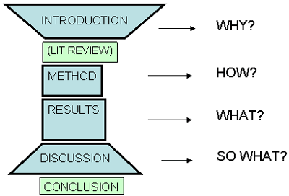
Why? HoW? what? So what?

Slide 132
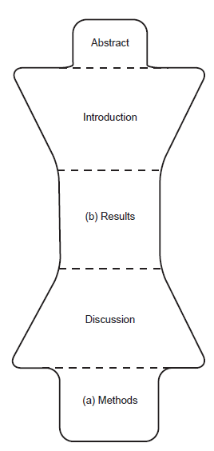
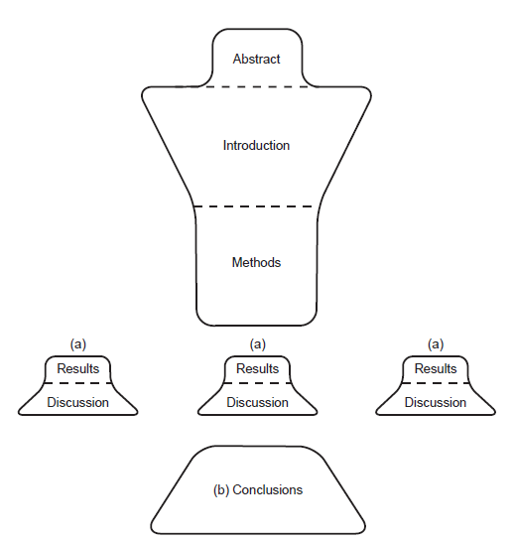
Possible alterations: changing order

Slide 133
1. Title
2. Author(s) and institution(s)
3. Abstract, key-words
4. Introduction
5. Methodology (Method)
6. Results
7. Discussion/Conclusion
8. References

Slide 134
Title
raise questions about the research in the mind of the reader: either attracts potential readers or dissuades them from reading the article
should give enough information to inform the reader what the study is about, indicate the „story” the results tell
there should be no doubt what issue is being investigated, clearly identify the field and the type of the research (e.g. primary research or overview)

Slide 135

Good title: Tsang (1996) “Comparing the Effects of Reading and Writing on Writing Performance.”
Less good title: Zhongganggao (2001) “Second Language Learning and the Teaching of Grammar”
Too long: De Groot & Poot (1997): Word Translation at Three Levels of Proficiency in a Second Language: The Ubiquitous Involvement of Conceptual Memory

Slide 136
3 criteria to look for in the title:
focus of the study
type of article
succinctness
Notes:
In summary, the three criteria to look for in a title are: focus of the study, type of article, and succinctness. The first two are the most impor- tant because they quickly inform you whether the paper is what you are searching for. The third is more of a stylistic issue, which you should keep in mind if you ever have to entitle a paper of your own. Take time to do the following exercise to apply these criteria to some example titles that I have supplied, and then apply the criteria to other articles from your own search.

Slide 137

Abstract

Slide 138

Two basic characteristics:
Grabbing attention
Independent

Slide 139
Grabbing attention/ Sexy
An abstract is a short summary of a larger work, such as a dissertation or research paper.
It allows potential readers to quickly identify what your paper is about and decide if it’s worth reading.

Slide 140
Grabbing attention
It can be a real challenge to condense your whole dissertation into just a couple of hundred words, but the abstract will be the first (and sometimes only) part that people read, so it’s important to get it right.

Slide 141
Independent
It should be a completely independent, self-contained text, not an excerpt copied from your paper or dissertation.
It should be fully understandable on its own to someone who hasn’t read your full paper or related sources.

Slide 142

Light at the end of the tunnel
The abstract appears at the VERY BEGINNING of a document,
BUT it should be THE LAST THING YOU WRITE.

Slide 143
Short and coincise
Most abstracts are around 150-300 words, but the length depends on the requirements of your assignment —often you will be given a strict word limit.
A good abstract is short but impactful, so make sure every word counts.
Avoid unnecessary filler words, and avoid obscure jargon that requires explanation.

Slide 144
Main challange: writing shortly
Avoid passive sentences
Avoid the noun style
Avoid long sentences
Avoid repetition
Avoid detailed descriptions
Only include the main elements
Source: https://www.scribbr.com/academic-writing/shorten-abstract-summary/

Slide 145
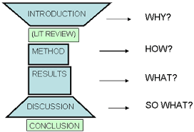
A miniature
The easiest approach to writing an abstract is to imitate the structure of the larger work—think of it as a miniature version of your dissertation or research paper.

Slide 146
An abstract should include
A statement of your main topic, purpose and objectives
A brief description of the methodology
An overview of the most significant findings or arguments
A summary of your conclusions and recommendations

Slide 147
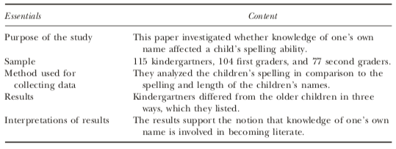
Abstract analysis grid

Slide 148
which content belong to which part?
Generally speaking, the main reasons behind choosing Hungarian kindergartens are the better quality of the pedagogic work and the more sympathetic personnel. However, motivations differ according to the nationality of the parents: Ukrainian families would like that their children learn the Hungarian language, ethnically mixed pairs choose according to inner and outer quality aspects of the kindergarten, while for the Hungarian parents the most important thing is to prepare their children for the Hungarian-medium school.
The paper examines the tendencies of kindergarten and school choice in Transcarpathia in the 2017–2018 academic year….
To conclude we can establish that
… the survey points out that the post Euromaidan political and economic crisis overwrites the actual nationalist discourses in the Ukrainian education and language policy: not only parents of Hungarian homogeneous marriages choose Hungarian kindergartens and schools, but also their counterparts of ethnically heterogeneous and Ukrainian homogeneous marriages follow the same strategy.
Based on 407 questionnaires, the survey points out …

Slide 149

Keywords

Slide 150
Introduction
the brains of the study
We should find:
the topic being investigated
why it is important enough to be studied
the research question
any theory being considered
any hypothesis being proposed
constructs and special terminology should be defined
Notes:
The introduction is the brains of the study. In it we should find the topic be- ing investigated, why it is important enough to be studied, the research question, any theory being considered, any hypothesis being proposed, and any predictions made. In addition, constructs and special terminology should be defined that will be used throughout the study.
Typically, the introduction should provide historical context to the issue being investigated and bring in any theory that may be relevant to the reader. Often this is referred to as the literature review of the study (although not nec- essarily referred to as such), in that it summarizes and references a number of articles to introduce the reader to the study. However, this is not a litera- ture review, such as referred to in chapter 2, which is a complete document that provides a broad overview of research and thinking on a given area. Rather, a literature review within the introduction of a study is a highly or- chestrated, logical argument consisting of a number of statements to provide the reasoning behind the study. With each statement, a study is summarized and/or referenced for support of the statement. At the end of the argument, there should be a conclusion in the form of at least one research question and possibly a hypothesis or several hypotheses. Hypotheses, in turn, should be operationally defined and translated into predictions.

Slide 151
Literature review - a highly orchestrated, logical argument consisting of a number of statements to provide the reasoning behind the study
with each statement, a study is summarized and/or referenced for support of the statement
each statement needs to be supported by findings from at least one study
if no support is provided, the statement is no more than a hypothesis and needs to be tested
E.g. “Women are better language learners than men”
The support for each statement will be in the form of at least one reference to a study
Statements without support weaken the overall argument
Notes:
In the discipline of logic (Giere, 2004), a statement is either true or false and is used in a logical argument as one of the premises of the argument (see Appendix B for a more detailed explanation). Each statement needs to be supported by findings from at least one study to warrant the statement as a premise of the argument. If no support is provided, the statement is no more than a hypothesis and needs to be tested before it can be used as a premise in any argument. For example, if I want to make the statement “Women are better language learners than men” as one of the premises of my argument, I had better cite at least one study to back this up. If there is no primary research to back this statement up, it cannot be used as one of the premises of my argument. It becomes a hypothesis that needs to be tested in a study of its own.
The support for each statement will be in the form of at least one refer- ence to a study that you can look up to see whether the statement has sup- port. If there is no reference to a study after a statement, the statement should be treated with suspicion. Statements without support weaken the overall argument.

Slide 152
Referees are likely to look here for evidence to answer the following questions
Is the contribution new?
Is the contribution significant?
Is it suitable for publication in the journal?
Notes:
As your primary reading audience of editor and referees will probably start reading at the Introduction, an effective Introduction is particularly important.
Referees are likely to look here for evidence to answer the following questions
Applied linguistics researchers have identified five main stages that commonly appear in research article Introductions (Figure 8.1). These stages have been
identified through analyzing many published articles, and interesting variations have been found across different subdisciplines of science. However, for our
purposes in this book, the five broad stages give us a useful framework that is flexible enough to be applicable in most contexts. But please remember that they do not represent a recipe to be followed unreflectively; rather, they provide a pattern for you to test on papers in your own field, and to refine into a useful tool for your own use.
These stages do not always occur strictly in the order given in Figure 8.1, and some may be repeated within a given Introduction. For example Stage 2/Stage 3 sequences often recur when an author wants to justify specific aspects or components of a study. To help you see what we mean by these stages, we first ask you to read the article introduction presented in Table 8.1 and consider our identification of the stages and their locations.

Slide 153
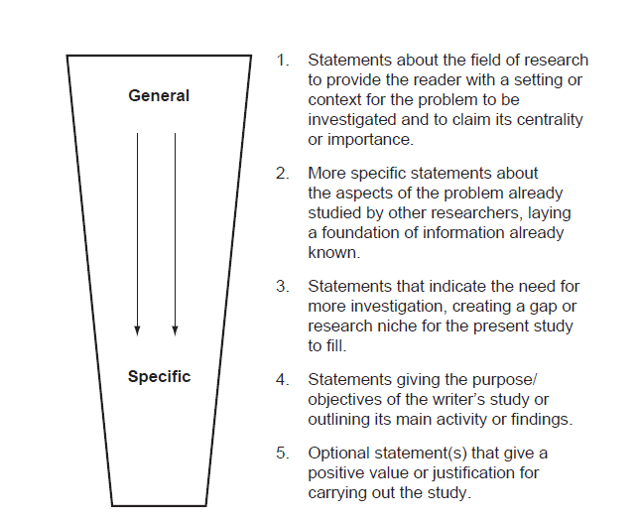
Notes:
Applied linguistics researchers have identified five main stages that commonly appear in research article Introductions (Figure 8.1). These stages have been
identified through analyzing many published articles, and interesting variations have been found across different subdisciplines of science. However, for our
purposes in this book, the five broad stages give us a useful framework that is flexible enough to be applicable in most contexts. But please remember that they do not represent a recipe to be followed unreflectively; rather, they provide a pattern for you to test on papers in your own field, and to refine into a useful tool for your own use.
These stages do not always occur strictly in the order given in Figure 8.1, and some may be repeated within a given Introduction. For example Stage 2/Stage 3 sequences often recur when an author wants to justify specific aspects or components of a study. To help you see what we mean by these stages, we first ask you to read the article introduction presented in Table 8.1 and consider our identification of the stages and their locations.

Slide 154
Stage 1. Locating your project within an existing field of scientific research
begin with broad statements
present tense
present perfect tense
broad, general statements - one sub-area of the field - the authors’ own particular topic
Old information – new information
Notes:
that would generally be accepted as fact by the members of their reading audience
The present tense is often used for this kind of statement because one function of the present tense in English is expressing information perceived as always true. Sentences written in the present perfect tense are also common in Stage 1, expressing what has been found over an extended period in the past and up to the present.
One way to think about this is to begin in a selected country and imagine you are moving from that country (the broad area where the Introduction begins)
and zooming in on a province in that country, and finally focusing on a particular city, which represents the topic area of research to be presented in the paper.

Slide 155
Using references in Stages 2 and 3
Selected literature
- to justify
- construct a gap or niche for your work (however or although, little information, few studies, unclear, or needs further investigation)
Literature – all the published research articles, review articles, and books in a given field;
Information published on websites that have been peer-reviewed or belong to organizations with appropriate scientific reputations.
Notes:
Niché - keret

Slide 156
References and citations
1. Information prominent citation
Shrinking markets are also evident in other areas.* The wool industry is experiencing difficulties related to falling demand worldwide since the development of high-quality synthetic fibres (Smith 2000).
2. Author prominent citation style 1
Shrinking markets are also evident in other areas. As Smith (2000) pointed out, the wool industry is experiencing difficulties related to falling demand worldwide since the development of high-quality synthetic fibres
Notes:
*This first sentence is a ‘‘topic sentence’’ for the paragraph: its function here is to form a link to the previous paragraph (which discussed shrinking markets), and to alert the reader to the topic of the current paragraph. Topic sentences are an effective way of creating logical flow in science writing.

Slide 157
3. Author prominent citation style 2
Shrinking markets are also evident in other areas. Smith (2000) argued that the wool industry was experiencing difficulties related to falling demand worldwide since the development of high-quality synthetic fibres. However, Jones et al. (2004) found that industry difficulties were more related to quality of supply than to demand issues. It is clear that considerable disagreement exists about the underlying sources of these problems.
4. Weak author prominent citation
Several authors have reported that the wool industry is experiencing difficulties related to falling demand since the development of high-quality synthetic fibres (Smith 2000; Wilson 2003; Nguyen 2005). For example, Smith (2000 ) highlighted .
5. Citing when you cannot obtain the original reference
[The finding or fact you want to cite] (Smith 1962, cited in Jones 2002)
Notes:
However, there is a danger attached to the author prominent style. If it is over-used, it can make the text sound like a list, rather than a logically
constructed argument. We recommend that you use this style sparingly, perhaps when you are approaching the specifics of the gap your study will address.

Slide 158
References and citations
The important thing to watch for is that it is clear to your reader whether the idea or fact you are using in each and every sentence is your own, or has come from the work of another person.
Inverted commas (‘‘ . . . ’’) are extremely rare in science writing
Paraphrase!

Slide 159
Stage 4: The statement of purpose or main activity
aim or purpose of the study to be reported
flexibility
keep a list of possible wordings
begin writing with Stage 4, as defining the aim of the study

Slide 160
Editing for logical flow
Strategy 1: Always introduce ideas
Strategy 2: Move from general information to more specific information
Strategy 3: Put old (or given) information before new information
Strategy 4: Make a link between sentences within the first seven to nine words
Strategy 5: Try to include the verb and its subject in the first seven to nine words of a sentence

Slide 161
Methodology
the skeleton of the study
If it is well written, others should be able to replicate the study exactly
The ability to replicate a study is the principal criterion used to judge the quality of this component of a research report
It tells us:
who was studied, what was studied, and how the information was collected and analyzed
Notes:
The methodology (or method) section consists of the skeleton of the study. If it is well written, others should be able to replicate the study exactly. The ability to replicate a study is the principal criterion used to judge the quality of this component of a research report.
The methodology section tells us who was studied, what was studied, and how the information was collected and analyzed. The following outline lists the typical subsections found under this heading. Studies vary in what sub- sections they include under the methodology section, but the information contained in the following subsections should be presented in some manner.

Slide 162
Sample
Research design
treatment(s) (optional)
techniques (optional)
materials (optional)
Data-collection procedures
instruments (optional)
observational methods
Procedures followed

Slide 163
Sample
describes the participants/subjects or the objects of the study
It should also explain the rationale used for selecting the participants so that the reader may be able to assess whether the resulting data are valid for the purpose of the study
Notes:
Sample. This subsection of the methodology section describes the participants/subjects or the objects of the study from which the data were gathered. A well-written sample section provides as much detail as needed about the participants/objects. It should also explain the rationale used for selecting the participants so that the reader may be able to assess whether the resulting data are valid for the purpose of the study.
In a study using participants, for example, Zahar, Cobb, and Spada (2001) described their participants as 144 Grade 7 male ESL students. They continued by providing information about the fact that they had been placed in different ESL levels, how much class time they had completed prior to the study, and their language background. With this information, the reader can decide whether the results of the study are applicable to the question under consideration.

Slide 164
Research design
explains the overall structural design used in the study
In a well-written design section, the variables of the study are clearly identified and defined. the term construct is usually replaced by the term variable
Notes:
The research design subsection, often referred to as design, explains the overall structural design used in the study. There are a number of designs available, and each one has its appropriate use. Each has its strengths and weaknesses depending on how well the data answer the re- search question(s). In a well-written design section, the variables1 of the study are clearly identified and defined. In fact the term construct is usually replaced by the term variable. If something does not vary, it is not a variable. For example, language ability is a construct that varies (i.e., people vary in language abil- ity). Therefore, it is referred to as variable when used in a study, regardless of whether the word construct is used. Gender is a variable in that it has two possibilities: male and female. Examples of other possible variables are na- tionality, language proficiency, method of instruction, and so on.

Slide 165
Data-Collection Procedures
Explains in detail how the information is collected for the purpose of a research study.
Most studies involve either instruments and/or observational procedures.
Notes:
This subsection explains in detail how the information is collected for the purpose of a research study. Most studies in- volve either instruments and/or observational procedures.

Slide 166
Procedure
a detailed explanation of how the complete study was executed
it describes when and how the treatments (if any) were administered, when and how the instruments (if any) were given, and/or when and how observation methods were used
main criterion for judging the quality of this subsection is whether we have enough information to replicate the study if need be
Notes:
This subsection is a detailed explanation of how the complete study was executed. In some studies, the data-collection pro- cedure subsection and this section are the same. The procedures subsecttion describes when and how the treatments (if any) were administered, when and how the instruments (if any) were given, and/or when and how observation methods were used. The main criterion for judging the quality of this subsection is whether we have enough information to replicate the study if need be. I

Slide 167
Results
The results of any data analysis are given
The strengths and weaknesses of a study can often be found in the choice of a data analysis procedure that affects the results
Notes:
In this section, the results of any data analysis are given. Depending again on the nature of the research design, different methods are used to try to make sense out of the data. One common method is to use statistics. Often many readers jump over this section, thinking it is only for the mathematically inclined. However, one of my goals in chapter 7 is to help the consumer of research not to be intimidated by strange Greek symbols, tables full of numbers, and graphs full of lines.
Not all studies have results sections filled with statistics. In some studies, what I later refer to as qualitative studies, the results section contains verbal data consisting of detailed descriptions of what was observed. Researcher(s) spend extended amounts of time gathering large quantities of verbal data, with the main purpose of identifying patterns and trends that will guide in answering the research questions of the study. Occasionally, some descriptive statistics are used to help illustrate these patterns. More is said about the issues involved in this type of analysis in chapter 7.
The results section of a study is important and should not be avoided. The strengths and weaknesses of a study can often be found in the choice of a data analysis procedure that affects the results. Conclusions based on faulty results cannot be used to answer our research questions. Chapter 7 expands the results section more. It compares how verbal and numerical data are treated and the criteria that need to be used when evaluating whether they have been properly used.

Slide 168
„Story” – the key driver of an article
♦ main points of your results
♦ focus on your tables and figures
Aim to reach agreement on:
♦ which data should be included;
♦ what are the important points that form the story of the paper;
♦ what is/are the take-home message or messages.

Slide 169
Questions to focus on in the drafting process
1 What do my results say? (two sentences maximum, a very brief summary of the main points, no background!)
2 What do these results mean in their context? (i.e. what conclusions can be drawn from these results?)
3 Who needs to know about these results? (i.e. who specifically forms the audience for this paper you are going to write?)
4 Why do they need to know? (i.e. what contribution will the results make to ongoing work in the field? Or, what will other researchers be missing if they haven’t read your paper?)

Slide 170
Designing figures
Determine the design elements you want in the figure.
Consider:
♦ which variable needs to have the most prominent symbol or line (heaviest line weighting);
♦ whether you want to emphasize differences or similarities between elements; and
♦ what scale, scale intervals, maximum and minimum values, and statistical representations are most meaningful.

Slide 171
- be consistent!
- keep figures free from clutter!
- shrink your figures to the standard style!
Figures are most appealing to the eye when they
♦ have 3:2 proportions;
♦ are boxed when there is relatively little ink in the figure; or
♦ are unboxed if there are numerous lines, bars or columns.
Weaknesses:
♦ the wrong figure type has been chosen and relationships between elements are not obvious when they are important or are apparent when they do not exist;
♦ weak descriptive titles are used when a story-telling title would be appropriate;

Slide 172
♦ data already shown in the text or tables are repeated in the figure;
♦ the shape, shading, pattern or weight of symbols, markers, or lines does not emphasize the main results or the story of the figure;
♦ the figure is unnecessarily cluttered with lines, legend symbols, numbers, or poorly chosen axis scale divisions;
♦ axes are not labelled descriptively or are labelled with the jargon of the scientific subdiscipline or research group;
♦ numbers are included when the exact values are not important to the story and the approximate values can be derived from the x and y axes; and
♦ data categories are not sorted to show priorities or important relationships between elements or the design of related figures is not consistent enough to allow rapid appraisal.

Slide 173
♦ highlight the most important information most prominently;
♦ be essential to telling and supporting the story with evidence;
♦ be clear and consistent in style and do not duplicate data already presented.

Slide 174
Designing tables
- keep tables free from clutter!
- define abbreviations!
- don’t box tables!
- use horizontal lines as separators and space to separate columns.
Weaknesses:
♦ weak descriptive titles are used when a story-telling title would be appropriate;
♦ inclusion of unnecessary or redundant data (e.g. data that are not referred to in the text and do not contribute to the story, or columns of a known constant);

Slide 175
♦ inclusion of non-significant or over-precise numbers (which lead to a false sense of accuracy or clutter, respectively);
♦ omission of data necessary for the reader to make important calculations from experimental data (omitted from either the tables or text);
♦ table not arranged to highlight the most significant results;
♦ data not sorted to show important relationships between elements.

Slide 176
Figure legends and table titles
1 A title which summarizes what the figure is about.
2 Details of results or models shown in the figure or supplementary to the figure.
3 Additional explanation of the components of the figure, methods used, or essential details of the figure’s contribution to the results story.
4 Description of the units or statistical notation included.
5 Explanation of any other symbols or notation used.

Slide 177
Writing about results
- highlight the main points
- do not repeat in words all the results from the tables or figures
Functions of results section:
♦ to highlights the important findings;
♦ to locate the figure(s) or table(s) where the results can be found;
♦ to comment on (but not to discuss) the results.

Slide 178
Highlight+location e.g.:
Measurements of root length density (Figure 3) revealed that the majority of roots of both cultivars were found in the upper substrate layers.
The response of lucerne root growth to manganese rate and depth treatments was similar to that of shoots (Figure 2).
Location:
Figure 17 shows the average number of visits per bird.

Slide 179
Discussion
Discussion Introduction
iI is not necessary to include in the Introduction all the literature that will be referred to in the Discussion

Slide 180
Checklist
1. A reference to the main purpose or hypothesis of the study, or a summary of the main activity of the study.
2. A restatement or review of the most important findings, generally in order of their significance, including
i whether they support the original hypothesis, or how they contribute to the main activity of the study, to answering the research questions, or to meeting the research objectives; and
ii whether they agree with the findings of other researchers

Slide 181
3 Explanations for the findings, supported by references to relevant literature, and/or speculations about the findings, also supported by literature citation.
4. Limitations of the study that restrict the extent to which the findings can be generalized beyond the study conditions.
5. Implications of the study (generalizations from the results: what the results mean in the context of the broader field).
6. Recommendations for future research and/or practical applications.

Slide 182
TASK 3:Critical analysis of relevant academic literature: writing a literature review (600 words) for the selected problem (November 15)
Next seminar: November 19

Slide 183
Sources
Check these resources:
http://alkalmazottnyelvtudomany.hu/en/issue-xx-2020-1/
https://bgazrt.hu/nemzetpolitikai-kutatointezet/folyoiratok/hungarian-journal-of-minority-studies/ https://bgazrt.hu/nemzetpolitikai-kutatointezet/folyoiratok/minority-studies-2012-2015/
Or use other

Slide 184
Legal and ethical aspects of research
TOPIC 15

Slide 185
The relationship between research and education
TOPIC 16

Slide 186
active participation of the students in the following tasks:
(1) Defining research problems: writing a 300-word research proposal giving (a minimum of 4) reasons why students think it is a good research problem (September 30).
(2) Designing research methods: design a mini questionnaire or an interview guide (October 15)
(3) Critical analysis of relevant academic literature: writing a literature review (600 words) for the selected problem (November 15)
(4) Data analysis: make an individual sample of qualitative or quantitative analysis (November 30)
(5) Reporting the results: writing a well structured (IMRAD) research report (December 15)
(6) A final exam.

