Slide 1
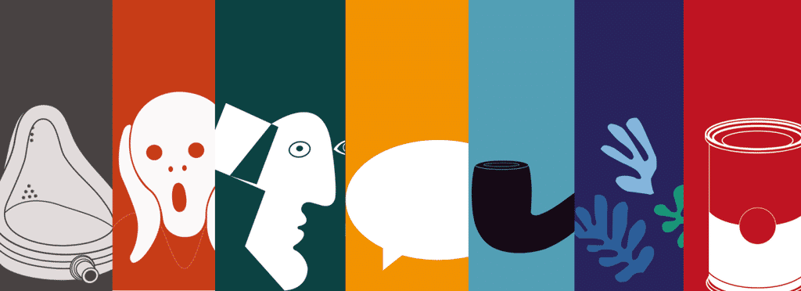
Modernism. The ideas of modernism. Imagism. Traditionalism. Fantasy, realism and experimentalism.

Slide 2
Modernism
Modernism, in the fine arts, a break with the past and the concurrent search for new forms of expression. Modernism fostered a period of experimentation in the arts from the late 19th to the mid-20th century, particularly in the years following World War I.
In an era characterized by industrialization, rapid social change, and advances in science and the social sciences (e.g., Freudian theory), Modernists felt a growing alienation incompatible with Victorian morality, optimism, and convention. New ideas in psychology, philosophy, and political theory kindled a search for new modes of expression.

Slide 3
Modernism - Introduction
A series of reforming cultural movements in art and architecture, music, literature and the applied arts emerged in the three decades before 1914;
Encouraged the re-examination of every aspect of existence (e.g. commerce / philosophy);
Goal: finding which was "holding back" progress, + replacing it with new, progressive and better ways of reaching the same end;
New realities of the industrial and mechanized age: permanent and imminent;
World view: the new = the good, the true and the beautiful.

Slide 4
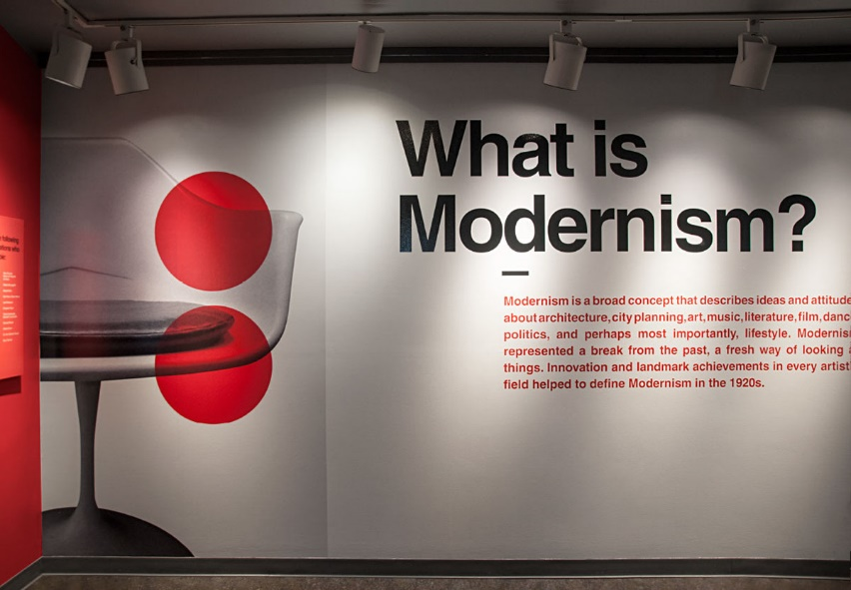
The ideas of modernism
Among the factors that shaped modernism were the development of modern industrial societies and the rapid growth of cities, followed by the horror of World War I.
Modernism was essentially based on a utopian vision of human life and society and a belief in progress, or moving forward.
Modernist ideals pervaded art, architecture, literature, religious faith, philosophy, social organization, activities of daily life, and even the sciences.

Slide 5
Modernism In Literature
The enormity of the war had undermined humankind’s faith in the foundations of Western society and culture, and postwar Modernist literature reflected a sense of disillusionment and fragmentation. A primary theme of T.S. Eliot’s long poem The Waste Land (1922), a seminal Modernist work, is the search for redemption and renewal in a sterile and spiritually empty landscape. With its fragmentary images and obscure allusions, the poem is typical of Modernism in requiring the reader to take an active role in interpreting the text.
Many Modernists wrote in free verse and they included many countries and cultures in their poems. Some wrote using numerous points-of-view or even used a “stream-of-consciousness” style. These writing styles further demonstrate the way the scattered state of society affected the work of writes at that time.

Slide 6
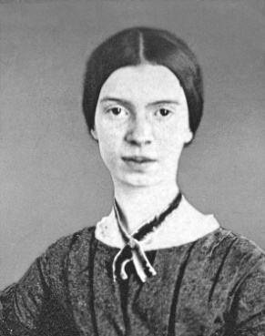
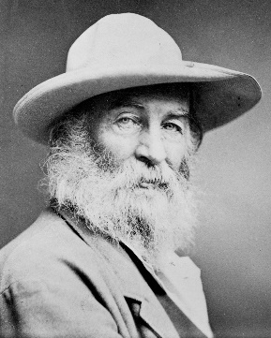
Emily Dickinson and Walt Whitman are thought to be the mother and father of the movement because they had the most direct influence on early Modernists. Some time after their deaths, the Imagist poets began to gain importance. The University of Toledo’s Canaday Center has a rich collection of poetry and critical work from that era.
Imagist poets generally wrote shorter poems and they chose their words carefully so that their work would be rich and direct. The movement started in London, where a group of poets met and discussed changes that were happening in poetry. Ezra Pound soon met these individuals, and he eventually introduced them to H.D. and Richard Aldington in 1911. In 1912, Pound submitted their work to Poetry magazine.

Slide 7
Imagism
After H.D.’s name, he signed the word "Imagiste" and that was when Imagism was publicly launched. Two months later, Poetry published an essay which discusses three points that the London group agreed upon. They felt that the following rules should apply when writing poetry:
1. Direct treatment of the "thing," whether subjective or objective.
2. To use absolutely no word that does not contribute to the presentation.
3. As regarding rhythm: to compose in the sequence of the musical phrase, not in sequence of a metronome.

Slide 8
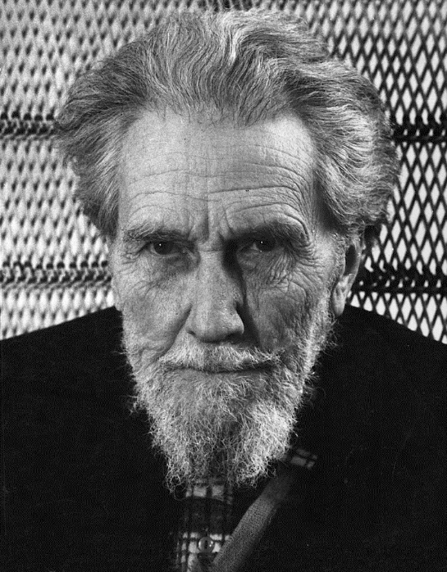
Imagism was born in England and America in the early twentieth century. A reactionary movement against romanticism and Victorian poetry, imagism emphasized simplicity, clarity of expression, and precision through the use of exacting visual images.
Though Ezra Pound is noted as the founder of imagism, the movement was rooted in ideas first developed by English philosopher and poet T. E. Hulme, who, as early as 1908, spoke of poetry based on an absolutely accurate presentation of its subject, with no excess verbiage.

Slide 9
Traditionalism
The fundamental Traditionalist principle is that truth, which includes morality, is both knowable and unchanging.
Traditional writers include acknowledged masters of traditional forms and diction who write with a readily recognizable craft, often using rhyme or a set metrical pattern.
Often they are from the U.S. Eastern seaboard or from the southern part of the country, and teach in colleges and universities. Richard Eberhart and Richard Wilbur; the older Fugitive poets John Crowe Ransom, Allen Tate, and Robert Penn Warren; such accomplished younger poets as John Hollander and Richard Howard; and the early Robert Lowell are examples. They are established and frequently anthologized.

Slide 10
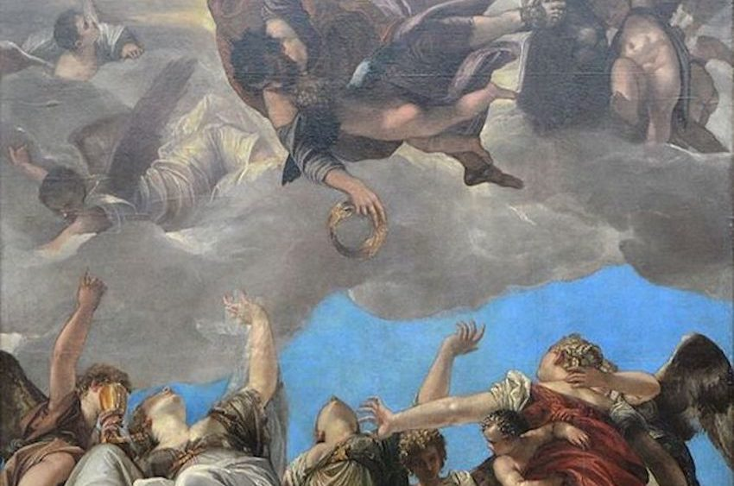
Traditionalist poets are generally precise, realistic, and witty; like Richard Wilbur (1921- ), they are often influenced in these directions by 15th- and 16th-century British metaphysical poets brought to favor by T.S. Eliot. Wilbur's most famous poem, "A World Without Objects Is a Sensible Emptiness" (1950), takes its title from Thomas Traherne, a metaphysical poet. Its vivid opening illustrates the clarity some poets have found within rhyme and formal regularity.
Traditional poets, unlike many experimentalists who distrust "too poetic" diction, welcome resounding poetic lines.

Slide 11
Fantasy
Fantasy literature is literature set in an imaginary universe, often but not always without any locations, events, or people from the real world. Magic, the supernatural and magical creatures are common in many of these imaginary worlds. Fantasy literature may be directed at both children and adults.
Fantasy is a subgenre of speculative fiction and is distinguished from the genres of science fiction and horror by the absence of scientific or macabre themes, respectively, though these genres overlap. Historically, most works of fantasy were written, however, since the 1960s, a growing segment of the fantasy genre has taken the form of films, television programs, graphic novels, video games, music and art.
A number of fantasy novels originally written for children and adolescents, such as Alice's Adventures in Wonderland, the Harry Potter series, The Lord of the Rings and The Hobbit also attract an adult audience.

Slide 12
Types of Fantasy
Medieval
Fantasy stories that are medievalist in nature; particularly focused on topics such as King Arthur and his knights, royal court, sorcery, magic, and so on. Furthermore, they are usually set in medieval times. They often involve human protagonists facing supernatural antagonists—opponents like fire-breathing dragons, evil witches, or powerful wizards.
High or epic fantasy
Set in a magical environment that has its own rules and physical laws, this subgenre’s plots and themes have a grand scale and typically center on a single, well-developed hero or a band of heroes, such as Frodo Baggins and his cohorts in J. R. R. Tolkien’s The Lord of the Rings (1954).

Slide 13
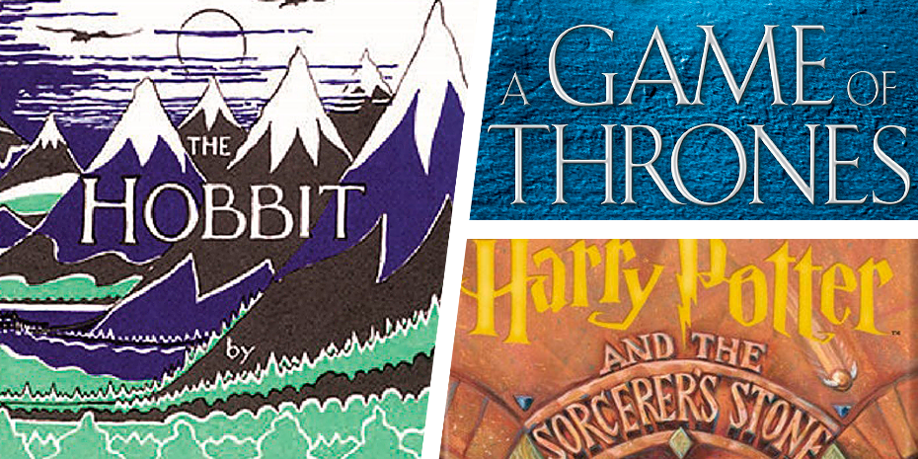
Low fantasy
Set in the real world, low fantasy includes unexpected magical elements that shock characters, like the plastic figurines come to life in Lynne Reid Banks’s The Indian in the Cupboard (1980).
Magical realism
While similar to low fantasy, magical realism characters accept fantastical elements like levitation and telekinesis as a normal part of their otherwise realistic world, as in Gabriel García Márquez’s classic One Hundred Years of Solitude (1967).
Sword and sorcery
A subset of high fantasy, it focuses on sword-wielding heroes, such as the titular barbarian in Robert E. Howard’s Conan pulp fiction stories, as well as magic or witchcraft.

Slide 14
Dark fantasy
Combining elements of fantasy and horror, its aim is to unnerve and frighten readers, like the gargantuan, otherworldly monsters in H. P. Lovecraft’s universe.
Fables
Using personified animals and the supernatural, fables impart moral lessons, like the stories in Aesop’s Fables and Arabian Nights.
Fairy tales
Intended for children, these fairy tales and folk tales are typically set in distant magical worlds (with beginnings like “Once upon a time, in a land far, far away…”) where trolls, dragons, witches, and other supernatural characters are an accepted truth, as in the Brothers Grimm’s Grimm’s Fairy Tales (1812).
Superhero fiction
Unlike stories in which a hero acquires special abilities through scientific means, such as exposure to radiation, these protagonists’ powers are supernatural.

Slide 15
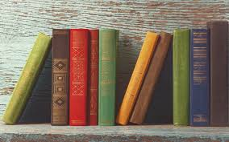
Realism
Literary movement that developed towards the end of the Civil War and stressed the actual (reality) as opposed to the imagined or fanciful.
Why did this literary movement come about?
• A reaction against Romanticism – rejected heroic, adventurous, or unfamiliar subjects.
• The harsh reality of frontier life and the Civil War shattered the nation’s idealism.

Slide 16
Elements of Literary Realism
Realistic characters and setting;
Comprehensive detail about everyday occurrences;
Plausible plot (a story that could happen in your town);
Real dialects of the area;
Character development important;
Importance in depicting social class;
Class is important; the novel has traditionally served the interests and aspirations of an insurgent middle class;
Diction is natural vernacular, not heightened or poetic; tone may be comic, satiric, or matter-of-fact.

Slide 17
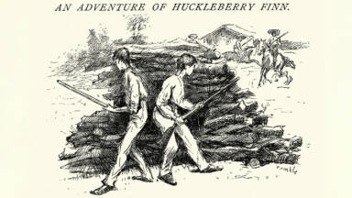
Types of Literary Realism
Magical realism - a unique subgenre with elements of magic woven into the realistic setting (One Hundred Years of Solitude)
Social realism - explores the lives of workers and poor, focusing on the working class; provides social commentary on the devastating conditions of these people (Of Mice and Men)
Naturalism - uses the scientific method and scientific principles to explore humans and their relationships (A Rose for Emily)
Psychological realism - dives into the psyche of the characters; rather than focusing on the plot, it looks more at the character’s thoughts and motivations (The Portrait of a Lady)

Slide 18
Experimentalism
Experimental literature is a genre that is, according to Professor Warren Motte of the University of Colorado in his essay Experimental Writing, Experimental Reading, "difficult to define with any sort of precision." He says the "writing is often invoked in an "offhand manner" and the focus is on "form rather than content."
It can be in written form of prose narrative or poetry, but the text may be set on the page in differing configurations than that of normal prose paragraphs or in the classical stanza form of verse.
It may also be entwined with images of a real or abstract nature, with the use of art or photography. Furthermore, while experimental literature was handwritten on paper or vellum, the digital age has seen an exponential leaning to the use of digital computer technologies.

Slide 19
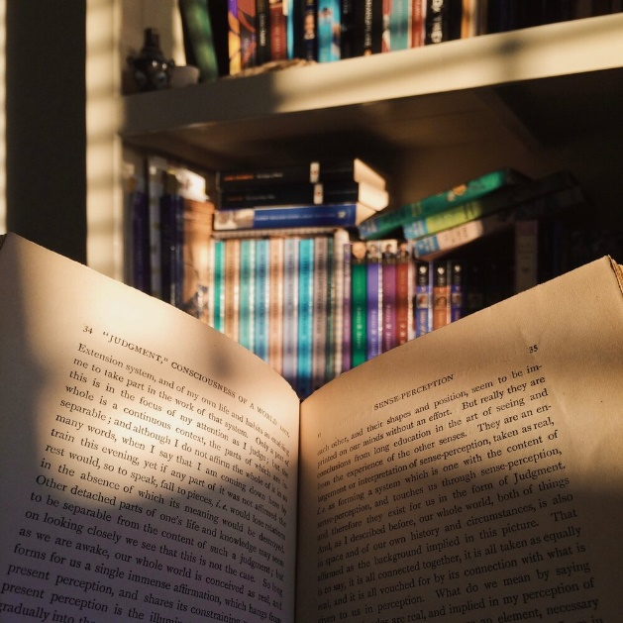
In the 1910s, artistic experimentation became a prominent force, and various European and American writers began experimenting with the given forms. Tendencies that formed during this period later became parts of the modernist movement.
The Cantos of Ezra Pound, the post-World War I work of T. S. Eliot, prose and plays by Gertrude Stein, were some of the most influential works of the time, though James Joyce's Ulysses is generally considered[according to whom?] the most important work of the time. The novel ultimately influenced not only more experimental writers, such as Virginia Woolf, but also less experimental writers, such as Hemingway.

Slide 20
The historical avant-garde movements also contributed to the development of experimental literature in the early and middle 20th century. In the Dadaist movement, poet Tristan Tzara employed newspaper clippings and experimental typography in his manifestoes. The futurist author F.T. Marinetti espoused a theory of "words in freedom" across the page, exploding the boundaries of both conventional narrative and the layout of the book itself as shown in his "novel" Zang Tumb Tumb.
Contemporary American authors David Foster Wallace, Giannina Braschi, and Rick Moody, combine some of the experimental form-play of the 1960s writers with a more emotionally deflating, irony, and a greater tendency towards accessibility and humor.
In the early 21st century, many examples of experimental literature reflect the emergence of computers and other digital technologies, some of them actually using the medium on which they are reflecting. Such writing has been variously referred to electronic literature, hypertext, and codework. Others have focused on exploring the plurality of narrative point of views, like the Uruguayan American writer Jorge Majfud in La reina de América and La ciudad de la luna.

