Slide 1

Postmodernism. ”The Angry Young People.”

Slide 2
Postmodernism
Postmodernism is a broad movement that developed in the mid- to late 20th century across philosophy, the arts, architecture, and criticism, marking a departure from modernism. The term has been more generally applied to describe a historical era said to follow after modernity and the tendencies of this era.
Postmodernism is generally defined by an attitude of skepticism, irony, or rejection toward what it describes as the grand narratives and ideologies associated with modernism, often criticizing Enlightenment rationality and focusing on the role of ideology in maintaining political or economic power. Postmodern thinkers frequently describe knowledge claims and value systems as contingent or socially-conditioned, framing them as products of political, historical, or cultural discourses and hierarchies.

Slide 3
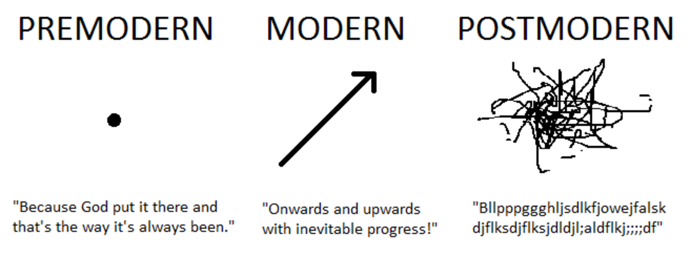
Postmodern critical approaches gained popularity in the 1980s and 1990s, and have been adopted in a variety of academic and theoretical disciplines, including cultural studies, philosophy of science, economics, linguistics, architecture, feminist theory, and literary criticism, as well as art movements in fields such as literature, contemporary art, and music.
Postmodernism is often associated with schools of thought such as deconstruction, post-structuralism, and institutional critique, as well as philosophers such as Jean-François Lyotard, Jacques Derrida, and Fredric Jameson.

Slide 4
Initially, postmodernism was a mode of discourse on literature and literary criticism, commenting on the nature of literary text, meaning, author and reader, writing, and reading.Postmodernism developed in the mid- to late-twentieth century across philosophy, the arts, architecture, and criticism as a departure or rejection of modernism.
Postmodernist approaches have been adopted in a variety of academic and theoretical disciplines, including political science, organization theory, cultural studies, philosophy of science, economics, linguistics, architecture, feminist theory, and literary criticism, as well as art movements in fields such as literature and music. As a critical practice, postmodernism employs concepts such as hyperreality, simulacrum, trace, and difference, and rejects abstract principles in favor of direct experience.
In 1996, Walter Truett Anderson described postmodernism as belonging to one of four typological world views which he identifies as:
(a) Postmodern-ironist, which sees truth as socially constructed.
(b) Scientific-rational, in which truth is defined through methodical, disciplined inquiry.
(c) Social-traditional, in which truth is found in the heritage of American and Western civilization.
(d) Neo-Romantic, in which truth is found through attaining harmony with nature or spiritual exploration of the inner self

Slide 5
Theories and derivatives
Structuralism and post-structuralism
Like structuralists, post-structuralists start from the assumption that people's identities, values and economic conditions determine each other rather than having intrinsic properties that can be understood in isolation. Postmodernist ideas in philosophy and in the analysis of culture and society have expanded the importance of critical theory.
Deconstruction
One of the most well-known postmodernist concerns is "deconstruction," a theory for philosophy, literary criticism, and textual analysis developed by Jacques Derrida. Critics have insisted that Derrida's work is rooted in a statement found in Of Grammatology: "Il n'y a pas de hors-texte" (there is no Outside-text). Such critics misinterpret the statement as denying any reality outside of books. The statement is actually part of a critique of "inside" and "outside" metaphors when referring to text, and is corollary to the observation that there is no "inside" of a text as well.

Slide 6
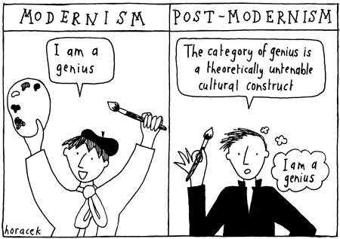
Post-postmodernism
The connection between postmodernism, posthumanism, and cyborgism has led to a challenge to postmodernism, for which the terms "postpostmodernism" and "postpoststructuralism" were first coined in 2003.
In some sense, we may regard postmodernism, posthumanism, poststructuralism, etc., as being of the 'cyborg age' of mind over body. Deconference was an exploration in post-cyborgism (i.e. what comes after the postcorporeal era), and thus explored issues of postpostmodernism, postpoststructuralism, and the like. To understand this transition from 'pomo' (cyborgism) to 'popo' (postcyborgism) we must first understand the cyborg era itself.

Slide 7
Postmodern literature
Postmodern literature is literature characterized by reliance on narrative techniques such as fragmentation, paradox, and the unreliable narrator; and is often (though not exclusively) defined as a style or a trend which emerged in the post–World War II era.
This style of experimental literature emerged strongly in the United States in the 1960s through the writings of authors such as Kurt Vonnegut, Thomas Pynchon, Kathy Acker, and John Barth. Postmodernists often challenge authorities, which has been seen as a symptom of the fact that this style of literature first emerged in the context of political tendencies in the 1960s.
Postmodern works are seen as a response against dogmatic following of Enlightenment thinking and Modernist approaches to literature.
Postmodern literature, like postmodernism as a whole, tends to resist definition or classification as a “movement”.

Slide 8
Postmodernism understands that grand narratives hide, silence and negate contradictions, instabilities and differences inherent in any social system. Postmodernism favours “mini-narratives,” stories that explain small practices and local events, without pretending universality and finality. Postmodernism realizes that history, politics and culture are grand narratives of the power-wielders, which comprise falsehoods and incomplete truths.
Postmodernism is one of those words that has made itself at home in our everyday language. Just think how often you've heard a movie or a book being described as "so postmodern." From Andy Warhol's pop art, to authors like Chuck Palahniuk and Douglas Coupland, to ultra-popular movies like Moulin Rouge, Scream, and Pulp Fiction, there's no getting around it: postmodernism has become part of our lives and our entertainment.

Slide 9
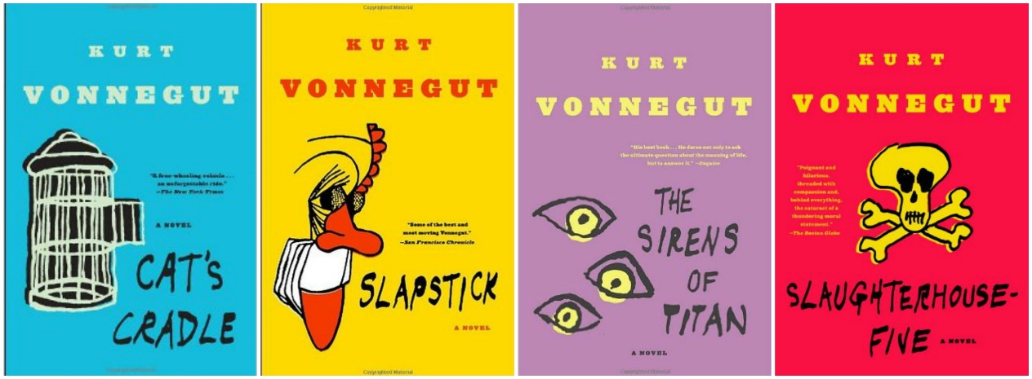
Common themes and techniques
Irony, playfulness, black humour
Linda Hutcheon claimed postmodern fiction as a whole could be characterized by the ironic quote marks, that much of it can be taken as tongue-in-cheek. This irony, along with black humor and the general concept of "play" (related to Derrida's concept or the ideas advocated by Roland Barthes in The Pleasure of the Text) are among the most recognizable aspects of postmodernism.
Intertextuality
Since postmodernism represents a decentered concept of the universe in which individual works are not isolated creations, much of the focus in the study of postmodern literature is on intertextuality: the relationship between one text (a novel for example) and another or one text within the interwoven fabric of literary history. Intertextuality in postmodern literature can be a reference or parallel to another literary work, an extended discussion of a work, or the adoption of a style.

Slide 10

Pastiche
Related to postmodern intertextuality, pastiche means to combine, or "paste" together, multiple elements. In Postmodernist literature this can be a homage to or a parody of past styles. It can be seen as a representation of the chaotic, pluralistic, or information-drenched aspects of postmodern society. It can be a combination of multiple genres to create a unique narrative or to comment on situations in postmodernity. For Example: Margaret Atwood uses science fiction and fairy tales.
Metafiction
Metafiction is essentially writing about writing or "foregrounding the apparatus", as it's typical of deconstructionist approaches, making the artificiality of art or the fictionality of fiction apparent to the reader and generally disregards the necessity for "willing suspension of disbelief." For example, postmodern sensibility and metafiction dictate that works of parody should parody the idea of parody itself.

Slide 11
Fabulation
Fabulation is a term sometimes used interchangeably with metafiction and relates to pastiche and Magic Realism. It is a rejection of realism which embraces the notion that literature is a created work and not bound by notions of mimesis and verisimilitude.
Poioumena
Poioumenon (plural: poioumena; from Ancient Greek: ποιούμενον, "product") is a term coined by Alastair Fowler to refer to a specific type of metafiction in which the story is about the process of creation.
Historiographic metafiction
Linda Hutcheon coined the term "historiographic metafiction" to refer to works that fictionalize actual historical events or figures; notable examples include The General in His Labyrinth by Gabriel García Márquez (about Simón Bolívar), Flaubert's Parrot by Julian Barnes (about Gustave Flaubert).

Slide 12
Temporal distortion
This is a common technique in modernist fiction: fragmentation and nonlinear narratives are central features in both modern and postmodern literature. Temporal distortion in postmodern fiction is used in a variety of ways, often for the sake of irony. Historiographic metafiction (see above) is an example of this. Distortions in time are central features in many of Kurt Vonnegut's nonlinear novels, the most famous of which is perhaps Billy Pilgrim in Slaughterhouse-Five becoming "unstuck in time".
Magic realism
Magic realism may be literary work marked by the use of still, sharply defined, smoothly painted images of figures and objects depicted in a surrealistic manner. The themes and subjects are often imaginary, somewhat outlandish and fantastic and with a certain dream-like quality.
Technoculture and hyperreality
Fredric Jameson called postmodernism the "cultural logic of late capitalism". "Late capitalism" implies that society has moved past the industrial age and into the information age. Likewise, Jean Baudrillard claimed postmodernity was defined by a shift into hyperreality in which simulations have replaced the real.

Slide 13
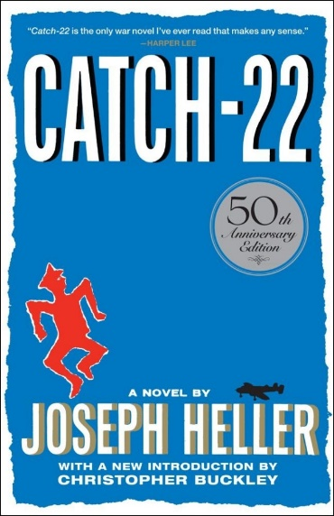

Paranoia
Perhaps demonstrated most famously and effectively in Heller's Catch-22, the sense of paranoia, the belief that there's an ordering system behind the chaos of the world is another recurring postmodern theme.
Maximalism
Dubbed maximalism by some critics, the sprawling canvas and fragmented narrative of such writers as Dave Eggers and David Foster Wallace has generated controversy on the "purpose" of a novel as narrative and the standards by which it should be judged. The postmodern position is that the style of a novel must be appropriate to what it depicts and represents.

Slide 14
Minimalism
Literary minimalism can be characterized as a focus on a surface description where readers are expected to take an active role in the creation of a story. The characters in minimalist stories and novels tend to be unexceptional. Generally, the short stories are "slice of life" stories. Minimalism, the opposite of maximalism, is a representation of only the most basic and necessary pieces, specific by economy with words. Among those categorized as postmodernist, literary minimalism is most commonly associated with Jon Fosse and especially Samuel Beckett.
Fragmentation
Fragmentation is another important aspect of postmodern literature. Various elements, concerning plot, characters, themes, imagery and factual references are fragmented and dispersed throughout the entire work. In general, there is an interrupted sequence of events, character development and action which can at first glance look modern. Fragmentation purports, however, to depict a metaphysically unfounded, chaotic universe. It can occur in language, sentence structure or grammar.

Slide 15
Many critics and scholars find it best to define postmodern literature against the popular literary style that came before it: modernism. In many ways, postmodern literary styles and ideas serve to dispute, reverse, mock and reject the principles of modernist literature.
For example, instead of following the standard modernist literary quest for meaning in a chaotic world, postmodern literature tends to eschew, often playfully, the very possibility of meaning. The postmodern novel, story or poem is often presented as a parody of the modernist literary quest for meaning. Thomas Pynchon's postmodern novel The Crying of Lot 49 is a perfect example of this. In this novel, the protagonist's quest for knowledge and understanding results ultimately in confusion and the lack of any sort of clear understanding of the events that transpired.

Slide 16
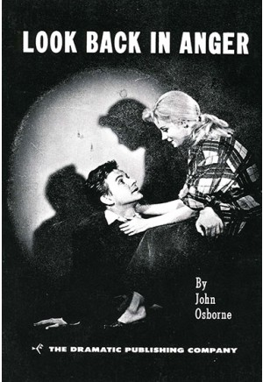
Angry Young Men
Angry Young Men, various British novelists and playwrights who emerged in the 1950s and expressed scorn and disaffection with the established sociopolitical order of their country. Their impatience and resentment were especially aroused by what they perceived as the hypocrisy and mediocrity of the upper and middle classes.
The group's leading figures included John Osborne and Kingsley Amis. The phrase was originally coined by the Royal Court Theatre's press officer in order to promote Osborne's 1956 play Look Back in Anger. It is thought to be derived from the autobiography of Leslie Paul, founder of the Woodcraft Folk, whose Angry Young Man was published in 1951.
Following the success of the Osborne play, the label "angry young men" was later applied by British media to describe young writers who were characterised by a disillusionment with traditional British society. The term, always imprecise, began to have less meaning over the years as the writers to whom it was originally applied became more divergent, and many of them dismissed the label as useless.

Slide 17
They shared an outspoken irreverence for the British class system, its traditional network of pedigreed families, and the elitist Oxford and Cambridge universities. They showed an equally uninhibited disdain for the drabness of the postwar welfare state, and their writings frequently expressed raw anger and frustration as the postwar reforms failed to meet exalted aspirations for genuine change.
When Sir Laurence Olivier played the leading role in Osborne’s second play, The Entertainer (1957), the Angry Young Men were acknowledged as the dominant literary force of the decade.
Their novels and plays typically feature a rootless, lower-middle or working-class male protagonist who views society with scorn and sardonic humour and may have conflicts with authority but who is nevertheless preoccupied with the quest for upward mobility.
Among the other writers embraced in the term are the novelists John Braine (Room at the Top, 1957) and Alan Sillitoe (Saturday Night and Sunday Morning, 1958) and the playwrights Bernard Kops (The Hamlet of Stepney Green, 1956) and Arnold Wesker (Chicken Soup with Barley, 1958). Like that of the Beat movement in the United States, the impetus of the Angry Young Men was exhausted in the early 1960s.

Slide 18
Some Postmodern works
Joseph Heller, Catch-22 (1961)
Kurt Vonnegut, Cat's Cradle (1963)
John Barth, Lost in the Funhouse (1968)
Thomas Pynchon, Gravity's Rainbow (1973)
Zadie Smith, White Teeth (2000)

Slide 19
After postmodernism
As it was mentioned before, post-postmodernism is a wide-ranging set of developments in critical theory, philosophy, architecture, art, literature, and culture which are emerging from and reacting to postmodernism. Another similar recent term is metamodernism.
Consensus on what constitutes an era can not be easily achieved while that era is still in its early stages.
However, a common theme of current attempts to define post-postmodernism is emerging as one where faith, trust, dialogue, performance, and sincerity can work to transcend postmodern irony.

