Slide 1
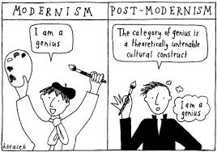
Postmodernism

Slide 2
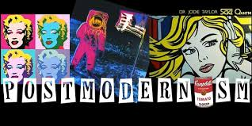
Postmodernism refers to a socio-cultural and literary theory and a shift in perspective that has manifested in a variety of disciplines including the social sciences, art, architecture, literature, fashion, communications, and technology.
The postmodern shift in perception began sometime back in the late 1950s, and is probably still continuing.
Postmodernism can be associated with the power shifts of the post-Second World War era.

Slide 3
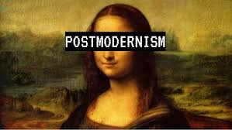
Postmodernism shares many of the features of Modernism.
Both schools reject the rigid boundaries between high and low art.
Postmodernism even goes a step further and deliberately mixes low art with high art, the past with the future, or one genre with another.
Both these schools also employed pastiche, which is the imitation of another’s style.
Parody and pastiche serve to remind the reader that the work is not “real” but fictional, constructed.

Slide 4


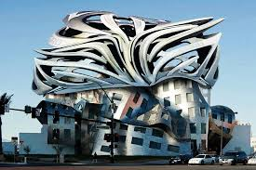
Structuralism and post-structuralism
Deconstruction
Post-postmodernism

Slide 5
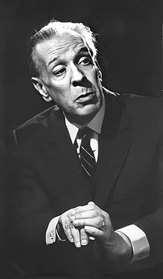
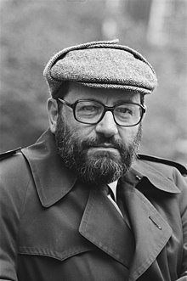
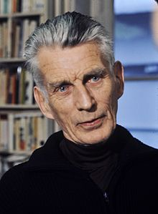
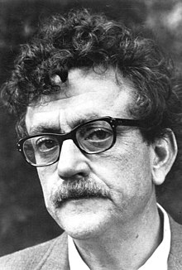
Literature
Jorge Luis Borges
Samuel Beckett
Umberto Eco
Kurt Vonnegut

Slide 6

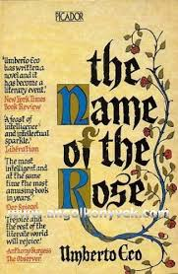
Postmodern literature is characterized by the use of
  metafiction
  unreliable narration
  self-reflexivity
Thematizes both historical and political issues.

Slide 7
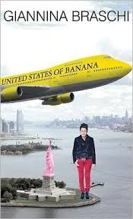
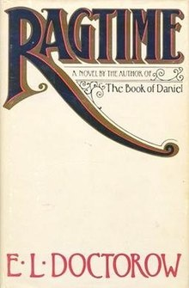
Common themes and techniques
Irony, playfulness, black humour
Intertextuality
Pastiche
Metafiction
Fabulation
Historiographic metafiction

Slide 8
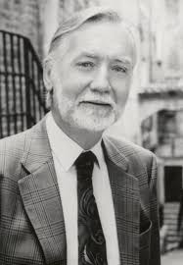
POSTMODERNISM IN BRITAIN
One of the key issues of postmodernist writing is the interrelation of literature and history. Barry Unsworth, the author of Losing Nelson, examines sceptically the myth of the British national hero and the whole process of constructing historical legends.
One of the most important historical themes is the WW II. James Ballard's autobiographical novel Empire of the Sun deals with an English teenager's dramatic experience in China

Slide 9
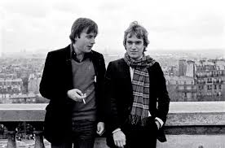
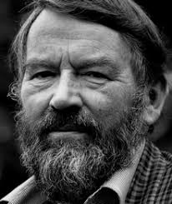
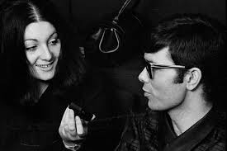
Postmodernist authors
JOHN FOWLES (novel The Rachel Papers)
MARTIN AMIS (novel Money)
LILY BRETT (novel Too Many Men)

