Slide 1
The Celtic Kingdoms: Wales, Scotland, Ireland

Slide 2
Plan:
1
Wales
2
Ireland
3
Scotland
4
Вставьте Ваш текст

Slide 3
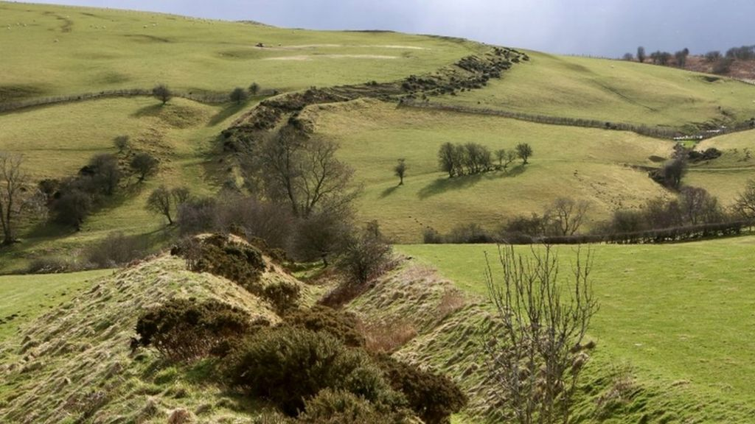
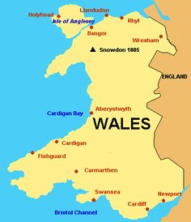
Wales
By the eight century most of the Celts had been driven into the Welsh peninsula. They were kept out of England by Offa’s Dyke.
These Celts called themselves cymry, “fellow countrymen”.
The cymry could only live in the crowded valleys. The rest of the land was rocky and too poor for anything expect keeping animals. For this reason the population remained small.

Slide 4
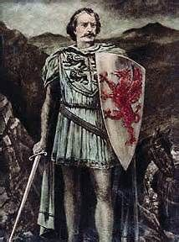
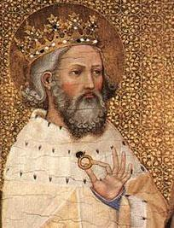
Wales
Society was based on family groupings, each of which owned one or more village or farm settlement.
Tribal chiefs became overlords over neighbouring family groups. Each of these kings tried to conquer the others, and the idea of a senior king developed.
In 1039 Gruffydd AP (son of) Llewelyn was the first Welsh king strong enough to rule over all Wales. He died when he was killed by a cymry.
Welsh kings after him were able to rule only after they had promised loyalty to Edward the Confessor, king of England.

Slide 5
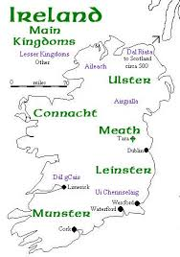
Ireland
Ireland was never invaded by either the Romans or the Anglo-Saxons. It was a land of monasteries and had a flourishing Celtic culture.
As in Wales, people were known by the family grouping they belonged to. The kings in this tribal society were chosen by election. The idea was that the strongest man should lead.
Five kingdoms grew up in Ireland: Ulster in the north, Munster in the southwest, Leinster in the southeast, Connaught in the west.

Slide 6
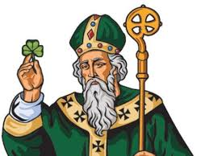
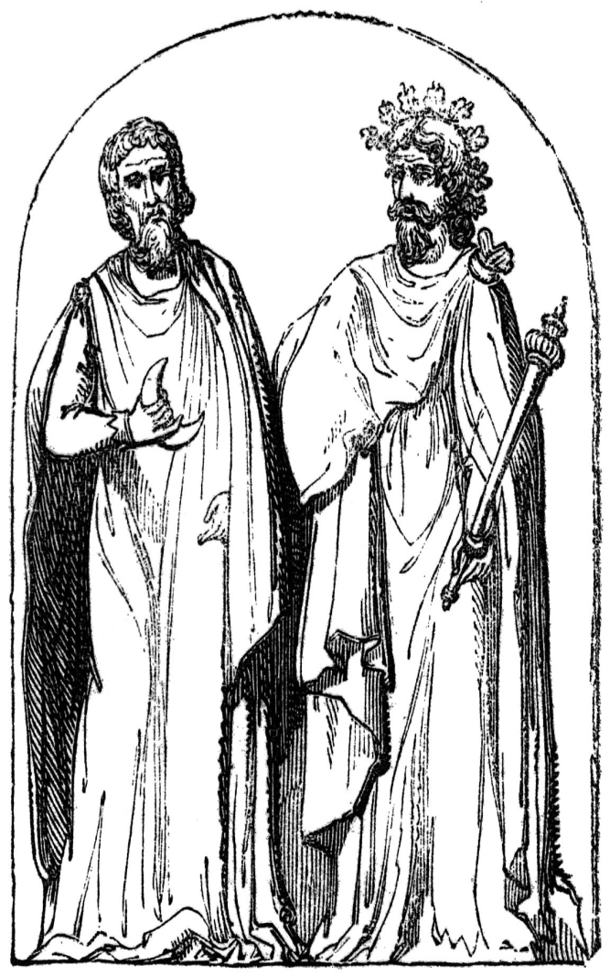
Ireland
Christianity came to Ireland in AD 430. The message of Christianity was spread in Ireland by a British slave, Patrick, who became the "patron saint" of Ireland.
Christianity brought writing, which weakened the position of the Druids, who depended on memory and the spoken word.
This period is often called Ireland's "golden age". Invaders were unknown and culture flowered. But the five kingdoms were often at war.

Slide 7
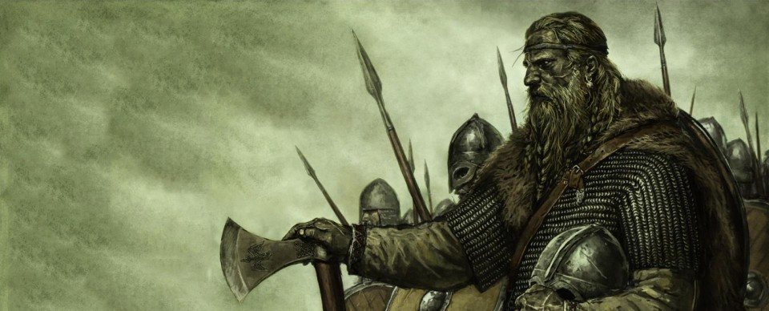
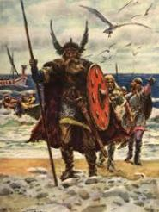
Ireland
The "golden age" suddenly ended with the arrival of Viking raiders, who stole all the monasteries had.
The Vikings, who were traders, brought fresh economic and political action into Irish life.
In 859 Ireland chose its first high king, but it was not an effective solution because of the quarrels that took place each time a new king was chosen.

Slide 8
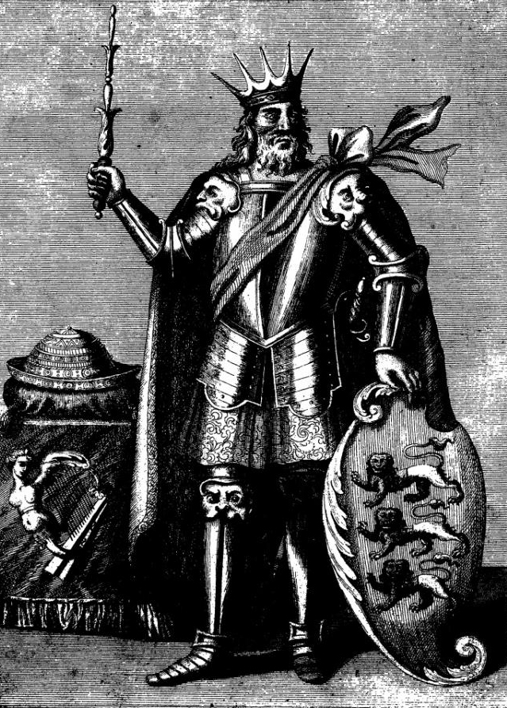
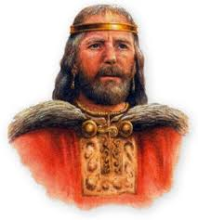
Ireland
Dublin was founded by the Vikings. The high kingship of Ireland lasted only twelve years, from 1002 to 1014 while Ireland was ruled by Brian Boru.
He tried to create one single Ireland, and encouraged the growth of organization in the Church, in administration, and in learning.
A century later another king of Leinster, invited the Normans of England to help him against his high king. This gave the Normans the excuse they wanted to enlarge their kingdom.

Slide 9
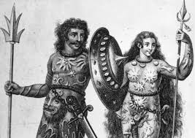
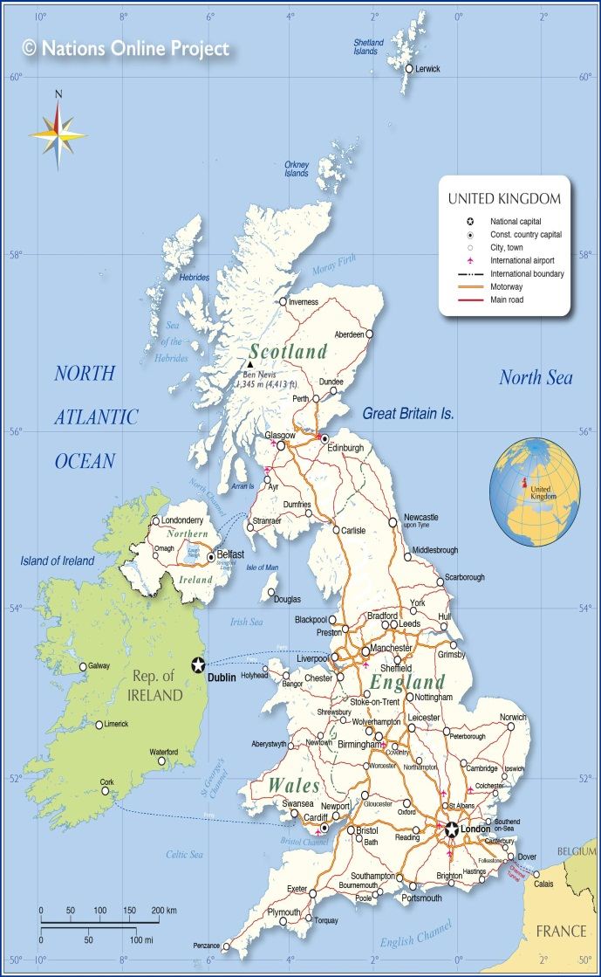
Scotland
As a result of its geography Scotland has two different societies: the north west and the south east. In the second one much of the countryside is like England, rich, welcoming and easy to farm.
In the north people stayed tied to their family groups, in the south society was more easily influenced by the changes taking place in England.
Scotland was populated by four separate groups of people. The main group, the Picts, lived mostly in the north and north east. They spoke mostly Celtic, and they seemed to have been the earliest inhabitants of the land.

Slide 10
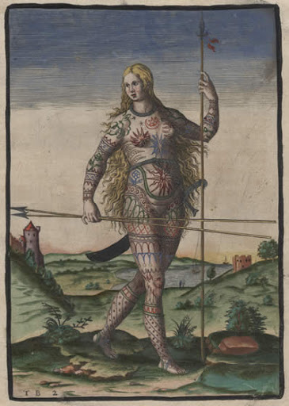
Scotland
The Picts were different form the Celts because they inherited their rights, their names and properties from their mothers, not from their fathers.
The non-Pictish inhabitants were mainly Scots. The Scots were Celtic settlers who had started to move into the Highlands from Ireland in the fourth century.
In 843 the Pictish and Scottish kingdoms were united under a Scottish king.
The third group were the Britons, who inhabited the lowlands, and had been part of the Romano-British world.

Slide 11
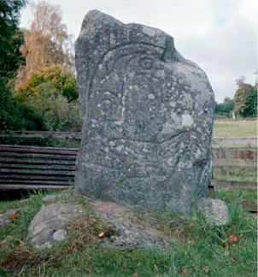
Scotland
Finally, there were Angles from Northumbria who had pushed northwards into the Scottish Lowlands.
Unity between Picts, Scots and Britons was achieved for several reasons. They all shared their way of life, although they kept some animals, they spent more time growing crops.
Land was held by individual people. Land was distributed for farming by the local lord. This system encouraged the Angles of Scotland to develop a non-tribal system of control.
As in Ireland and Wales, foreign invaders increased the speed of political change. Vikings attacked the coastal areas of Scotland.
Clach an Tiompain, a Pictish symbol stone in Strathpeffer

Slide 12
Scotland
In order to resist them, Picts and Scots fought together against the enemy raiders and settlers.
However, the English were a greater danger than the Vikings. The Scots decided to seek the friendship of the English.
England was obviously stronger than Scotland, but, luckily for the Scots, both the north of England and Scotland were difficult to control from London.
Scotland remained a difficult country to rule even from its capital, Edinburh. Travel was often impossible in winter, and slow and difficult in summer. It was easy for a clan chief or noble to throw off the rule of the king.

