Slide 1
Country Studies
Earliest Times
The foundation Stones

Slide 2
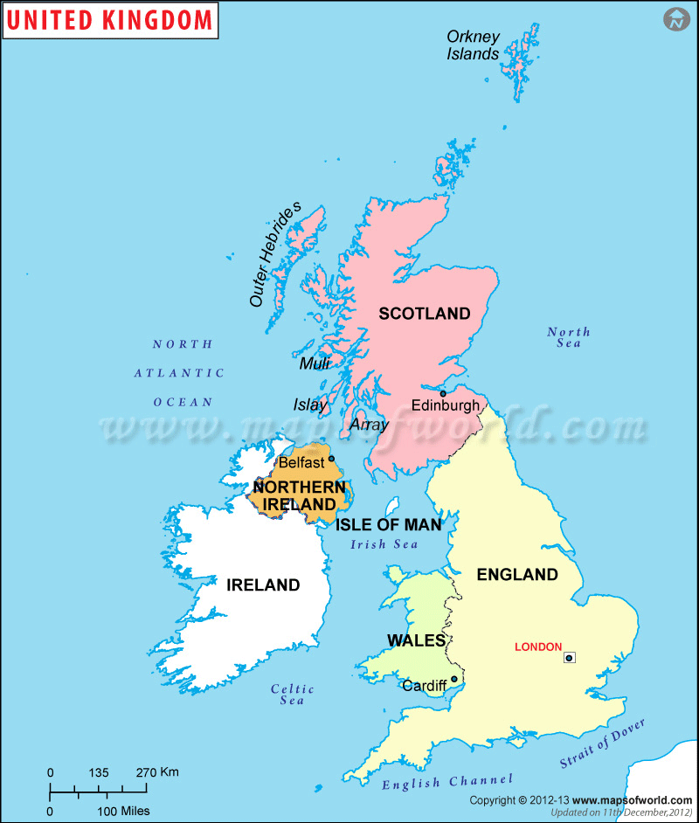
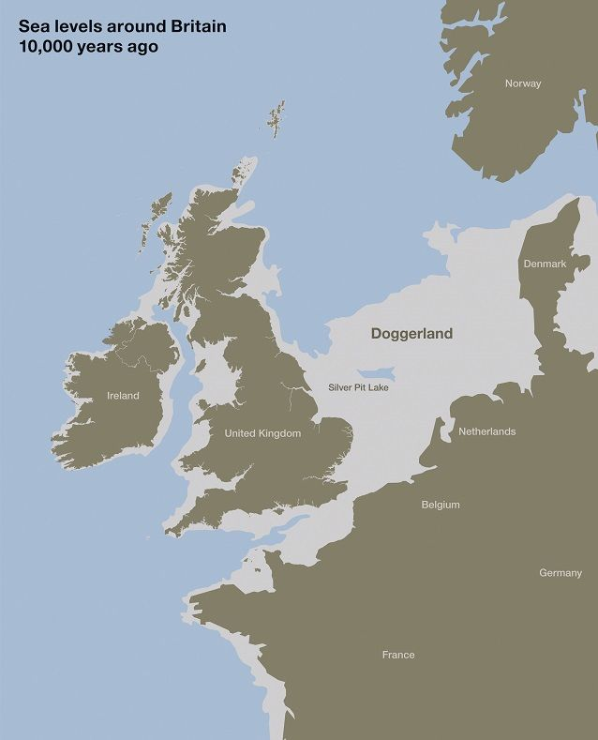
Britain's prehistory
Britain is an island, and Britain's history has been closely connected with the sea . Until modern times it was as easy to travel across water as it was across land , where roads were frequently unusable. At moments of great danger Britain has been saved from danger by its surrounding seas. Britain's history and its strong national sense have been shaped by the sea.
Britain has not always been an island . It became one only after the end of the last ice age. The temperature rose and the ice cap melted , flooding the lower-lying land that is now under the North Sea and the English Channel.

Slide 3
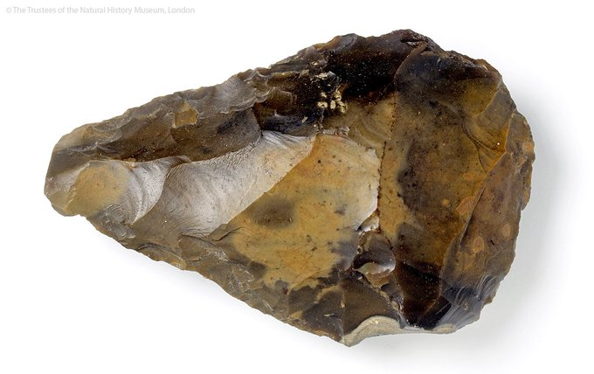
The first evidence of human life is a few stone tools, dating from one of the warmer periods, about 250, 000 BC . These simple objects show that there were two different kinds of inhabitant. The earlier group made their tools from flakes of flint, similar in kind to stone tools found across the north European plain as far as Russia. The other group made tools from a central core of flint, probably the earliest method of human tool making.
flint hand axe was discovered at the site of Swanscombe in Kent which was inhabited about 500,000 to 300,000 years ago.

Slide 4
50,000 BC. - during this time a new type of human being seems to have arrived, who was the ancestor of the modern British. These people looked similar to the modern British, but were probably smaller and had a life span of only about thirty years.
Around 10, 000 BC - as the Ice Age drew to a close, Britain was peopled by small groups of hunters, gatherers and fishers. Few had settled homes, and they seemed to have followed herds of deer which provided them with food and clothing. By about 5000 BC Britain had finally become an island,

Slide 5
About 3000 BC Neolithic (or New Stone Age ) people crossed the narrow sea from Europe in small round boats of bent wood covered with animal skins. Each could carry one or two persons. These people kept animals and grew corn crops, and knew how to make pottery, They probably came from either the Iberian (Spanish) peninsula or even the North African coast. They were small, dark, and long-headed people, and may be the forefathers of dark-haired inhabitants of Wales and Cornwall today. They settled in the western parts of Britain and Ireland, from Cornwall at the southwest end of Britain all the way to the far north.

Slide 6
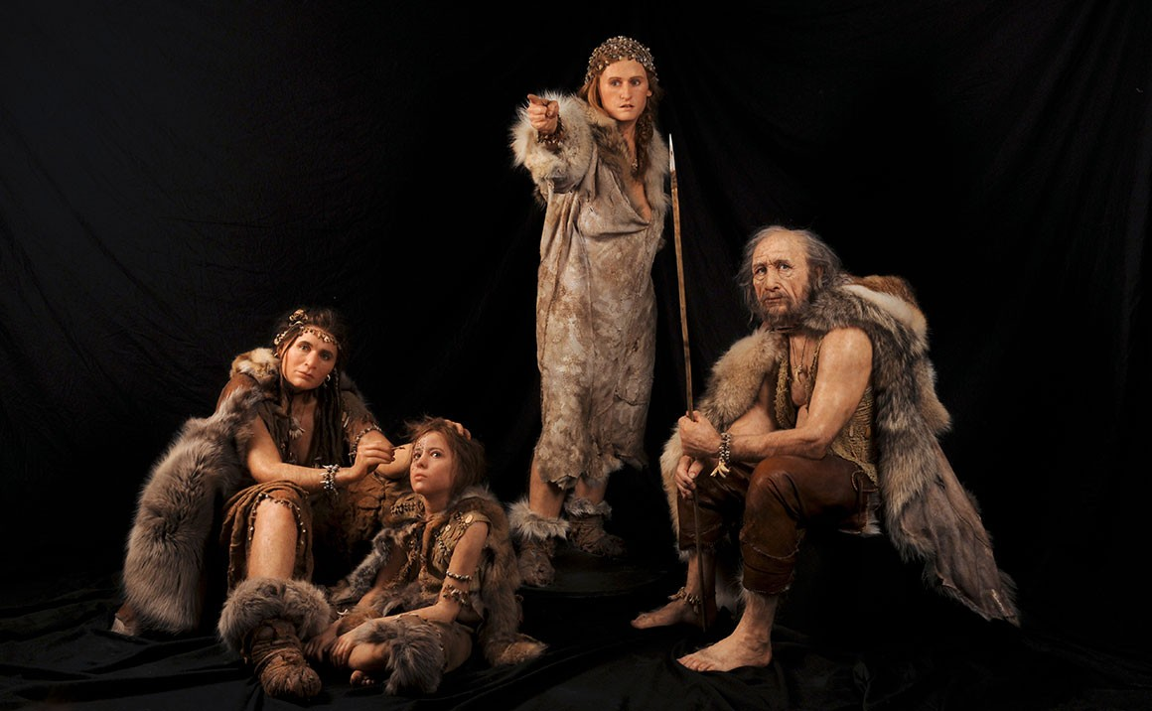
First Britons
Humans arrived in Britain nearly one million years ago

Slide 7
Skara Brae
Skara Brae is a Neolithic Age site, consisting of ten stone structures, near the Bay of Skaill, Orkney, Scotland. Today the village is situated by the shore but when it was inhabited (c.3100-2500 BCE) it would have been further inland.
The name `Skara Brae’ is a corruption of the old name for the site, `Skerrabra’ or `Styerrabrae’ which designated the mound which buried (and thereby preserved) the buildings of the village. The name by which the original inhabitants knew the site is unknown. Skara Brae is listed by UNESCO as a World Heritage Site.

Slide 8
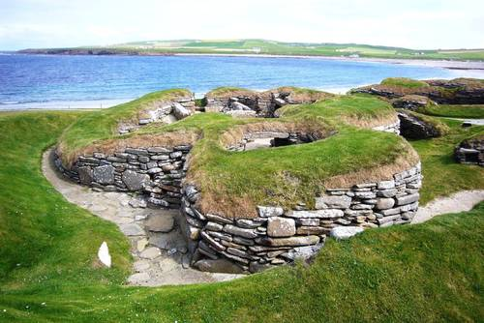
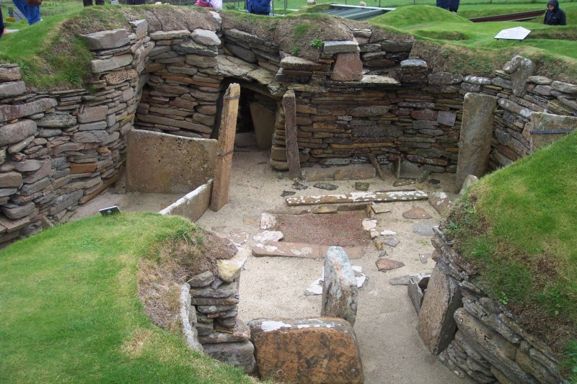
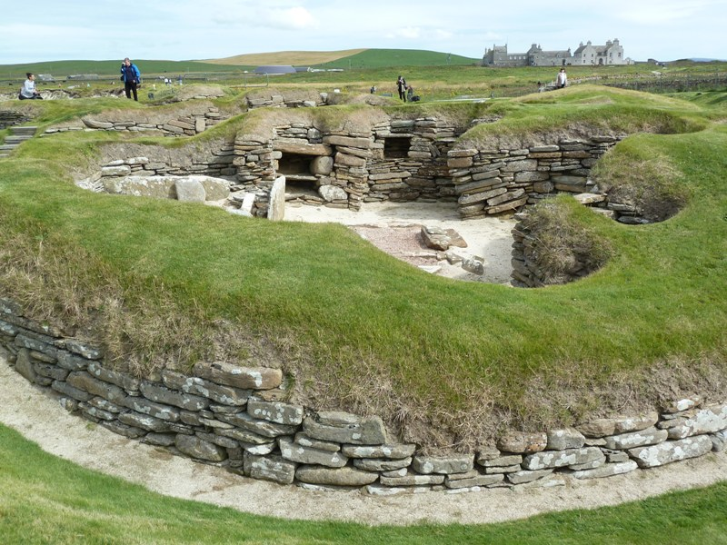

Slide 9
Stonehenge
After 3000 BC the people started building great circles of earth banks and ditches. Inside, they built wooden buildings and stone circles. These "henges", as they are called, were centres of religious, political and economic power. By far the most spectacular, both then and now, was Stonehenge.
The precise purposes of Stonehenge remain a mystery, the huge bluestones were brought to the site from south Wales

Slide 10
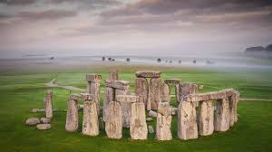
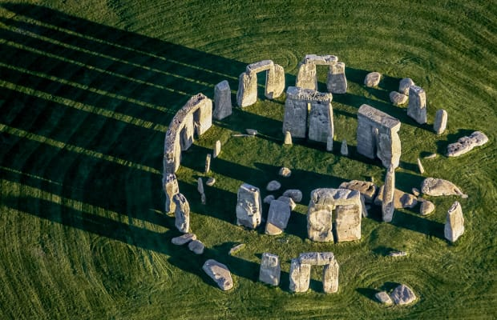
Stonehenge is one of the most outstanding features in Britain. Why it is arranged in this way is a mystery but the alignment of the central stone and the heel stone is such that he sun rises over them on Midsummer’s Day and it may be in connection with sun worship.

Slide 11
“Beaker” people
After 2400 BC new groups of people arrived in southeast Britain from Europe . They were roundheaded and strongly built, taller than Neolithic Britons. It is not known whether they invaded by armed force, or whether they were invited by Neolithic Britons because of their military or metalworking skills. Their influence was soon felt and, as a result, they became leaders of British society. Their arrival is marked by the first individual graves, furnished with pottery beakers, from which these people get their name: the "Beaker" people.

Slide 12
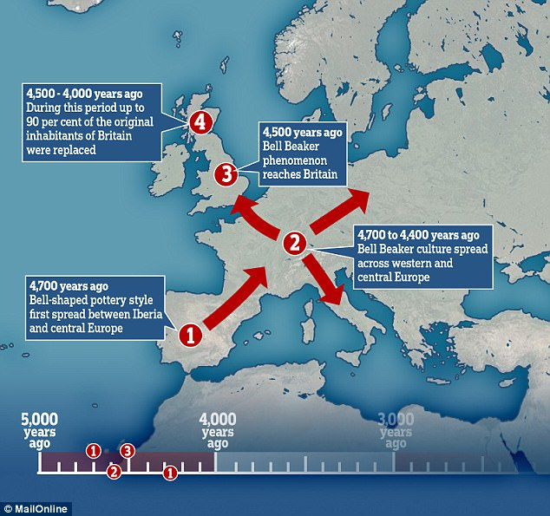
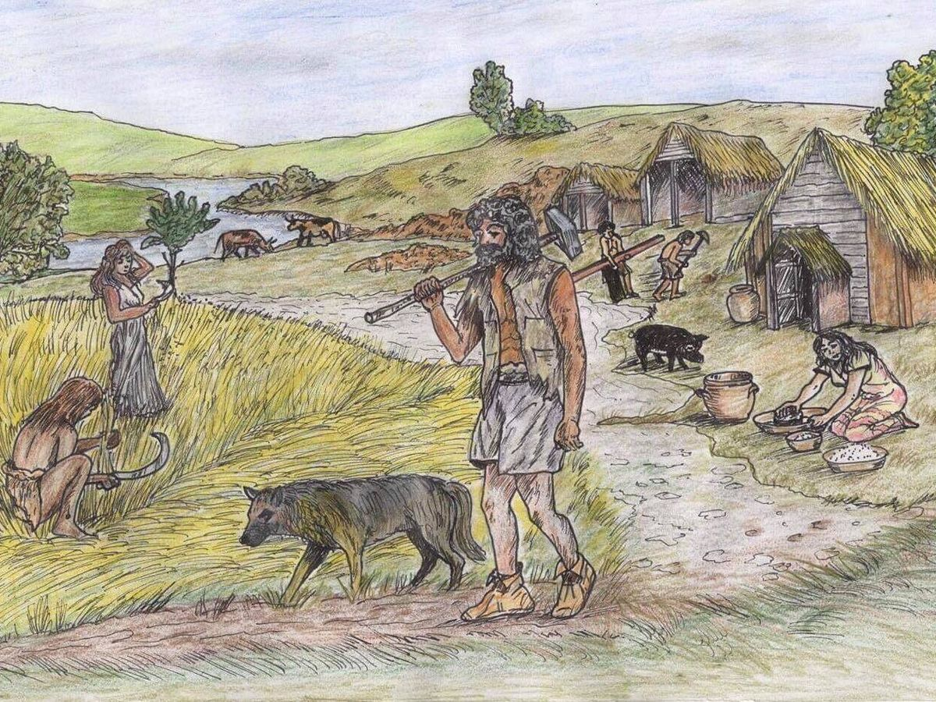
The pot on the left is from Sierentz in France (© Anthony Denaire) , and from Bathgate in Scotland (© National Museums Scotland) on the right.

Slide 13
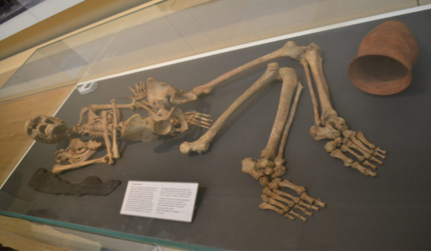
The Barnack Burial
Why did people now decide to be buried separately and give up the old communal burial barrows? It is difficult to be certain, but it is thought that the old barrows were built partly to please the gods of the soil, in the hope that this would stop the chalk upland soil getting poorer. The Beaker people brought with them from Europe a new cereal, barley, which could grow almost anywhere. Perhaps they felt it was no longer necessary to please the gods of the chalk upland soil.
The Beaker people probably spoke an Indo-European language. They seem to have brought a single culture to the whole of Britain. They also brought skills to make bronze too ls and these began to replace stone ones. But they accepted many of the old ways
The Barnack Burial (British Museum)

Slide 14
1300 BC onwards the henge civilisation seems to have become less important , and was overtaken by a new form of society in southern England, that of a settled farming class. At first this farming society developed in order to feed the people at the henges, but eventually it became more important and powerful as it grew richer. The new farmers grew wealthy because they learned to enrich the soil with natural waste materials so that it did not become poor and useless

Slide 15
The Celts
Around 700 BC, another group of people began to arrive. Many of them were tall, and had fair or red hair and blue eyes. These were the Celts, who probably came from central Europe or further east, from southern Russia, and had moved slowly westwards in earlier centuries.
The Celts were technically advanced. They knew how to work with iron, and could make better weapons than the people who used bronze. It is possible that they drove many of the older inhabitants westwards into Wales, Scotland and Ireland. The Celts began to control the lowland areas of Britain

Slide 16
The Celts are important in British history because they are the ancestors of many of the people in Highland Scotland. Wales, Ireland, and Cornwall today. The Iberian people of Wales and Cornwall took on the new Celtic culture. Celtic languages, which have been continuously used in some areas since that time, are still spoken.
As with previous groups of settlers, we do not even know for certain whether the Celts invaded Britain or came peacefully as a result of the lively trade with Europe. The Celts were organised into different tribes, and tribal chiefs were chosen from each family or tribe, sometimes as the result of fighting matches between individuals, and sometimes by election.

Slide 17
The last Celtic arrivals from Europe were the Belgic tribes
The Celtic tribes continued the same kind of agriculture as the Bronze Age people before them. But their use of iron technology and their introduction of more advanced ploughing methods made it possible for them to farm heavier soils. However, they continued to use, and build, hillforts.
The hill-fort remained the centre for local groups. The insides of these hill-forts were filled with houses, and they became the simple economic capitals and smaller "towns" of the different tribal areas into which Britain was now divided. Today the empty hill-forts stand on lonely hill tops. Yet they remained local economic centres long after the Romans came to Britain, and long after they went.

Slide 18
Celtic clothing
According to the Romans, the Celtic men wore shirts and breeches (knee-length trousers), and striped or chec ked cloaks fastened by a pin . It is possible that the Scottish tartan and dress developed from this "striped cloak". The Celts were also "very careful about cleanliness and neatness”

Slide 19
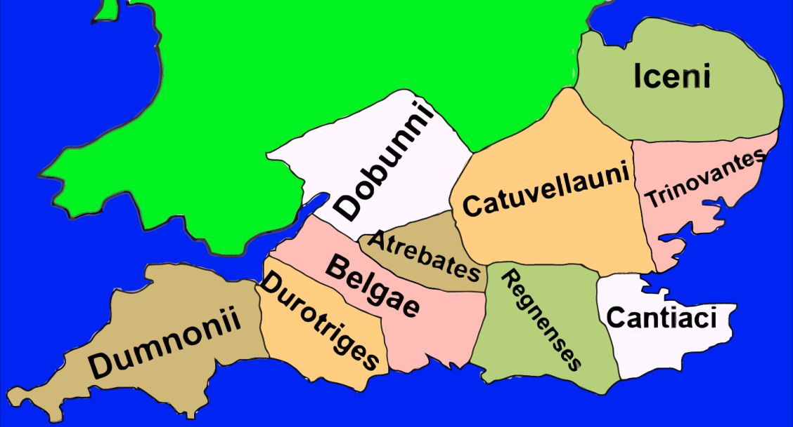
Celtic Tribes
The Celtic tribes were ruled over by a warrior class, of which the priests, or Druids, seem to have been particularly important members. These Druids could not read or write, but they memorised all the religious teachings, the tribal laws, history, medicine and other knowledge necessary in Celtic society. The Druids from different tribes all over Britain probably met once a year. They had no temples, but they met in sacred groves of trees, on certain hills, by rivers or by river sources.

Slide 20
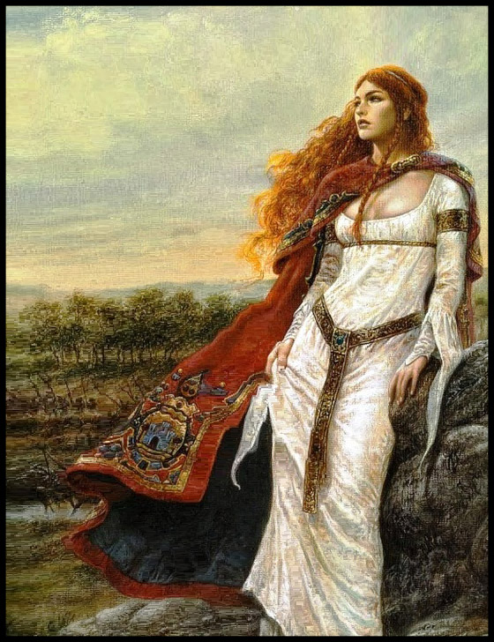
Celtic Women
During the Celtic period women may have had more independence than they had again for hundreds of years. When the Romans invaded Britain two of the largest tribes were ruled by women who fought from their chariots. The most powerful Celt to stand up to the Romans was a woman , Boadicea. She had become queen of her tribe when her husband had died. She was tall, with long red hair, and had a frightening appearance. In AD 61 she led her tribe against the Romans. She nearly drove them from Britain, and she destroyed London, the Roman capital, before she was defeat ed and killed

Slide 21
Boudicca
Boudicca, also spelled Boadicea or Boudica, (died 60 or 61 CE), ancient British queen who in 60 CE led a revolt against Roman rule.
Boudicca’s husband, Prasutagus, was king of the Iceni (in what is now Norfolk). When Prasutagus died in 60 with no male heir, he left his private wealth to his two daughters and to the emperor Nero, trusting thereby to win imperial protection for his family. Instead, the Romans annexed his kingdom, humiliated his family, and plundered the chief tribesmen. While the provincial governor Suetonius Paulinus was absent in 60 or 61, Boudicca raised a rebellion throughout East Anglia. The insurgents burned Camulodunum (Colchester), Verulamium (St. Albans), the mart of Londinium (London), and several military posts.
According to the Roman historian Tacitus, Boudicca’s rebels massacred 70,000 Romans and pro-Roman Britons and cut to pieces the Roman 9th Legion. Paulinus met the Britons at a point thought to be near present-day Fenny Stratford on Watling Street and regained the province in a desperate battle. Upon her loss, Boudicca either took poison or died of shock or illness.

Slide 22
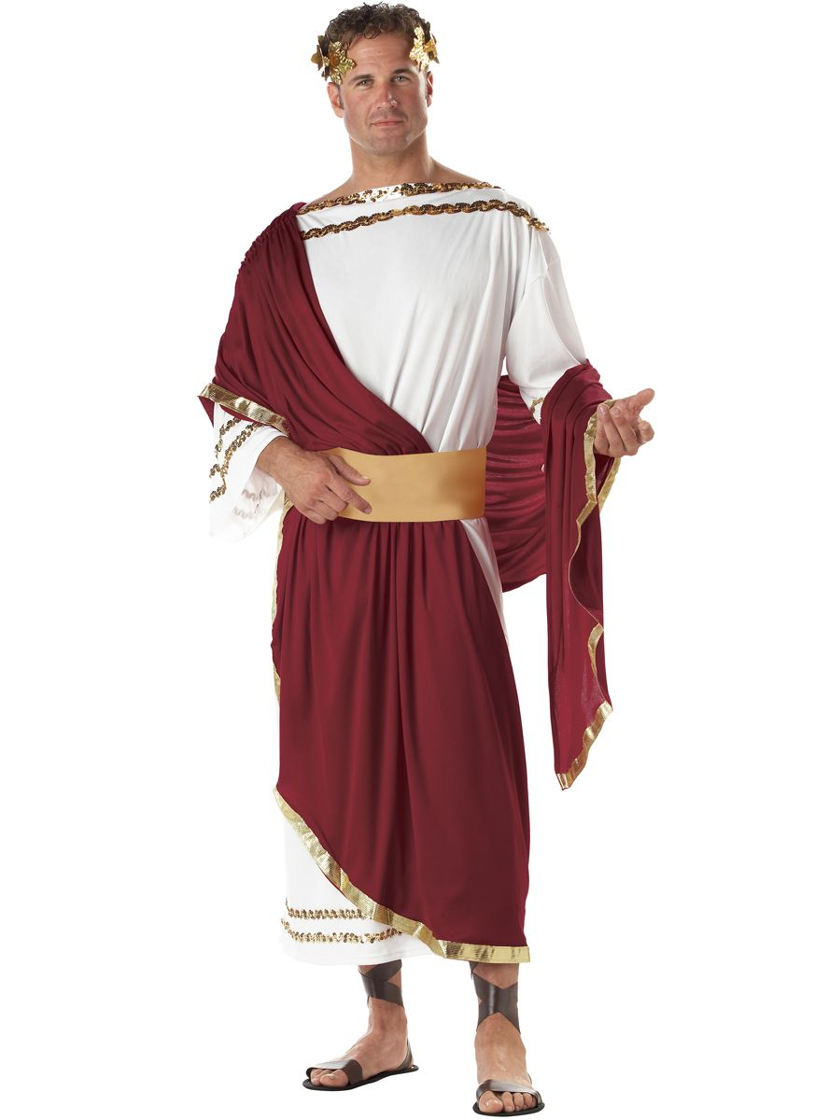
The Romans
The name "Britain" comes from the word "Pretani ", the Greco-Roman word for the inhabitants of Britain. The Romans mispronounced the word and called the island "Britannia". The Romans had invaded because the Celts of Britain were working with the Celts of Gaul against them. The British Celts were giving the m food, and allowing them to hide in Britain. There was another reason . The Celts used cattle to pull their ploughs and this meant that richer, heavier land could be farmed. Under the Celts Britain had become an important food producer because of its mild climate .
The Romans brought the skills of reading and writing to Britain.
The wearing of the national dress came to be valued and the toga [the Roman cloak] came into fashion.

Slide 23
The Celtic peasantry remained illiterate and only Celtic speaking, a number of town dwellers spoke Latin and Greek with ease, and the richer landowners in the country almost certainly used Latin
55 BC - Julius Caesar first came to Britain
AD 43 - Roman army actually occupied Britain

Slide 24
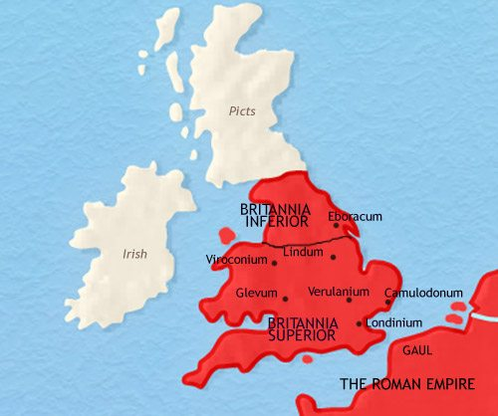
The Romans established a Romano-British culture across the southern half of Britain, from the River Humber to the River Severn . This part of Britain was inside the empire. Beyond were the upland areas, under Roman control but not developed. These areas were watched from the towns of York, Chester and Caerleon in the western peninsula of Britain that later became known as Wales.

Slide 25
Roman legions leave Britain
AD 367 - Roman control of Britain came to an end as the empire began to collapse. The first signs were the attacks by Celts of Caledonia. The Roman legions found it more and more difficult to stop the raiders from crossing Hadrian 's wall. The same was happening on the European mainland as Germanic groups, Saxons and Franks, began to raid the coast of Gaul
AD 409 - Rome pulled its last soldiers out of Britain and the Romano-British, the Romanised Celts, were left to fight alone against the Scots, the Irish and Saxon raiders from Germany.

