Slide 1
Dialects in Great Britain

Slide 2
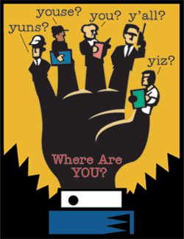
A dialect is
a variant, or variety, of a language spoken in a certain geographical area.
A complete system of verbal communication (oral but not necessarily written), with its own vocabulary, grammar, and syntax.

Slide 3
British Dialects
Southern English dialects Midlands English dialects Northern English dialects Scottish English dialects
Hiberno-English

Slide 4
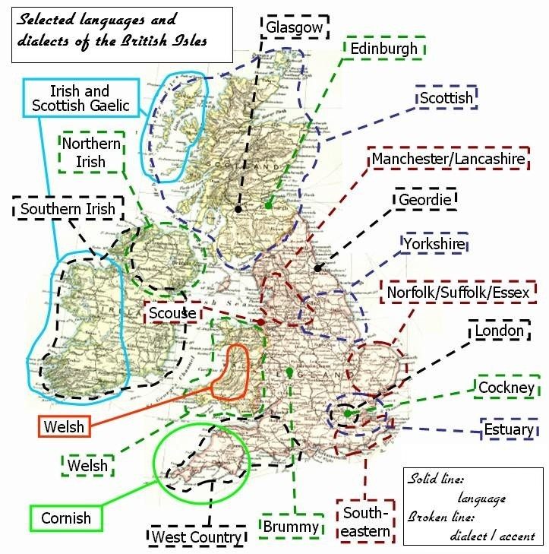

Slide 5
England
Northern English
Northumberland (Geordie, Pitmatic)
Durham (Mackem)
  Cumbrian
  Yorkshire
  Lancashire
  Merseyside (Scouse)
●

Slide 6
GEORDIE
hoppings | fairground
ket | rubbish
worm | monster
gadgie | guy
canny | pleasant
hacky | dirty
howay | Come on!
sackless | stupid, useless

Slide 7
Сommon phrases and greetings:
Hoo ye gannin? or Hoo's ya fettle? 'How are you?'
Champion. 'Very good, very well'
Bonny day the day. 'It's nice weather'
Whey aye, man. 'That's right'
Give ower, y'a kiddin. 'Come on, you're joking'
Hadaway man. 'I'm still not convinced'
Ya taakin shite. 'I really disagree with that'
Tara now, pet. 'Goodbye (to female)'
Wee's yon slapper? 'Who's the young lady?' (derogatory)

Slide 8
I telt you to give us a one, but you've forgetten. If you divvent give us it noo, I'm gannin yearm.

Slide 9
'I told you to give me one, but you've forgotten'. 'If you don't give me it now, I'm going home'

Slide 10
Workman visiting doctor: Me leg's bad, man, can ye give us a sick note?
Doctor: Can you walk?
Workman: Work? Y'a kiddin' man, A cannet even waak!
'blow' becomes blaa and 'cold' cowld, but in other words such as 'flow' and 'slow' the vowels are not changed in the same way.
A number of words are said to have pronunciation indicating a possible survival from earlier periods of English, such as gan 'go', lang 'long' aks 'ask' and deed 'died' The word 'can't' is usually pronounced cannet.

Slide 11
YORKSHIRE
Attercop: spider
Backend: autumn
Bairn: child (Also used in Scotland and Northumberland)
Dale: valley
Goodies/spice: sweets
Kelter/kelterment: junk/rubbish/litter
Kittling: kitten
Varmint: vermin (Old form surviving in America and Yorkshire)
Yam: home
Rick, reek: smoke, to smoke

Slide 12
idiomatic expressions
Allus at t’ last push up - always at the last moment
Nobbut a mention - just a small amount
It’s nut jannock - it’s not fair
’e wor ’ard on - he was fast asleep
Livin’ tally / ower t’ brush - living together as man and wife but not married
Tek a good likeness - be very photogenic
It caps owt - it beats everything
Goin’ dahn t’ nick - ill and not going to get better
A reight gooid sooart - a really kind person

Slide 13
SCOUSE
Baird – girlfriend, wife
Boss – excellent
Blower – telephone
Burr'I . – But I…
To buzz – to ring – ("Give us a buzz" - Ring me)
Char – tea
Cop shop – police station
Gunnite – good night
Last – awful
Moby – mobile phone
Nimps – easy
Pezzie – gift, present

Slide 14
Midlands English
East
Derbyshire
Nottingham
Lincolnshire
Leicestershire
West
● Black Country (Yam Yam)
● Birmingham (Brummie)
East Anglia

Slide 15
Phrases of East Midlanders:
It's black uvver Bill's mother's - it looks like rain
Coggie - swimming costume
Croaker – doctor
Duck's necks - bottle of lemonade
Gorra bag on - in a bad mood
Laropped – drunk
Nesh – cold
Old cock – friend, mate
Skants – pants

Slide 16
Some language experts recently declared Leicester the birthplace of modern Standard English.
At the City of Leicester School, the pupils of all backgrounds find themselves using Leicester dialect.
my yard (my house )
chuddie (pants)
gis a gleg – (give me a look at it )
ow a ya?- (how are you?)
wassup? – (What is going on?)
snitch – (tale teller)

Slide 17
Nottingham is also renowned for its dialect
"corshucan" (of course you can)
Gizza glegg (May I see that)
glegg (to look- смотреть)
jitteh (an alleyway, cut-through between houses –)

Slide 18
BLACK COUNTRY
this dialect if also called
The dialect of the Black Country area remains perhaps one of the last examples of early English still spoken today
Yam Yam
Breffus – breakfast
Cag-mag – gossip
Clobber – clothes
Dishle - cup of tea
Flics – cinema
Ooman – woman
Opple – apple
Suck – sweets

Slide 19
BRUMMIE
Brummie (or Brummy) refers to things connected with the city of Birmingham in England: particularly its people, known as Brummies, and their accent and dialect of the English language.
bab when referring to ‘a spouse’ or ‘female’.
it's lookin a bit black over bills mothers
You talkin to me or chewin a brick someone was being aggressive verbally

Slide 20
O'rite - alright
Man – mate
Sound/sweet/mint' – excellent
Outdoor - off-licence
Have a doss - laze about
Fair play - well done
Buzz – bus –
Def it out! - Leave it alone! –
Soz - 'Sorry'

Slide 21
NORFOLK
Much of the distinctive vocabulary of Broad Norfolk has now died out and only the older generations use the fullest amount, so the speech of most of Norfolk is now more an accent than a dialect.
The Friends of Norfolk Dialect (FOND) is a group which formed in 1999 with the aim of preserving and promoting Broad Norfolk.
Afront - in front
Bor – neighbour/boy
Dodman – snail
Hold yew hard! - Hang on a moment!
Mawther – girl/young woman
Rum - curious, strange, funny

Slide 22
ESTUARY ENGLISH
It is widely spoken in and around London and, more generally, in the southeast of England and along the river Thames and its estuary.
The omission of the -ly adverbial ending, as in You're turning it too slow or They talked very quiet for a while.
Generalization of the third person singular form (I gets out of the car), especially in narrative style; also the generalized past tense use of was, as in We was walking down the road.

Slide 23
COCKNEY
One of the best known Southern dialects is Cockney, the regional dialect of London.
Bees and Honey – money
Bird – prison (from bird lime = time)
China - mate/friend – (from China plate = mate)
Dog and bone – phone
Elbows and knees – trees
Elephant's trunk – drunk
Loaf of bread – head
Pig’s ear – beer
Rabbit and pork – to talk

Slide 24
"Got to my mickey, found me way up the apples, put on me whistle and the bloody dog went. It was me trouble telling me to fetch the teapots."

Slide 25
"Got to my house (mickey mouse), found my way up the stairs (apples and pears), put on my suit (whistle and flute) when the phone (dog and bone) rang. It was my wife (trouble and strife) telling me to get the kids (teapot lids)."

Slide 26
SCOTTISH ENGLISH
To James Smith
Dear Smith, the slee'st, pawkie thief, That e'er attempted stealth or rief ! Ye surely hae some warlock-brief Owre human hearts;
For ne'er a bosom yet was prief
Against your arts.
For me, I swear by sun an' moon,
An' ev'ry star that blinks aboon ,
Ye've cost me twenty pair o' shoon ,
Just gaun to see you;
Robert Burns

Slide 27
Here slee'st means ‘slyest’;
pawkie – cunning, sly;
e'er – ever;
or – ere, before;
rief – robbery, plunder ;
hae – have;
warlock-brief – wizard’s contract (with the devil);
owre – over;
prief – proof;
an' – and;
blinks – looks smiling;
aboon – above;
o' – of ;
shoon – shoes;
gaun – going;
ither – other;
mair – more;
taen – taken; wi' – with.

Slide 28
WENGLISH
Aim – to throw
Belfago – loudly
Carn – can’t
Credit – to believe
Flag – an unreliable person
Glad and Sorry - on the "never-never" (glad to have it, sorry to have to pay for it)
Grizzle - to complain
In a (like a) winky – very quickly
Losins/loshins – sweets
Mamgu/myngu – (usually pronounced /mungee/) grandmother
On the trot – consecutively

Slide 29
HIBERNO-ENGLISH
HIBERNO-ENGLISH. A VARIETY of English in Ireland, used mainly by less educated speakers whose ancestral tongue was IRISH GAELIC. It is strongest in and around the Gaeltachts (Irish-speaking regions) and in rural areas. It preserves certain Gaelic features in pronunciation, syntax, and vocabulary while at the same time many of its speakers approximate to the ANGLO-IRISH or ULSTER SCOTS norms of the area in which they live.

Slide 30
Pronunciation
Such words as cat and garden sound like ‘kyat’ and ‘gyarden’: initial /k/ and /g/ with a following semivowel /j/.
(2) Such names as Hugh and Hughes sound as if they began with a ‘ky’.
(3) Such words as true, drew sound like ‘threw’ and ‘dhrew’: dental rather than alveolar realizations of /t, d/.
(4) In such words as pine, time, come, the opening consonant is aspirated, the /t/ in time sounding like a cross between t and the th in three: aspiration of syllable-initial /p, t, k/.
(5) Some GAELIC rhythms include the use of an unstressed initial word in questions: An' do you like it?; An' was it nice?
The unstressed word is usually and, but well and sure also occur.
In Gaelic, questions normally begin with an unstressed element, which in the present tense is an: An maith leat é? Do you like it?

