Slide 1
Northern English. Welsh English.
Vivien Eva Palko II/4

Slide 2
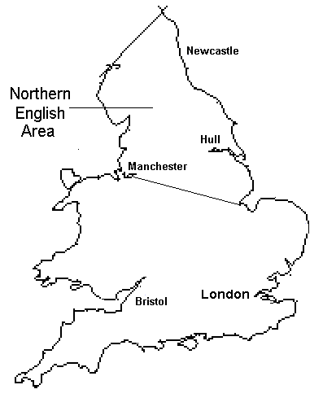
Northern English
is a group of dialects of the English language.
includes Northumbrian, Cumbrian, Tyke and Scouse.
shows Danish influence.
is one of the major groupings of British English.

Slide 3
NE contains:
Cumbrian dialect
• Geordie (spoken in the Newcastle upon Tyne/Greater Tyneside area)
Lancashire dialect
• Mackem (spoken in Sunderland/Wearside)
• Mancunian (spoken in the Manchester area)
• Pitmatic (2 variations, one spoken in the former mining communities of County Durham and the other in Northumberland)
• Scouse (spoken in Liverpool with variations as far as North Wales)
• Stokie (spoken in Stoke-on-Trent)
• Teesside dialect (spoken in some areas of County Durham and Yorkshire, mainly around the Tees estuary)
• Tyke (spoken in Yorkshire)

Slide 4
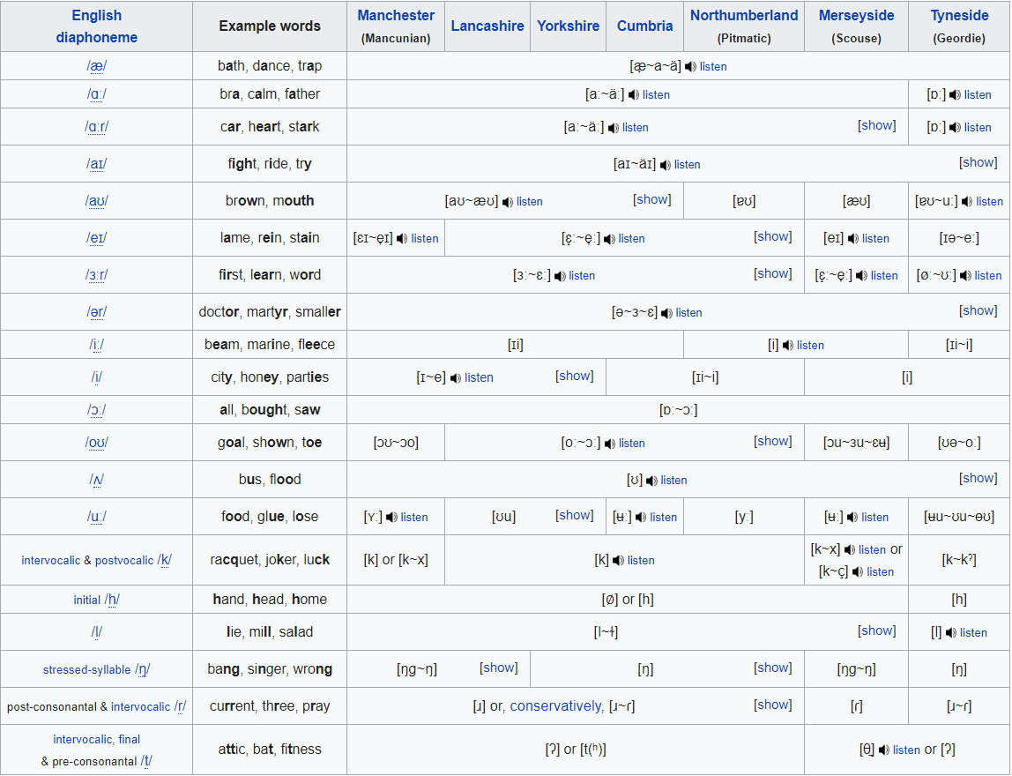

Slide 5
The Northern English lexis includes many words derived from Norse languages, from Middle English.
bairn = child
bonny = beautiful
gang or gan = go/gone/going
kirk = church
Yan is stills sometimes used to mean one as in someyan (someone), that yan (that one).
https://www.youtube.com/watch?v=QmxksDIL1cw

Slide 6
Welsh English
Welsh English/Anglo-Welsh/Wenglish refer to the dialects of English spoken in Wales by Welsh people.
The dialects are significantly modified by Welsh grammar and nouns, and contain a number of unique words.

Slide 7
Features of WE:
• Distinctive pitch differences giving a "sing-song" effect.
• Lengthening of all vowels is common in strong valleys accents.
• A tendency towards using an alveolar trill /r/ (the 'rolled r') in place of an approximant /r/ (the 'normal English r').
• Yod-dropping does not occur after any consonant, so rude and rood, threw and through, chews and choose, chute and shoot etc. are distinct.
• Sometimes adding the word "like" or "indeed" to the end of a sentence for emphasis, or using them as stop-gaps.

Slide 8
Straightforward borrowings of words from the Welsh language (cwtsh, picking to rain), grammar from the language has crept into English spoken in Wales.
Placing something at the start of a sentence emphasises it: "furious, she was".
Periphrasis and auxiliary verbs are used in spoken Welsh, resulting in the English: "He do go there", "I do do it”.
Misappropriation into English sentence forms of Welsh verbs. The Welsh verb dysgu (meaning both to learn and to teach) is mistranslated in the common Wenglish form, „He learned me to drive”, in place of the correct English usage, „He taught me to drive”.

Slide 9
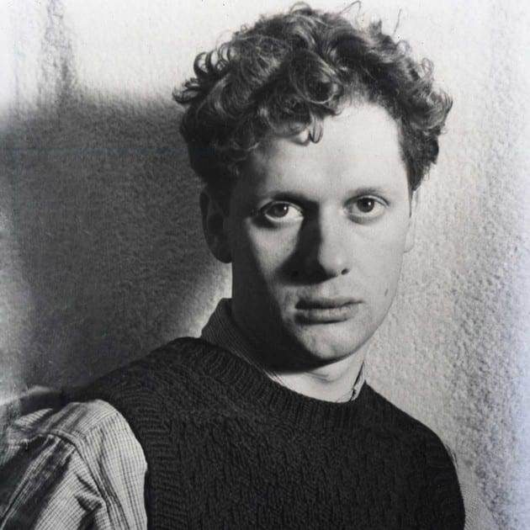
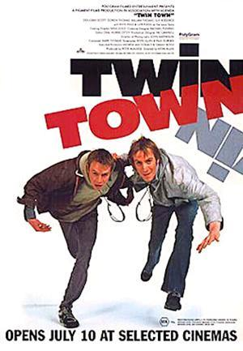
The sing-song Welsh accent familiar to many English people is generally associated with South Wales.
Accents from South Wales can be heard from the actors:
Richard Burton Anthony Hopkins Dylan Thomas
Swansea accents are prominent in the film Twin Town and popular Welsh actress Catherine Zeta-Jones also has a Swansea accent.

Slide 10
The accents of North Wales arc markedly different:
less sing-song
more consistently high-pitched voice
the vowels pressed to the back of the throat.
consonants are pronounced very clearly, including at the end of a word, so bad can sound like batt.
the R sound is rolled extensively
the dark L is used at the beginning/middle of words, for example in lose, bloke, and valley
the sound /z/ is often pronounced unvoiced (the sound does not exist in Welsh), so lose is pronounced the same as loose.

Slide 11
In North East Wales, the accent can sound like that of Cheshire or Staffordshire. Scouse-like Liverpool accents are used around Qucensferry and Flint. Around Wrexham, accents are similar to Scouse and younger people to particular have begun to use more Scouse-like vocabulary, such as la and kid. To the ears of an Englishman a Wrexham accent can sound Scouse or just generally like Northern English.
The accents of West-Wales, especially North Carmarthenshire and Ceredigion, are gentler in nature than either the valleys or the Northern Welsh accents and are one of the more beautiful British accents to listen to.

Slide 12
Vowels:
https://www.youtube.com/watch?v=8K5UrkaWEuk

Slide 13
Thank you for your attention!

