Slide 1
The Invaders
The Saxon Invasion
Government
Christianity
The Vikings

Slide 2
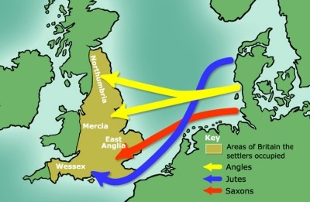
The Anglo-Saxons
At first the Germanic tribes only raided Britain , but after AD 430 they began to settle. The newcomers were warlike and illiterate.
The invaders came from three powerful Germanic tribes, the Saxons, Angles and Jutes. The Jutes settled mainly in Kent and along the south coast, and were soon considered no different from the Angles and Saxons. The Angles settled in the east, and also in the north Midlands, while the Saxons settled between the Jutes and the Angles in a band of land from the Thames Estuary westwards. The Anglo-Saxon migrations gave the larger part of Britain its new name, England , "the land of the Angles"

Slide 3
The British Celts fought the raiders and settlers from Germany as well as they could. However, during the next hundred years they were slowly pushed westwards. Finally most were driven into the mountains in the far west, which the Saxons called "Weallas" , or "Wales" , meaning "the land of the foreigners". Some Celts were driven into Cornwall, where they later accepted the rule of Saxon lords.
In the north, other Celts were driven into the lowlands of the country which became known as Scotland. Some Celts stayed behind, and many became slaves of the Saxons. Hardly anything is left of Celtic language or culture in England , except for the names of some rivers, Thames, Mersey, Severn and Avon , and two large cities, London and Leeds.

Slide 4
The strength of Anglo-Saxon culture is obvious even today. Days of the week were named after Germanic gods: Tig (Tuesday), Wodin (Wednesday), Thor (Thursday), Frei (Friday). New place-names appeared on the map. The first of these show that the earliest Saxon villages, like the Celtic ones, were family villages. The ending -ing meant folk or family, thus "Reading" is the place of the family of Rada, "Hastings" of the family of Hasta. Ham means farm, ton means settlement. Birmingham, Nottingham or Southampton
The Anglo-Saxons established a number of kingdoms, some of which still exist in county or regional names to this day

Slide 5
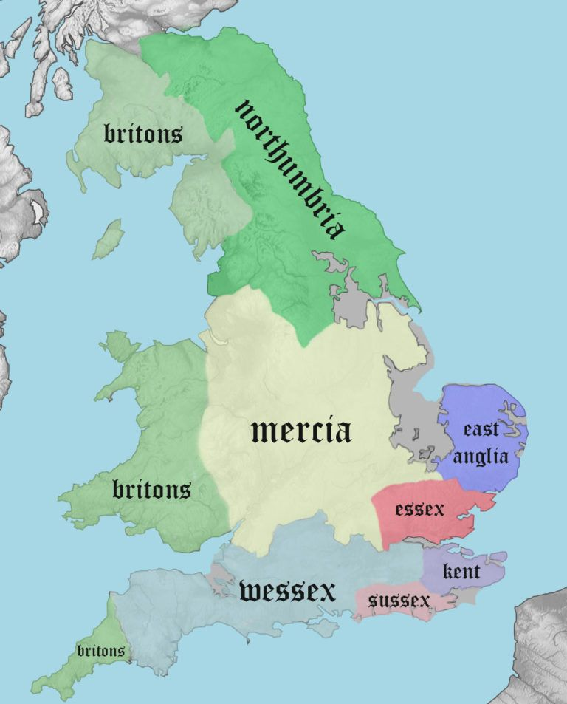
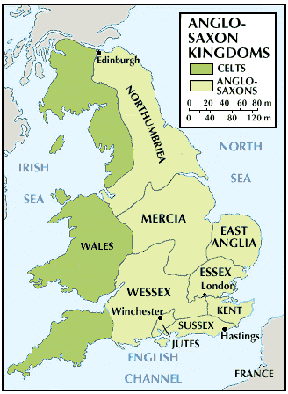
The 7 Kingdoms
Heptarchy - word used to designate the period between the establishment of Anglo-Saxon kingdoms in England toward the end of the 5th century CE and the destruction of most of them by the Danes in the second half of the 9th century. It is derived from the Greek words for "seven" and "rule." The seven kingdoms were Northumbria, Mercia, East Anglia, Essex, Kent, Sussex, and Wessex.

Slide 6
“Kingship of the English”
King Offa of Mercia (757-96), claimed "kingship of the English“. He had good reason to do so. He was powerful enough to employ thousands of men to build a huge dyke, or earth wall, the length of the Welsh border to keep out the troublesome Celts. But although he was the most powerful king of his time, he did not control all of England.
The power of Mercia did not survive after Offa's death. At that time, a king's power depended on the person al loyalty of his followers. After his death the next king had to work hard to rebuild these personal feelings of loyalty. Most people still believed, as the Celts had done, that a man' s first duty was to his own family. However, things were changing. The Saxon kings began to replace loyalty to family with loyalty to lord and king.

Slide 7
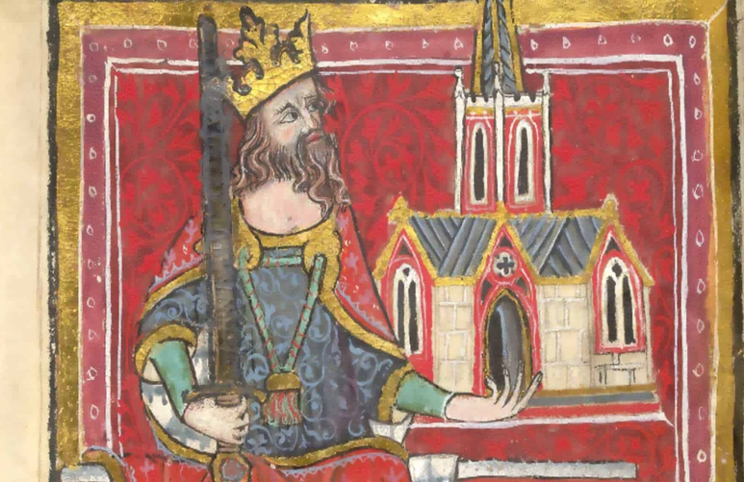
King Offa of Mercia

Slide 8
Government
The Saxons created institutions which made the English state strong for the next 500 years. One of these institutions was the King's Council, called the Witan. The Witan probably grew out of informal groups of senior warriors and churchmen to whom kings like Offa had turned for advice or support on difficult matters. For the Witan's authority was based on its right to choose kings, and to agree the use of the king's laws. Without its support the king's own authority was in danger.
The Saxons divided the land into new administrative areas, based on shires or counties. These shires, established by the end of the tenth century, remained almost exactly the same for a thousand years. "Shire" is the Saxon word, "county" the Norman one, but both are still used. Over each shire was appointed a shire reeve, the king's local administrator. In time his name became shortened to "sheriff" .

Slide 9
Christianity
We cannot know how or when Christianity first reached Britain, but it was certainly well before Christianity was accepted by the Roman Emperor Constantine in the early fourth century AD. In the last hundred years of Roman government Christianity became firmly established across Britain, both in Roman-controlled areas and beyond. However, the Anglo-Saxons belonged to an older Germanic religion and they drove the Celts into the west and north. In the Celtic areas Christianity continued to spread, bringing paganism to an end.
In 597 pope Gregory the Great sent a monk, Augustine to re-establish Christianity in England. He went to Canterbury, the capital of the king of Kent.

Slide 10
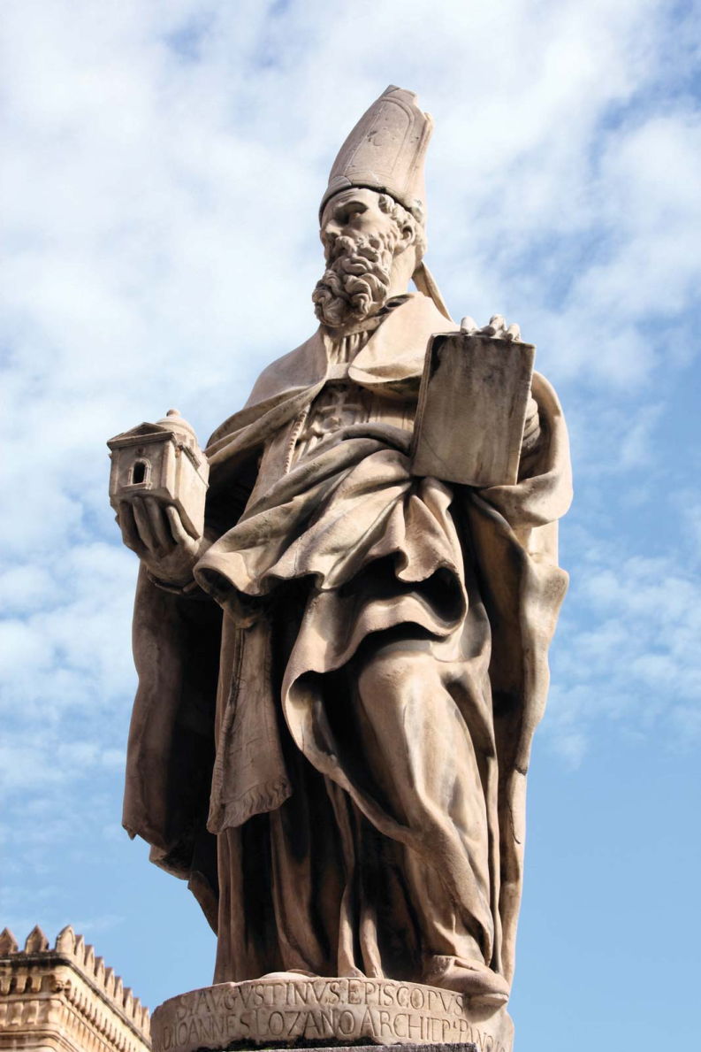
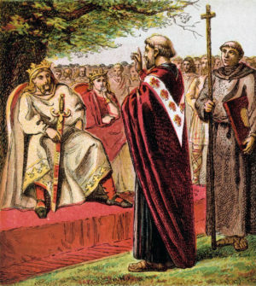
St. Augustine

Slide 11
Augustine became the first Archbishop of Canterbury in 601. He was very successful. Several ruling families in England accepted Christianity. But Augustine and his group of monks made little progress with the ordinary people.
It was the Celtic Church which brought Christianity to the ordinary people of Britain. The Celtic bishops went out from their monasteries of Wales, Ireland and Scotland, walking from village to village teaching Christianity. In spite of the differences between Anglo-Saxons and Celts, these bishops seem to have been readily accepted in Anglo-Saxon areas. The bishops from the Roman Church lived at the courts of the kings, which they made centres of Church power across England.
The two Christian Churches, Celtic and Roman, could hardly have been more different in character. One was most interested in the hearts of ordinary people, the other was interested in authority and organisation. The competition between the Celtic and Roman Churches reached a crisis because they disagreed over the date of Easter. In 663 at the Synod (meeting) of Whitby the king of Northumbria decided to support the Roman Church. The Celtic Church retreated as Rome extended its authority over all Christians, even in Celtic parts of the island .

Slide 12
England had become Christian very quickly.
By 660 only Sussex and the Isle of Wight had not accepted the new faith
Saxon kings helped the Church to grow, but the Church also increased the power of kings. Bishops gave kings their support, which made it harder for royal power to be questioned. Kings had "God's approval".
The value of Church approval was all the greater because of the uncertainty of the royal succession. An eldest son did not automatically become king, as kings were chosen from among the members of the royal family, and any member who had enough soldiers might try for the throne. In addition, at a time when one king might try to conquer a neighbouring kingdom, he would probably have a son to whom he would wish to pass this enlarged kingdom when he died.
And so when King Offa arranged for his son to be crowned as his successor, he made sure that this was done at a Christian ceremony led by a bishop. It was good political propaganda, because it suggested that kings were chosen not only by people but also by God.

Slide 13
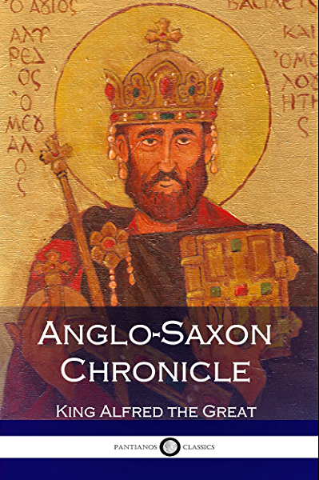
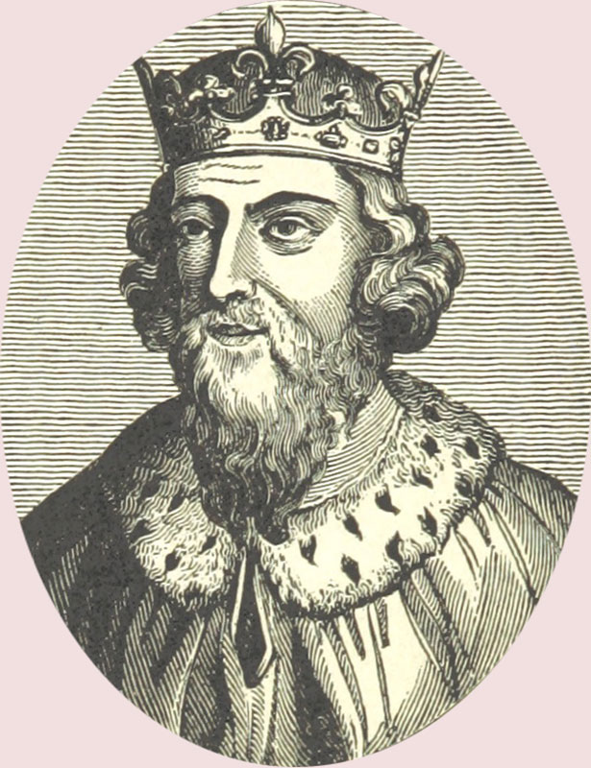
There were other ways in which the Church increased the power of the English state. It established monasteries, or minsters, for example Westminster, which were places of learning and education. These monasteries trained the men who could read and write, so that they had the necessary skills for the growth of royal and Church authority.
The king who made most use of the Church was Alfred, the great king who ruled Wessex from 871- 899. He used the literate men of the Church to help establish a system of law, to educate the people and to write down important matters. He started the Anglo-Saxon Chronicle, the most important source, together with Bede 's Ecclesiastical History of the English People, for understanding the period

Slide 14
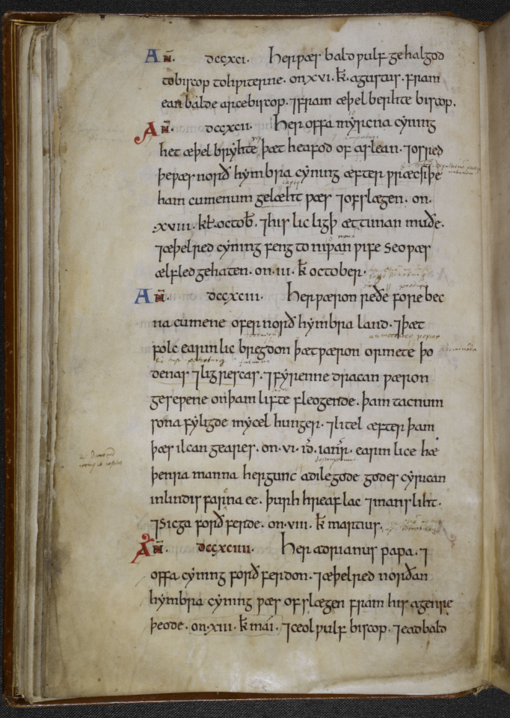
Anglo-Saxon Chronicle
This national chronicle, or annual record of events, was originally compiled around 890 during the reign of King Alfred the Great. It was the first attempt to give a systematic year-by-year account of English history, and it was later maintained, and added to, by generations of anonymous scribes until the middle of the 1100s.
The entry on the left for 793 (dccxciii) tells us about the first Viking raid on Lindisfarne, Northumberland, and the omens that preceded it: ‘Here were dreadful forewarnings come over the land of Northumbria, and woefully terrified the people: these were amazing sheets of lightning and whirlwinds, and fiery dragons were seen flying in the sky.’
The Danish and Norwegian Vikings that eventually settled in parts of the north and east introduced many Scandinavian words from their Old Norse language into English, for example the words they, take, dirt, and place names containing thorpe.

Slide 15
Anglo-Saxon Chronicle: original text
Ann. dccxciii.
Her pæron reðe forebecna cumene ofer norðhymbra land . 7þæt folc earmlic bre?don þætpæron ormete þodenas 7li?rescas . 7 fyrenne dracan ?æron ?ese?ene on þam lifte fleo?ende . þam tacnum sona fyli?de mycel hun?er . 7 litel æfter þam þæs ilcan ?eares . on . vi . id. ianr . earmlice hæthenra manna her?unc adile?ode ?odes cyrican in Lindisfarna ee . þurh hreaflac 7 mansliht . 7 Sic?a forthferde . on . viii . kl. martius.

Slide 16
In present day English:
Year 793.
Here were dreadful forewarnings come over the land of Northumbria, and woefully terrified the people: these were amazing sheets of lightning and whirlwinds, and fiery dragons were seen flying in the sky. A great famine soon followed these signs, and shortly after in the same year, on the sixth day before the ides of January, the woeful inroads of heathen men destroyed god’s church in Lindisfarne island by fierce robbery and slaughter. And Sicga died on the eighth day before the calends of March.

Slide 17
This process gave power into the hands of those who could read and write, and in this way class divisions were increased. The power of landlords, who had been given land by the king, was increased because their names were written down. Peasants, who could neither read nor write, could lose their traditional rights to their land, because their rights were not registered.
The Anglo-Saxon kings also preferred the Roman Church to the Celtic Church for economic reasons. Villages and towns grew around the monasteries and increased local trade. Many bishops and monks in England were from the Frankish lands (France and Germany) and elsewhere. They were invited by English rulers who wished to benefit from closer Church and economic contact with Europe. Most of these bishops and monks seem to have come from churches or monasteries along Europe's vital trade routes. In this way close contact with many parts of Europe was encouraged. In addition they all used Latin, the written language of Rome, and this encouraged English trade with the continent

Slide 18
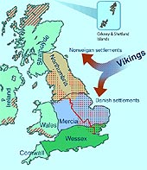
The Vikings
Towards the end of the eighth century new raiders were tempted by Britain 's wealth. These were the Vikings, a word which probably means eirher "pirates" or "the people of the sea inlets", and they came from Norway and Denmark.
Like the Angle-Saxons they only raided at first. They burnt churches and monasteries along the east, north and west coasts of Britain and Ireland. London was itself raided in 842.
In 865 the Vikings invaded Britain. This time they came to conquer and to settle. The Vikings quickly accepted Christianity and did not disturb the local population. By 875 only King Alfred in the west of Wessex held out against the Vikings, who had already taken most of England.
After some serious defeats Alfred won a decisive battle in 878, and eight years later he captured London . He was strong enough to make a treaty with the Vikings.

Slide 19
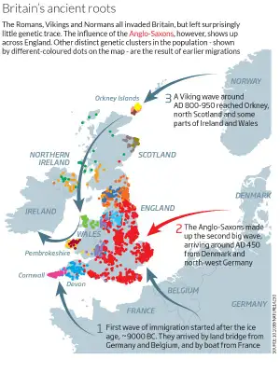
Britain’s ancient roots

Slide 20
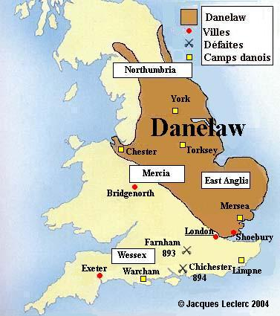
Danelaw
Viking rule was recognised in the east and north of England. It was called the Danelaw, the land where the law of the Danes ruled. In the rest of the country Alfred was recognised as king. During his struggle against the Danes, he had built walled settlements to keep them out.
By 950 England seemed rich and peaceful again after the troubles of the Viking invasion, But soon afterwards the Danish Vikings started raiding westwards. The Saxon king, Ethelrcd, decided to pay the Vikings to stay away. To find the money he set a tax on all his people, called Danegeld, or "Danish money".
Who should be king? - When Erhelred died Cnut (or Canure), the leader of the Danish Vikings, controlled much of England . He became king for the simple reason that the royal council, the Witan, and everyone else, feared disorder. Rule by a Danish king was far better than rule by no one at all. Cnut died in 1035, and his son died shortly after, in 1040. The Witan chose Edward, one of Saxon Erhelred's sons, to be king.

Slide 21
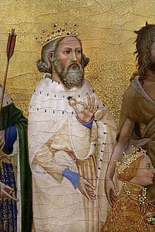
Edward, the Confessor
Edward, known as "the Confessor" . was more interested in the Church than in kingship. Church building had been going on for over a century. and he encouraged it. By the time Edward died there was a church in almost every village. The pattern of the English village, with its manor house and church , dates from this time. Edward started a new church fit for a king at Westminster, just outside the city of Lon on . In fact Westminster Abbey was a Norman, not a Saxon building, because he had spent almost all his life in Normandy, and his mot her was a daughter of the duke of Normandy

Slide 22
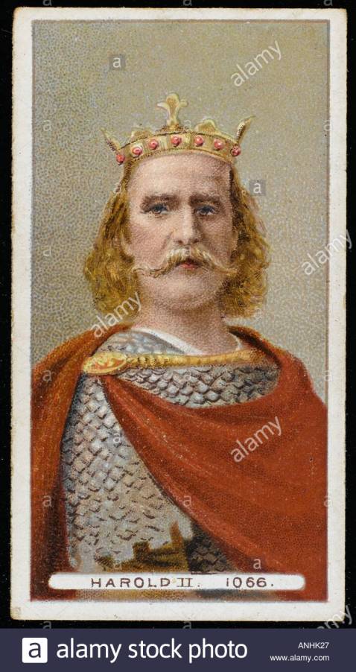
Harold Godwinson
Edward only lived until 1066, when he died without an obvious heir.
The question of who should follow him as king was one of the most important in English history.
Edward had brought many Normans to his English court from France. These Normans were not liked by the more powerful Saxon nobles, particularly by the most powerful family of Wessex, the Godwinsons.
It was a Godwinson Harold, whom the Witan chose to be the next king of England. Harold had already shown his bravery and ability. He had no royal blood , but he seemed a good choice for the throne of England.

Slide 23
The future of the English throne
Harold's right to the English throne was challenged by Duke William of Normandy . William had two claims to the English throne .
His first claim was that King Edward had promised it to him.
The second claim was that Harold, who had visited William in 1064 or 1065, had promised William that he, Harold, would not try to take the throne for himself. Harold did not deny this second claim, but said that he had been forced to make the promise and that because it was made unwillingly he was not tied by it.
Harold was faced by two dangers, one in the south and one in the north. The Danish Vikings had not given up their claim to the English throne. In 1066 Harold had to march north into Yorkshire to defeat the Danes. No sooner had he defeated them than he learnt that William had landed in England with an army. His men were tired. hut they had no time to rest. They marched south as fast as possible.

Slide 24
Duke William of Normandy
Harold decided not to wait for the whole Saxon army. The fyrd, to gather because William's army was small. He thought he could beat them with the men who had don e so well against the Danes. However, the Norman soldiers were better armed , better organised, and were mounted on horses. If he had waited , Harold might have won . But he was de feated and killed in battl e near Hastings.
William marched to London, which quickly gave in when he began to burn villages outside the city. He was crowned king of England in Edward's new church of Westminster Abbey on Christmas Day, 1066.

Slide 25
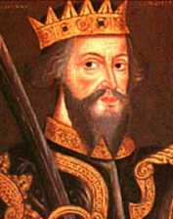
King William I
The Conqueror
Name: King William I The Conqueror
Father: Robert I, Duke of Normandy
Mother: Arlette (Herleva) daughter of Fulbert (illegitimate)
Born: September 1028 at Falaise, Normandy
Ascended to the throne: December 25, 1066 aged 38 years
Crowned: December 25, 1066 at Westminster Abbey
Married: Matilda, Daughter of Count of Flanders
Died: September 9, 1087 at Rouen, France, aged 59 years, and 7 days
Buried at: St Stephens Abbey, Caen, Normandy

Slide 26
King William I The Conqueror
King of England from 25 December 1066.
He was the illegitimate son of Duke Robert the Devil whom he succeeded as Duke of Normandy in 1035. Claiming that his 2nd cousin King Edward the Confessor had bequeathed him the English throne, William invaded England in September 1066, defeating Harold II Godwineson at the Battle of Hastings on 14 October 1066.
William's coronation took place in Westminster Abbey on Christmas Day 1066. He completed the establishment of feudalism in England, compiling detailed records of land and property in the Domesday Book, and kept the barons firmly under control. He died in Rouen after a fall from his horse and is buried in Caen, France. He was succeeded by his son William II.

Slide 27
Seminar Topics
1. The pre-history of Britain: The Celts
2. The pre-history of Britain: The Romans
3. Anglo-Saxon invaders. The Vikings
4. The Celtic Kingdoms: Wales. Scotland. Ireland

