Slide 1
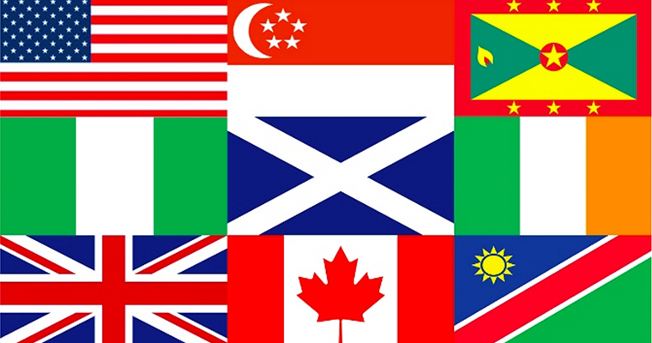
The dialects of English

Slide 2
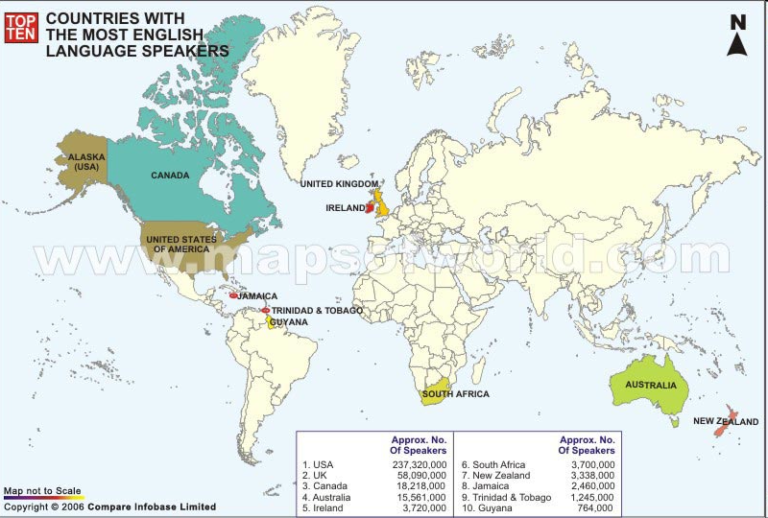

Slide 3
Countires with English as a first language

Slide 4
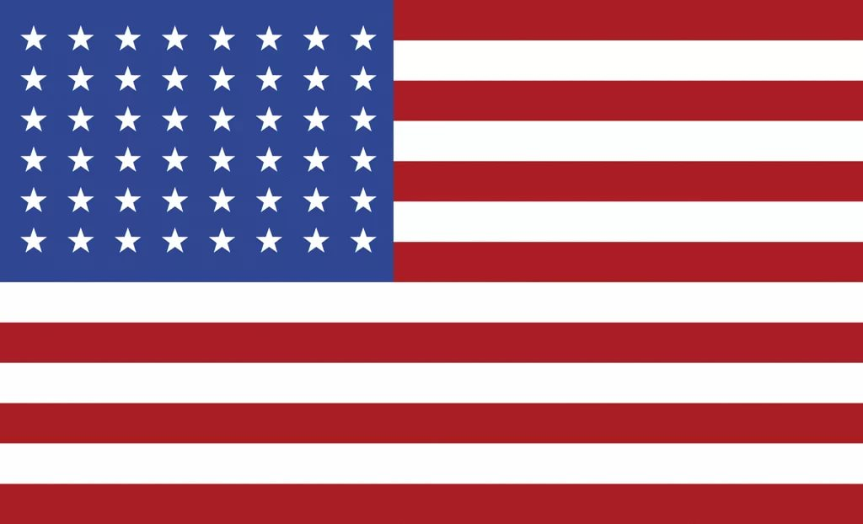
American English

Slide 5
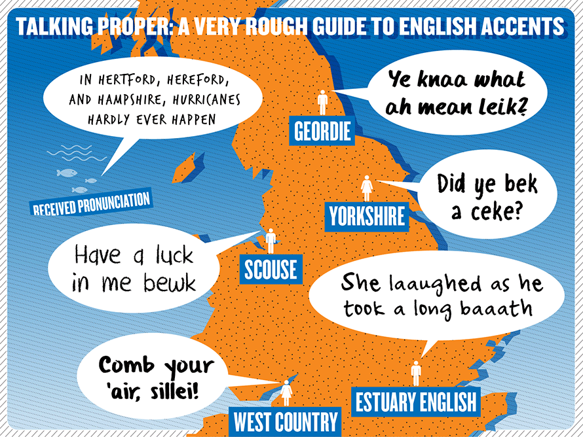
American English
It has a number of regional accents but
on the whole they share enough common
features in pronunciation and speech
patterns so that the spoken language
in the USA can be clearly distinguished
from the language spoken in UK or from
other varieties of spoken English.
Common characteristics of regional
American accents include such features
as the sound [r] pronounced in all
positions in words (e.g., hard [ha:rd], more [mo:r], first [fərst]); the sound [æ] in words like "ask, last, class, demand, dance" (whereas British English has [a:] in such cases); the sound [o] that sounds like [a:] in words like "hot, off, rob, gone, sorry, bother, want"; the sound [yu:] pronounced as [u:] after the letters "d, n, s, t" (duplicate, news, sue, student, tune).
In writing the letter U is missed, e.g. our – or, colour – color.

Slide 6
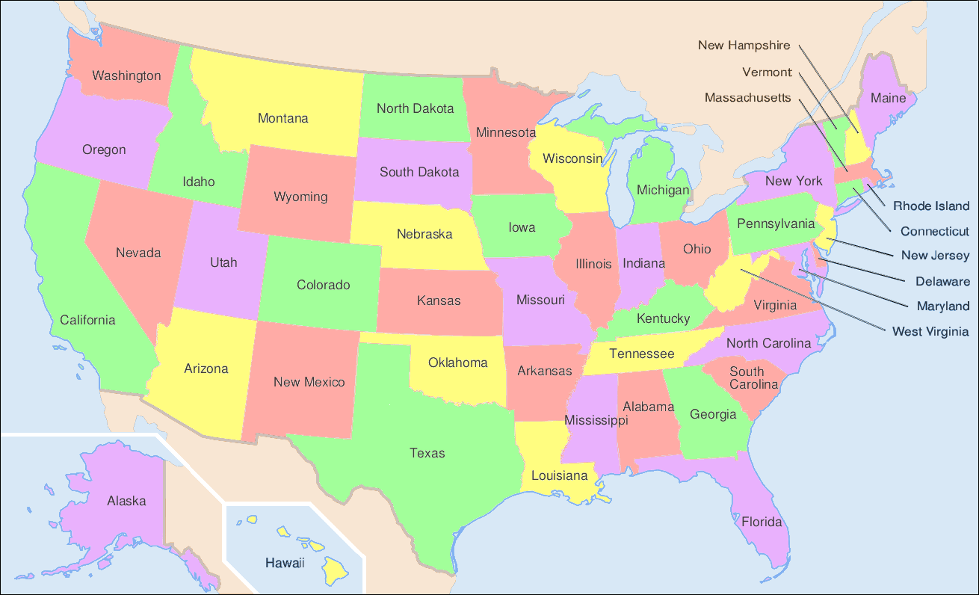
Northern (Massachussets, Connecticut, Vermont, New York, Michigan, Illinois, New York City area etc.) VS north midland (Pennsylvania, Ohio, Indiana, Illinois, Iowa, Missouri, Kansas etc.) :
fog, hog: /fag/, /hag/ -- /fog/, /hog/
roof: /ruf/, /huf/ -- /ru:f/, /hu:f/
cow, house: /kau/, /haus/ -- /kæu/, /hæus/
wash: /wa:sh/ -- /wosh/, /worsh/
darning needle -- snake feeder
pail -- bucket
teeter-totter -- see-saw
fire-fly -- lightning-bug
Eastern New England, Boston area, NYC area
drop r’s
insert transitional r’s, as in law’r’n awdah
Eastern New England, Boston area, Virginia area
/æ/ frequently becomes /a/, e.g. in aunt, dance, glass
Mary-marry-merry (/eir/-/ær/-/er/) distinctions preserved only in r-less areas, rapidly disappearing from American speech
loss of voiceless w: which > /wic/
loss of voiceless y: human > /yum'n/
Southern and south midland:
"drawl" [lengthening, fronting, and raising vowels]
/ai/ > /æ:/ in find, mind
/oi/ > /o/ in boil, oil
/u:/ > /yu:/ in due, tuesday
au/ > /æu/ in out, doubt
/e/ > /ei/ in bed, head
/e/ > /i/ in pen, ten
greasy > greazy
carry > tote
dragged > drug
you > you all, y’all
Southern:
help, bulb, wolf > /hep/, /bœb/, /wuf/
Southern vs south midland:
drop r’s -- strong, sometimes retroflex, r’s
wash: /wa:sh/ -- /wosh/, /worsh/
think: /thingk/ -- /theingk/
egg: /eg/ -- /eig/
moon: /mu:n/ -- /mü:n/
snake doctor -- snake feeder
snap beans -- green beans
goobers -- peanuts
Standard English is closest to the "northern cities" which stretches from Pennsylvania to Michigan. There's a southern accent called a “twang” that can change depending on where in the south you are. Texas area has a “drawl”, lots of y'all's and such. There's a western dialect which is similar to the Californian surfer image of that area. Then there are also a lot of distinct accents. Cali has a stereotype of surfers "yo bro", and valley girl "like oh my gosh, totally". Wisconsin's use a instead of o, like a as in hat. So they say Wisconsin like Wiscansin. New Jersey and New York talk a lot faster and seemingly rougher, "Aye u, im walkin ere" etc. West Virginia/Kentucky have almost hillbilly accents. Louisiana has a Cajun accent. They can talk extremely fast as well.

Slide 7
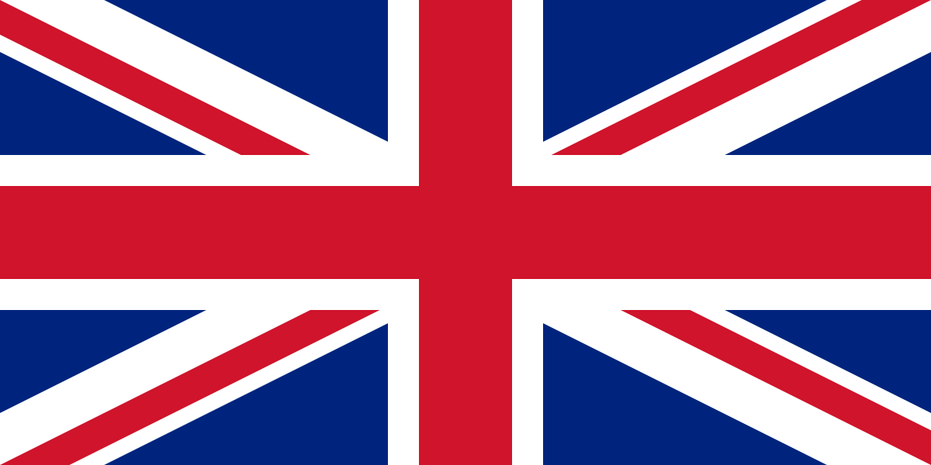
The dialects in Great Britain

Slide 8
The dialects in Great Britain
British accents include Received Pronunciation, Cockney, Estuary, Midlands English, West Country, Northern England, Welsh, Scottish, Irish, and many others.

Slide 9
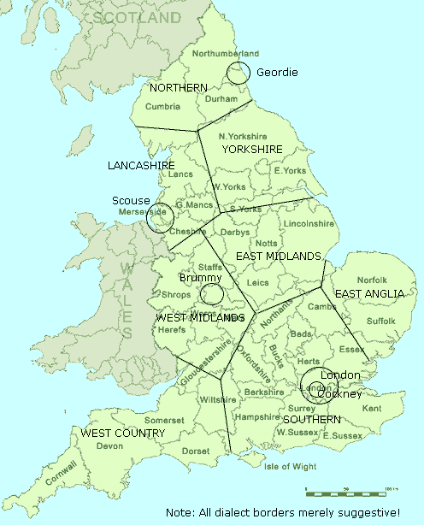
Southern
It includes r-dropping after vowels, unless followed by another vowel. Instead, vowels are lengthened or have an /'/ off-glide, so fire becomes /fai'/, far becomes /fa:/, and so on.
regular use of "broad a" (/a:/), where GA (General American) would use /æ/.
"long o" is pronounced /'u/, where GA uses /ou/.
final unstressed i is pronounced /i/, where GA uses /i:).
t between vowels retained as /t/ (or a glottal stop, in its variants), where GA changes it to /d/.

Slide 10
Received Pronunciation (RP)
The English of well-bred Londoners, especially graduates of the public schools (e.g. Eton and Harrow) and "Oxbridge", was the origin of "the Queen's English," also known as RP, Received Standard, BBC English, Public school English normative English or "posh". RP is a Southern England accent, but it does not have any regional peculiarities. RP is close to standard English pronunciation as it is described in textbooks for learners of English as a 2d language and is traditionally taught to foreign learners of English.

Slide 11

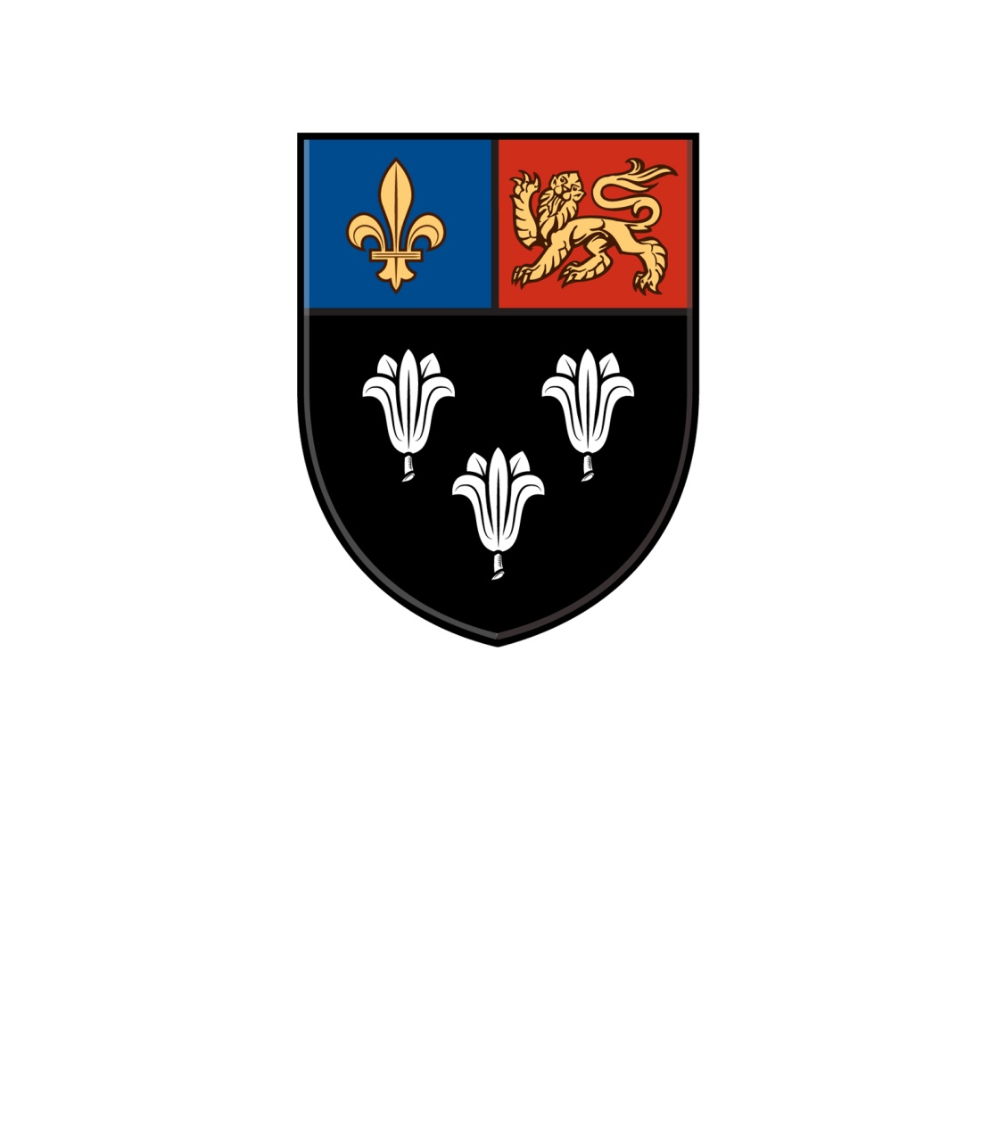
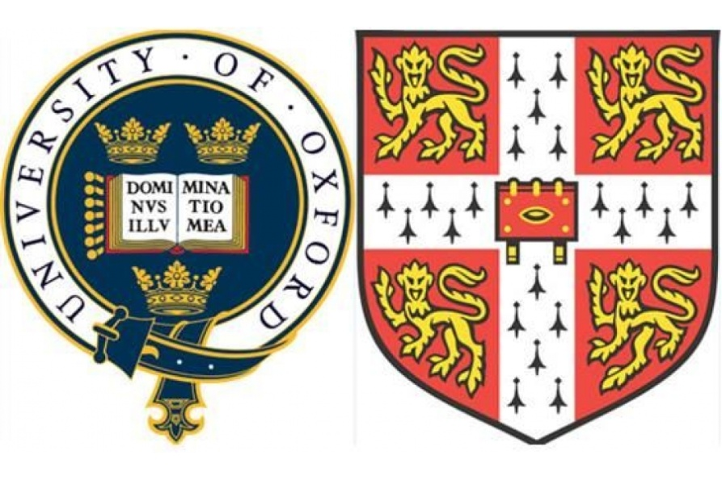

Slide 12
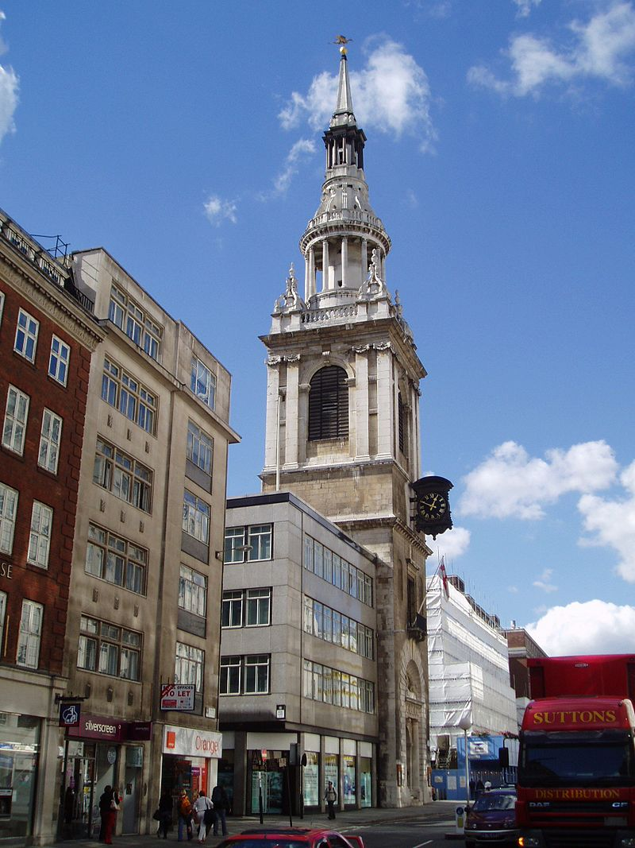
Cockney
The term Cockney traditionally refers to people born within an area of London, that is covered by "the sound of Bow bells“ of St Mary-le-Bow (a church). Also it’s the dialect of the working class of East End London. In late Middle English it denoted a spoilt child and in Middle English “cokeney” meant ‘cock's egg’, a small misshapen egg. A later sense was ‘a town-dweller regarded as affected or puny’, from which the current sense arose in the early 17th c.

Slide 13
Cockney
initial h is dropped, so house becomes /aus/ (or even /a:s/).
/th/ and /dh/ become /f/ and /v/ respectively: think > /fingk/, brother > /brœv'/.
t between vowels becomes a glottal stop: water > /wo?'/.
diphthongs change, sometimes dramatically: time > /toim/, brave > /braiv/, etc.
Grammatical features:
Use of me instead of my, for example, "At's me book you got 'ere". Cannot be used when "my" is emphasised; e.g., "At's my book you got 'ere" (and not "his").
Use of ain't
Use of double negatives, for example "I ditn't see nuffink.“

Slide 14
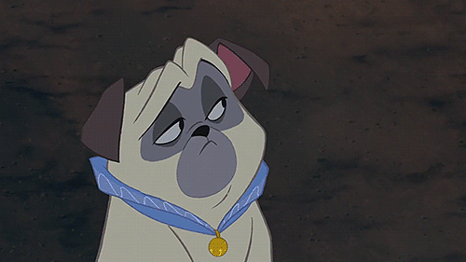
Cockney
Besides it includes a large number of slang words, including the famous rhyming slang:
have a butchers - take a look

Slide 15

Cockney
Besides it includes a large number of slang words, including the famous rhyming slang:
north and south - mouth

Slide 16
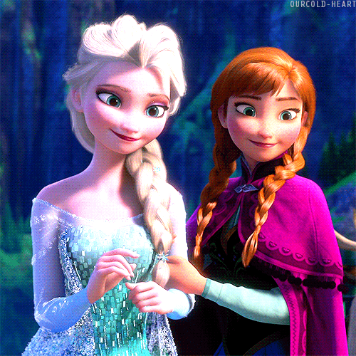
Cockney
Besides it includes a large number of slang words, including the famous rhyming slang:
skin and blister - sister

Slide 17

Cockney
Besides it includes a large number of slang words, including the famous rhyming slang:
apples and pears - stairs

Slide 18
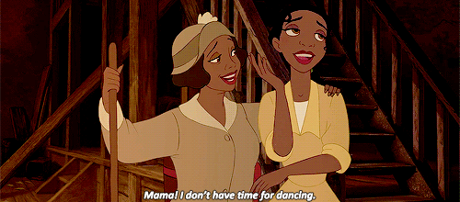
Cockney
Besides it includes a large number of slang words, including the famous rhyming slang:
rabbit and pork - talk

Slide 19
Estuary English
From London down the Thames a new working and middle class dialect has evolved and it rapidly becomes "the" southern dialect. It combines some characteristics of Cockney with RP, but makes much less use of Cockney slang. It’s popular especially among so-called 'chattering classes' (people like journalists, who talk a lot).
It is called Estuary English because many upwardly mobile professional people among whom it is fashionable live in the Docklands area of London by the river. It is also called Mockney because it is a fake form of Cockney English, without all the colourful language play.

Slide 20
Estuary English
Generally, the grammar is unchanged but features such as the 'glottal stop', where the letter T is not pronounced in the middle of words such as 'bottle' (pronounced 'bo'all') are used.

Slide 21
East Anglian
This dialect is similar to the Southern, but keeps its h's:
t between vowels usually becomes a glottal stop.
/ai/ becomes /oi/: time > /toim/.
RP yu becomes u: after n, t, d... as in American English.
the -s in the third person singular is usually dropped [e.g. he goes > he go, he didn't do it > he don't do it]

Slide 22
East Midlands
The dialect of the East Midlands, once filled with interesting variations from county to county, is now predominantly RP. R's are dropped, but h's are pronounced. The only signs that differentiate it from RP:
ou > u: (so go becomes /gu:/).
RP yu; becomes u: after n, t, d... as in American English.

Slide 23
The West Country
r's are not dropped.
initial s often becomes z (singer > zinger).
initial f often becomes v (finger > vinger).
vowels are lengthened.

Slide 24
West Midlands
This is the dialect of Ozzie Osbourne! While pronunciation is not that different from RP, some of the vocabulary is:
are > am; am, are (with a continuous sense) > bin;
is not > ay; are not > bay.
Brummie is the version of West Midlands spoken in Birmingham.

Slide 25
Lancashire
It is spoken north and east of Liverpool and has the southern habit of dropping r's. Other features:
/œ/ > /u/, as in luck (/luk/);
/ou/ > /oi/, as in hole (/hoil/).
Scouse is the very distinctive Liverpool accent, a version of the Lancashire dialect, that the Beatles made famous. Features:
the tongue is drawn back;
/th/ and /dh/ > /t/ and /d/ respectively.
final k sounds like the Arabic q.
for is pronounced to rhyme with fur.

Slide 26
Yorkshire
The Yorkshire dialect is known for its sing-song quality, a little like Swedish.
/œ/ > /u/, as in luck (/luk/).
the is reduced to t'.
initial h is dropped.
was > were.
still use thou (pronounced /tha/) and thee.
aught and naught (pronounced /aut/ or /out/ and /naut/ or /nout/) are used for anything and nothing.

Slide 27
Northern
The Northern dialect closely resembles the southern-most Scottish dialects. It retains many old Scandinavian words, such as bairn for child, and not only keeps its r's, but often rolls them. The most outstanding version is Geordie, the dialect of the Newcastle area.
-er > /æ/, so father > /fædhæ/.
/ou/ > /o:'/, so that boat sounds like each letter is pronounced.
talk > /ta:k/
work > /work/
book > /bu:k/
my > me
me > us
our > wor
you plural > youse

Slide 28
Wales
Welsh English is characterized by a sing-song quality and lightly rolled r's. It has been strongly influenced by the Welsh language, although it is increasingly influenced today by standard English, due to the large number of English people vacationing and retiring there.
“ing” is [in]; [h] is present; “wood” in Eng has [u], in WE may have both [u] and [a]

Slide 29
Scotland
There are several "layers" of Scottish English. Most people today speak standard English with little more than the changes just mentioned, plus a few particular words that they themselves view as normal English, such as to jag (to prick) and burn (brook). In rural areas, many older words and grammatical forms, as well as further phonetic variations, still survive, but are being rapidly replaced with more standard forms. But when a Scotsman (or woman) wants to show his pride in his heritage, he may resort to quite a few traditional variations in his speech. There are also several urban dialects, particularly in Glasgow and Edinburgh. In the Highlands, especially the Western Islands, English is often people's second language, the first being Scottish Gaelic. Highland English is pronounced in a lilting fashion with pure vowels.

Slide 30
Scotland
Scottish English uses a number of special dialect words. For example lake – loch; mountain – ben; church – kirk; to remember – to mind; beautiful – bonny; to live – to stay; a girl – lassie; no – ken
/oi/, /ai/, and final /ei/ > /'i/, e.g. oil, wife, tide...
final /ai/ > /i/, e.g. ee (eye), dee (die), lee (lie)...
/ou/ > /ei/, e.g. ake (oak), bate (boat), hame (home), stane (stone), gae (go)...
/au/ > /u:/, e.g. about, house, cow, now... (often spelled oo or u)
/o/ > /a:/, e.g. saut (salt), law, aw (all)...
/ou/ > /a:/, e.g. auld (old), cauld (cold), snaw (snow)...
/æ/ > /a/, e.g. man, lad, sat...
also: pronounce the ch's and gh's that are silent in standard English as /kh/: nicht, licht, loch...

Slide 31
Scotland
The grammar:
Present tense: often, all forms follow the third person singular (they wis, instead of they were).
Past tense (weak verbs): -it after plosives (big > biggit); -t after n, l, r, and all other unvoiced consonants (ken > kent); -ed after vowels and all other voiced consonants (luv > luved).
Past tense (strong verbs): come > cam, gang > gaed and many more.
On the other hand, many verbs that are strong in standard English are weak in Scottish English: sell > sellt, tell > tellt, mak > makkit, see > seed, etc.
Past participle is usually the same as the past (except for many strong verbs, as in standard English)
Present participle: -in (ken > kennin)
The negative of many auxiliary verbs is formed with -na: am > amna, hae (have) > hinna, dae (do) > dinna, can > canna, etc.
Irregular plurals: ee > een (eyes), shae > shuin (shoes), coo > kye (cows).
Common diminutives in -ie: lass > lassie, hoose > hoosie...
Common adjective ending: -lik (= -ish)
Demonstratives come in four pairs (singular/plural): this/thir, that/thae, thon/thon, yon/yon.
Relative pronouns: tha or at.
Interrogative pronouns: hoo, wha, whan, whase, whaur, whatna, whit.
Each or every is ilka; each one is ilk ane.
Numbers: ane, twa, three, fower, five, sax, seeven, aucht, nine, ten, aleeven, twal...

Slide 32
Ireland
Irish English is strongly influenced by Irish Gaelic:
r after vowels is retained
"pure" vowels (/e:/ rather than /ei/, /o:/ rather than /ou/)
/th/ and /dh/ > /t/ and /d/ respectively.
The sentence structure of Irish English often borrows from the Gaelic:
Use of be or do in place of usually:
  I do write... (I usually write)
Use of after for the progressive perfect and pluperfect:
  I was after getting married (I had just gotten married)
Use of progressive beyond what is possible in standard English:
  I was thinking it was in the drawer
Use of the present or past for perfect and pluperfect:
  She’s dead these ten years (she has been dead...)
Use of let you be and don’t be as the imperative:
  Don’t be troubling yourself
Use of it is and it was at the beginning of a sentence:
  it was John has the good looks in the family
  Is it marrying her you want?
Substitute and for when or as:
  It only struck me and you going out of the door
Substitute the infinitive verb for that or if:
  Imagine such a thing to be seen here!
Drop if, that, or whether:
  Tell me did you see them
Statements phrased as rhetorical questions:
  Isn’t he the fine-looking fellow?
Extra uses of the definite article:
  He was sick with the jaundice
Unusual use of prepositions:
  Sure there’s no daylight in it at all now
As with the English of the Scottish Highlands, the English of the west coast of Ireland, where Gaelic is still spoken, is lilting, with pure vowels.

Slide 33
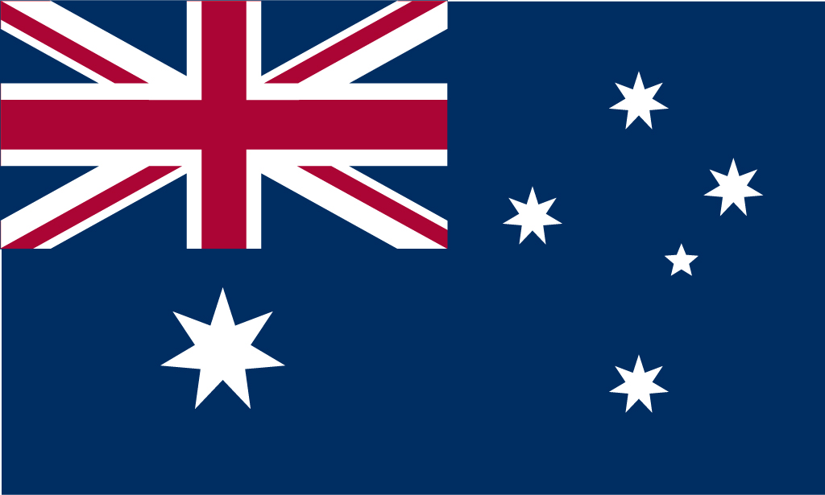
Australian English

Slide 34
Australian English
Australian English is predominantly British English, and especially from the London area. R’s are dropped after vowels, but are often inserted between two words ending and beginning with vowels.
The vowels reflect a strong “Cockney” influence: The long a (/ei/) tends towards a long i (/ai/), so pay sounds like pie to an American ear. The long i (/ai/), in turn, tends towards oi, so cry sounds like croy. Ow sounds like it starts with a short a (/æ/). Other vowels are less dramatically shifted.
Even some rhyming slang has survived into Australlian English: Butcher’s means look (butcher’s hook); hit and miss means piss; loaf means head (loaf of bread) and so on.

Slide 35
Like American English has absorbed numerous American Indian words, Australian English has absorbed many Aboriginal words:
nulla-nulla -- a club
wallaby -- small kangaroo
wombat -- a small marsupial
woomera -- a weapon
wurley -- a simple shelter
...not to mention such ubiquitous words as kangaroo, boomerang, and koala!
Colorful expressions also abound:
Like a greasespot -- hot and sweaty
Like a stunned mullet -- in a daze
Like a dog’s breakfast -- a mess
Up a gumtree -- in trouble
Mad as a gumtree full of galahs -- insane
Happy as a bastard on Fathers’ Day -- very happy
Dry as a dead dingo’s donger -- very dry indeed
Another characteristic of Australian English is abbreviated words, often ending in -y, -ie, or -o:
aussie -- Australian
chalky -- teacher
chewie -- chewing gum
chockie -- chocoloate
footy -- football
frostie -- a cold beer
lavvy -- lavatory
lippie -- lipstick
lollies -- sweets
mossie -- mosquito
mushies -- mushrooms
oldies -- one’s parents
rellies -- one’s relatives
sammie -- sandwich
sickie -- sick day
smoko -- cigarette break
sunnies – sunglasses

Slide 36
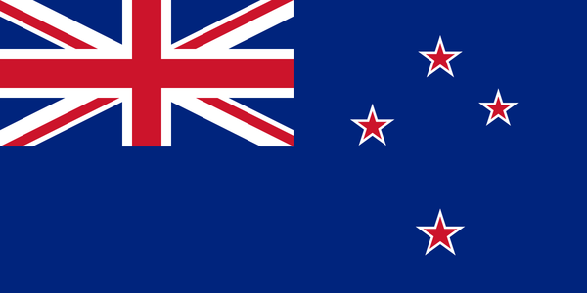
New Zealand English

Slide 37
New Zealand English
New Zealand English is heard by Americans as "Ozzie Light." The characteristics of Australian English are there to some degree, but not as intensely. The effect for Americans is uncertainty as to whether the person is from England or Australia. One clue is that New Zealand English sounds "flatter" (less modulated) than either Australian or British English and more like western American English.

Slide 38
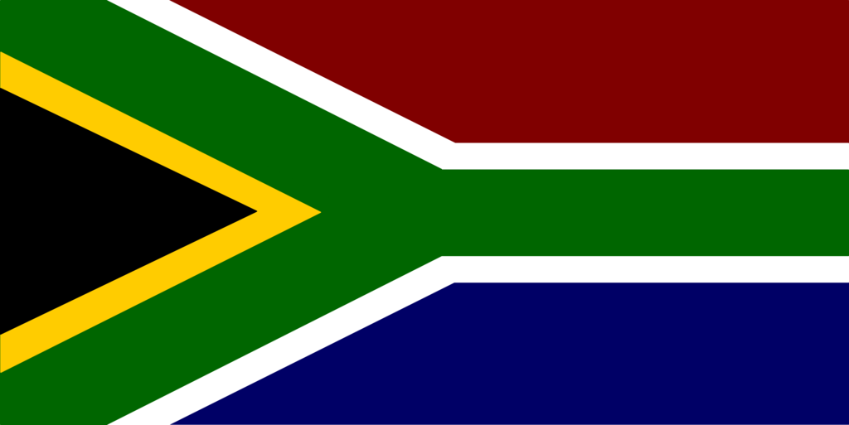
The Republic of South Africa

Slide 39
The Republic of South Africa
South African English is close to RP but often with a Dutch influence. English as spoken by Afrikaners is more clearly influenced by Dutch pronunciation. Just like Australian and American English, there are numerous words adopted from the surrounding African languages, especially for native species of animals and plants. As spoken by black South Africans for whom it is not their first language, it often reflects the pronunciation of their Bantu languages, with purer vowels. Listen, for example, to Nelson Mandela or Bishop Tutu.
i - as in bit is pronounced 'uh'
long /a:/ in words like 'past', 'dance'
t in middle of words pronounced as d's ('pretty' becomes '/pridi:/')
donga - ditch, from Xhosa
dagga - marijuana, from Xhoixhoi (?)
kak - bullshit, from Afrikaans
fundi - expert, from Xhosa and Zulu umfundi (student).
Dialects also varies slightly from east to west: In Natal (in western South Africa), /ai/ is pronounced /a:/, so that why is pronounced /wa:/.

Slide 40

Canadian English

Slide 41
Canadian English
Canadian English is generally similar to northern and western American English. The one outstanding characteristic is called Canadian rising:
/ai/ and /au/ become /œi/ and /œu/, respectively.
Americans can listen to the newscaster Peter Jennings for these sounds.
One unusual characteristic found in much Canadian casual speech is the use of sentence final "eh?" even in declarative sentences.
Most Canadians retain r's after vowels, but in the Maritimes, they drop their r's, just like their New England neighbors to the south.
Newfoundland has a very different dialect, called Newfie, that seems to be strongly influenced by Irish immigrants:
/th/ and /dh/ > /t/ and /d/ respectively.
am, is, are > be's
I like, we like, etc. > I likes, we likes, etc.

Slide 42
Thank you for your attention!

