Slide 1
New trends in translation theory
Lecture 7

Slide 2
A new name
Theory or science of translation? English speaking scholars usually avoid the word „science” because in English it is generally applied to natural sciences.
In the case of translation theory, we cannot develop a formalised, logically consistent system of concepts, starting with axioms and accepting new claims.
In the past few years, the term „Translation Studies” has been increasingly used in literature, while the use of „Science of Translation” or the „Theory of Translation” has been declining.
Hungarian terms: fordítástudomány, fordításelmélet, transzlatológia, traduktológia.

Slide 3
New social tasks
The information on linguistic translation research seems to be increasing in volume and importance. The science of translation has now become the science of European integration.
Enormous amounts of texts have to be translated in the countries of the European Community because of the many official languages.
Development of new linguistic technologies: Computer Assisted Translation (CAT).
Social needs are prompting new developments in translation, with new schools, new research centres and journals being established.

Slide 4
New centres of research
Translator and Interpreter Training Institute in Vienna.
Leuven Research Centre for Translation, Communication and Cultures.
The College of Foreign Languages in Savonlinna.
Translation Studies Institute, Charles University, Prague.
University of Surrey: Peter Newmark.
United States: Eugene Nida.
Canadian Association of Translation Studies.

Slide 5
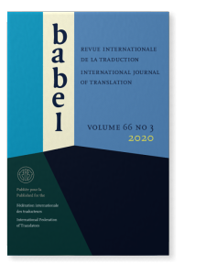
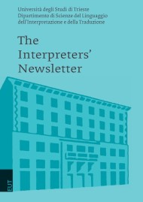
New journals
Traditional international translation journals: Babel; Meta.
1988 – Interpreters’ Newsletter.
1989 – Target (International Journal of Translation Studies).
1993 – Perspective: Studies in Translatology.
1995 – The Translator (Mona Baker).
TRANSST (International Newsletter of Translation Studies), edited by Gideon Toury.
1996 – Language International.

Slide 6
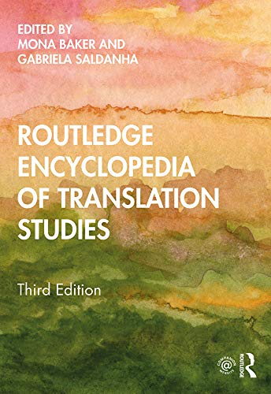
New book series and encyclopaedias
John Benjamins in Amsterdam published 4 translation/interpretation journals (Babel, Language International, Target, Interpreting) and 2 corpus linguistics and terminology journals (International Journal of Corpus Linguistics and Terminology).
Multilingual Matters publishing house: Topics in Translation.
St. Jerome publishing house in Manchester: The Translator, Dictionary of Translation Studies, Bibliography of Translation Studies.
1998 – The Encyclopaedia of Translation Studies (Baker).

Slide 7
New research methods (empirical methods)
To be able to formulate truly generalizable statements about the process of translation, the traditional method of comparing SL and TL texts cannot be regarded as satisfactory anymore.
Research is needed that is conducted under „laboratory conditions”, performing pre-planned and replicable experiments.
Translation research may move in 3 directions, depending on whether it is the product, the process, or the function that is in the centre of attention.

Slide 8
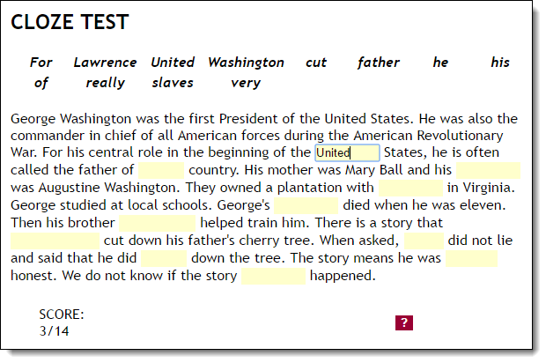
The cloze test
Cloze tests are very effective in measuring language proficiency in general.
These tests can be prepared by deleting every fifth or sixth word from a continuous stretch of text, and the reader has to fill in the missing words.
Participants can also demonstrate how understandable the text or translation is.
Cloze tests are capable of measuring the readability of translated texts.

Slide 9
The questionnaire method
Another method to measure readers’ reactions is the use of questionnaires, in which readers, having gone through the translation, write down their intuitive impressions about the text read.
Readers can judge if it is an original Hungarian text or a translation to demonstrate the phenomenon of „quasi-correctness”.
Explicitation – the technique of making explicit in the TL text information that is implicit in the SL text.
Obligatory additions are necessary to create grammatically well-formed TL sentences. They occur due to missing categories.
Optional additions are needed to create a unified coherent TL text.

Slide 10
The introspective method
In psychology, it was used as a research tool for the experimental investigation of thinking processes.
1986 – introspection was first used during translation. Hans Krings analysed the think aloud protocols of language learners.
Another experiment pointed out that for professional translators many processes are likely to be highly automatized and therefore not accessible via verbal report procedures.

Slide 11
Corpus analysis
In earlier times the term „corpus” denoted any collection of texts from a particular author. Now a corpus must meet the following 3 criteria:
1. It must be a collection of texts that can be read by machine and is thus analysable automatically.
2. A corpus may include not only written texts, but also spoken discourse.
3. A corpus is not the work of a single author, but it is a collection of texts from various sources and on various topics.

Slide 12
Multilingual corpora
Baker (1995) proposes 3 main types:
1) Parallel corpora contain the original text and its TL translation. They can show how experienced translators overcome translation problems.
2) Multilingual corpora contain texts selected on the basis of identical criteria, which are not translations of each other.
3) Comparable corpora contain texts in the same language, but original English texts are not compared to their translations. Instead, authentic English texts are compared to translated English texts.

Slide 13
Intercultural communication
Communication is becoming globalised which means that the number of translated texts is increasing.
The study of intercultural communication is gradually becoming a new auxiliary science of translation studies.
The translator is an intercultural expert, mediating not only between languages but also between cultures. Interpreters are regarded as intercultural mediators to an even greater extent.
Translation studies has always assumed that translators are consciously aware of the characteristics of their own and other cultures, only they do not always think of using this knowledge in translation.

Slide 14
Media translation
The translation of advertisements, commercials, films, TV and radio broadcasts have long been an important topic in translation studies.
These sources of information provide an insight into the problems resulting from intercultural differences.
Translators must be able to realise these differences between cultures and create an advertisement which is in accordance with the social, cultural and economic environment of the receivers.
Film subtitling and dubbing are also important.

Slide 15
The 2nd and 3rd periods of linguistic translation theory
The 2nd great period in the development of translation theory starting in the 1980s is best described as the interdisciplinary period. The apparatus and terminology of sciences within linguistics (semantics, pragmatics) and outside linguistics (sociology, psychology) brought new ideas and research methods into translation theory.
The 3rd period, our times, is characterized by the launch of empirical research, establishing the theoretical foundations of teaching translation and interpretation. There is also an enormous growth in the demand for translation, due to the increased needs of multinational companies and various international organisations.

Slide 16
Linguistic translation theory in Hungary
Linguistic translation theory in Hungary emerged rather late because of the country’s isolation from international research community, and the lack of a centre coordinating and financing translation research.
1973 – the establishment of the Interpreter and Translator Training Centre of Eötvös Loránd University. The start of linguistic research on translation.
Transferre necesse est conferences in Hungary with plenary speakers including Eugene Nida, Peter Newmark, José Lambert, etc.
Universities launched some forms of translator training programme.

